Slide 1
Introduction to Algorithms
Lecture 1

Slide 2
Overview
Instructor: 沙朝锋
cfsha@fudan.edu.cn
Textbook: CLRS – Introduction to Algorithms. 算法导论 (第三版)
  Kleinberg & Tardos. Algorithm Design.
考核：0.3*作业 + 0.3*min{期中,期末} + 0.4*max{期中,期末}

Slide 3
Prerequisites
A strong understanding of programming.
A solid background in discrete mathematics, including probability.

Slide 4
Schedule - 1
Lec1: 课程简介、排序算法、算法复杂度分析(渐进运行时间、O等符号定义)、主定理。
Lec2: 主定理证明和应用、分治法(以矩阵乘积，多项式乘积和FFT为例)、以AB=C验证为例引入随机算法思想。
Lec3: Randomized Quicksort, 比较排序下界, order statistics以及线性时间Median算法(Select)，求frequent item的Misra-Gries算法。
Lec4: 哈希函数：全域哈希、Perfect hashing；简介ball-and-bin模型，two-choices扩展，consistent hashing及分析。
Lec5: 开放寻址法，Cuckoo hashing及分析，Bloom filter, Count-sketch.

Slide 5
Schedule - 2
Lec6: 均摊分析(以Binary Counter和Dynamic Table为例介绍了aggregating, accounting和potential三种分析)。
Lec7: 动态规划：memorize方法；例子：weighted interval schedule, 矩阵连乘，最长公共子序列(LCS)，带权重的最优二分查找树，多段线性回归，背包问题。
Lec8: 动态规划：树上的独立集、旅行商问题；贪心法：以单机任务调度、哈夫曼编码、最小生成树算法Prim和Kruskal为例。
Lec9: Union-Find数据结构, 在线算法.
Lec10:最短路径算法(single-source, all-pairs)；网络流定义，网络流算法：Ford-Fulkerson.

Slide 6
Schedule – 3
Lec11: 网络流算法：Edmons-Karp (shortest path, fattest path, capacity scaling), Dinic算法, 网络流的应用, Min-cut (RCA算法)。
Lec12: 二分图上的匹配算法；多项式和FFT算法.
Lec13: 线性规划：建模、Primal-dual, weak/strong duality定理，应用。
Lec14: 机器学习算法：聚类、乘法权重更新算法、梯度下降.
Lec15: NP完全问题：P和NP定义、多项式时间归约、SAT问题；NPC问题证明：Clique, Vertex Cover, Independent Set, 3SAT, 3-Coloring, 哈密尔顿回路等。
Lec16: 近似度定义, 近似算法：Job scheduling, Vertex Cover, Set Cover, k-cente, Max SAT问题等；贪心、random rounding等方法。

Slide 7
Algorithms
An algorithm is a sequence of computational steps that transform the input into the output.
Applications of Algorithms
  Everywhere!
Hard problems

Slide 8
Analysis of algorithms
Proving correctness.
Running-time guarantees: the theoretical study of computer-program performance and resource usage.
  Code and test?

Slide 9
Why study algorithms and performance?
Composability
  Scaling: Speed is fun!
Designing better algorithms
Understanding
  Complexity-theoretic motivation: Performance often draws the line between what is feasible and what is impossible.
Algorithmic mathematics provides a language for talking about program behavior.

Slide 10
The problem of sorting
Input: sequence <a₁, a₂,…, a_{n}> of numbers.
Output: permutation <a’₁, a’₂,…, a’_{n}> such that a’₁≤ a’₂ ≤…≤a’_{n}.
Example:
  Input: 8 2 4 9 3 6
  Output: 2 3 4 6 8 9

Slide 11
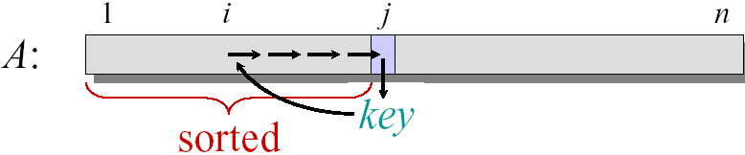
Insertion sort
Insertion-Sort(A, n) // A[1..n]
for j ← 2 to n
do key ← A[j]
i ← j − 1
while i > 0 and A[i] > key
do A[i+1] ← A[i]
i ← i − 1
A[i+1] ← key

Slide 12
Example of insertion sort
8 2 4 9 3 6
2 8 4 9 3 6
2 4 8 9 3 6
2 4 8 9 3 6 2 3 4 8 9 6

Slide 13
Running time
The running time depends on the input: an already sorted sequence is easier to sort.
Parameterize the running time by the size of the input n
Seek upper bounds on the running time T(n) for the input size n, because everybody likes a guarantee.

Slide 14
Kinds of analyses
Worst-case: (usually)
  T(n) = maximum time of algorithm on any input of size n.
Average-case: (sometimes)
  T(n) = expected time of algorithm over all inputs of size n.
  Need assumption of statistical distribution of inputs.
Best-case: (bogus)
  Cheat with a slow algorithm that works fast on some input.

Slide 15
Machine-independent time
What is insertion sort’s worst-case time?
It depends on the speed of our computer:
  relative speed (on the same machine),
  absolute speed (on different machines).
Big Idea:
  Ignore machine-dependent constants.
  Look at growth of T(n) as n→∞.
“Asymptotic Analysis”

Slide 16
Θ-notation
Math:
Θ(g(n)) = {f(n) : there exist positive constants
c₁, c₂, and n₀ such that 0 ≤ c₁g(n) ≤
f(n) ≤ c₂g(n) for all n ≥ n₀}
Engineering:
Drop low-order terms; ignore leading constants.
Example: 2n³ + 150n²−250n + 6024 = Θ(n³)

Slide 17
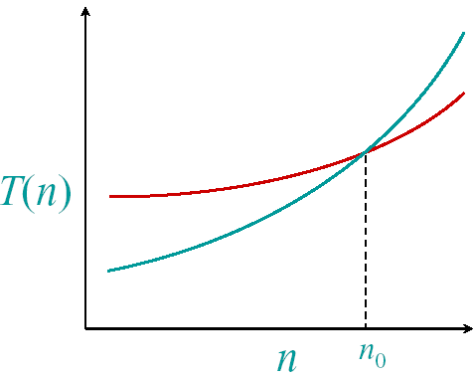
Asymptotic performance
When n gets large enough, a Θ(n²) algorithm always beats a Θ(n³) algorithm
We shouldn’t ignore
asymptotically slower
algorithms, however.
Real-world design
situations often call for a
careful balancing of
engineering objectives.
Asymptotic analysis is a
useful tool to help to
structure our thinking.

Slide 18
Insertion sort analysis
Worst case: Input reverse sorted.
Average case: All permutations equally likely.
Is insertion sort a fast sorting algorithm?
Moderately so, for small n.
Not at all, for large n.

Slide 19
Merge sort
Merge-Sort A[1..n]
1. If n = 1, done.
2. Recursively sort A[1..[n/2]]
and A[[n/2]+1..n]
3. “Merge” the 2 sorted arrays.
Key subroutine: Merge

Slide 20
Merging two sorted arrays
12 20 12 20 12 20 12 20 12 20 12
11 13 11 13 11 13 11 13 11 13
9 7 9 7 9 9
1 2
1 2 7 9 11 12
Time = Θ(n) to merge a total
of n elements (linear time).

Slide 21
Analyzing merge sort
T(n) Merge-Sort A[1..n]
Θ(1) 1. If n = 1, done.
2T(n/2) 2. Recursively sort A[1..[n/2]]
and A[[n/2]+1..n]
Θ(n) 3. “Merge” the 2 sorted lists.
Sloppiness: Should be T([n/2]) + T(n/2), but it turns out not to matter asymptotically.

Slide 22
Recurrence for merge sort
We shall usually omit stating the base case when T(n) = Θ(1) for sufficiently small n, but only when it has no effect on the asymptotic solution to the recurrence.
CLRS provides several ways to find good upper bound on T(n).
if n = 1 ;
if n > 1.

Slide 23
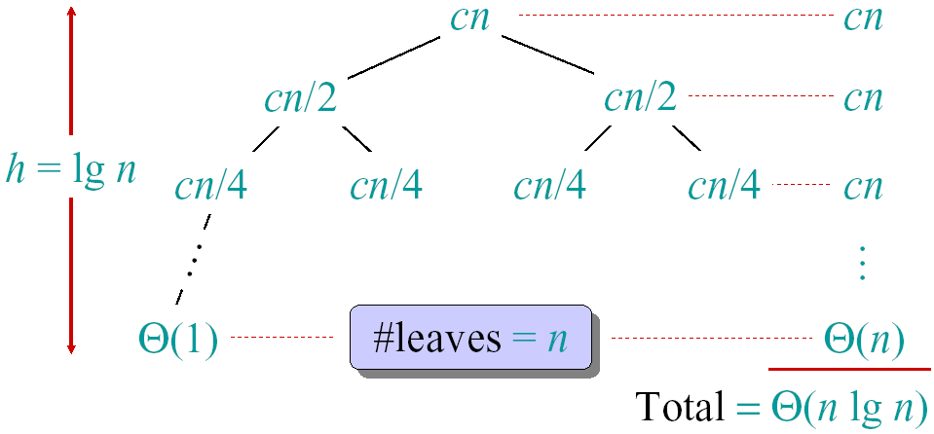
Recursion tree
Solve T(n)=2T(n/2)+cn, where c>0 is constant.

Slide 24
Conclusions
Θ(n*lgn) grows more slowly than Θ(n²).
Therefore, merge sort asymptotically beats insertion sort in the worst case.
In practice, merge sort beats insertion sort for n > 30 or so.
Go test it out for yourself.

Slide 25
Asymptotic notation
O-notation (“big-Oh”, upper bounds)
f(n) = O(g(n)) if ∃ const c, n₀ such that 0≤ f(n) ≤ cg(n), ∀n≥n₀.
e.g. 2n² = O(n³) (c=1, n₀=2)
Think of O(g(n)) as a set of functions:
O(g(n)) = {f(n): ∃ const c, n₀ such that 0≤ f(n) ≤ cg(n), ∀n≥n₀}
Then 2n² ∈ O(n³)

Slide 26
Ω-notation (lower bounds)
Again, think of Ω(g(n)) as a set of functions:
Ω(g(n)) = {f(n): ∃ const c, n₀ such that 0 ≤ cg(n) ≤ f(n), ∀n≥n₀}
e.g. n^{½} = Ω(lgn) (c=1, n₀=16)

Slide 27
Θ-notation (tight bounds)
Θ(g(n)) = {f(n): ∃ const c₁, c₂, n₀ such that 0 ≤ c₁g(n) ≤ f(n) ≤ c₂g(n), ∀n≥n₀}
Example:
Pick c₁= ¼ , c₂ = ¾ (educated guess),
then find satisfying n₀=8.

Slide 28
Useful Theorems
Theorem: Leading constants and lower-order terms don’t matter.
Theorem: (O ∩ Ω) ⇔ Θ.
Two more asymptotic notations:
  “Little-Oh” notation f(n) = o(g(n))
  “Little-omega” notation f(n) = ω(g(n))

Slide 29
Solving Recurrences
Like solving integrals, differential equations, etc.
Three methods:
  Substitution, Iteration, Master
Substitution Method (most general)
  Guess form of solution
  Verify by induction
  Solve for satisfying constant.

Slide 30
Example of substitution method proof
Example: solve T(n) = 4T(n/2) + n
  Guess that T(n) ∈ O(n³), i.e. that T of form cn³.
  Assume T(k) ≤ ck³ for k < n and
  Prove T(n) ≤ cn³ by induction
  T(n) = 4T(n/2) + n ≤ 4c(n/2)³ + n
  = cn³/2 + n = cn³ − (cn³/2−n)
  ≤ cn³ if c ≥ 2 and n ≥ 1
Thus T(n)=O(n³)!

Slide 31
Substitution Method (cont.)
Notes:
To prove inductive step, try to write expression as
<answer you want> − <something > 0>
In example above:
did not show that T(n) = Ω(n) or Θ(n) thus n³ is not a tight bound!
Can show O(n²).

Slide 32
Substitution: Achieving Tighter Bounds
Try to show T(n)=O(n²)
Assume T(k) ≤ ck²
T(n) = 4T(n/2) + n
≤ 4c(n/2)² + n
= cn² + n
≤ cn² for no choice of c>0. Lose.
What went wrong?

Slide 33
Fallacious argument
The problem? We couldn’t rewrite the equality
T(n) = cn² + n
as
T(n) = cn² − <(something positive)>
in order to show the inequality we wanted:
T(n) ≤ cn²

Slide 34
Corrected Proof
Idea: Strength inductive hypothesis by subtracting lower-order term:
Assume T(k)≤c₁k² − c₂k for k< n
T(n) = 4T(n/2) + n Given
≤ 4(c₁(n/2)² − c₂(n/2)) + n Ind. Hyp.
= c₁n² − 2c₂n + n simplify
= c₁n² − c₂n − (c₂n−n) Rearrange
≤ c₁n² − c₂n if c₂ ≥ 1
Pick c₁ big enough to handle initial conditions.
Thus T(n)=O(n²)!

Slide 35
Iterating recurrences
Basic idea: expand, and convert to summation
Example:
T(n)=n+4T(n/2)
=n+4(n/2+4T(n/4))
=n+4(n/2+4(n/4+4T(n/8)))
=n+4(n/2+4(n/4+4(n/8+4T(n/16))))
=n+2n+4n+…+2^{lgn}T(1)
=2⁰n+2¹n+2²n+…+2^{lgn}T(1)
=Θ(n²)+Θ(n)=Θ(n²)

Slide 36
To iterate recurrences
Should know rules and have intuition for arithmetic and geometric series
Math can be messy and hard. Often, use iterating recurrence to generate guess for substitution method.

Slide 37
Iteration method: Visualizing recursion tree
Construction of recursion tree for
T(n) = T(n/4) + T(n/2) + n²:
n²
n²
(n/4)²
(n/2)²
T(n/4)
T(n/2)
n²
T(n/16)
T(n/8)
T(n/8)
T(n/4)
(n/4)²
(n/2)²
5n²/16
(n/16)²
(n/8)²
(n/8)²
(n/4)²
25n²/256
Θ(n²)

Slide 38
Iteration method: Visualizing recursion tree
Another recurrence:
T(n) = T(n/3) + T(2n/3) + n:
Recursion tree:
n
n
n/3
2n/3
n
n/9
2n/9
2n/9
4n/9
n
Total: O(nlogn)

Slide 39
Next week
Recurrences: Master method
Divide and conquer: Strassen’s algorithm, polynomial multiplication
  Reading: Chapter 4
作业：2.3-6, 2.3-7, 2-1, 2-4.

