Slide 1
Introduction to Algorithms
Lecture 11

Slide 2
Topics
Definition of linear programming and examples
Duality
Algorithms for linear program

Slide 3
Linear programming
Linear programming is very useful algorithmically, both for proving theorems and for solving real-world problems.
linear programs can be solved efficiently, both in theory (meaning in polynomial time) and in practice
design approximation algorithms for NP-hard problems that use linear programming
Linear programming is conceptually useful, especially LP duality.
max flow <--> min cut

Slide 4
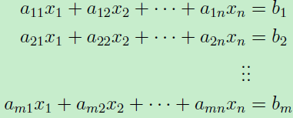
Systems of Linear Equations
m linear equations in real-valued variables x₁, …, x_{n}:
The a_{ij}'s and the b_{i}'s are given.
The goal is to check whether or not there are values for the x_{j}‘s such that all m constraints are satisfied. (e.g. Gaussian elimination)
What about inequalities?

Slide 5
The Diet Problem
Carbs
Protein
Fat
Iron
Cost
1 slice bread
30
5
1.5
10
30¢
1 cup yogurt
10
9
2.5
0
80¢
2tsp Peanut Butter
6
8
18
6
20¢
US RDA Minimum
300
50
70
100
Minimize 30 x₁ + 80 x₂ + 20 x₃
s.t. 30x₁ + 10x₂ + 6x₃ ≥ 300
5x₁ + 9x₂ + 8x₃ ≥ 50
1.5x₁ + 2.5x₂ + 18x₃ ≥ 70
10x₁ + 6 x₃ ≥ 100
x₁, x₂, x₃ ≥ 0

Slide 6
Linear Program
This is called a linear program (LP)
All constraints are linear in our decision variables
Objective function is linear
Don’t allow x₁⋅ x₂ ≥ 100, log x₃, that’s a polynomial program. Much harder.

Slide 7
LP – Standard Form
Given rational numbers a_{ij}, c_{j}, and b_{i}, 1 ≤ i ≤ m, 1 ≤ j ≤ n, find x₁, x₂, …, x_{n} (decision variables) that maximizes the linear function (objective)
subject to the linear constraints
Feasible solutions
x_{i} ≥ 0, 1 ≤ i ≤ n

Slide 8
LP – Standard Form
max c^{T}x (Primal)
subject to
Ax ≤ b.
x ≥ 0.
where
c = (c₁,…,c_{n})^{T}, b = (b₁,…,b_{m})^{T}.
A = [a_{ij}]_{m×n}.

Slide 9
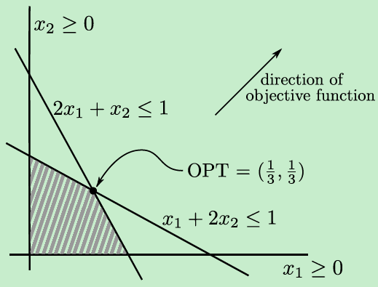
Geometric Intuition
max x₁ + x₂
s.t.
x₁ + 2x₂ ≤ 1
2x₁ + x₂ ≤ 1
x₁, x₂ ≥ 0

Slide 10
Geometric Intuition
A linear constraint (a_{i}^{T}x ≤ b_{i}) in n dimensions corresponds to a halfspace in R^{n}. Thus a feasible region is an intersection of halfspaces.
The level sets ({x : c^{T}x = const}) of the objective function are parallel (n-1)-dimensional hyperplanes in R^{n}, each orthogonal to the coefficient vector c of the objective function.
The optimal solution is the feasible point furthest in the direction of c (for a maximization problem) or -c (for a minimization problem).
When there is a unique optimal solution, it is a vertex (i.e., “corner”) of the feasible region.

Slide 11
Convexity Properties
Feasible region Ax ≤ b, x ≥ 0 is convex.
If p and q are in the feasible region, then so is the line segment joining p and q. Why?
Since Ap ≤ b and Aq ≤ b, for any λ ∈ [0,1],
λAp ≤ λb and (1 − λ)Aq ≤ (1 − λ)b
So A(λp + (1 − λ)q) ≤ b
Also λp ≥ 0 and (1 − λ)q ≥ 0 since p ≥ 0 and q ≥ 0
More generally, intersections of convex sets are convex.
Max c^{T}x occurs at a vertex. Can we just enumerate all vertices?

Slide 12
Modeling Network Flow
Variables: f_{uv} for each edge (u,v), representing positive flow.
Objective: maximize Σ_{v} f_{sv}
Constraints:
For all edges (u,v), 0 ≤ f_{uv} ≤ c(u,v) (capacity constraints)
For all v ∉ {s, t} , Σ_{u} f_{uv} = Σ_{u} f_{vu} (flow conservation)

Slide 13
Linear Programming Duality
Consider the following LP:
In an attempt to solve P we can produce upper bounds on its optimal value.
(P) max x₁ + x₂
st.
4x₁ + x₂ ≤ 2
x₁ + 2x₂ ≤ 1
x₁, x₂ ≥ 0

Slide 14
Some Upper Bounds
(P) max x₁ + x₂
st.
4x₁ + x₂ ≤ 2 (1)
x₁ + 2x₂ ≤ 1 (2)
x₁, x₂ ≥ 0
x₁ + x₂ ≤ 4x₁ + x₂ ≤ 2
x₁ + x₂ ≤ x₁ + 2x₂ ≤ 1
x₁ + x₂ ≤ 1/7(4x₁ + x₂) + 3/7(x₁ + 2x₂) ≤ 5/7
Best upper bound? x₁ + x₂ ≤ y₁(4x₁ + x₂) + y₂(x₁ + 2x₂)

Slide 15
Linear Programming: Primal
Decision variables: x₁, x₂,…,x_{n} ≥ 0.
max c₁x₁ + c₂x₂ + … + c_{n}x_{n}. (upper bounds?)
st.
a₁₁x₁ + a₁₂x₂ + … + a_{1n}x_{n} ≤ b₁
a₂₁x₁ + a₂₂x₂ + … + a_{2n}x_{n} ≤ b₂
…
a_{m1}x₁ + a_{m2}x₂ + … + a_{mn}x_{n} ≤ b_{m}
← y₁
← y₂
← y_{m}

Slide 16
Linear Programming: Duality
Introducing decision variables: y₁,y₂,…,y_{m} ≥ 0.
Constraints:
a₁₁y₁ + a₂₁y₂ + … + a_{m1}y_{m} ≥ c₁
a₁₂y₁ + a₂₂y₂ + … + a_{m2}y_{m} ≥ c₂
…
a_{1n}y₁ + a_{2n}y₂ + … + a_{mn}y_{m} ≥ c_{n}
Objective: min b₁y₁ + b₂y₂ + … + b_{m}y_{m}.

Slide 17
Linear Programming: Duality
The dual problem:
min b^{T}y
s.t.
A^{T}y ≥ c.
y ≥ 0.
Dual of the dual is primal.

Slide 18
Linear Programming Duality
Dual problem:
(D) min 2y₁ + y₂
st.
4y₁ + y₂ ≥ 1
y₁ + 2y₂ ≥ 1
y₁, y₂ ≥ 0
(P) max x₁ + x₂
st.
4x₁ + x₂ ≤ 2
x₁ + 2x₂ ≤ 1
x₁, x₂ ≥ 0
(D) min 2y₁ + y₂
st.
4y₁ + y₂ ≥ 1
y₁ + 2y₂ ≥ 1
y₁≥ 0, y₂ ≤ 0
(P’) max x₁ + x₂
st.
4x₁ + x₂ ≤ 2
x₁ + 2x₂ ≥ 1
x₁, x₂ ≥ 0
4y₁ - y₂ ≥ 1
y₁ - 2y₂ ≥ 1
y₂ ≥ 0
y₂ := -y₂
-x₁ - 2x₂ ≤ -1

Slide 19
Weak Duality
If x is a feasible solution to the primal LP and y is a feasible solution to the dual LP then
c^{T}x ≤ b^{T}y.
Proof.
c^{T}x ≤ (A^{T}y)^{T}x = y^{T}Ax ≤ y^{T}b.
Let (P),(D) be a primal-dual pair of linear programs. If x,
y are feasible solutions to (P),(D), and c^{T}x = y^{T}b, then
both x and y are both optimal.

Slide 20
Example: Primal
Max Flow (path decomposition)
Let P denote the set of all s-t paths.
(P) max Σ_{p ∈P} f_{p}
subject to:
Σ_{p ∈P:e∈p} f_{p} ≤ c_{e} for all e∈E
f_{p}≥ 0 for all p∈P.

Slide 21
Example: Primal
Rewrite the primal as follow:
max 1^{T}f
s.t. Af ≤ c
f ≥ 0.
where f = [f₁, …, f_{|P|}]^{T}, A_{ep} = 1[e ∈ p], c = [c_{e}]^{T}.

Slide 22
Example: Dual
Decision variables {y_{e}}_{e∈E}.
(D) min c^{T}y
st. A^{T}y ≥ 1
y ≥ 0
Rewrite it as follows:
min Σ_{e ∈E} c_{e}y_{e}
subject to:
Σ_{e:e∈p} y_{e} ≥ 1 for all p∈P
y_{e}≥ 0 for all e∈E.

Slide 23
Interpretation of Dual
Every s-t cut corresponds to a feasible solution to this dual linear program.
Fix a cut (A,B), with s ∈ A and t ∈ B, and set
y_{e} = 1[e ∈ cut(A,B)]
Feasibility: every s-t path must cross the cut (A,B) as some point.
Σ_{e ∈E} c_{e}y_{e} = Σ_{e ∈cut(A,B)} c_{e} = capacity(A,B).
Max flow value = P* ≤ D* ≤ Min cut

Slide 24
Interpretation of Dual
Max-flow min-cut theorem:
P* = D*
Then,
OPT of dual = D* = min cut value.
It implies that the linear program (D), despite allowing fractional solutions, always admits an optimal solution in which each decision variable is either 0 or 1.

Slide 25
Take-aways
The example illustrates three general points.
The duals of natural linear programs are often natural in their own right.
Strong duality. (We verified it in a special case)
Some natural linear programs are guaranteed to have optimal integral solutions.

Slide 26
Recipe for Taking Duals
Dual variables correspond to primal constraints.
Dual constraints correspond to primal variables.
Maximization and minimization get exchanged, the objective function and right-hand side get exchanged.
The constraint matrix gets transposed.
The true meaning of the dual: feasible dual solutions
correspond to bounds on the best-possible primal objective
function value (derived from taking linear combinations of
the constraints), and the optimal dual solution is the tightest
possible such bound.

Slide 27
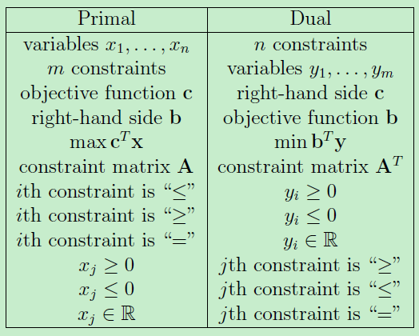
Recipe for Taking Duals

Slide 28
Strong Duality Theorem
Suppose the primal LP is feasible (i.e., it has at least one solution) and bounded (i.e., the optimal value is not ∞). Then the dual LP is also feasible and bounded.
Moreover, if x* is the optimal primal solution, and y* is the optimal dual solution, then
c^{T}x* = b^{T}y*.
To prove x∗ is optimal, I can give you y∗ and you can check if x∗ is feasible for the primal, y∗ is feasible for the dual, and c^{T}x∗ = b^{T}y∗.

Slide 29
Complementary Slackness Conditions
Let (P),(D) be a primal-dual pair of linear programs. If x, y are feasible solutions to (P),(D), and the following two conditions hold then both x and y are both optimal.
Whenever x_{j} ≠ 0, y satisfies the jth constraint of (D) with equality.
Whenever y_{i} ≠ 0, x satisfies the ith constraint of (P) with equality.
a₁₁x₁ + a₁₂x₂ + … + a_{1n}x_{n} ≤ b₁
a₂₁x₁ + a₂₂x₂ + … + a_{2n}x_{n} ≤ b₂
…
a_{m1}x₁ + a_{m2}x₂ + … + a_{mn}x_{n} ≤ b_{m}
a₁₁y₁ + a₂₁y₂ + … + a_{m1}y_{m} ≥ c₁
a₁₂y₁ + a₂₂y₂ + … + a_{m2}y_{m} ≥ c₂
…
a_{1n}y₁ + a_{2n}y₂ + … + a_{mn}y_{m} ≥ c_{n}

Slide 30

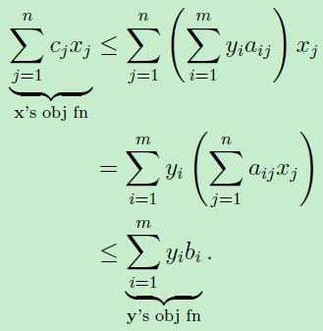

Complementary Slackness Conditions
The first condition implies that:
for each j = 1,…, n.
The second condition implies that:
for each i = 1,…,m.
Weak duality: c^{T}x ≤ (A^{T}y)^{T}x = y^{T}Ax ≤ y^{T}b.

Slide 31
A General Algorithm Design Paradigm
Why are the complementary slackness conditions interesting?
They offer three principled strategies for designing algorithms for solving linear programs and their special cases.

Slide 32
A General Algorithm Design Paradigm
x is feasible for (P).
y is feasible for (D).
x, y satisfy the complementary slackness conditions.
Pick two of these three conditions to maintain at all times, and work toward achieving the third.

Slide 33
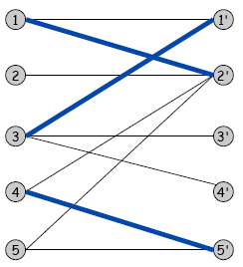
Bipartite Graph Matching
Given a bipartite graph G = (L,R,E) with a cost c_{e} for each edge, the linear program (P-BM) is:
min ∑_{e} c_{e}x_{e}
subject to:
∑_{e∈δ(v)} x_{e} = 1, for all v ∈ L ∪ R
x_{e} ≥ 0, for all e ∈ E.
where δ(v) denotes the edges incident to v.
Each x_{e} is either equal to 1 (if e is in the chosen matching) or 0 (otherwise).
The linear program is free to use fractional values for the decision variables.
L
R

Slide 34
Bipartite Graph Matching
In matrix-vector form, this linear program is:
min c^{T}x
subject to:
Ax = 1
x ≥ 0
where A is the (L ∪ R) × E matrix:
A_{ve} = 1[e ∈δ(v)]

Slide 35
The Dual Linear Program
Dual variables p_{v} for each vertex v.
In matrix-vector form:
max 1^{T}p
subject to:
A^{T}p ≤ c
Unpacking this dual linear program: (D-BM)
max ∑_{v∈L∪R} p_{v}
subject to:
p_{u} + p_{v} ≤ c_{uv}. for each (u,v) ∈ E.

Slide 36
The Dual Linear Program
Rewrite the constraints of (D-BM) as
(reduced cost) c_{uv} – p_{u} – p_{v} ≥ 0 (*)
for every edge (u,v) ∈ E.
Check out the complementary slackness conditions for the primal-dual pair (P-BM),(D-BM).
Because all constraints in (P-BM) are equations (not counting the non-negativity constraints), the second condition is trivial.
The first condition states that whenever x_{e} > 0, the corresponding constraint (*) should hold with equality (edge e should have zero reduced cost.)

Slide 37
Primal-Dual Algorithms
The Hungarian algorithm maintains the second two conditions (p is feasible for (D-BM) and complementary slackness conditions) at all times.
And works toward the first condition (primal feasibility, i.e., a perfect matching).
OPT of (D-PM) ≤ OPT of (P-PM) ≤ min-cost perfect matching.

Slide 38
Algorithms for Linear Programming
Simplex Algorithm (Dantzig)
Practical, but exponential time in the worst-case
Ellipsoid Algorithm (Khachian)
First polynomial time algorithm, but slow in practice
Karmarkar’s Algorithm (interior point)
Polynomial time algorithm and competitive in practice
Software: LINDO, CPLEX, Solver (in Excel)

Slide 39
作业：29.2-7, 29-5
预习：34

