Slide 1
Introduction to Algorithms
Lecture 12

Slide 2
Today’s Topics
Some difficult problems
P and NP
Polynomial-time reductions
Cook’s Theorem (SAT Problem)
NP-complete problems
Clique
Independent set
Vertex cover …

Slide 3
P vs NP (interconnectedness of all things)
A whole course by itself
We’ll do just one lecture
More in “Theory of Computation”, “Computational Complexity”, etc.

Slide 4
Have seen so far
Algorithms for various problems
Running times O(nm²), O(n²) , O(n log n), O(n), etc.
i.e., polynomial in the input size
Can we solve all (or most of) interesting problems in polynomial time ?
Not really…

Slide 5
Example difficult problem
Traveling Salesperson Problem (TSP)
Input: undirected graph with lengths on edges
Output: shortest tour that visits each vertex exactly once
Best known algorithm: O(n²2^{n}) time.

Slide 6
Another difficult problem
Clique:
Input: undirected graph G = (V, E)
Output: largest subset C of V such that every pair of vertices in C has an edge between them
Best known algorithm: O(n2^{n}) time

Slide 7
What can we do?
Spend more time designing algorithms for those problems
People tried for a few decades, no luck
Prove there is no polynomial time algorithm for those problems
Would be great
Seems really difficult
Best lower bounds for “natural” problems:
Ω(n²) for restricted computational models
4.5n for unrestricted computational models

Slide 8
What else can we do?
Show that those hard problems are essentially equivalent. i.e., if we can solve one of them in poly time, then all others can be solved in poly time as well.
Works for at least 10 000 hard problems

Slide 9

The benefits of equivalence
Combines research efforts
If one problem has poly-time solution, then all of them do
P₁
P₂
P₃

Slide 10

A more realistic scenario
Once an exponential lower bound is shown for one problem, it holds for all of them.
But someone is happy…
P₁
P₂
P₃

Slide 11
Summing up
If we show that a problem Π is equivalent to ten thousand other well studied problems without efficient algorithms, then we get a very strong evidence that Π is hard.
We need to:
Identify the class of problems of interest
Define the notion of equivalence
Prove the equivalence(s)

Slide 12
Class of problems: NP
Decision problems: answer YES or NO. E.g.,”is there a tour of length ≤ K” ?
Solvable in non-deterministic polynomial time:
Intuitively: the solution can be verified in polynomial time
E.g., if someone gives us a tour T, we can verify if T is a tour of length ≤ K.
Therefore, TSP is in NP.

Slide 13
Formal definitions of P and NP
A problem Π is solvable in poly time (or Π ∈ P), if there is a poly time algorithm V(.) such that for any input x:
Π(x) = YES iff V(x) = YES
A problem Π is solvable in non-deterministic poly time (or Π ∈ NP), if there is a poly time algorithm V(. , .) such that for any input x:
Π(x)=YES iff there exists a certificate y of size poly(|x|) such that V(x, y)=YES

Slide 14
Examples of problems in NP
Is “Does there exist a clique in G of size ≥ K” in NP ?
Yes: V(x, y) interprets x as a graph G, y as a vertex set C, and checks if all vertices in C are adjacent and if |C| ≥ K
Is Sorting in NP ?
No, not a decision problem.
Is “Sortedness” in NP ?
Yes: ignore y, and check if the input x is sorted.

Slide 15
Reductions: Π’ to Π
YES
YES
x’
f(x’) = x
f
A for Π
f
NO
NO
A’ for Π’

Slide 16
Reductions
Π’ is poly time reducible to Π (Π’ ≤ Π) iff there is a poly time function f that maps inputs x’ of Π’ into inputs x of Π, such that for any x’
Π’(x’) = Π(f(x’))
Fact 1: if Π ∈ P and Π’ ≤ Π then Π’ ∈ P
Fact 2: if Π ∈ NP and Π’ ≤ Π then Π’ ∈ NP
Fact 3: if Π’ ≤ Π and Π” ≤ Π’ then Π” ≤ Π

Slide 17
Showing equivalence between difficult problems
Options:
Show reductions between all pairs of problems
Reduce the number of reductions (!) using transitivity of “≤”
Show that all problems in NP are reducible to a fixed Π. To show that some problem Π’∈NP is equivalent to all difficult problems, we only show Π ≤ Π’.
TSP
Clique
Π
P₃
P₄
Π’
P₅

Slide 18
The first problem Π
Satisfiability problem (SAT):
Given: a formula ϕ with m clauses C₁,…, C_{m} over n variables.
Example: x₁ ∨ x₂ ∨ x₅ , x₃ ∨ ¬ x₅
Check if there exists TRUE/FALSE assignments to the variables that makes the formula satisfiable

Slide 19
SAT is NP-complete
Fact: SAT ∈NP
Theorem [Cook’71]: For any Π’ ∈ NP , we have Π’ ≤ SAT.
Definition: A problem Π such that for any Π’∈NP we have Π’ ≤ Π, is called NP-hard
Definition: An NP-hard problem that belongs to NP is called NP-complete
Corollary: SAT is NP-complete.

Slide 20
What we will prove
SAT
Clique
Independent Set
Follow from Cook’s Theorem
Vertex Cover
Conclusion: all of the above problems are
NP-complete

Slide 21
Clique again
Clique:
Input: undirected graph G = (V, E), K
Output: is there a subset C of V, |C| ≥ K, such that every pair of vertices in C has an edge between them

Slide 22
SAT ≤ Clique
Given a SAT formula ϕ = C₁, …, C_{m} over x₁, …, x_{n}, we need to produce G = (V, E) and K, such that ϕ satisfiable iff G has a clique of size ≥ K.
Notation: a literal is either x_{i} or ¬x_{i}

Slide 23
SAT ≤ Clique reduction
For each literal t occurring in ϕ, create a vertex v_{t}
Create an edge v_{t} – v_{t’} iff:
t and t’ are not in the same clause, and
t is not the negation of t’

Slide 24
SAT ≤ Clique example
Formula: x₁∨ x₂ ∨ x₃, ¬x₂ ∨ ¬x₃, ¬x₁ ∨ x₂
Graph:
Claim: ϕ satisfiable iff G has a clique of size ≥ m
¬x₂
x₁
¬x₃
x₂
x₃
x₂
¬x₁

Slide 25
Proof
“→” part:
Take any assignment that satisfies ϕ.
E.g., x₁ = F, x₂ = T, x₃ = F
Let the set C contain one satisfied literal per clause
C is a clique
¬x₂
x₁
¬x₃
x₂
x₃
x₂
¬x₁

Slide 26
Proof
“←” part:
Take any clique C of size m (i.e., = m)
Create a set of equations that satisfies selected literals.
E.g., x₃ = T, x₂ = F, x₁= F
The set of equations is consistent and the solution satisfies ϕ
¬x₂
x₁
¬x₃
x₂
x₃
x₂
¬x₁

Slide 27
Altogether
We constructed a reduction that maps:
YES inputs to SAT to YES inputs to Clique
NO inputs to SAT to NO inputs to Clique
The reduction works in poly time
Therefore, SAT ≤ Clique→ Clique is NP-hard
Clique is in NP → Clique is NP-complete

Slide 28
Independent set (IS)
Input: undirected graph G = (V, E)
Output: is there a subset S of V, |S| ≥ K such that no pair of vertices in S has an edge between them

Slide 29
Clique ≤ IS
Given an input G = (V, E), K to Clique, need to construct an input G’=(V’,E’), K’ to IS, such that G has clique of size K iff G’ has IS of size K’.
Construction: K’= K, V’= V, E’= E^{c}
Reason: C is a clique in G iff it is an IS in G’s complement.

Slide 30
Vertex cover (VC)
Input: undirected graph G = (V, E)
Output: is there a subset C of V, |C| ≤ K such that each edge in E is incident to at least one vertex in C.

Slide 31
IS ≤ VC
Given an input G=(V, E), K to IS, need to construct an input G’=(V’, E’), K’ to VC, such that G has an IS of size K iff G’ has VC of size K’.
Construction: V’ = V, E’ = E, K’ = |V| − K
Reason: S is an IS in G iff V − S is a VC in G.

Slide 32
Exact-3SAT
Exact-3SAT:
Given: a formula ϕ with m clauses C₁,…, C_{m} over n variables such that |C_{i}| = 3 for 1 ≤ i ≤ m.
Example: x₁ ∨ x₂ ∨ x₃ , ¬x₁ ∨ ¬x₂ ∨ ¬x₃,
¬x₁∨ ¬x₂ ∨ ¬x₃
Check if there exists TRUE/FALSE assignments to the variables that makes the formula satisfiable.

Slide 33
SAT ≤ Exact-3SAT
Reduction:
x → x ∨ y₁ ∨ y₂, x ∨ y₁ ∨ ¬y₂, x ∨ ¬y₁ ∨ y₂, x ∨ ¬y₁ ∨ ¬y₂.
x₁ ∨ x₂→ x₁ ∨ x₂ ∨ y, x₁ ∨ x₂ ∨ ¬y.
x₁ ∨ x₂ … ∨ x_{k-1} ∨ x_{k} (k ≥ 4) → x₁ ∨ x₂ ∨ y₁, ¬y₁ ∨ x₃ ∨ y₂, ¬y₂ ∨ x₄ ∨ y_{3,} …, ¬y_{k-4} ∨ x_{k-2} ∨ y_{k-3}, ¬y_{k-3} ∨ x_{k-1} ∨ x_{k}.

Slide 34
k-Colorability
Let C a finite set of colors and G = (V, E) an undirected graph.
A coloring is a map : χ: V → C such that χ(u) ≠ χ(v) for (u,v) ∈ E.
Given G and k, the k-colorability problem is to determine whether there exists a coloring using no more than k colors.
For k = 2, the problem is easy: a graph is 2-colorable iff it is bipartite iff it has no odd cycle.

Slide 35
SAT ≤ 3-Colorability
Three special vertices: R, G, B.
Include a vertex for each literal, and connect each literal to its complement and to the vertex B:
R
G
B
x
¬x
B

Slide 36
SAT ≤ 3-Colorability
Construct a subgraph for each clause:
A coloring of the vertices on the top row with either red or green can be extended to a 3-coloring of the whole subgraph iff at least one of them is colored green.
x
y
¬z
u
¬v
w
G
G
G
G
G
G
G
G

Slide 37
SAT ≤ 3-Colorability
x
y
¬z
u
¬v
w
G
G
B
G
B
G
R
G
B
G
B
G
B
G
G
R
G
B
R
G
R

Slide 38
SAT ≤ 3-Colorability
Another case:
x
y
¬z
G
G
G
G
R

Slide 39
SAT ≤ 3-Colorability
Case 1:
x
y
¬z
G
G
R
G
B
G
B
G
R
B
R
G

Slide 40
SAT ≤ 3-Colorability
Case 2:
x
y
¬z
R
R
R
G
B
G
B
G
B
G
G
R
R
G
?

Slide 41
Exact (Set) Cover
Given a finite set X and a family of subsets S of X, is there a subset S’ ⊆ S such that every element of X lies in exactly one element of S’?
X = {x₁, x₂,…,x_{n}}
S = {X₁,X₂,…,X_{m}}, X_{j} ⊆ X.
S’ ⊆ S: ∀x_{i} ∈X, ∃X_{j} ∈ S’, x_{i} ∈ X_{j} and x_{i} ∉ X_{j’} (j’ ≠ j)?

Slide 42
3-Colorability ≤ Exact Cover
Let C = {red, green, blue}
For each u ∈ V, let N(u) be the set of neighbors of u in G.
For each u ∈ V, include u in X along with 3(|N(u)|+1) additional elements of X.
Three sets S_{u}^{red}, S_{u}^{green}, and S_{u}^{blue}, each with |N(u)| + 1 elements.

Slide 43
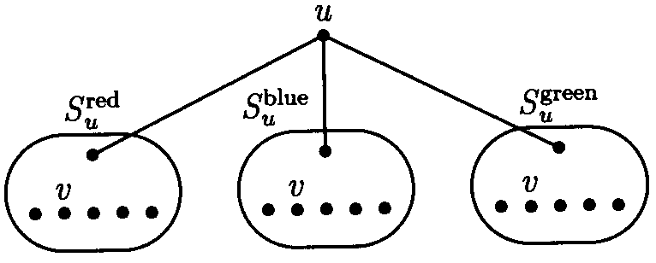
3-Colorability ≤ Exact Cover
For each color c, pick a special element p_{u}^{c} from S_{u}^{c} and associate the remaining |N(u)| elements of S_{u}^{c} with the elements of N(u) in a one-to-one fashion.
Let q_{uv}^{c} denote the element of S_{u}^{c} associated with v ∈ N(u).
The set S contains all two element sets of the form {u, p_{u}^{c}}.

Slide 44
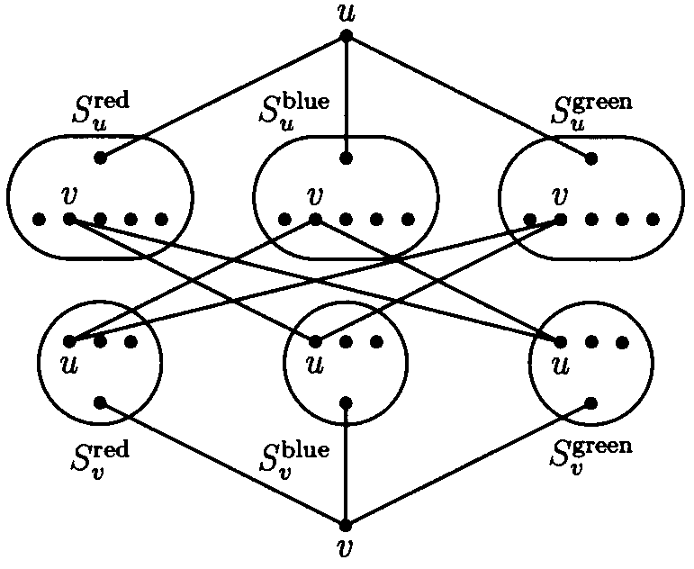
3-Colorability ≤ Exact Cover
Include all two element sets of the form {q_{uv}^{c}, q_{vu}^{c’}} for all (u,v) ∈ E and c, c’ ∈ C with c ≠ c’.

Slide 45
3-Colorability ≤ Exact Cover
u: |N(u)| = 5
p_{u}^{red}
p_{u}^{green}
p_{u}^{blue}
q_{uv}^{red}
q_{uv}^{green}
q_{uv}^{blue}
q_{vu}^{red}
q_{vu}^{green}
q_{vu}^{blue}
p_{v}^{red}
p_{v}^{green}
p_{v}^{blue}
v: |N(v)| = 3

Slide 46
3-Colorability ≤ Exact Cover
u: |N(u)| = 5
p_{u}^{red}
p_{u}^{green}
p_{u}^{blue}
q_{uv}^{red}
q_{uv}^{green}
q_{uv}^{blue}
q_{vu}^{red}
q_{vu}^{green}
q_{vu}^{blue}
p_{v}^{red}
p_{v}^{green}
p_{v}^{blue}
v: |N(v)| = 3

Slide 47
Integer Programming
Given rational numbers a_{ij}, c_{j}, and b_{i}, 1 ≤ i ≤ m, 1 ≤ j ≤ n, find integers x₁, x₂, …, x_{n} that maximizes the linear function
subject to the linear constraints
Reduction: Vertex Cover ≤ IP.
min ∑_{v} x_{v}
st x_{u} + x_{v} ≥ 1,∀(u,v)∈E
x_{v} ∈ {0, 1}, ∀v∈V

Slide 48
Knapsack
Given a finite set S, integer weight function w: S → N, benefit function b: S → N, weight limit W ∈ N, and desired benefit B ∈ N, determine whether there exists a subset S’ ⊆ S such that

Slide 49
Subset Sum
Given a finite set S, integer weight function w: S → N, and target integer B, determine whether there exists a subset S’ ⊆ S such that

Slide 50
Partition
Given a finite set S and integer weight function w: S → N, determine whether there exists a subset S’ ⊆ S such that

Slide 51
Reductions
Partition ≤ Subset Sum:
Subset Sum ≤ Partition: introducing two new elements of weight N – B and N – (Σ – B) (N > Σ), respectively, where
Partition ≤ Knapsack: b = w, and W=B= Σ/2.

Slide 52


Exact Cover ≤ Subset Sum
Exact cover (X, S) with X = {0,1…,n-1}.
f_{x} = |{A ∈ S: x ∈ A}| for each x ∈X.
Let p > f_{x} for all x ∈X.
Encode A ∈ S as the number:
and take

Slide 53
Bin Packing
Given a finite set S, volumes w: S → N, and bin size B ∈ N, what is minimum number of bins needed to contain all the elements of S?
Decision version?
Reduction: Partition ≤ Bin Packing.

Slide 54
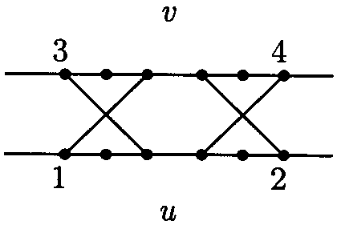
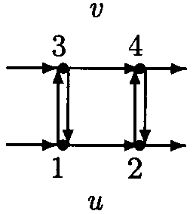
Hamiltonian Circuit
A Hamiltonian circuit in a directed or undirected graph G = (V, E) is a circuit that visits each vertex in the graph exactly once.
The Hamiltonian circuit problem is to determine for a given graph G whether a Hamiltonian circuit exists.
Reduction: Vertex Cover ≤ Hamiltonian Circuit.

Slide 55
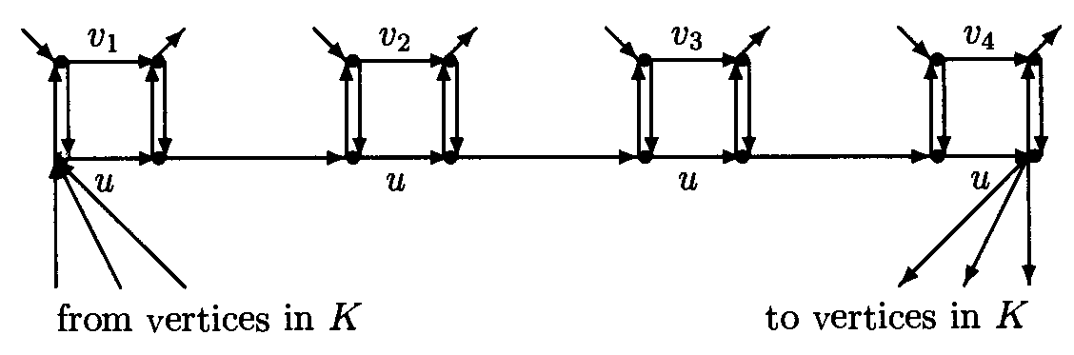
Hamiltonian Circuit
A set K of k extra vertices.
There is an edge from each vertex in K to the first vertex in the u loop, and an edge from the last vertex in the u loop to each vertex in K.
u loop

Slide 56
Traveling Salesman (TSP)
Given a number k ≥ 0 and a directed graph G = (V, E) with nonnegative edge weight w: E → N, does there exist a tour of total weight at most k visiting each vertex exactly once and returning home?
Reduction: Hamiltonian Circuit ≤ TSP.

Slide 57
A Partial Taxonomy of Hard Problems
Packing problems: independent set, set packing.
Covering problems: Vertex cover, set cover.
Partitioning problems: Graph coloring, 3-dimensional matching.
Sequencing problem: Hamiltonian cycle, TSP.
Numerical problems: Subset sum.
Constraint satisfaction problem: SAT, 3-SAT.

Slide 58
Further Reading
Michael Garey and David Johnson, Computers and Intractability: A Guide to the Theory of NP-Completeness.
Michael Sipser, Introduction to the Theory of Computation, 中信出版社, 2002.
Christos Papadimitriou, Computational Complexity, 清华大学出版社, 2004.

Slide 59
作业：34.4-7 (构图后参考22.5的SCC算法), 34.5-1, 34.5-8
预习：ch35

