Slide 1
Introduction to Algorithms
FFT

Slide 2
Today’s Topics
Fast Fourier Transform
Polynomial multiplication
Applications of FFT

Slide 3
Discrete Fourier Transform
Discrete Fourier Transform (DFT):
Given: coefficients of a polynomial
a(x) = a₀ + a₁x + … + a_{n-1}x^{n-1}
Goal: compute a( ), a( ) …a( ), is the “principal n-th root of unity”
Challenge: Perform DFT in O(n log n) time.

Slide 4
Motivation: Computer Science
We will see how to multiply two polynomials in O(n log n) time using FFT
Multiplication of polynomials → mult. of (large) integers - cryptography
Also: string/pattern matching, etc.

Slide 5
DFT
Recall: want a( ), a( ) … a( )
is the “principal n-th root of unity, i.e., for j=0…n-1 we have
We will work in the field of complex numbers where
is indeed the principal n-th root of unity:

Slide 6

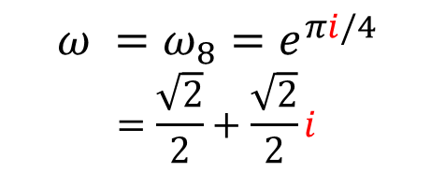
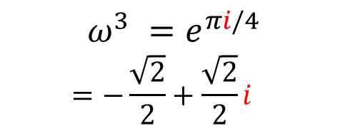
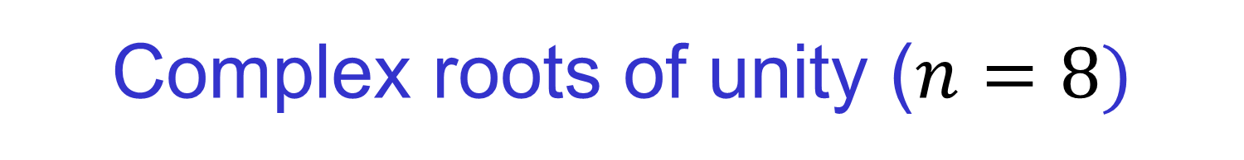





Complex roots of unity ($n=8)$
$$ω^{2}=i$$
$$ω^{3} =e^{πi/4} \\ =−\frac{\sqrt{2}}{2}+\frac{\sqrt{2}}{2}i$$
$$ω =ω_{8}=e^{πi/4} \\ =\frac{\sqrt{2}}{2}+\frac{\sqrt{2}}{2}i$$
$$ω^{4}=−1$$
$$ω^{0}=ω^{8}=1$$
$$ω^{5}$$
$$ω^{7}$$
$$ω^{6}=−i$$

Slide 7
Halving Lemma
If n > 0 is even, then the squares of the n complex n-th roots of unity are the n/2 complex (n/2)-th roots of unity, i.e.:
Proof:

Slide 8
FFT
Divide-and-conquer algorithm
“Split” a(x) into a^{[0]}(x) and a^{[1]}(x):
a^{[0]}(x) = a₀ + a₂x + … + a_{n-2}x^{n/2-1}
a^{[1]}(x) = a₁ + a₃x + … + a_{n-1}x^{n/2-1}
Therefore
a^{[0]}(x²) + x a^{[1]}(x²) = a(x)

Slide 9
FFT: the algorithm
Recall we need to evaluate the polynomial a at points
Suffices to
Evaluate polynomials a^{[0]} and a^{[1]} at points
Compute
However,
Thus, we just need to recursively evaluate two polynomials with degree n/2-1 at n/2 points!
Time: T(n) = 2T(n/2) + O(n) → T(n) = O(n log n)

Slide 10
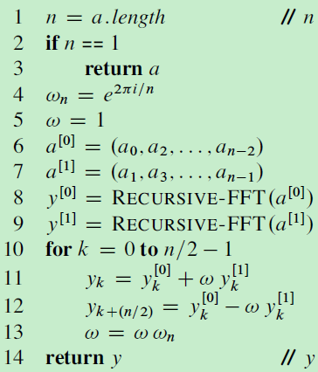
Recursive FFT

Slide 11
Comments
We assumed that n is a power of 2
This is NOT without loss of generality

Slide 12
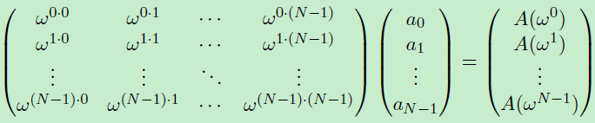
DFT
Forward computation of DFT:

Slide 13
Inverse DFT
Given: the values a( ), a( ) … a( ), denoted by y₀, y₁, … , y_{n-1}.
Goal: compute the coefficients a₀, a₁,…,a_{n-1}
Algorithm:
“Observe” that , y(x) is a polynomial with coefficients y₀,…, y_{n-1} (see CLRS for proof)
Run FFT

Slide 14

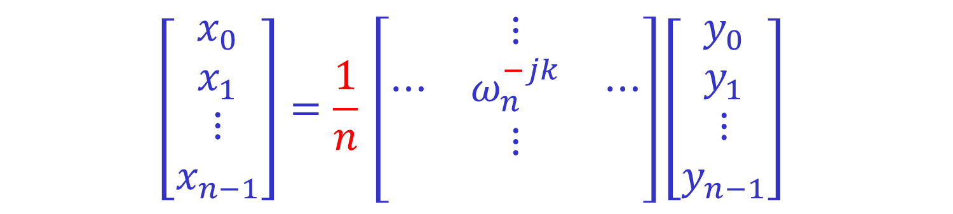
The Inverse DFT
The inverse DFT is very similar to the DFT:
$$\left[\begin{matrix}x_{0} \\ x_{1} \\ \begin{matrix}⋮ \\ x_{n−1}\end{matrix}\end{matrix}\right]=\frac{1}{n} \left[\begin{matrix} & ⋮ & \\ ⋯ & ω_{n}^{−jk} & ⋯ \\ \begin{matrix} \\ \end{matrix} & \begin{matrix}⋮ \\ \end{matrix} & \begin{matrix} \\ \end{matrix}\end{matrix}\right]\left[\begin{matrix}y_{0} \\ y_{1} \\ \begin{matrix}⋮ \\ y_{n−1}\end{matrix}\end{matrix}\right]$$
To prove it, we need show that
$$\sum_{ℓ=0}^{n−1}{ω_{n}^{jℓ}ω_{n}^{−ℓk}}= \left\{\begin{matrix} n & if j=k \\ 0 & otherwise\end{matrix}\right.$$
(Recall that if $C=AB$, then $c_{j,k}=\sum_{ℓ=0}^{n−1}{a_{j,ℓ}b_{ℓ,k}}$.)

Slide 15

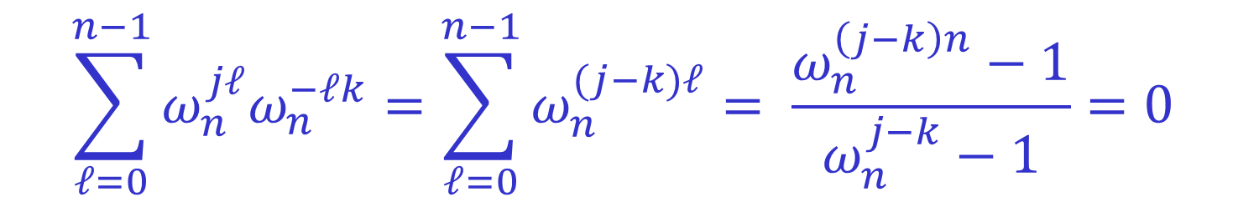
The Inverse DFT
$$\sum_{ℓ=0}^{n−1}{ω_{n}^{jℓ}ω_{n}^{−ℓk}}= \left\{\begin{matrix} n & if j=k \\ 0 & otherwise\end{matrix}\right.$$
If $j=k$, then $ω_{n}^{jℓ}ω_{n}^{−ℓk}=1$, so the claim is obvious.
If $j≠k$, and $0≤j,k<n$, then:
$$\sum_{ℓ=0}^{n−1}{ω_{n}^{jℓ}ω_{n}^{−ℓk}}=\sum_{ℓ=0}^{n−1}{ω_{n}^{(j−k)ℓ}}= \frac{ω_{n}^{\left(j−k\right)n}−1}{ω_{n}^{j−k}−1}=0$$
as $ω_{n}^{\left(j−k\right)n}={\left(ω_{n}^{n}\right)}^{j−k}=1$, while $ω_{n}^{j−k}≠1$.
(Recall that if $a≠1$, then $\sum_{ℓ=0}^{n−1}{a^{ℓ}}= \frac{a^{n}−1}{a−1}$.)

Slide 16
Polynomial multiplication
Input: a(x) = a₀ + a₁x + … + a_{n-1}x^{n-1},
b(x) = b₀ + b₁x + … + b_{n-1}x^{n-1},
Output: c(x)=a(x)b(x)=c₀+c₁x+…+c_{2n-2}x^{2n-2}
c_{i}=a₀b_{i}+a₁b_{i-1}+…+a_{i-1}b₁+a_{i}b₀
How to solve it in O(n log n) time ?

Slide 17
FFT-based algorithm
Extend a, b to degree 2n-2 (by adding 0’s)
Compute and
(via FFT)
Compute
Compute c₀, c₁,…,c_{2n-2} (via inverse FFT)
Same time as FFT

Slide 18
Uniqueness of c
Can show (CLRS) that if we fix the values of a (d-1)-degree polynomial at d different points, then the polynomial is unique
E.g., there is only one line passing through 2 points
Therefore, the algorithm is correct

Slide 19





Convolution
$$x=\left(x_{0},x_{1},…,x_{n−1}\right)$$
$$z=x∗y$$
$$y=\left(y_{0},y_{1},…,y_{n−1}\right)$$
$$z=\left(z_{0},z_{1},…,z_{2n−1}\right)$$
$$z_{k}=\sum_{i+j=k}{x_{i}y_{j}}=\sum_{i}{x_{i}y_{k−i}}$$
$$\max\left\{0,k−n\right\}≤i≤min⁡\{k,n\}$$
Naturally extends to $x$ and $y$ having different length.

Slide 20





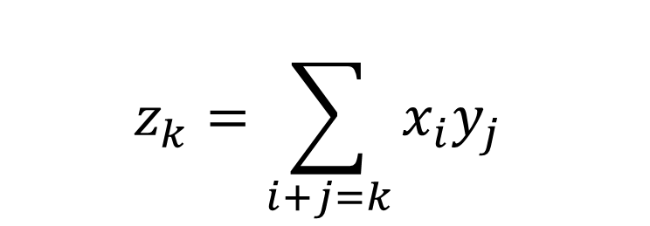








Convolution
$$x=\left(x_{0},x_{1},…,x_{n−1}\right)$$
$$z=x∗y$$
$$y=\left(y_{0},y_{1},…,y_{n−1}\right)$$
$$z=\left(z_{0},z_{1},…,z_{2n−1}\right)$$
$$z_{k}=\sum_{i+j=k}{x_{i}y_{j}}$$
$$z_{0}=x_{0}y_{0}$$
$$z_{1}=x_{0}y_{1}+x_{1}y_{0}$$
$$z_{2}=x_{0}y_{2}+x_{1}y_{1}+x_{2}y_{0}$$
$$z_{3}=x_{0}y_{3}+x_{1}y_{2}+x_{2}y_{1}+x_{3}y_{0}$$
$$z_{4}=x_{1}y_{3}+x_{2}y_{2}+x_{3}y_{1}$$
$$z_{5}=x_{2}y_{3}+x_{3}y_{2}$$
Example:$n=4$
$$z_{6}=x_{3}y_{3}$$
For convenience
$$z_{7}=0$$

Slide 21



Convolution
$$x_{0}$$ | $$x_{1}$$ | $$x_{2}$$ | $$x_{3}$$
$$y_{0}$$ | $$y_{1}$$ | $$y_{2}$$ | $$y_{3}$$
$$y_{3}$$ | $$y_{2}$$ | $$y_{1}$$ | $$y_{0}$$
Reverse$y$.
Shift$y$ to starting position.
Compute products for each aligment.

Slide 22






Convolution
$$x_{0}$$ | $$x_{1}$$ | $$x_{2}$$ | $$x_{3}$$
$$y_{3}$$ | $$y_{2}$$ | $$y_{1}$$ | $$y_{0}$$
$$z_{0}=x_{0}y_{0}$$
$$z_{1}=x_{0}y_{1}+x_{1}y_{0}$$
$$z_{2}=x_{0}y_{2}+x_{1}y_{1}+x_{2}y_{0}$$
$$z_{3}=x_{0}y_{3}+x_{1}y_{2}+x_{2}y_{1}+x_{3}y_{0}$$
$$z_{4}=x_{1}y_{3}+x_{2}y_{2}+x_{3}y_{1}$$
$$z_{5}=x_{2}y_{3}+x_{3}y_{2}$$
$$z_{6}=x_{3}y_{3}$$

Slide 23
Three Evenly Spaced 1s within a Binary String
Given a binary string S of length n, let S[i] denote the ith bit, for 0 ≤ i < n.
L = {i: S[i] = 1} be the indices with ones.
Whether there are three evenly spaced 1s within S?
Example: 11100000; 110110010 (yes)
1011 (no)

Slide 24
Three Evenly Spaced 1s – Naïve Solution
Try all starting indices i and all gap lengths d, and for each (i, d) pair, check in O(1) if S[i] = S[i + d] = S[i + 2d] = 1.
There are at most n choices for i and for d, so total runtime is O(n²).
S[i – d] = S[i] = S[i + d] = 1

Slide 25
Three Evenly Spaced 1s - using convolutions
Construct a polynomial:
Example: 110110010
Compute p(x)² using FFT multiplication.
If the coefficient of x^{2b} is 3 or more for any b∈ L then output YES. Otherwise, output NO.
O(n)

Slide 26
Three Evenly Spaced 1s - using convolutions
The coefficient of x^{t} is the number of ordered pairs (a, c) such that a, c ∈ L and a + c = t.
The pair (b, b) always contributes 1 to the
coefficient of x^{2b}.
If there exists some other pair (a, c) where a ≠ c, a + c = 2b, and a, c ∈ L, then the coefficient of x^{2b} will be at least 3.

Slide 27
String Matching – 1
Input: Two strings t[0…n-1] and p[0…m-1], containing symbols from alphabet Σ
Goal: find all “shifts” 0≤ i < n-m such that t[i…i+m-1] = p.
Example:
Σ = { , a, b,…, z}
t[1…18] = “to be or not to be”
p[1..2] = “be”
Shifts: 3, 16

Slide 28
String Matching – 2
Define:
There is a match at index i if and only if X[i] = 0.
How to compute Y in O(n log n)?
0 ≤ i < n – m
0 ≤ i < n – m

Slide 29
String Matching – 3
Let t’ be the reverse of t. Then
Let k = n – 1 – i – j. Then
Let f be the poly with coefficients p₁, p₂, …, p_{m-1} and g be the poly with coefficients t’₀, t’₁,… ,t’_{n-1}. Then Y[i] is the coefficient of x^{n-1-i} in fg.

Slide 30
String Matching – 4
Suppose p contains wildcard characters, which can match any character t.
Replace each * with 0.
Let
There is a match at index i if and only if X[i] = 0.

