Slide 1
Introduction to Algorithms
Lecture 3

Slide 2
Recap
Master Theorem
Unbalanced recursion trees
Divide-and-conquer paradigm
Strassen’s algorithm
Polynomial multiplication

Slide 3
Today
Quicksort
Probability
Randomized Algorithms
Show that Θ(nlogn) is the best possible running time for a sorting algorithm.
Order statistics
Frequent items

Slide 4
Verification: witness
Computers can sometimes make mistakes, due for example to incorrect programming or hardware failure.
It would be useful to have simple ways to double-check the results of computations.
For some problems, we can use randomness to efficiently verify the correctness of an output.

Slide 5
Verifying Matrix Multiplication
Input: Three n × n matrices, A, B, C.
Output: “Yes” if AB = C. “No” otherwise.
pick a vector r = (r₁,…, r_{n}) such that each r_{i} is i.i.d. uniform from a finite set S, with |S| ≥ 2
if (AB)r ≠ Cr then output no
else output yes
Theorem: If AB ≠ C , then Pr(ABr = Cr) ≤ 1/|S|.
(Proof: principle of deferred decisions)

Slide 6
Verifying Matrix Multiplication
To decrease the probability of error, repeat the algorithm t times (independently).
If we get no at least once, output no; otherwise, output yes.
Since each trial is independent:
Pr[error] ≤ |S|^{-t}.

Slide 7
Quicksort
Proposed by C.A.R. Hoare in 1962.
Divide-and-conquer algorithm.
Sorts “in place”
like insertion sort
unlike merge sort
Very practical (with tuning)

Slide 8
Divide-and-conquer
Divide: Partition the array into two subarrays around a pivot x such that elements in lower subarray ≤ x ≤ elements in upper subarray.
Conquer: Recursively sort the two subarrays.
Combine: Trivial (because in place).
Key: Linear-time partitioning procedure.
≤ x
x
≥ x

Slide 9
Partition procedure
Partition(A, p, r)
//Partition A[p..r] around last element x=A[r]
//Return q s.t. A[q] = x and A[q+1] > x.
x←A[r]
i←p
while A[i] ≤ x and i ≤ r
do i ← i + 1
for j ← i + 1 to r
do if A[j] ≤ x
then exchange A[i] ↔ A[j]
i ← i +1
return i–1

Slide 10
Example of partition
shows elements to be exchanged.
7 8 2 6 5 1 3 4
x←4 (pivot)
i
j
2 8 7 6 5 1 3 4
i
j
2 1 7 6 5 8 3 4
i
j
2 1 3 6 5 8 7 4
move pivot
i
j
2 1 3 4 5 8 7 6
≤pivot
pivot
>pivot

Slide 11
Correctness proof idea
Loop invariant:
Time = Θ(n) for n-element subarray
j increment n – 1 times, Θ(1) work each time
≤ x
> x
?
x
p
i
j
r

Slide 12
Quicksort
Quicksort(A, p, r)
if p < r
then q ← Partition(A, p, r)
Quicksort(A, p, q−1)
Quicksort(A, q+1, r)
Initial call: Quicksort(A, 1, length[A])

Slide 13
Analysis of Quicksort
Assume all input elements are distinct. Picking index of element is equivalent to picking element.
Running time depends on distribution of splits. Assume all splits have same probability.

Slide 14
Analysis of Quicksort (best case)
If we’re lucky, Partition splits the array evenly:
T(n) = 2T(n/2) + Θ(n)
= Θ(n lgn) (same as merge sort)
What if the split is always ?
What is the solution to this recurrence?

Slide 15
Analysis of “almost-best” case
T(n)

Slide 16
Analysis of “almost-best” case
cn
T(n/10)
T(9n/10)

Slide 17
Analysis of “almost-best” case
cn
cn/10
9cn/10
T(n/100)
T(9n/100)
T(9n/100)
T(81n/100)

Slide 18
Analysis of “almost-best” case
cn
cn
cn/10
9cn/10
cn
log_{10/9}n
cn/100
9cn/100
9cn/100
81cn/100
cn
O(n) leaves
Θ(1)
Θ(1)

Slide 19
Analysis of “almost-best” case
cn
cn
cn/10
9cn/10
cn
log_{10/9}n
log₁₀n
cn/100
9cn/100
9cn/100
81cn/100
cn
O(n) leaves
Θ(1)
Θ(1)
cnlog₁₀n ≤ T(n) ≤ cnlog_{10/9}n + O(n)

Slide 20
Analysis of Quicksort (worst case)
How might we be unlucky?
one side of partition has no elements
because T(0) = Θ(1)

Slide 21
When does worst case occur?
input is already sorted (or reverse sorted)
same recurrence for worst case of insertion sort, but input already sorted is best case for insertion.

Slide 22
Analysis of Quicksort
Suppose we alternate lucky, unlucky, lucky,
unlucky…
L(n) = 2U(n/2) + Θ(n) lucky
U(n) = L(n–1) + Θ(n) unlucky
then
L(n) = 2(L(n/2–1) + Θ(n/2)) + Θ(n)
= 2L(n/2–1) + Θ(n)
= Θ(n lgn)

Slide 23
How to avoid the bad cases?
How can we make sure we are usually lucky?
Partition around “middle” (n/2th) element. (Attempt to avoid the bad cases of sorted or reverse-sorted data.)
No, still has bad input permutation.
What is it?
Partition around random element.
Works well in practice.

Slide 24
“Randomized” algorithm
running time is independent of input ordering
no specific input elicits worst-case behavior (adversary argument)
worst case determined only by output of random number generator

Slide 25
Randomized Quicksort
Assume all elements are distinct
Partition around random element
⇒ all splits (0 : n–1, 1 : n–2,…, n–1 : 0) are equally likely with probability 1/n.

Slide 26
Randomized Quicksort
New “randomized” partitioning: swap before
actually partitioning.
Randomized-Partition(A, p, r)
i←Random(p, r)
exchange A[r]↔A[i]
return Partition(A, p, r)
Randomized-Quicksort(A, p, r)
if p<r
then q←Randomized-Partition(A, p, r)
Randomized-Quicksort(A, p, q–1)
Randomized-Quicksort(A, q+1, r)

Slide 27
Analysis of randomized algorithms
interested in average or expected running time
Need to review the key ideas from probability

Slide 28
Probability
sample space (set) S of elementary events (elements)
e.g. the (set of) 36 ways 2 dice can fall
An event A is a subset of S
e.g. rolling 7 with 2 dice
A probability distribution Pr{} is a mapping from events of S to R.

Slide 29
Probability axioms
Pr{A} ≥ 0
Pr{S} = 1
Pr{A∪B} = Pr{A} + Pr{B} if A∩B = ∅
e.g. in dice example, Pr{A} = |A|/36.

Slide 30
Probability
Pr{A∪B} = Pr{A} + Pr{B} − Pr{A∩B}
≤ Pr{A} + Pr{B}
e.g.
Pr{roll 4 or doubles}
= Pr{roll 4} + Pr{roll doubles}
− Pr{roll (2,2)}
= 3/36 + 6/36 − 1/36 = 8/36

Slide 31
Probability
For discrete probability distributions (S finite
or countable infinite)
A (discrete) random variable (RV) X is a
function from sample space S to R.
The event “X=x” is defined to be
{s∈S : X(s) = x}

Slide 32
Probability
Example: Roll 2 dice
|S|=36 possible outcomes
Uniform distribution: Each element has probability 1/|S| = 1/36.
Let X be sum of dice.
Pr{X=5} = 4/36
{(1,4), (2,3), (3,2), (4,1)}

Slide 33
Expectation
Expected value:
Linearity of expectation:
E[aX+Y] = aE[X] + E[Y] for constant a

Slide 34
Independence of two r.v.s
Two random variables X and Y are independent, if ∀x, y
Pr{X=x and Y=y} = Pr{X=x}·Pr{Y=y}
If X and Y are independent,
E[XY] = E[X]·E[Y]

Slide 35
Back to Randomized Quicksort
Assume all element are distinct.
Partition around random element
⇒ all splits (0 : n–1, 1 : n–2,…, n–1 : 0) are equally likely with probability 1/n.
For k=0,…,n–1, let X_{k} be RV s.t.:
Then
E[X_{k}] = Pr{X_{k}=1} = 1/n
if Partition generates k:n–k–1 split
otherwise

Slide 36
Analysis of Randomized Quicksort
Assume random number generates independent
choices throughout algorithm.
Let
T(n) = random variable (RV)
for running time on input of size n
then
interested in expected running time E[T(n)].

Slide 37
Analysis of Randomized Quicksort

Slide 38
Analysis of Randomized Quicksort
Want to show E[T(n)] = Θ(n lgn), i.e. average
running time is Θ(n lgn).
Will prove:
E[T(n)] ≤ anlgn + b for constant a,b
Using fact:

Slide 39
Analysis of Randomized Quicksort
by picking a large enough
Pick b large enough to handle initial conditions. Then pick a
to handle final inequality above.

Slide 40
Proving fact…

Slide 41
Quicksort in practice
Quicksort is great general-purpose sorting algorithm.
Quicksort is typically over twice as fast as merge sort.
Quicksort can benefit substantially from code tuning.
Quicksort behaves well even with caching and virtual memory.

Slide 42
Comparison sort
All the sorting algorithms we have seen so far
are comparison sorts: only use comparisons to
determine the relative order of elements
e.g., insertion sort, merge sort, quicksort, heapsort.
The best worst-case running time that we’ve
seen for comparison sorting is O(nlogn).
Is O(nlogn) the best we can do?
Decision trees can help us answer this question.

Slide 43
Decision-tree example
Sort <a₁,a₂,…,a_{n}>
1:2
Each internal node is labeled i:j for i,j∈{1,…,n}.
The left subtree shows subsequent comparisons if a_{i} ≤ a_{j}.
The right subtree shows subsequent comparisons if a_{i} ≥ a_{j}.
2:3
1:3
123
1:3
213
2:3
132
312
231
321

Slide 44
Decision-tree example
Sort <a₁,a₂,…,a_{n}>
=<9,4,6>:
1:2
9≥4
Each internal node is labeled i:j for i,j∈{1,…,n}.
The left subtree shows subsequent comparisons if a_{i} ≤ a_{j}.
The right subtree shows subsequent comparisons if a_{i} ≥ a_{j}.
2:3
1:3
123
1:3
213
2:3
132
312
231
321

Slide 45
Decision-tree example
Sort <a₁,a₂,…,a_{n}>
=<9,4,6>:
1:2
Each internal node is labeled i:j for i,j∈{1,…,n}.
The left subtree shows subsequent comparisons if a_{i} ≤ a_{j}.
The right subtree shows subsequent comparisons if a_{i} ≥ a_{j}.
2:3
1:3
9≥6
123
1:3
213
2:3
132
312
231
321

Slide 46
Decision-tree example
Each internal node is labeled i:j for i,j∈{1,…,n}.
The left subtree shows subsequent comparisons if a_{i} ≤ a_{j}.
The right subtree shows subsequent comparisons if a_{i} ≥ a_{j}.
Sort <a₁,a₂,…,a_{n}>
=<9,4,6>:
1:2
2:3
1:3
123
1:3
213
2:3
4≤6
132
312
231
321

Slide 47
Decision-tree example
Sort <a₁,a₂,…,a_{n}>
=<9,4,6>:
1:2
2:3
1:3
123
1:3
213
2:3
132
312
231
321
4 ≤ 6 ≤ 9

Slide 48
Decision-tree model
A decision tree can model the execution of any
comparison sort:
One tree for each input size n.
View the algorithm as splitting whenever it compares two elements.
The tree contains the comparisons along all possible instruction traces.
The running time of the algorithm = the length of the path taken.
worst-case running time = height of tree.

Slide 49
Lower bound for decision-tree sorting
Theorem. Any decision tree that can sort n elements
must have height Ω(n lg n) .
Proof.
The tree must contain ≥ n! leaves, since there
are n! possible permutations.
A height-h binary tree has ≤ 2^{h} leaves. Thus, n! ≤ 2^{h}.
h ≥ lg(n!) (lg is mono. increasing)
≥ lg ((n/e)^{n}) (Stirling’s formula)
= n lg n – n lg e
= Ω(n lg n) .

Slide 50
Lower bound for comparison sorting
Corollary. Merge sort is an asymptotically
optimal comparison sorting algorithm.

Slide 51
Order statistics
Select the i th smallest of n elements (the element with rank i).
• i = 1: minimum;
• i = n: maximum;
• i = or : median.
Naive algorithm: Sort and index ith element.
Worst-case running time = O(n lg n) + O(1)
= O(n lg n),
using merge sort.

Slide 52
Randomized divide-and-conquer
RAND-SELECT(A, p, q, i) _ ith smallest of A[ p…q]
if p = q then return A[ p]
r←RAND-PARTITION(A, p, q)
k ← r – p + 1 _ k = rank(A[r])
if i = k then return A[ r]
if i < k
then return RAND-SELECT( A, p, r – 1, i )
else return RAND-SELECT( A, r + 1, q, i – k )
k
≤ A[r]
≥ A[r]
p
r
q

Slide 53
Example
Select the i = 7th smallest:
Partition:
Select the 7 – 4 = 3rd smallest recursively.
6
10
13
5
8
3
2
11
pivot
2
5
3
6
8
13
10
11
k=4

Slide 54
Intuition for analysis
Assume that all elements are distinct.
Lucky:
T(n) = T(9n/10) + Θ(n)
= Θ(n)
Unlucky:
T(n) = T(n – 1) + Θ(n)
= Θ(n²)
Worse than sorting!

Slide 55
Analysis
The probability that a random pivot induces lucky partition is at least 8/10
Let t_{i} be the number of partitions performed between the (i-1)-th and the i-th lucky partition
The total time is at most:
t₁n + t₂(9/10)n + t₃(9/10)²n + …
The total expected time is at most:
10/8 n + 10/8 (9/10) n + 10/8 (9/10)² n + …
=O(n) 10/8是不走运的期望 9/10是递减的规模

Slide 56
Alternative analysis of expected time
The analysis follows that of randomized quicksort,
but it’s a little different.
Let T(n) = the random variable for the running time
of RAND-SELECT on an input of size n, assuming
random numbers are independent.
For k = 0, 1, …, n–1, define the indicator random
variable
if PARTITION generates a k:n–k–1 split,
otherwise.

Slide 57
Analysis (continued)
To obtain an upper bound, assume that the ith
element always falls in the larger side of the
partition:
if 0:n–1 split,
if 1:n–1 split,
if n–1:0 split,

Slide 58
Calculating expectation
Take expectations of both sides.

Slide 59
Calculating expectation
Linearity of expectation.

Slide 60
Calculating expectation
Independence of X_{k} from other random
choices.

Slide 61
Calculating expectation
Linearity of expectation; E[X_{k}] = 1/n .

Slide 62
Calculating expectation
Upper terms
appear twice.

Slide 63
Hairy recurrence
Prove: E[T(n)] ≤ cn for constant c > 0 .
The constant c can be chosen large enough so that E[T(n)] ≤ cn for the base cases.
Use fact:

Slide 64
Substitution method
Substitute inductive hypothesis.

Slide 65
Substitution method
Use fact.

Slide 66
Substitution method
Express as desired – residual.

Slide 67
Substitution method
if c is chosen large enough so that
cn/4 dominates the Θ(n).

Slide 68
Summary of randomized order-statistic selection
Works fast: linear expected time.
Excellent algorithm in practice.
But, the worst case is very bad: O(n²).
Q. Is there an algorithm that runs in linear time in the
worst case?
A. Yes, due to Blum, Floyd, Pratt, Rivest, and Tarjan
[1973].
IDEA: Generate a good pivot recursively.

Slide 69
Worst-case linear-time order statistics
SELECT(i, n)
1.Divide the n elements into groups of 5. Find the
median of each 5-element group by rote.
2.Recursively SELECT the median x of the
group medians to be the pivot.
3.Partition around the pivot x. Let k = rank(x).
4.if i = k then return x
elseif i < k
then recursively SELECT the ith smallest
element in the lower part
else recursively SELECT the (i–k)th smallest
element in the upper part
Same as
RAND-
SELECT

Slide 70
Choosing the pivot

Slide 71
Choosing the pivot
1. Divide the n elements into groups of 5.

Slide 72
Choosing the pivot
1. Divide the n elements into groups of 5.
Find the median of each 5-element group by rote.
lesser
greater

Slide 73
Choosing the pivot
x
lesser
1. Divide the n elements into groups of 5.
Find the median of each 5-element group by rote
2. Recursively SELECT the median x of the
group medians to be the pivot.
greater

Slide 74
Analysis
At least half the group medians are ≤ x, which
is at least group medians.
x
lesser
greater

Slide 75
Analysis (Assume all elements are distinct)
At least half the group medians are ≤ x, which
is at least group medians.
Therefore, at least elements are ≤ x.
x
lesser
greater

Slide 76
Analysis (Assume all elements are distinct)
At least half the group medians are ≤ x, which
is at least group medians.
Therefore, at least elements are ≤ x.
Similarly, at least elements are ≥ x.
x
lesser
greater

Slide 77
Minor simplification
For n ≥ 50, we have .
Therefore, for n ≥ 50 the recursive call to SELECT in Step 4 is executed recursively on ≤ 3n/4 elements.
Thus, the recurrence for running time can assume that Step 4 takes time T(3n/4) in the worst case.
For n < 50, we know that the worst-case time is T(n) = Θ(1).

Slide 78
Developing the recurrence
T(n)
SELECT(i, n)
Divide the n elements into groups of 5. Find the median of each 5-element group by rote.
Recursively SELECT the median x of the group medians to be the pivot.
Partition around the pivot x. Let k = rank(x).
if i = k then return x
elseif i < k
then recursively SELECT the i th
smallest element in the lower part
else recursively SELECT the (i–k)th
smallest element in the upper part
Θ(n)
T(n/5)
Θ(n)
T(3n/4)

Slide 79
Solving the recurrence
if c is chosen large enough to handle both the Θ(n)
and the initial conditions.
Substitution:
T(n) ≤ cn

Slide 80
Conclusions
Since the work at each level of recursion is a constant fraction (19/20) smaller, the work per level is a geometric series dominated by the linear work at the root.
In practice, this algorithm runs slowly, because the constant in front of n is large.
The randomized algorithm is far more practical.

Slide 81
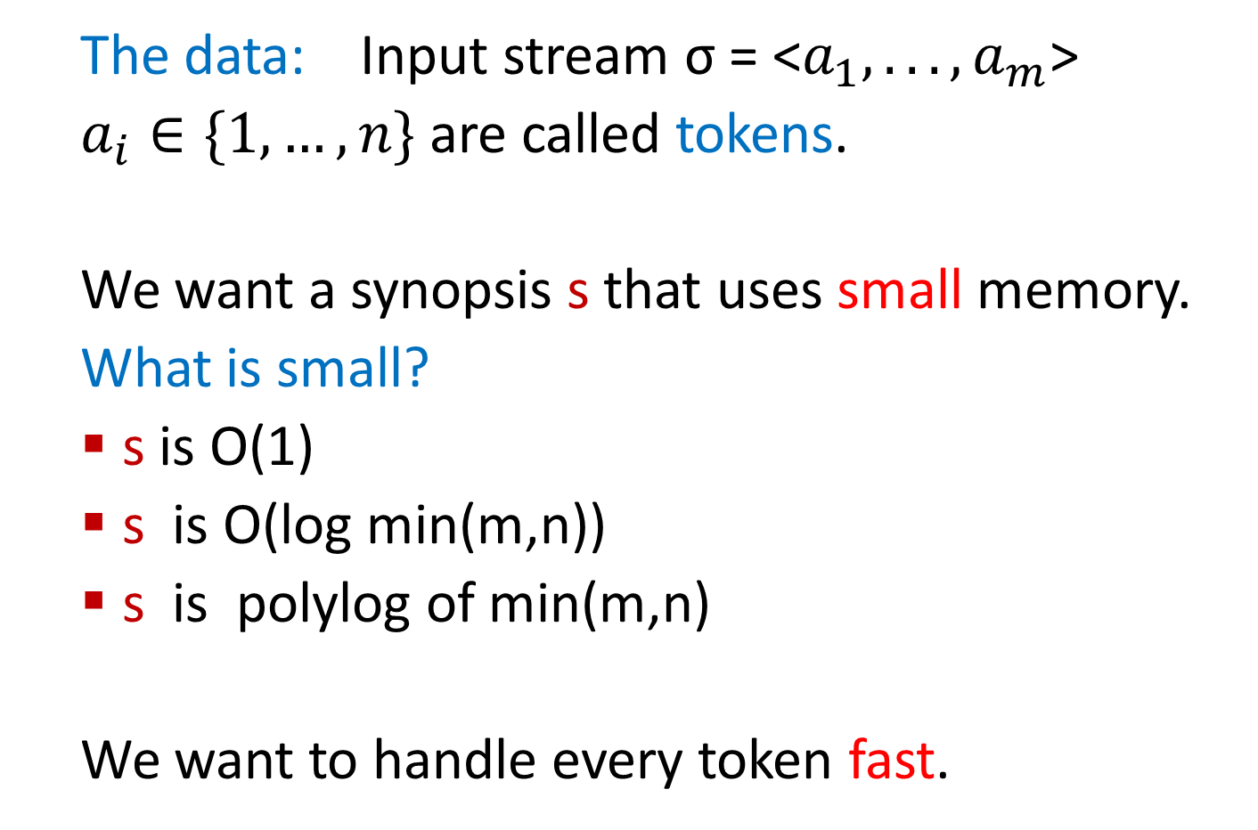
The Data Stream Model

Slide 82
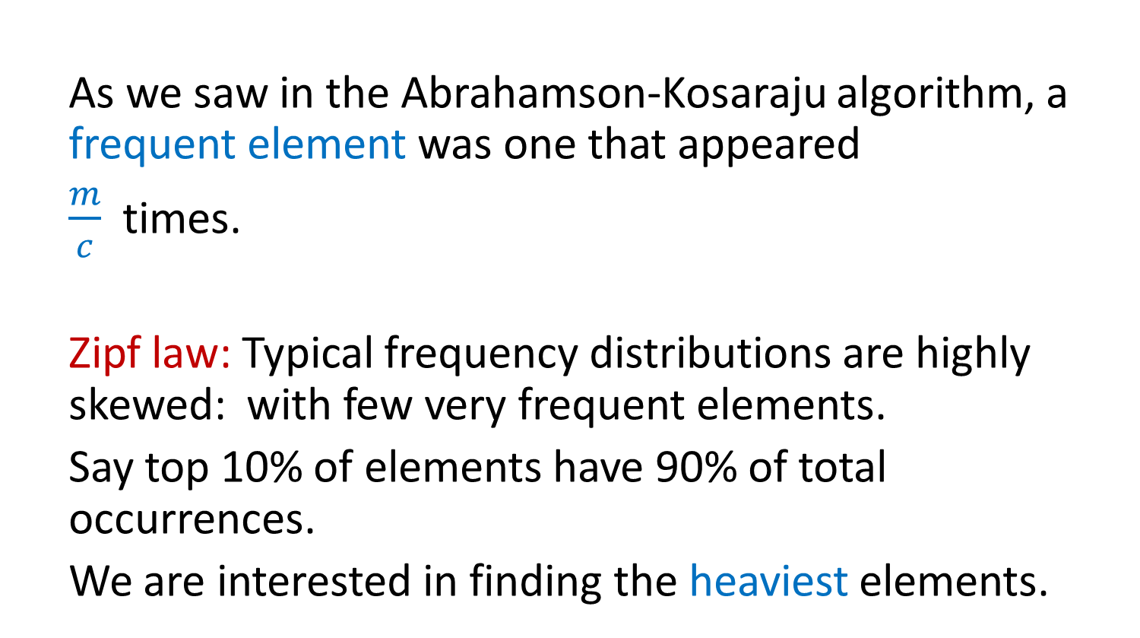
Finding Frequent Items

Slide 83

Frequent Items: Exact Solution
32,
12,
14,
32,
7,
12,
32,
7,
6,
12,
4,
Exact solution:
Create a counter for each distinct token on its first occurrence
When processing a token, increment the counter
32
12
14
7
6
4

Slide 84
Deterministic Streaming Algorithm for Finding Frequent Items
The Misra-Gries algorithm [1982] finds these frequent elements deterministically, using
O(c log m) bits, in two passes.

Slide 85
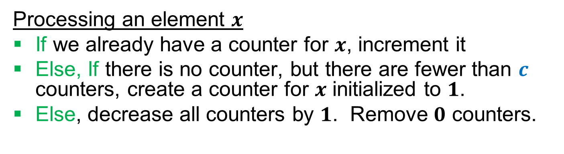
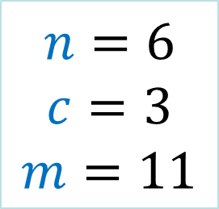
Frequent Elements: Misra Gries 1982
32,
12,
14,
32,
7,
12,
32,
7,
6,
12,
4,
32
12
14
12
7
12
4

Slide 86
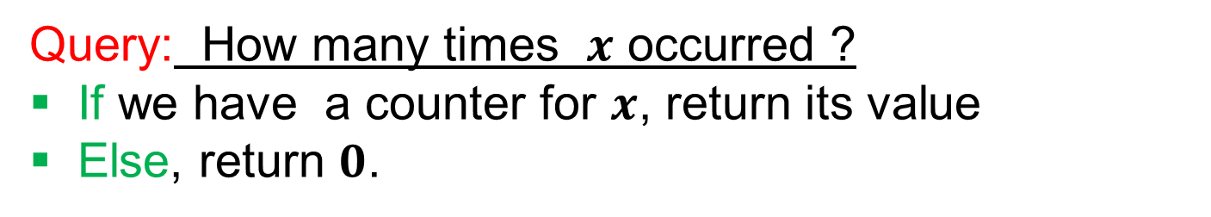
Frequent Elements: Misra Gries 1982
32,
12,
14,
32,
7,
12,
32,
7,
6,
12,
4,
This is clearly an under-estimate.
What can we say precisely?

Slide 87
Algorithm Analysis
Space: c counters of log m + log n bits, i.e.
O(c(log m + log n))
Time: O(log c) per token.
Output quality?

Slide 88
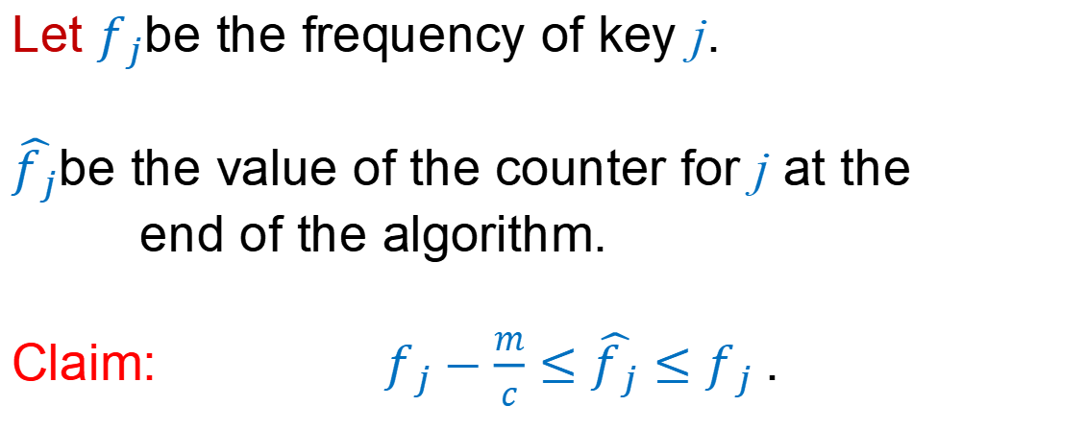
Algorithm Analysis
Let $f_{j}$be the frequency of key j.
$\hat{f_{j}}$be the value of the counter for j at the
end of the algorithm.
Claim: $f_{j}−\frac{m}{c}≤\hat{f_{j}}≤f_{j}$.

Slide 89
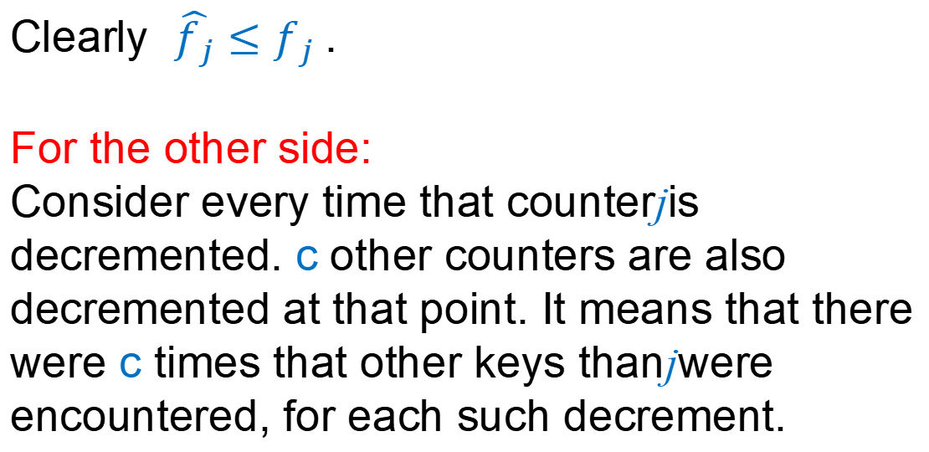
Proof
Clearly $\hat{f_{j}}≤f_{j}$.
For the other side:
Consider every time that counterjis decremented. c other counters are also decremented at that point. It means that there were c times that other keys thanjwere encountered, for each such decrement.

Slide 90
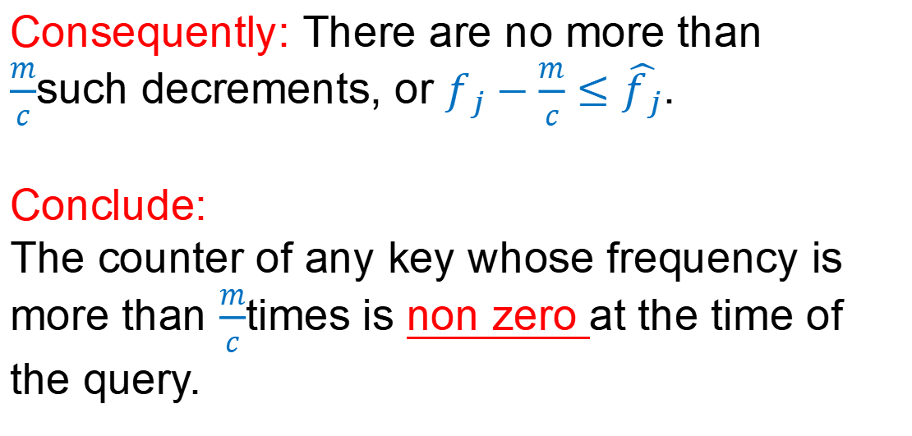
Proof
Consequently: There are no more than $\frac{m}{c}$such decrements, or $f_{j}−\frac{m}{c}≤\hat{f_{j}}$.
Conclude:
The counter of any key whose frequency is more than $\frac{m}{c}$times is non zero at the time of the query.

Slide 91
Finding Frequent Elements
How do we verify that all elements in the counters are frequent?
-- Another pass.

Slide 92
作业 & 预习
作业：9.3-1, 9.3-8, 9-3
预习：ch11

