Slide 1
Introduction to Algorithms
Lecture 4

Slide 2
Today’s topics
Direct-accessible table
Hash tables
Hash functions
Universal hashing
Perfect Hashing
Open addressing

Slide 3
Data Structures
Role of data structures:
Encapsulate data
Support certain operations (e.g., INSERT, DELETE, SEARCH)
Our focus: efficiency of the operations
Algorithms vs. data structures

Slide 4
Symbol-table problem
Symbol table T holding n records:
How should the data structure T be organized?
record
Operations on T:
INSERT(T,x)
DELETE(T,x)
SEARCH(T,k)
x
key[x]
Other fields
containing
satellite data

Slide 5
Direct-accessible table
IDEA: Suppose that the set of keys is K ⊆ {0,
1, …, m–1}, and keys are distinct.
Set up an array T[0 . . m–1]:
Then, operations take Θ(1) time.
Problem: The range of keys can be large:
64-bit numbers (which represent 18,446,744,073,709,551,616 different keys),
character strings (even larger!).
if k∈K and keys[x] = k
otherwise.

Slide 6
Hash functions
Solution: Use a hash function h to map the
universe U of all keys into
{0, 1, …, m–1}:
When a record to be inserted maps to an already
occupied slot in T, a collision occurs.
T
 | 0
 | h(k₁)
 | h(k₄)
 | h(k₂) = h(k₅)
 | h(k₃)
 | m-1
k₁
k₅
k₄
k₂
k₃
K

Slide 7
Resolving collisions by chaining
Records in the same slot are linked into a list.
T
i
49
86
52
h(49) = h(86) = h(52) = i

Slide 8
Analysis of chaining
We make the assumption of simple uniform
hashing:
Each key k ∈ K of keys is equally likely to be hashed to any slot of table T, independent of where other keys are hashed.
Let n be the number of keys in the table, and
let m be the number of slots.
Define the load factor of T to be
α = n/m
= average number of keys per slot.

Slide 9
Balls in Bins
Throw n balls randomly into m bins
All throws are uniform and independent

Slide 10
Search cost
Expected time to search for a record with
a given key = Θ(1 + α).
Expected search time = Θ(1) if α = O(1),
or equivalently, if n = O(m).
apply hash
function and
access slot
search
the list

Slide 11
Choosing a hash function
The assumption of simple uniform hashing is hard to
guarantee, but several common techniques tend to
work well in practice as long as their deficiencies
can be avoided.
Desirata:
A good hash function should distribute the keys uniformly into the slots of the table.
Regularity in the key distribution should not affect this uniformity.

Slide 12
Multiplication method
Assume that all keys are integers, m = 2^{r}, and our
computer has w-bit words. Define
h(k) = (A·k mod 2^{w}) rsh (w – r),
where rsh is the “bit-wise right-shift” operator
and A is an odd integer in the range 2^{w–1} < A < 2^{w}.
Don’t pick A too close to 2^{w}.
Multiplication modulo 2^{w} is fast.
The rsh operator is fast.

Slide 13



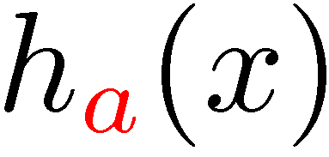

Multiplication method example
h(k) = (A·k mod 2^{w}) rsh (w – r)
Suppose that m = 8 = 2³ and that our computer
has w = 7-bit words:
1 0 1 1 0 0 1 = A
1 1 0 1 0 1 1 = k
×
×
1 0 0 1 0 1 0 0 1 1 0 0 1 1
h(k)

Slide 14
Dot-product method
Randomized strategy:
Let m be prime. Decompose key k into r + 1 digits,
each with value in the set {0, 1,…, m–1}.
That is, let k = <k₀, k₁, …, k_{r}>, where 0 ≤ k_{i} < m.
Pick a = <a₀, a₁, …, a_{r}> where each a_{i} is chosen
randomly from {0, 1, …, m–1}.
Excellent in practice, but expensive to compute.
Define

Slide 15
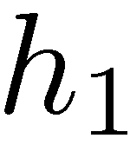
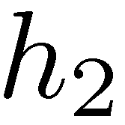
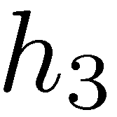
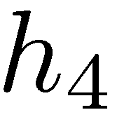
Tabulation based hash functions [Patrascu-Thorup (2012)]
“byte”
A variant can also be used to hash strings
h_{i} can be stored in a small table
+
Very efficient in practice
Very good theoretical properties

Slide 16
A weakness of hashing “as we saw it”
Problem: For any hash function h, a set of
keys exists that can cause the average access
time of a hash table to skyrocket.
An adversary can pick all keys from
{k ∈ U : h(k) = i} for some slot i.

Slide 17
A weakness of hashing “as we saw it”
IDEA: Choose the hash function at random,
independently of the keys.
Even if an adversary can see your code, he or she cannot find a bad set of keys, since he or she doesn’t know exactly which hash function will be chosen.

Slide 18
Universal hashing
Definition. Let U be a universe of keys, and
let H be a finite collection of hash functions,
each mapping U to {0, 1, …, m–1}. We say
H is universal if for all x, y∈U, where x ≠ y,
we have |{h ∈ H: h(x) = h(y)}| ≤ |H|/m.
H
That is, the chance
of a collision
between x and y is at most
1/m if we choose h
randomly from H.
{h: h(x) = h(y)}

Slide 19
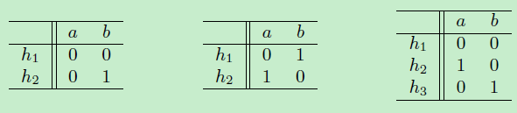
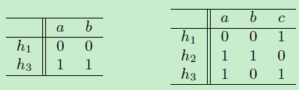
Universal hashing
Equivalent to:
Pr_{h←H} [h(x) = h(y)] ≤ 1/m
for all x, y ∈ U, where x ≠ y.
Examples:
hash functions mapping the set {a, b} to {0, 1}.
universal
hashing
not

Slide 20
Universality is good
Theorem. Let h be a hash function chosen
(uniformly) at random from a universal set H
of hash functions. Suppose h is used to hash
n arbitrary keys into the m slots of a table T.
Then, for a given key x, we have
E[#collisions with x] < n/m

Slide 21
Proof of the theorem
Proof. Let C_{x} be the random variable denoting
the total number of collisions of keys in T
with x, and let
Note: E[c_{xy}] = 1/m and
if h(x) = h(y),
otherwise.

Slide 22
Proof (cont.)
Take expectation of
both sides.
Linearity of
expectation.
E[c_{xy}] = 1/m
Algebra.

Slide 23
Constructing a set of universal hash functions
Let m be prime. Decompose key k into r + 1
digits, each with value in the set {0, 1, …, m–1}.
That is, let k = k₀, k₁, …, k_{r}, where 0 ≤ k_{i} < m.
Randomized strategy:
Pick a = a₀, a₁, …, a_{r} where each a_{i} is chosen
randomly from {0, 1, …, m–1}.
Dot product,
modulo m
Define
How big is H = {h_{a}}?
|H| = m^{r+1}

Slide 24
Universality of dot-product hash functions
Theorem. The set H = {h_{a}} is universal.
Proof. Suppose that
x = x₀, x₁, …, x_{r} and
y = y₀, y₁, …, y_{r} are distinct keys. Thus,
they differ in at least one digit position, wlog
position 0. For how many h_{a} ∈ H do x and y
collide?

Slide 25
Proof (cont.)
Equivalently, we have
or
which implies that

Slide 26
Fact from number theory
Theorem. Let m be prime. For any z ∈ Z_{m}
such that z ≠ 0, there exists a unique z^{–1} ∈ Z_{m}
such that
z · z^{–1} ≡ 1 (mod m).
Example: m = 7.
z | 1 | 2 | 3 | 4 | 5 | 6
z^{–1} | 1 | 4 | 5 | 2 | 3 | 6

Slide 27
Back to the proof
We have
and since x₀ ≠ y₀ , an inverse (x₀ – y₀ )^{–1} must exist,
which implies that
Thus, for any choices of a₁, a₂, …, a_{r}, exactly
one choice of a₀ causes x and y to collide.

Slide 28
Proof completed
Q. How many h_{a}’s cause x and y to collide?
A. There are m choices for each of a₁, a₂, …, a_{r} ,
but once these are chosen, exactly one choice
for a₀ causes x and y to collide, namely
Thus, the number of h_{a}’s that cause x and y
to collide is m^{r} · 1 = m^{r} = |H|/m.

Slide 29
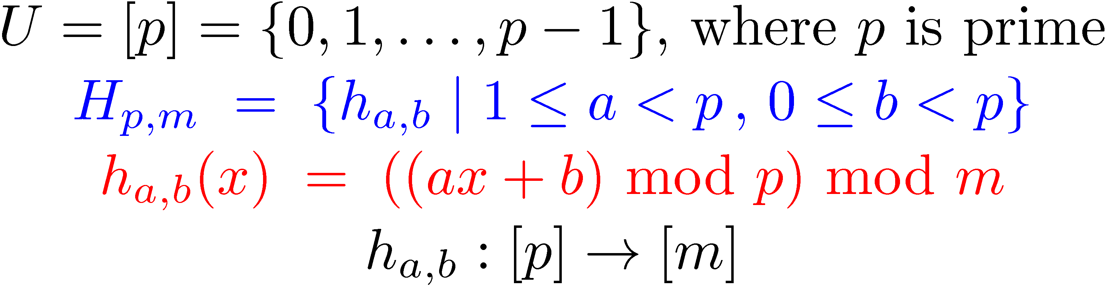
A simple universal family [Carter-Wegman (1979)]
To represent a function from the family we only need two numbers, a and b.
The size m of the hash table can be arbitrary.

Slide 30
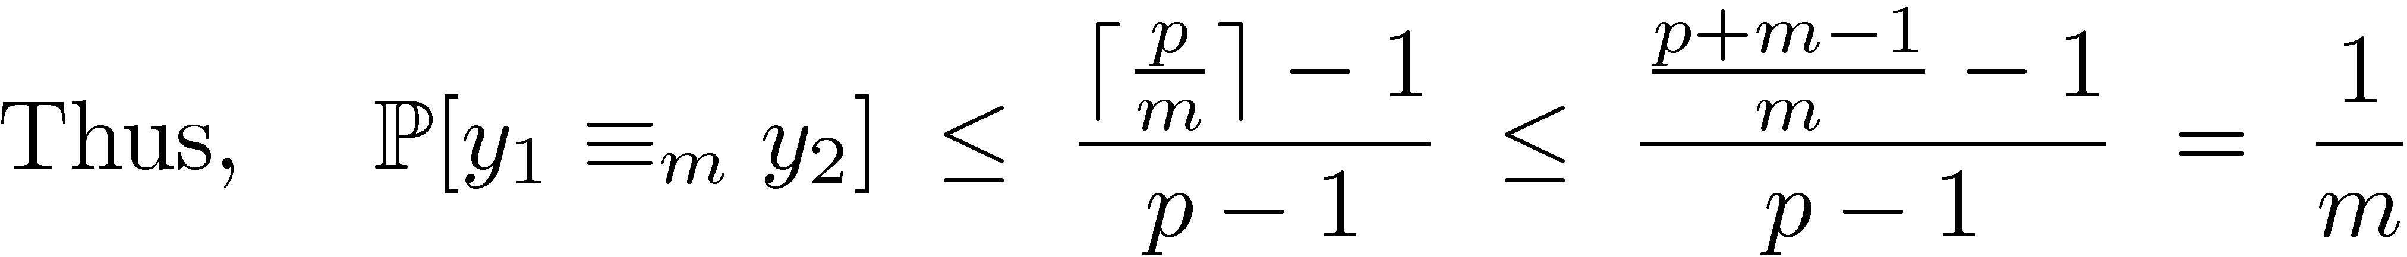
A simple universal family [Carter-Wegman (1979)]

Slide 31
Perfect hashing
Given a set of n keys, construct a static hash table of
size m = O(n) such that SEARCH takes Θ(1) time in
the worst case.
T
0
S₁
IDEA: Two-
level scheme
with universal
hashing at
both levels.
1
4
31
14
27
2
h₃₁(14) = h₃₁(27) = 1
S₄
3
4
1
00
26
5
S₆
No collisions
at level 2!
6
9
86
40
37
22
m a
0 1 2 3 4 5 6 7 8

Slide 32
Collisions at level 2
Theorem. Let H be a class of universal hash
functions for a table of size m = n². Then, if
we use a random h ∈ H to hash n keys into the
table, the expected number of collisions is at
most 1/2.

Slide 33
Collisions at level 2
Proof. By the definition of universality, the
probability that 2 given keys in the table
collide under h is 1/m = 1/n². Since there are
pairs of keys that can possibly collide, the
expected number of collisions is

Slide 34
No Collisions at level 2
Corollary. The probability of no collisions is at least
1/2.
Proof. Markov’s inequality says that for any
nonnegative random variable X, we have
Pr{X ≥ t} ≤ E[X]/t.
Applying this inequality with t = 1, we find that the
probability of 1 or more collisions is at most 1/2.
Thus, just by testing random hash functions
in H, we’ll quickly find one that works.

Slide 35
Analysis of storage
Theorem. If we store n keys in a hash table of size m
= n using a hash function h randomly chosen from a
universal class of hash functions, then
where n_{j} is the number of keys hashing to slot j.

Slide 36
Proof of the Theorem
The summation is just the total numbers of collisions.
Use fact
Linearity of expectation
n is not a random variable

Slide 37
Proof of the Theorem (cont.)
By the properties of universal hashing, the
expected value of the summation is at most:
since m = n, thus

Slide 38
Analysis of storage (cont.)
Corollary. If we store n keys in a hash table of
size m = n using a hash function h randomly
chosen from universal class of hash functions
and we set the size of each secondary hash
table to m_{j} = n_{j}² for j = 0,1,…,m-1, then the
expected amount of storage required for all
secondary hash tables in a perfect hashing
scheme is less than 2n.

Slide 39
Resolving collisions by open addressing
No storage is used outside of the hash table itself.
Insertion systematically probes the table until an empty slot is found.
The hash function depends on both the key and probe number:
h : U × {0, 1, …, m–1} → {0, 1, …, m–1}.
The probe sequence <h(k,0), h(k,1), …, h(k,m–1)> should be a permutation of {0, 1, …, m–1}.
The table may fill up, and deletion is difficult (but not impossible).

Slide 40
Example of open addressing
Insert key k = 496:
0. Probe h(496, 0)
T
 | 0
586
133
204 | collision
481
 | m-1

Slide 41
Example of open addressing
Insert key k = 496:
0. Probe h(496, 0)
1. Probe h(496, 1)
T
 | 0
586 | collision
133
204
481
 | m-1

Slide 42
Example of open addressing
Insert key k = 496:
0. Probe h(496, 0)
1. Probe h(496, 1)
2. Probe h(496, 2)
T
 | 0
586
133
204
496 | insertion
481
 | m-1

Slide 43
Example of open addressing
Insert key k = 496:
0. Probe h(496, 0)
1. Probe h(496, 1)
2. Probe h(496, 2)
T
 | 0
586
133
204
496
481
 | m-1
Search uses the same probe
sequence, terminating
successfully if it finds the
key and unsuccessfully if it encounters an empty slot.

Slide 44
Probing strategies
Linear probing:
Given an ordinary hash function h′(k), linear probing
uses the hash function
h(k,i) = (h′(k) + i) mod m.
This method, though simple, suffers from primary
clustering, where long runs of occupied slots build
up, increasing the average search time. Moreover,
the long runs of occupied slots tend to get longer.

Slide 45
Probing strategies
Double hashing
Given two ordinary hash functions h₁(k) and h₂(k),
double hashing uses the hash function
h(k,i) = (h₁(k) + i×h₂(k)) mod m.
This method generally produces excellent results,
but h₂(k) must be relatively prime to m. One way
is to make m a power of 2 and design h₂(k) to
produce only odd numbers.

Slide 46
Analysis of open addressing – 1
We make the assumption of uniform hashing:
Each key is equally likely to have any one of the m! permutations as its probe sequence.
Theorem 1. Given an open-addressed hash
table with load factor α = n/m < 1, the
expected number of probes in an unsuccessful
search (inserting an element) is ≤ 1/(1–α).

Slide 47
Proof of the theorem
X: #probes made in an unsuccessful search.
E[X] = Σ_{i} Pr[X ≥ i]
A_{i}: there is an ith probe and it is to an occupied slot.
{X ≥i} = A₁∩A₂∩…∩A_{i-1}.
Pr[A₁∩A₂∩…∩A_{i-1}] = Pr[A₁]Pr[A₂|A₁]…Pr[A_{i-1}| A₁∩A₂∩…∩A_{i-2}] (chain rule)
Pr[A₁] = n/m.
Pr[A_{j}| A₁∩A₂∩…∩A_{j-1}] = (n – (j – 1))/(m – (j – 1)) ≤ n/m. (j > 1)

Slide 48
Proof of the theorem
Proof.
At least one probe is always necessary.
With probability n/m, the first probe hits an occupied slot, and a second probe is necessary.
With probability (n–1)/(m–1), the second probe hits an occupied slot, and a third probe is necessary.
With probability (n–2)/(m–2), the third probe hits an occupied slot, etc.
Observe that for i = 1, 2, …, n.

Slide 49
Proof (continued)
Therefore, the expected number of probes is

Slide 50
Implications of the theorem
If α is constant, then accessing an open addressed hash table takes constant time.
If the table is half full, then the expected number of probes is 1/(1–0.5) = 2.
If the table is 90% full, then the expected number of probes is 1/(1–0.9) = 10.

Slide 51
Analysis of open addressing – 2
Theorem 2. Given an open-addressed hash
table with load factor α = n/m < 1, the
expected number of probes in an successful
search is at most 1/α ln 1/(1 – α).
Proof.
E[#probes of searching (i+1)st elements inserted]
≤ 1/(1 – i/m) = m/(m – i)

Slide 52
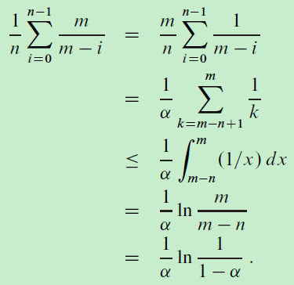
Analysis of open addressing – 2
Averaging over all n keys in the hash table

Slide 53
Further Topics
Cuckoo hashing
Bloom filter
Count-min sketch
Count sketch
Consistent hashing
The power of two choices
Fingerprint
...

Slide 54
Cuckoo Hashing: Basics
Introduced by Pagh and Rodler (2001)
Extremely simple:
2 tables: T₁ and T₂
Each of size m = (1+ε)n
2 hash functions: h₁ and h₂
Lookup:
Check in T₁ and T₂
d
t
h₂(x)
c
y
x
h₁(x)
x
b
a
Where is x?
...
...
z
T₁
T₂
Source: Moni Naor.

Slide 55
Cuckoo Hashing: Insertion Algorithm
To insert element x, call Insert(x, 1)
Insert(x, i):
1. Put x into location h_{i}(x) in T_{i}
2. If T_{i}[h_{i}(x)] was empty: return
3. If T_{i}[h_{i}(x)] contained element y: do Insert(y, 3–i)
Example:
d
t
c
y
h₂(y) = h₂(a)
x
b
h₁(e) = h₁(a)
a
To insert x:
Put in first location and displace residing element if needed
Put displaced element in its other location
Until finding a free spot
e
...
...
h₁(y)
z
T₁
T₂

Slide 56
Cuckoo Hashing: Insertion
What happens if we are not successful?
Unsuccessful stems from two reasons
Not enough space
The path goes into loops
Too long chains
Can detect both by a time limit.

Slide 57
Cuckoo Hashing: Deletion
Extremely simple:
2 tables: T₁ and T₂
Each of size m = (1+ε)n
2 hash functions: h₁ and h₂
As in Lookup:
Check in T₁ and T₂
Remove wherever found
d
t
h₂(x)
c
y
x
h₁(x)
x
b
a
Where is x?
...
...
z
T₁
T₂

Slide 58
The Cuckoo Graph
Set S ⊂ U containing n elements
h₁,h₂ : U {0,...,m-1}
Insertion algorithm achieves this
Bipartite graph with |L|=|R|=m
Edge (h₁(x), h₂(x)) for every x∈S
Facts:
S is successfully stored
Every connected component in the cuckoo graph has at most one cycle
Expected insertion time: O(1)
occupied
vacant

Slide 59


Cuckoo Hashing: Properties
Many attractive properties:
Lookup and deletion in 2 accesses in the worst case
May be done in parallel
Insertion takes amortized constant time
Reasonable memory utilization
No dynamic memory allocation
Lots of Generalizations
Lots of applications to related problems
Growing evidence of practicality on current architectures

Slide 60
Animation of Insertions
T₁
T₂
h₁( ) = 8
h₁( ) = 6
h₁( ) = 2
h₁( ) = 10
h₁( ) = 4
h₁( ) = 8
h₁( ) = 4
h₁( ) = 4
h₁( ) = 10
h₁( ) = 6
0
1
2
3
4
5
6
7
8
9
10
11
0
1
2
3
4
5
6
7
8
9
10
11
h₁( ) = 2
Input
h₂( ) = 6
h₂( ) = 1
h₂( ) = 8
h₂( ) = 10
h₂( ) = 4
h₂( ) = 4
h₁( ) = 6
h₂( ) = 8
Queue
With queue for de-amortization
Notes:
n = 10, epsilon = 0.2, so r = 12
log_2 10 = 3.3, so |Q| = 4, 0.7 for stash
L = 3 for simplicity (can explain 2.5 orally)

Slide 61
More than One Cycle
With probability Θ(1/n) Cuckoo Hashing fails
Recall: connected component with more than one cycle
Standard solution: rehashing
Meaning: insertion worst case may be O(n)
[KMW08] suggested stash
Saves rehashing
Actually reduces insertion worst case to O(log n)
Kirsch, Mitzenmacher,
Wieder

Slide 62
Lookup Problem
Given a set S = {x₁, x₂, x₃,…,x_{n}} on a universe U, want to answer queries of the form:
Example: a set of URLs from the universe of all possible URL strings.
Bloom filter provides an answer in
“Constant” time (time to hash).
Small amount of space.
But with some probability of being wrong.
Is y ∈ S ?

Slide 63
Bloom Filters
Start with an m bit array, filled with 0s.
B
0
0
0
0
0
0
0
0
0
0
0
0
0
0
0
0
Hash each item x_{j} in S k times. If H_{i}(x_{j}) = a, set B[a] = 1.
B
0
1
0
0
1
0
1
0
0
1
1
1
0
1
1
0
To check if y is in S, check B at H_{i}(y). All k values must be 1.
B
0
1
0
0
1
0
1
0
0
1
1
1
0
1
1
0
Possible to have a false positive; all k values are 1, but y is not in S.
B
0
1
0
0
1
0
1
0
0
1
1
1
0
1
1
0

Slide 64
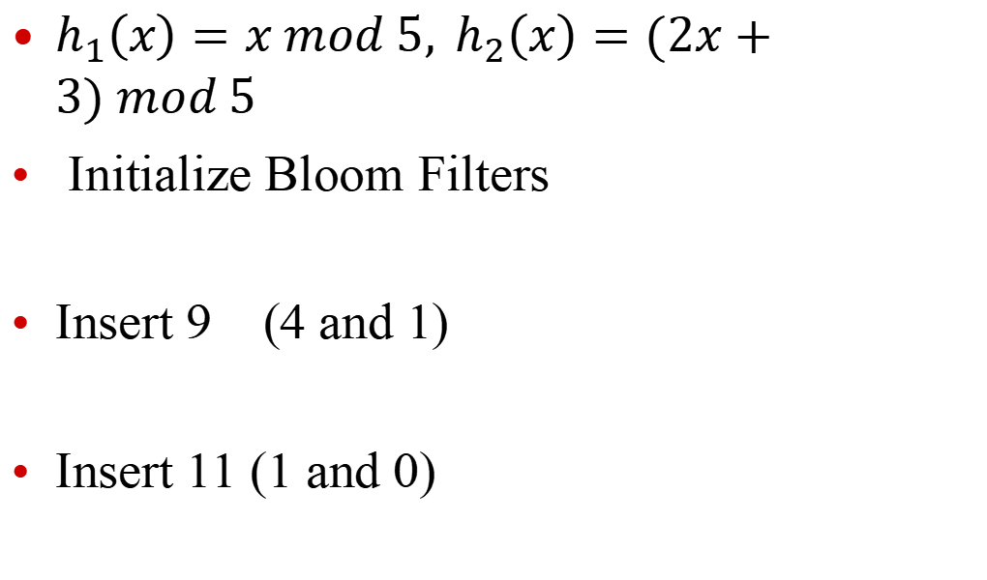
Illustration of Bloom Filters (K = 2)
$h_{1}\left(x\right)=x mod 5, h_{2}\left(x\right)=(2x+3) mod 5$
Initialize Bloom Filters
Insert 9 (4 and 1)
Insert 11 (1 and 0)
0 | 0 | 0 | 0 | 0
0 | 1 | 0 | 0 | 1
1 | 1 | 0 | 0 | 1

Slide 65
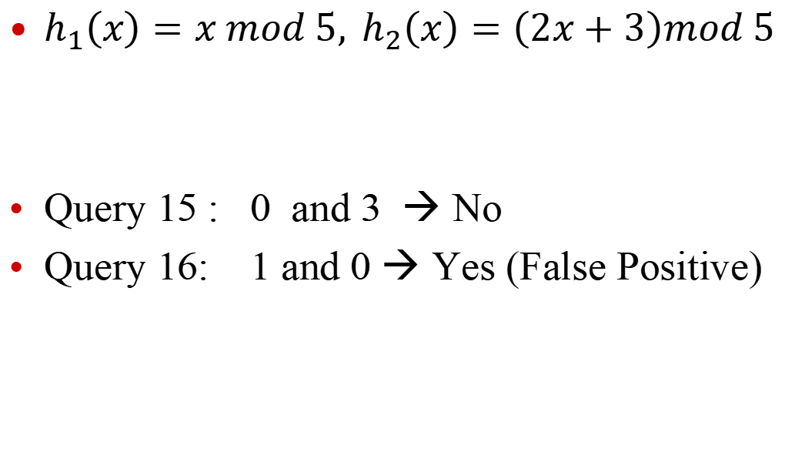
Illustration of Bloom Filters
$h_{1}\left(x\right)=x mod 5, h_{2}\left(x\right)=\left(2x+3\right)mod 5$
Query 15 : 0 and 3 → No
Query 16: 1 and 0 → Yes (False Positive)
1 | 1 | 0 | 0 | 1

Slide 66
Errors
Assumption: We have good hash functions, look random.
Given m bits for filter and n elements, choose number k of hash functions to minimize false positives:
Let
Let
As k increases, more chances to find a 0, but more 1’s in the array.
Find optimal at k = (ln 2)m/n by calculus.

Slide 67
Example
m/n = 8
Opt k = 8 ln 2 = 5.45...

Slide 68
Bloom Filters: Distributed Systems
Send Bloom filters of URLs.
Web Cache 1
Web Cache 2
Web Cache 3
Web Cache 4
Web Cache 5
Web Cache 6

Slide 69
Tradeoffs
Three parameters.
Size m/n : bits per item.
Time k: number of hash functions.
Error f: false positive probability.

Slide 70
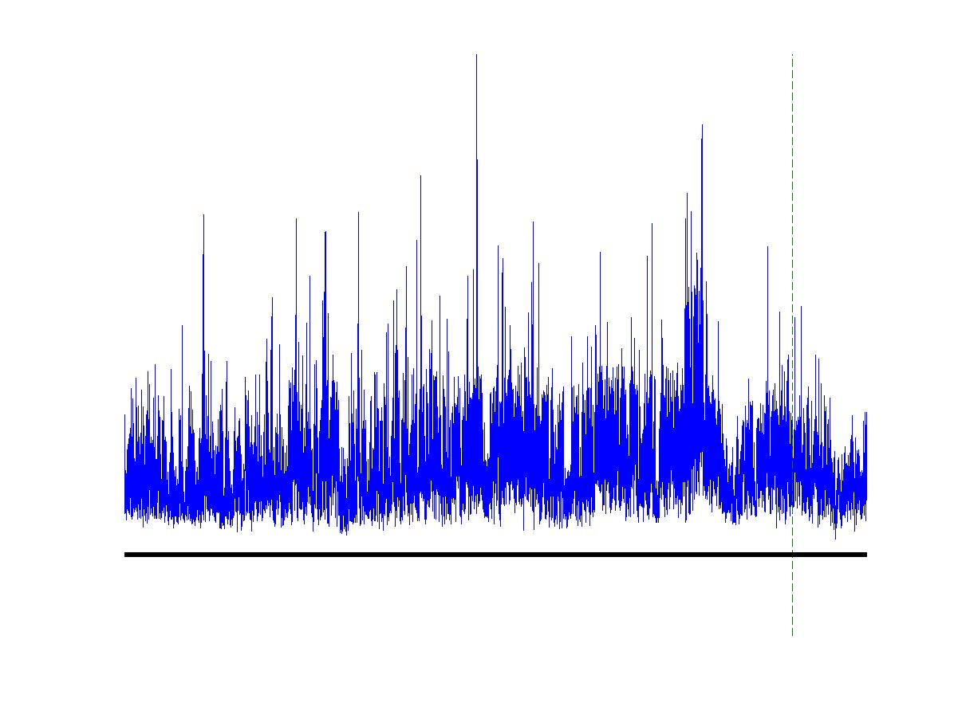
Data Streams
Input data element enter one after another (i.e., in a stream).
Cannot store the entire stream accessibly
How do you make critical calculations about the stream using a limited amount of memory?

Slide 71
Applications
Mining query streams
Google wants to know what queries are more frequent today than yesterday
Mining click streams
Yahoo wants to know which of its pages are getting an unusual number of hits in the past hour
Mining social network news feeds
E.g., look for trending topics on social media

Slide 72
Count-Min Sketch
Repeat Independently t times, take minimum (Count-Min)
Unless all the t counters messes up simultaneously, we have a good estimate.
For heavy hitters, unless every t counters has more than 2 heavy hitters we are fine.

Slide 73
Count-Min Sketch
Initialize:
C[1.. t][1..k] ← 0, where k = 2/ε and t = log(1/δ)
Choose t independent hash functions h₁,…, h_{t}: [n] → [k], each from a 2-universal family.

Slide 74

Count-Min Sketch
Process (j, c):
for i ← 1 to t
do C[i][h_{i}(j)] ← C[i][h_{i}(j)] + c
Output:
On query a, report

Slide 75


Count-Min Sketch – Analysis
Fact:
Let the random variable X_{i} denote C[i][h_{i}(a)] – f_{a}.
Y_{i,j} = 1[h_{i}(a) = h_{i}(j)], for j ∈ [n]\{a}.
Thus,
By 2-unersiality of h_{i}, E[Y_{i,j}] = 1/k.

Slide 76


Count-Min Sketch – Analysis
By linearity of expectation:
Apply Markov’s inequality:

Slide 77
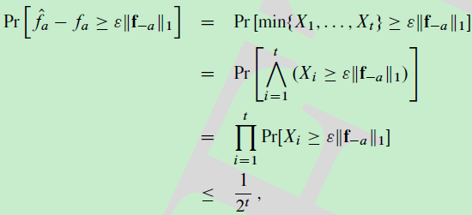
Count-Min Sketch – Analysis
The excess in the output is the minimum of the excess X_{i}:

Slide 78
作业：11.2-1, 11.3-5, 11-2.
预习：lec4 slides, 17.

