Slide 1
Introduction to Algorithms
Lecture 6

Slide 2
Today
Dynamic programming
Shortest paths in DAGs
Weighted Interval Scheduling
Longest common subsequence
Knapsack
Optimal BST
Matrix Chain Multiplication
Independent set in trees
TSP

Slide 3
Dynamic Programming
Dynamic programming is a metatechnique (not an algorithm) – like divide and conquer.
Here, “programming” isn’t computer programming; word comes from table-based solution method.
Divide & Conquer: break up into smaller problems
Dynamic Programming: solve all smaller problems but only reuse optimal subproblem solutions.

Slide 4
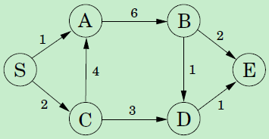
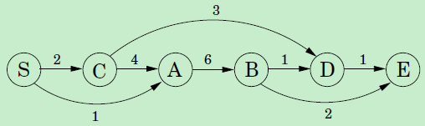
Shortest paths in DAGs
“Linearization”: the nodes can be arranged on a line so that all edges go from left to right.
dist[v] = min_{u:(u,v)∈E} {dist[u] + d(u,v)}

Slide 5
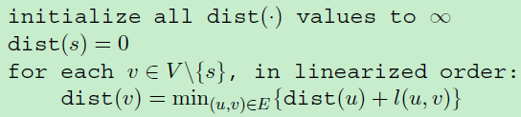
Shortest paths in DAGs
Solves a collection of subproblems, {dist(u): u ∈ V}.
Starts with the smallest of them, dist(s).
Proceed with s progressively larger subproblems.

Slide 6
Dynamic Programming
In dynamic programming we are not given a DAG; the DAG is implicit.
Its nodes are the subproblems (states) we define, and its edges are the dependencies (transition function) between the subproblems:
if to solve subproblem B we need the answer to subproblem A, then there is a (conceptual) edge from A to B.
In this case, A is thought of as a smaller subproblem than B.
Base case.

Slide 7
Dynamic Programming
Identify the set of subproblems. (state)
These subproblems must exhibit some kind of optimal substructure property.
The smaller ones should help to solve the larger ones.
Identify the relationship between subproblems. (recurrence relation, transition function)
Compute the value of an optimal solution, typically in a bottom-up fashion.
Construct an optimal solution from computed information.

Slide 8

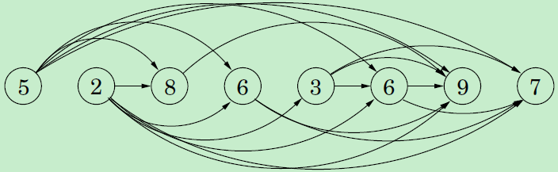
Longest Increasing Subsequence
L(j) is the length of the longest path - the longest increasing subsequence - ending at j.
L(j) = max{L(i) + 1, (i,j) ∈E}
DP on prefixes:
Time: O(n²).
L(j) = max_{i<j, ai<aj} {L(i) + 1}

Slide 9
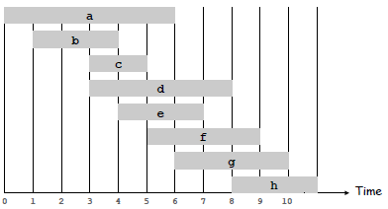
Weighted Interval Scheduling
Weighted interval scheduling problem.
Job j starts at s_{j}, finishes at f_{j}, and has weight or value v_{j}.
Two jobs compatible if they don't overlap.
Goal: find maximum weight subset of mutually compatible jobs.

Slide 10
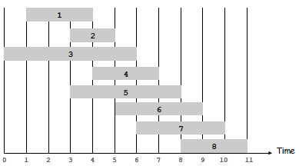
Weighted Interval Scheduling
Notation. Label jobs by finishing time: f₁ ≤ f₂ ≤ . . . ≤ f_{n}.
Def. p(j) = largest index i < j such that job i is compatible with j.
Ex: p(8) = 5, p(7) = 3, p(2) = 0.

Slide 11
Dynamic Programming: Binary Choice
Notation. OPT(j) = value of optimal solution to the problem consisting of job requests 1, 2, ..., j.
Case 1: OPT selects job j.
collect profit v_{j}
can't use incompatible jobs {p(j) + 1, p(j) + 2, ..., j - 1}
must include optimal solution to problem consisting of remaining compatible jobs 1, 2, ..., p(j)
Optimal substructure

Slide 12

Dynamic Programming: Binary Choice
Case 2: OPT does not select job j.
must include optimal solution to problem consisting of remaining compatible jobs 1, 2, ..., j-1
Optimal substructure

Slide 13
Weighted Interval Scheduling: Brute Force
Brute force algorithm.
Input: n, s₁,…,s_{n} , f₁,…,f_{n}, v₁,…,v_{n}
Sort jobs by finish times so that f₁ ≤ f₂ ≤ ... ≤ f_{n}.
Compute p(1), p(2), …, p(n)
Compute-Opt(j) {
if (j = 0) return 0
else return max(v_{j} + Compute-Opt(p(j)),
Compute-Opt(j-1))
}

Slide 14
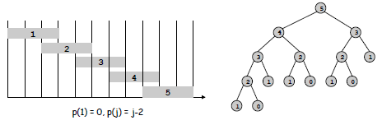
Weighted Interval Scheduling: Brute Force
Observation. Recursive algorithm fails spectacularly because of redundant sub-problems ⇒ exponential algorithms.

Slide 15
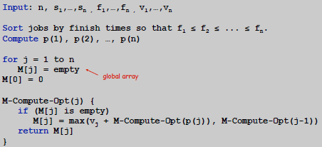
Weighted Interval Scheduling: Memoization
Memoization. Store results of each subproblem in a cache; lookup as needed.

Slide 16
Weighted Interval Scheduling: Running Time
Claim. Memoized version of algorithm takes O(n log n) time.
Sort by finish time: O(n log n).
Computing p(·): O(n log n) via sorting by start time.
M-Compute-Opt(j): each invocation takes O(1) time and either
(i) returns an existing value M[j]
(ii) fills in one new entry M[j] and makes two recursive calls

Slide 17
Weighted Interval Scheduling: Running Time
Overall running time of M-Compute-Opt(n) is O(n).
Remark. O(n) if jobs are pre-sorted by start and finish times.

Slide 18
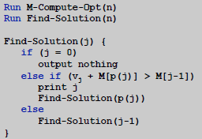
Weighted Interval Scheduling: Finding a Solution
Q. Dynamic programming algorithms computes optimal value. What if we want the solution itself?
A. Do some post-processing.
# of recursive calls ≤ n → O(n).

Slide 19
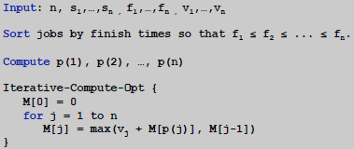
Weighted Interval Scheduling: Bottom-Up
Bottom-up dynamic programming. Unwind recursion.

Slide 20
Longest Common Subsequence (LCS)
Problem: Given two sequences x[1..m] and y[1..n],
find a longest subsequence common to both.
x: A B C B D A B
y: B D C A B A
Brute-force algorithm: For every subsequence of x,
check if it’s a subsequence of y.
Worst-case running time: Θ(n2^{m})
(2^{m} subsequences of x to check; each check takes Θ(n) time)

Slide 21
Recursive Algorithm
Better way:
For now, compute only length, not actual sequence.
Define c[i, j] = length of LCS of “prefixes”
x[1..i] and y[1..j].
Then c[m, n] = length of LCS of x and y.
Theorem:
if x[i] = y[j],
otherwise.

Slide 22
Proof
Proof of case where x[i] = y[j]
Let z[1..k] be LCS of x[1..i] and y[1..j]
(i.e., c[i, j] = k).
Now, z[k] = x[i] (= y[j]) (else could extend z by x[i]).
if x[i] = y[j],
otherwise.

Slide 23
Proof
Thus z[1..k−1] is CS of x[1..i−1] and y[1..j−1].
If ∃ a CS w longer than z[1..k−1], <w,x[i]> would be a CS longer than z.
Thus z[1..k−1] is LCS of x[1..i−1] and y[1..j−1]
(i.e., c[i−1, j−1] = k − 1).

Slide 24
Dynamic Programming Algorithm
LCS-Length(X, Y)
m ← length[X]
n ← length[Y]
for i ← 1 to m
do c[i, 0] ← 0
for j ← 0 to n
do c[0, j] ← 0
for i ← 1 to m
do for j ← 1 to n
do if x_{i} = y_{j}
then c[i, j] ← c[i − 1, j − 1] + 1
b[i, j] ← “ ”
else if c[i − 1, j] ≥ c[i, j − 1]
then c[i, j] ← c[i − 1, j]
b[i, j] ← “ ↑ ”
else c[i, j] ← c[i, j − 1]
b[i, j] ← “←”
return c and b

Slide 25
Example
X = <A, B, C, B>
Y = <B, D, C, A, B>
Which table entries must be known to compute c[i, j]?
j 0 1 2 3 4 5
i
y_{j}
B
D
C
A
B
0
x_{i}
0
0
0
0
0
0
A
1
0
0
0
0
1
1
2
B
0
1
1
1
1
2
3
C
0
1
1
2
2
2
4
B
0
1
1
2
2
3

Slide 26
Reconstructing the Sequence
Print-LCS(b,X,i,j)
if i = 0 or j = 0
then return
if b[i,j] = “ ”
then Print-LCS(b,X,i−1,j–1)
print x_{i}
elseif b[i,j] = “↑”
then Print-LCS(b,X,i–1,j)
else Print-LCS(b,X,i,j–1)

Slide 27
Knapsack Problem
Given a finite set S, integer weight function s: S → N, value function v: S → N, weight limit W ∈ N, find a subset S’ ⊆ S maximizing
such that

Slide 28
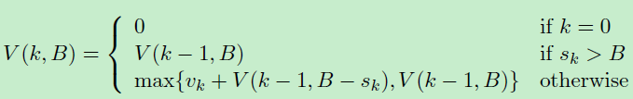
Knapsack Problem
Let V(k,B) denote the value of the highest value solution that uses items from among the set {1, 2,…,k} and uses space at most B.

Slide 29
Knapsack Problem
Initialize a 2-d array arr[i][j] to “empty” for all i,j.
V(k,B){
if (k == 0) return 0;
if (arr[k][B] != empty) return arr[k][B];
if (s_{k} > B) result = V(k-1,B);
else result = max{v_{k} + V(k-1, B-s_{k}), V(k-1, B)};
arr[k][B] = result;
return result;
}

Slide 30
Example: Optimal BST (Sedgewick)
Suppose we are doing string searching, and
know relative key frequencies
Example: spell; cc
Use Dynamic Programming to optimize BST.

Slide 31
Weighted Internal Path Length
Example BST, with search frequencies
Define “cost” of tree as frequency-weighted sum of node distance from root.
This is WIPL; here
1*1 + 4*2 + 2*2 + 2*3 + 3*3 +1*3 + 5*4 = 51
C
1
F
A
4
2
B
D
G
2
3
1
E
5

Slide 32
Intuition
Want to put highest-frequency keys near root
But must balance against cost of increased path lengths
First try: insert in order of decreasing frequency
WIPL is
1*5 + 4*2 + 2*2 + 3*3 + 1*3 + 2*4 + 5*1 =42
E
A
5
F
4
2
D
G
3
1
F
2
G
1

Slide 33
Algorithm
Given: keys K₁<K₂<…<K_{n}, 1≤ i ≤n and frequencies f_{i}, 1≤ i ≤n.
Find BST that minimizes, over all keys, of frequency times distance from root (access cost).
Idea: for subsequences of length 1,2,3,…,N-1, Find Optimal BST for search subsequence.
How?

Slide 34
Algorithm
Idea:
For each k, i ≤ k ≤ i+j [j+1 is length]
Place K_{k} at root of T
Lookup optimal BST L of K_{i}…K_{k–1} (left)
Lookup optimal BST R of K_{k+1}…K_{i+j} (right)
WIPL(T) = WIPL(L) + WIPL(R) +
so compare to current optimum and update

Slide 35
Optimal BST
Puts high-frequency keys near root,
But…keeps tree reasonably balanced!
N = 7; f_{k} = 4,2,1,3,5,2,1
D
3
A
E
4
5
B
F
2
2
C
G
1
1
WIPL is
1*3 + 4*2 + 5*2 + 2*3 + 2*3 +1*4 + 1*4 = 41

Slide 36
Matrix Chain Multiplication - Review
Recall how to multiply matrices.
Given two matrices
The product is
Time is O(def).
d
A
X
e
B
=
C
f
d
e
f

Slide 37
Matrix Chaining contd.
What about multiplying multiple matrices?
We know matrix multiplication is associative. Can we use this to help minimize calculations?
Sure, consider
If we multiply we do 4000 operations
But instead if we try we do 1575 operations

Slide 38
How do we parenthesize
Brute force - try all ways to parenthesize
Find out which has smallest number of operations by doing multiplication, then pick the best one.
But how many ways can we parenthesize these?
Equivalent to the number of ways to make a binary tree with n nodes. This is Ω(2^{n}). see Catalan numbers.

Slide 39
Optimality of Subproblems
Consider general question again, we want to parenthesize
Now suppose somehow we knew that the last multiplication we need to do was at the i^{th} position.
Then the problem is the same as knowing the best way to parenthesize and

Slide 40
Overlapping Subproblems
Again suppose we know where the final multiply is and we want to generalize the cost with a recurrence, consider

Slide 41
Matrix Chain Order

Slide 42
Weighted Independent Set (WIS)
Input: undirected graph G = (V, E, W)
Output: a subset S of V such that no pair of vertices in S has an edge between them. Goal: maximize
NP-hard.

Slide 43
Max-Weight Indep. Sets on Trees
Assume that the tree is rooted at some node r.
Let C(v) be the set of children of vertex v.
MIS(u) = Max-weight independent set of subtree hanging from u:
MIS(u) = max{∑_{v∈C(u)} MIS(v),
w_{u} + ∑_{v∈C(C(u))} MIS(v)}
Tree DP.

Slide 44
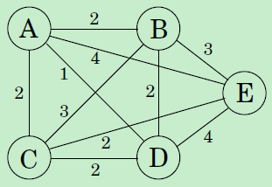
Traveling Salesperson Problem (TSP)
Input: undirected graph with lengths on edges.
Output: shortest tour that visits each vertex exactly once.
Brute-force: O(n!).
Best known algorithm: O(n²2^{n}) time.

Slide 45
TSP
What is the appropriate subproblem for the TSP?
Subproblems refer to partial solutions: the initial portion of a tour.
Suppose we have started at city 1 and are now in city j.
Need to know j. (to determine which cities are most convenient to visit next)
Need to know all the cities visited so far, so that we don't repeat any of them.

Slide 46
TSP
For a subset of cities S ⊆ {1, 2,…,n} that includes 1, and j ∈ S, let C(S, j) be the length of the shortest path visiting each node in S exactly once, starting at 1 and ending at j.
How to express C(S, j) in terms of smaller subproblems?

Slide 47
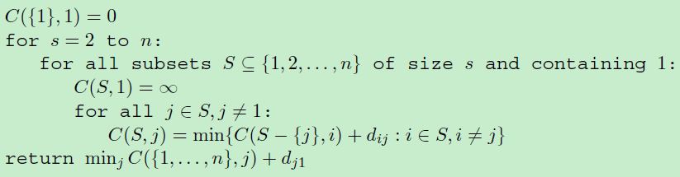
TSP
at most 2^{n}n subproblems, and each one takes linear time to solve.
Subset DP.

Slide 48
Interval DP Example
Problem: given a string x = x₁...x_{n}, find the minimum number of characters that need to be inserted to make it a palindrome.
Example:
x: Ab3bd
Can get “dAb3bAd” or “Adb3bdA” by inserting 2 characters (one ‘d’, one ‘A’)

Slide 49
Interval DP Example
Define subproblems
Let D_{ij} be the minimum number of characters that need to be inserted to make x_{i}...x_{j} into a palindrome
Find the recurrence
Consider a shortest palindrome y₁...y_{k} containing x_{i}...x_{j}
Either y₁ = x_{i} or y_{k} = x_{j} (why?)
y₂...y_{k−1} is then an optimal solution for x_{i+1}...x_{j} or x_{i}...x_{j−1} or x_{i+1}...x_{j−1}
Last case possible only if y₁ = y_{k} = x_{i} = x_{j}

Slide 50

Interval DP Example
Find the transition:
Find and solve the base case: D_{ii} = D_{i,i-1} = 0 for all i.
The entries of D must be filled in increasing order of j − i.

Slide 51
Homework
15.4-3 (Memoized version of LCS)
15-2
15-5

