Slide 1
Introduction to Algorithms
Lecture 7

Slide 2
Today’s Topics
Optimization Problems
Greedy Algorithms
Interval Scheduling
Stay ahead
Interval Partitioning
Lower/Upper bound
Minimizing Lateness
Exchange argument

Slide 3
Optimization Problems
A problem that may have many feasible solutions.
Each solution has a value.
In maximization problem, we wish to find a solution to maximize the value.
In the minimization problem, we wish to find a solution to minimize the value.

Slide 4
Greedy Algorithms
Many optimization problems can be solved more quickly using a greedy approach
The basic principle is that local optimal decisions may be used to build an optimal solution
But the greedy approach may not always lead to an optimal solution overall for all problems
The key is knowing which problems will work with this approach and which will not

Slide 5
Greedy algorithms
A greedy algorithm always makes the choice that looks best at the moment
The hope: a locally optimal choice will lead to a globally optimal solution
For some problems, it works
“Stay ahead”
Exchange argument
greedy algorithms tend to be easier to code

Slide 6
Interval scheduling
Job j starts at s_{j} and finishes at f_{j}.
Two jobs compatible if they don't overlap.
Goal: find maximum subset of mutually compatible jobs.
Dynamic programming? weighted … or:
c[i, j] = max_{a_k} ∈ _{A_ij} c[i,k] + c[k,j] + 1

Slide 7
Interval Scheduling: Greedy Algorithms
Greedy template. Consider jobs in some natural order.
Take each job provided it's compatible with the ones already taken.
[Earliest start time] Consider jobs in ascending order of s_{j}.
[Shortest interval] Consider jobs in ascending order of f_{j} - s_{j}.
[Fewest conflicts] For each job j, count the number of conflicting jobs c_{j}. Schedule in ascending order of c_{j}.
[Earliest finish time] Consider jobs in ascending order of f_{j}.

Slide 8
Counterexamples
[Earliest start time]
[Shortest interval]
[Fewest conflicts]

Slide 9
Earliest finish time
Sort jobs by finish times so that f₁ ≤ f₂ ≤ ... ≤ f_{n}.
A ← φ
for j = 1 to n {
if (job j compatible with A)
A ← A ∪ {j}
}
return A
Implementation. O(n log n).
Remember job j* that was added last to A.
Job j is compatible with A if s_{j} ≥ f_{j*}.

Slide 10
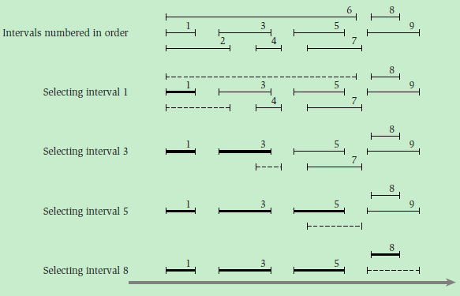
Sample run of the Interval Scheduling Algorithm

Slide 11
Earliest finish time - Analysis
Theorem. Greedy algorithm is optimal.
Pf. (our greedy rule “stays ahead”)
Let i₁, i₂, ... i_{k} denote set of jobs selected by greedy.
Let j₁, j₂, ... j_{m} denote set of jobs in the optimal solution with i₁ = j₁, i₂ = j₂, ..., i_{r} = j_{r} for the largest possible value of r.
f(i_{r}) ≤ f(j_{r}). (“stays ahead”)
Assume greedy is not optimal (m > k), and let's see what happens.

Slide 12
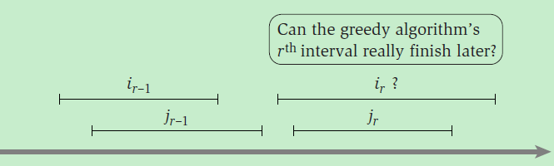
Earliest finish time - Analysis
f(i_{r-1}) ≤ f(j_{r-1}) ≤ s(j_{r})

Slide 13
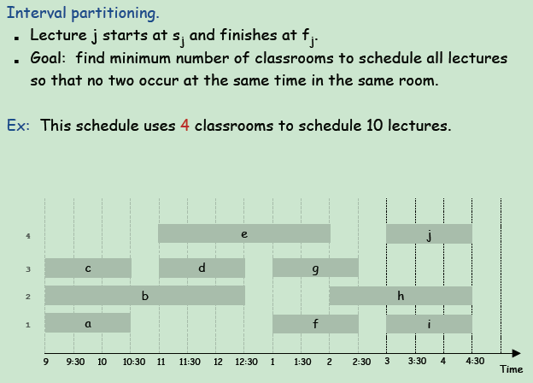
Interval Partitioning/Coloring

Slide 14
Interval Partitioning

Slide 15
Greedy algorithm
Consider lectures in some order, assigning each lecture to first available classroom (opening a new classroom if none is available). Which rule is optimal?
[Earliest start time] Consider lectures in ascending order of s_{j}.
[Earliest finish time] Consider lectures in ascending order of f_{j}.
[Shortest interval] Consider lectures in ascending order of f_{j} – s_{j}.
None of the above.

Slide 16
Interval Partitioning – Greedy Algorithm
Greedy algorithm. Consider lectures in increasing order of start time: assign lecture to any compatible classroom.
Implementation. O(n log n).
For each classroom k, maintain the finish time of the last job added.
Keep the classrooms in a priority queue.

Slide 17
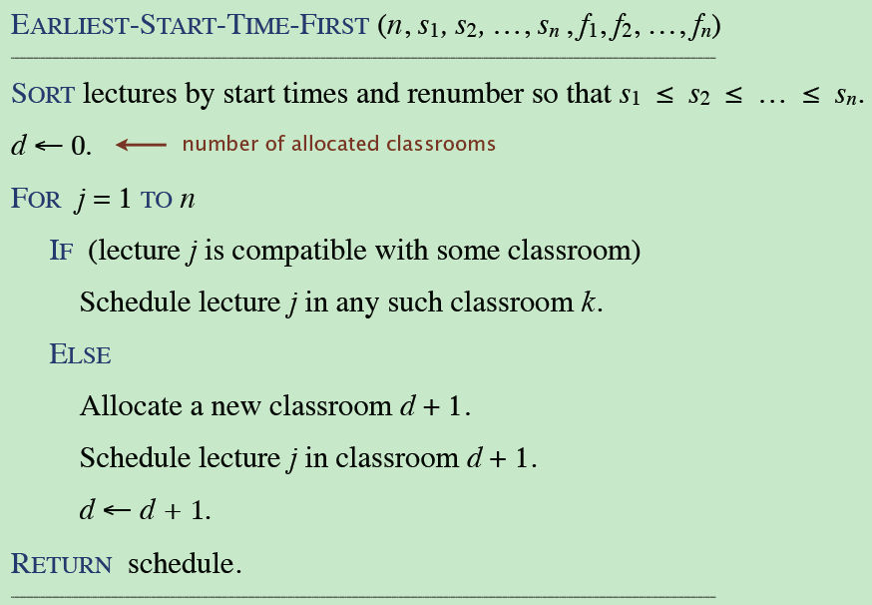
Interval partitioning: earliest-start-time-first algorithm

Slide 18
Interval partitioning: earliest-start-time-first algorithm
Sorting by start times takes O(n log n) time.
Store classrooms in a priority queue (key = finish time of its last lecture).
to allocate a new classroom, INSERT classroom onto priority queue.
to schedule lecture j in classroom k, INCREASE-KEY of classroom k to f_{j}.
to determine whether lecture j is compatible with any classroom, compare s_{j} to FIND-MIN.
Total # of priority queue operations is O(n); each takes O(log n) time.

Slide 19
Interval Partitioning – Greedy Analysis
Observation. Greedy algorithm never schedules two incompatible lectures in the same classroom.
Theorem. Greedy algorithm is optimal.
Find a simple, “structural” bound asserting that every possible solution must have at least a certain value.
Then show that the algorithm under consideration always achieves this bound.

Slide 20
Interval Partitioning – Lower Bound on Optimal Solution

Slide 21
Interval Partitioning – Greedy Analysis
Let d = number of classrooms that the greedy algorithm allocates.
Classroom d is opened because we needed to schedule a job, say j, that is incompatible with all d-1 other classrooms.
These d jobs each end after s_{j}.
Since we sorted by start time, all these incompatibilities are caused by lectures that start no later than s_{j}.
Thus, we have d lectures overlapping at time s_{j} + ε.
Key observation ⇒ all schedules use ≥ d classrooms.

Slide 22
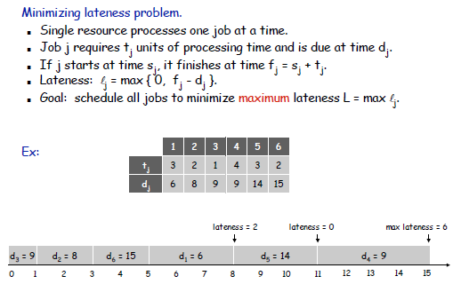
Scheduling to Minimizing Lateness

Slide 23
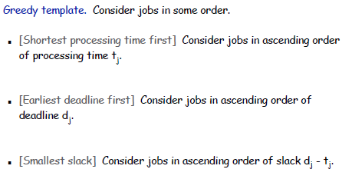
Minimizing Lateness: Greedy Algorithms
(completely ignores the deadlines of the jobs)
(never looks at the lengths of the jobs)

Slide 24
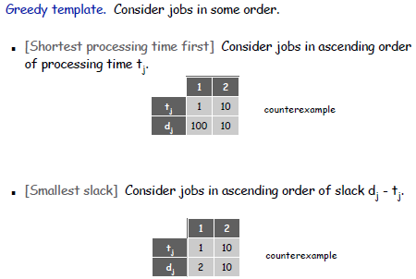
Minimizing Lateness: Greedy Algorithms

Slide 25
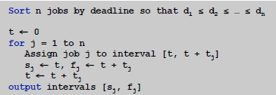

Minimizing Lateness: Greedy Algorithms
Greedy algorithm. Earliest deadline first.

Slide 26
Exchange Argument
Consider an optimal schedule S*.
Gradually modify S*, preserve its optimality at each step.
Eventually transform it into a schedule that is identical to the schedule S found by the greedy algorithm.

Slide 27
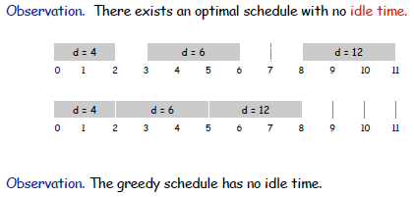
Minimizing Lateness: No Idle Time

Slide 28
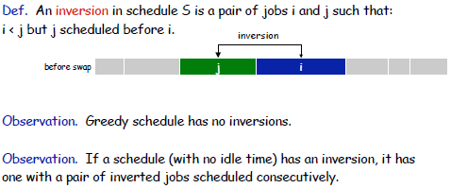

Minimizing Lateness: Inversions
All schedules with no inversions and no idle time have the same
maximum lateness.

Slide 29
Minimizing Lateness: Inversions
All schedules with no inversions and no idle time have the same
maximum lateness.

Slide 30
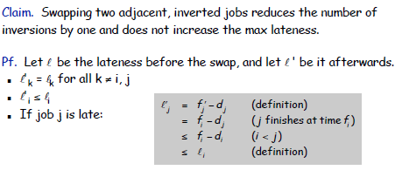
Minimizing Lateness: Inversions

Slide 31
Minimizing Lateness: Analysis of Greedy Algorithm
Theorem. Greedy schedule S is optimal.
Pf. Define S* to be an optimal schedule that has the fewest number of inversions.
Can assume S* has no idle time.
If S* has no inversions, then S = S*.
If S* has an inversion, let i-j be an adjacent inversion.
swapping i and j does not increase the maximum lateness and strictly decreases the number of inversions
this contradicts definition of S*

Slide 32
Data Compression
Suppose we have 1000000000 (1G) character data file that we wish to include in an email.
Suppose file only contains 26 letters {a,…,z}.
Suppose each letter α in {a,…,z} occurs with frequency f_{α}.
Suppose we encode each letter by a binary code
If we use a fixed length code, we need 5 bits for each character
The resulting message length is
Can we do better?

Slide 33
Huffman Codes
Most character code systems (ASCII, unicode) use fixed length encoding
If frequency data is available and there is a wide variety of frequencies, variable length encoding can save 20% to 90% space
Which characters should we assign shorter codes; which characters will have longer codes?

Slide 34
Data Compression: A Smaller Example
Suppose the file only has 6 letters {a,b,c,d,e,f} with frequencies
Fixed length 3G=3000000000 bits
Variable length
Fixed length
Variable length

Slide 35
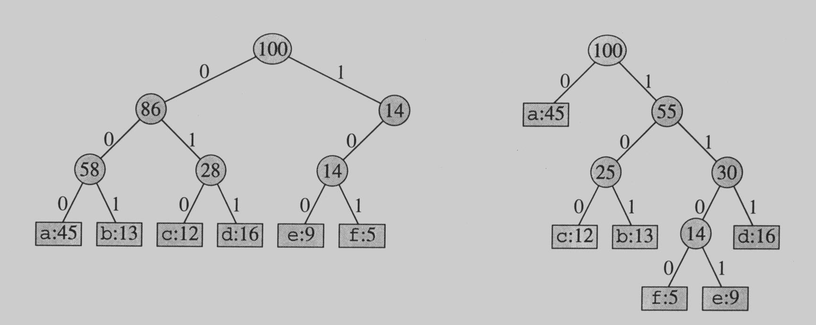
Prefix Codes
No encoding of a character can be the prefix of the longer encoding of another character, for example, we could not encode t as 01 and x as 01101 since 01 is a prefix of 01101
By using a binary tree representation we will generate prefix codes provided all letters are leaves

Slide 36
Prefix codes
A message can be decoded uniquely.
Following the tree until it reaches to a leaf, and then repeat!
Draw a few more tree and produce the codes!!!

Slide 37
Some Properties
Prefix codes allow easy decoding
Given a: 0, b: 101, c: 100, d: 111, e: 1101, f: 1100
Decode 001011101 going left to right, 0|01011101, a|0|1011101, a|a|101|1101, a|a|b|1101, a|a|b|e
An optimal code must be a full binary tree (a tree where every internal node has two children)
For C leaves there are C-1 internal nodes
The number of bits to encode a file is
where f(c) is the freq of c, d_{T}(c) is the tree depth of c, which corresponds to the code length of c

Slide 38
Optimal Prefix Coding Problem
Input: Given a set of n letters (c₁,…, c_{n}) with frequencies (f₁,…, f_{n}).
Construct a full binary tree T to define a prefix code that minimizes the average code length

Slide 39
Constructing the Optimal Prefix Code
X has probability masses p₁ ≥ p₂ ≥…≥ p_{m},
construct binary code to minimize
What should the optimal code look like?
If p_{i} > p_{j}, then l_{i} ≤ l_{j}.
The two longest codewords have the same length.
The two longest codewords differ only in the last bit.

Slide 40
Constructing the Optimal Prefix Code
Construction:
Take the two least likely symbols, merge them
to get a size m – 1 problem.
{p₁,…,p_{m–1}, p_{m}} → {p₁,…, p_{m–2},p_{m–1}+p_{m}}

Slide 41
The Huffman Algorithm
Huffman(C)
n ← |C|
Q ← C
for i ← 1 to n – 1
do allocate a new node z
left[z] ← x ← Extract-Min(Q)
right[z] ← y ← Extract-Min(Q)
f[z] ← f[x] + f[y]
Insert(Q, z)
return Extract-Min(Q) //return the root of the tree

Slide 42
The Huffman Algorithm
An appropriate data structure is a binary min-heap
Rebuilding the heap is lgn and n-1 extractions are made, so the complexity is O(n lg n)
The encoding is NOT unique, other encoding may work just as well, but none will work better

Slide 43

Fractional knapsack problem
Given a set S of n items, such that each item i has a positive benefit b_{i} and a positive weight w_{i}.
Find the maximum-benefit subset that does not exceed a given weight W.
Allowed to break items into fractions arbitrarily.

Slide 44

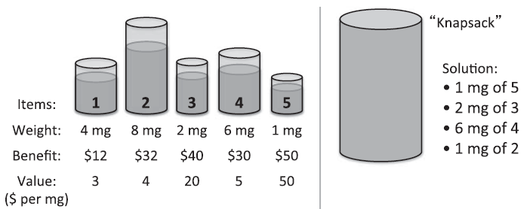
Fractional knapsack problem
The total benefit of the items taken is determined by the objective function:

Slide 45
Greedy methods
Determine the objective function to optimize.
Choose to include items into our knapsack based on their weights - take items in order by increasing weights.
Counterexample: weight-benefit pairs of (1, 10) and (10, 200).
Choose items in order based on their benefits.
Rank the items by their value = benefit/weight

Slide 46
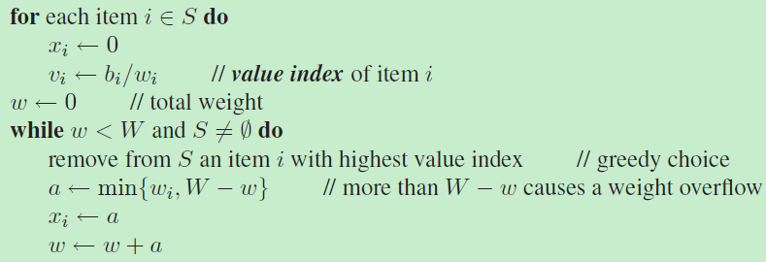
Greedy Alg. For Fractional Knapsack
FractionalKnapsack(S,W):

Slide 47
Greedy Alg. For Fractional Knapsack - Analysis
Theorem. Given a collection S of n items, such that each item i has a benefit b_{i} and weight w_{i}, we can construct a maximum-benefit subset of S, allowing for fractional amounts, that has a total weight W in O(n log n) time.

Slide 48
Greedy Alg. For Fractional Knapsack - Analysis
Pf (by contradiction). There is an optimal solution better than the one chosen by this greedy algorithm.
Then there must be two items i and j such that
x_{i} < w_{i}, x_{j} > 0, and v_{i} > v_{j}.
Let y = min{w_{i} − x_{i}, x_{j}}.
We could then replace an amount y of item j with an equal amount of item i.

Slide 49
LIS – Greedy algorithm
Theorem. The greedy algorithm can be implemented in O(n log n) time.
Use n stacks to represent n piles.
Use binary search to find leftmost legal pile.

Slide 50
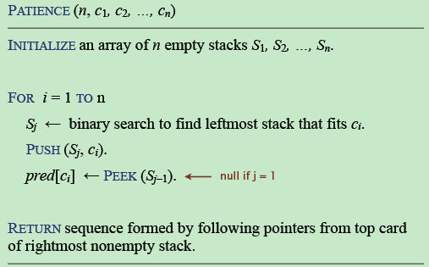
LIS – Greedy algorithm

Slide 51
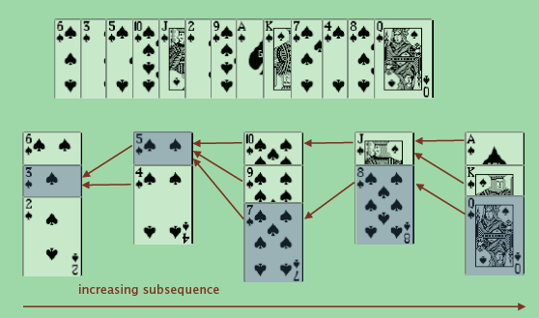
LIS – Greedy algorithm

