Slide 1
并行和分布式计算 Parallel and Distributed Computing 第 12 讲 MapReduce编程介绍
张 奇
复旦大学 计算机科学技术学院

Slide 2
目录
12.1 MapReduce简介
12.2 MapReduce算法设计基础

Slide 3

What is MapReduce?
Programming model for expressing distributed computations at a massive scale
Execution framework for organizing and performing such computations
Open-source implementation called Hadoop
http://www.cloudera.com

Slide 4
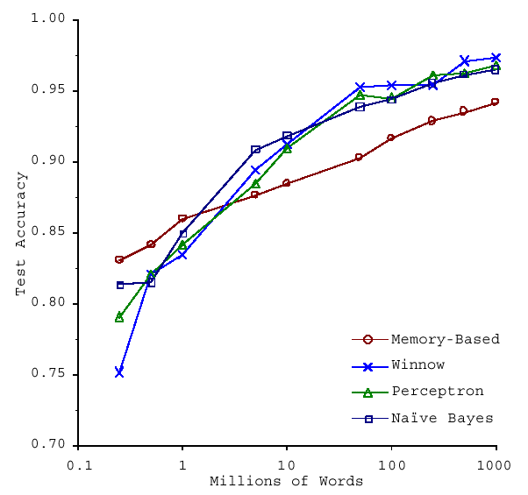
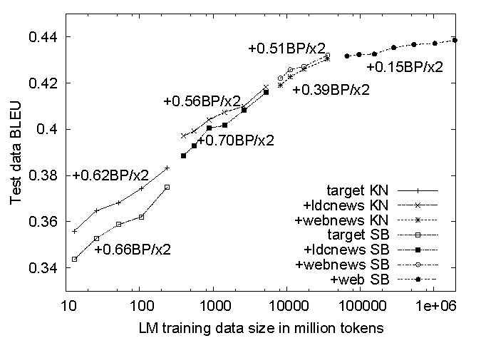
No data like more data!
s/knowledge/data/g;
How do we get here if we’re not Google?
(Banko and Brill, ACL 2001)
(Brants et al., EMNLP 2007)

Slide 5
What to do with more data?
Answering factoid questions
Pattern matching on the Web
Works amazingly well
Learning relations
Start with seed instances
Search for patterns on the Web
Using patterns to find more instances
Who shot Abraham Lincoln? → X shot Abraham Lincoln
Wolfgang Amadeus Mozart (1756 - 1791)
Einstein was born in 1879
Birthday-of(Mozart, 1756)
Birthday-of(Einstein, 1879)
PERSON (DATE –
PERSON was born in DATE
(Brill et al., TREC 2001; Lin, ACM TOIS 2007)
(Agichtein and Gravano, DL 2000; Ravichandran and Hovy, ACL 2002; … )

Slide 6
How do we scale up?

Slide 7
Divide and Conquer
“Work”
Partition
w₁
w₂
w₃
“worker”
“worker”
“worker”
r₁
r₂
r₃
Combine
“Result”

Slide 8
Parallelization Challenges
How do we assign work units to workers?
What if we have more work units than workers?
What if workers need to share partial results?
How do we aggregate partial results?
How do we know all the workers have finished?
What if workers die?
What is the common theme of all of these problems?

Slide 9
Common Theme?
Parallelization problems arise from:
Communication between workers (e.g., to exchange state)
Access to shared resources (e.g., data)
Thus, we need a synchronization mechanism

Slide 10
Managing Multiple Workers
Difficult because
We don’t know the order in which workers run
We don’t know when workers interrupt each other
We don’t know the order in which workers access shared data
Thus, we need:
Semaphores (lock, unlock)
Conditional variables (wait, notify, broadcast)
Barriers
Still, lots of problems:
Deadlock, livelock, race conditions...
Dining philosophers, sleeping barbers, cigarette smokers...
Moral of the story: be careful!

Slide 11
Current Tools
Shared Memory
Message Passing
Programming models
Shared memory (pthreads)
Message passing (MPI)
Design Patterns
Master-slaves
Producer-consumer flows
Shared work queues
Memory
P₁
P₂
P₃
P₄
P₅
P₁
P₂
P₃
P₄
P₅
producer
consumer
master
work queue
slaves
producer
consumer

Slide 12
Where the rubber meets the road
Concurrency is difficult to reason about
Concurrency is even more difficult to reason about
At the scale of datacenters (even across datacenters)
In the presence of failures
In terms of multiple interacting services
Not to mention debugging…
The reality:
Lots of one-off solutions, custom code
Write you own dedicated library, then program with it
Burden on the programmer to explicitly manage everything

Slide 13
What’s the point?
It’s all about the right level of abstraction
The von Neumann architecture has served us well, but is no longer appropriate for the multi-core/cluster environment
Hide system-level details from the developers
No more race conditions, lock contention, etc.
Separating the what from how
Developer specifies the computation that needs to be performed
Execution framework (“runtime”) handles actual execution
The datacenter is the computer!

Slide 14
“Big Ideas”
Scale “out”, not “up”
Limits of SMP and large shared-memory machines
Move processing to the data
Cluster have limited bandwidth
Process data sequentially, avoid random access
Seeks are expensive, disk throughput is reasonable
Seamless scalability
From the mythical man-month to the tradable machine-hour

Slide 15
MapReduce

Slide 16
Typical Large-Data Problem
Iterate over a large number of records
Extract something of interest from each
Shuffle and sort intermediate results
Aggregate intermediate results
Generate final output
Map
Reduce
Key idea: provide a functional abstraction for these two operations
(Dean and Ghemawat, OSDI 2004)

Slide 17
Roots in Functional Programming
Map
f
f
f
f
f
Fold
g
g
g
g
g

Slide 18
MapReduce
Programmers specify two functions:
map (k, v) → <k’, v’>*
reduce (k’, v’) → <k’, v’>*
All values with the same key are sent to the same reducer
The execution framework handles everything else…
What’s “everything else”?

Slide 19
MapReduce “Runtime”
Handles scheduling
Assigns workers to map and reduce tasks
Handles “data distribution”
Moves processes to data
Handles synchronization
Gathers, sorts, and shuffles intermediate data
Handles errors and faults
Detects worker failures and restarts
Everything happens on top of a distributed FS (later)

Slide 20
“Hello World”: Word Count

Slide 21
MapReduce
Programmers specify two functions:
map (k, v) → <k’, v’>*
reduce (k’, v’) → <k’, v’>*
All values with the same key are reduced together
The execution framework handles everything else…
Not quite…usually, programmers also specify:
partition (k’, number of partitions) → partition for k’
Often a simple hash of the key, e.g., hash(k’) mod n
Divides up key space for parallel reduce operations
combine (k’, v’) → <k’, v’>*
Mini-reducers that run in memory after the map phase
Used as an optimization to reduce network traffic

Slide 23
Two more details…
Barrier between map and reduce phases
But we can begin copying intermediate data earlier
Keys arrive at each reducer in sorted order
No enforced ordering across reducers

Slide 24
“Hello World”: Word Count
Map(String docid, String text):
for each word w in text:
Emit(w, 1);
Reduce(String term, Iterator<Int> values):
int sum = 0;
for each v in values:
sum += v;
Emit(term, value);

Slide 25
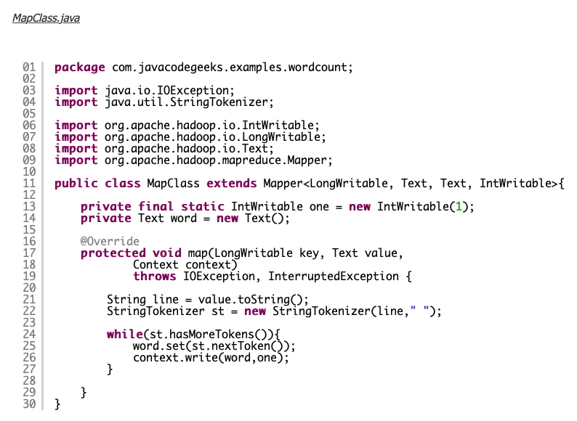
“Hello World”: Word Count

Slide 26
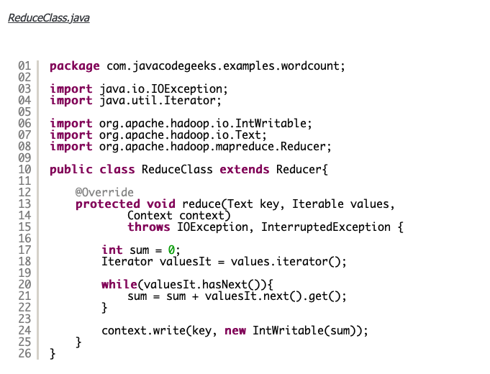
“Hello World”: Word Count

Slide 27
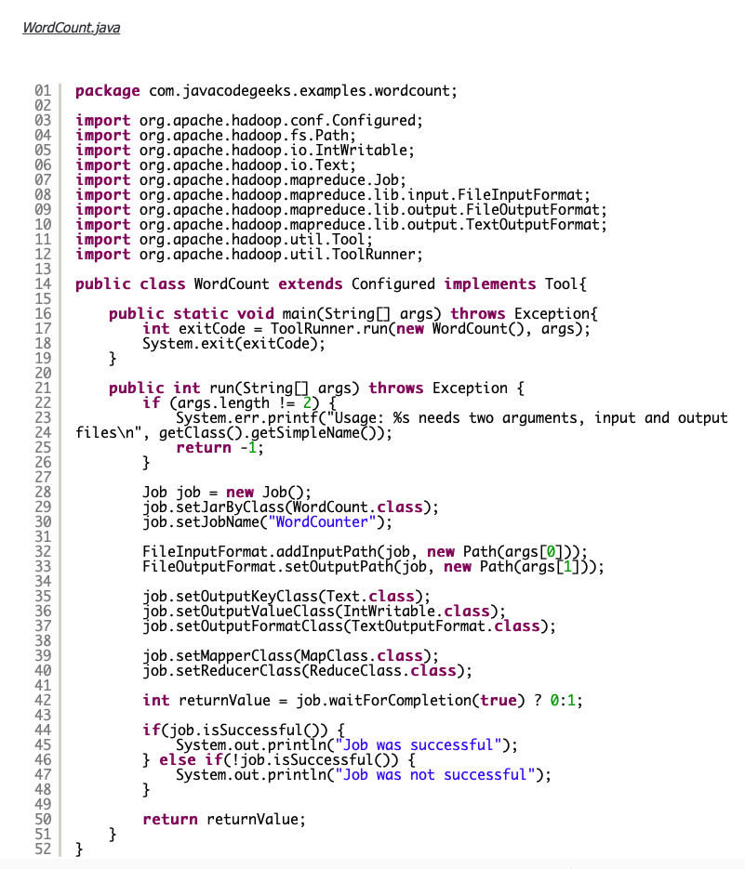
“Hello World”: Word Count

Slide 28
MapReduce can refer to…
The programming model
The execution framework (aka “runtime”)
The specific implementation
Usage is usually clear from context!

Slide 29
MapReduce Implementations
Google has a proprietary implementation in C++
Bindings in Java, Python
Hadoop is an open-source implementation in Java
Development led by Yahoo, used in production
Now an Apache project
Rapidly expanding software ecosystem
Lots of custom research implementations
For GPUs, cell processors, etc.

Slide 30
User Program
(1) submit
Master
(2) schedule map
(2) schedule reduce
worker
split 0
(6) write
output
file 0
split 1
(5) remote read
worker
split 2
(3) read
(4) local write
split 3
worker
split 4
worker
output
file 1
worker
Input
files
Map
phase
Intermediate files
(on local disk)
Reduce
phase
Output
files
Adapted from (Dean and Ghemawat, OSDI 2004)

Slide 31

How do we get data to the workers?
NAS
SAN
Compute Nodes
What’s the problem here?

Slide 32
Distributed File System
Don’t move data to workers… move workers to the data!
Store data on the local disks of nodes in the cluster
Start up the workers on the node that has the data local
Why?
Not enough RAM to hold all the data in memory
Disk access is slow, but disk throughput is reasonable
A distributed file system is the answer
GFS (Google File System) for Google’s MapReduce
HDFS (Hadoop Distributed File System) for Hadoop

Slide 33
GFS: Assumptions
Commodity hardware over “exotic” hardware
Scale “out”, not “up”
High component failure rates
Inexpensive commodity components fail all the time
“Modest” number of huge files
Multi-gigabyte files are common, if not encouraged
Files are write-once, mostly appended to
Perhaps concurrently
Large streaming reads over random access
High sustained throughput over low latency
GFS slides adapted from material by (Ghemawat et al., SOSP 2003)

Slide 34
GFS: Design Decisions
Files stored as chunks
Fixed size (64MB)
Reliability through replication
Each chunk replicated across 3+ chunkservers
Single master to coordinate access, keep metadata
Simple centralized management
No data caching
Little benefit due to large datasets, streaming reads
Simplify the API
Push some of the issues onto the client (e.g., data layout)
HDFS = GFS clone (same basic ideas)

Slide 35
From GFS to HDFS
Terminology differences:
GFS master = Hadoop namenode
GFS chunkservers = Hadoop datanodes
Functional differences:
No file appends in HDFS (planned feature)
HDFS performance is (likely) slower
For the most part, we’ll use the Hadoop terminology…

Slide 36
HDFS Architecture
HDFS namenode
Application
/foo/bar
(file name, block id)
File namespace
HDFS Client
block 3df2
(block id, block location)
instructions to datanode
(block id, byte range)
datanode state
HDFS datanode
HDFS datanode
block data
Linux file system
Linux file system
…
…
Adapted from (Ghemawat et al., SOSP 2003)

Slide 37
Namenode Responsibilities
Managing the file system namespace:
Holds file/directory structure, metadata, file-to-block mapping, access permissions, etc.
Coordinating file operations:
Directs clients to datanodes for reads and writes
No data is moved through the namenode
Maintaining overall health:
Periodic communication with the datanodes
Block re-replication and rebalancing
Garbage collection

Slide 38
Putting everything together…
namenode
job submission node
namenode daemon
jobtracker
tasktracker
tasktracker
tasktracker
datanode daemon
datanode daemon
datanode daemon
Linux file system
Linux file system
Linux file system
…
…
…
slave node
slave node
slave node

Slide 39
MapReduce Algorithm Design

Slide 40
MapReduce: Recap
Programmers must specify:
map (k, v) → <k’, v’>*
reduce (k’, v’) → <k’, v’>*
All values with the same key are reduced together
Optionally, also:
partition (k’, number of partitions) → partition for k’
Often a simple hash of the key, e.g., hash(k’) mod n
Divides up key space for parallel reduce operations
combine (k’, v’) → <k’, v’>*
Mini-reducers that run in memory after the map phase
Used as an optimization to reduce network traffic
The execution framework handles everything else…

Slide 42
“Everything Else”
The execution framework handles everything else…
Scheduling: assigns workers to map and reduce tasks
“Data distribution”: moves processes to data
Synchronization: gathers, sorts, and shuffles intermediate data
Errors and faults: detects worker failures and restarts
Limited control over data and execution flow
All algorithms must expressed in m, r, c, p
You don’t know:
Where mappers and reducers run
When a mapper or reducer begins or finishes
Which input a particular mapper is processing
Which intermediate key a particular reducer is processing

Slide 43
Tools for Synchronization
Cleverly-constructed data structures
Bring partial results together
Sort order of intermediate keys
Control order in which reducers process keys
Partitioner
Control which reducer processes which keys
Preserving state in mappers and reducers
Capture dependencies across multiple keys and values

Slide 44
Preserving State
Mapper object
Reducer object
one object per task
state
state
configure
API initialization hook
configure
map
one call per input key-value pair
reduce
one call per intermediate key
close
API cleanup hook
close

Slide 45
Importance of Local Aggregation
Ideal scaling characteristics:
Twice the data, twice the running time
Twice the resources, half the running time
Why can’t we achieve this?
Synchronization requires communication
Communication kills performance
Thus… avoid communication!
Reduce intermediate data via local aggregation
Combiners can help

Slide 46
Shuffle and Sort
Mapper
intermediate files (on disk)
merged spills (on disk)
Combiner
Reducer
circular buffer (in memory)
Combiner
other reducers
spills (on disk)
other mappers

Slide 47
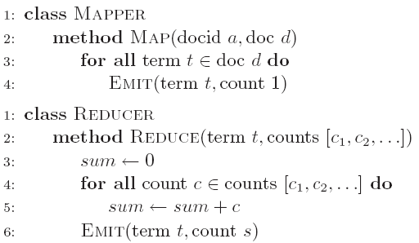
Word Count: Baseline
What’s the impact of combiners?

Slide 48
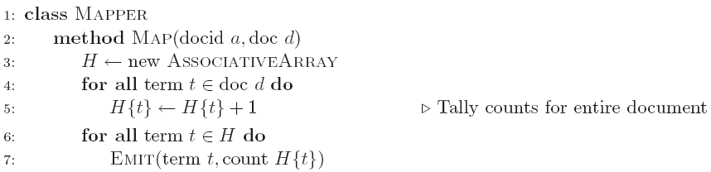
Word Count: Version 1
Are combiners still needed?

Slide 49
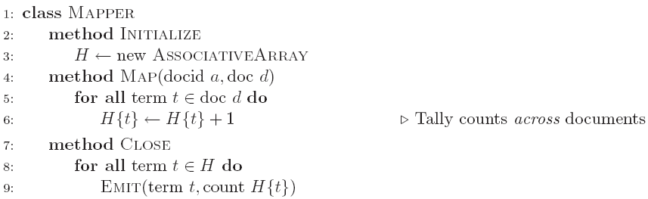
Word Count: Version 2
Key: preserve state across input key-value pairs!
Are combiners still needed?

Slide 50
Design Pattern for Local Aggregation
“In-mapper combining”
Fold the functionality of the combiner into the mapper by preserving state across multiple map calls
Advantages
Speed
Why is this faster than actual combiners?
Disadvantages
Explicit memory management required
Potential for order-dependent bugs

Slide 51
Combiner Design
Combiners and reducers share same method signature
Sometimes, reducers can serve as combiners
Often, not…
Remember: combiner are optional optimizations
Should not affect algorithm correctness
May be run 0, 1, or multiple times
Example: find mean of all integers associated with the same key

Slide 52
Algorithm Design: Running Example
Term co-occurrence matrix for a text collection
M = N x N matrix (N = vocabulary size)
M_{ij}: number of times i and j co-occur in some context (for concreteness, let’s say context = sentence)
Why?
Distributional profiles as a way of measuring semantic distance
Semantic distance useful for many language processing tasks

Slide 53
MapReduce: Large Counting Problems
Term co-occurrence matrix for a text collection = specific instance of a large counting problem
A large event space (number of terms)
A large number of observations (the collection itself)
Goal: keep track of interesting statistics about the events
Basic approach
Mappers generate partial counts
Reducers aggregate partial counts
How do we aggregate partial counts efficiently?

Slide 54
First Try: “Pairs”
Each mapper takes a sentence:
Generate all co-occurring term pairs
For all pairs, emit (a, b) → count
Reducers sum up counts associated with these pairs
Use combiners!

Slide 55
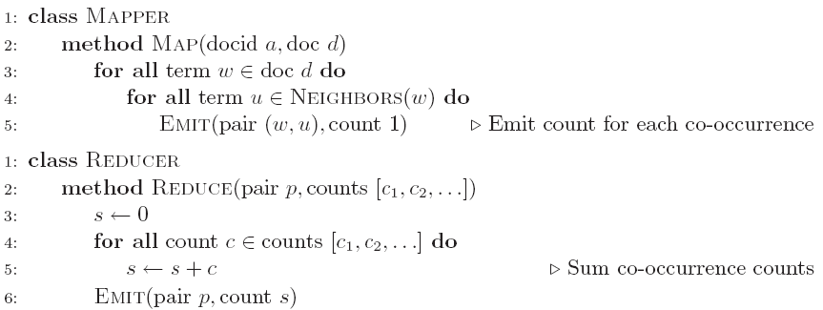
Pairs: Pseudo-Code

Slide 56
“Pairs” Analysis
Advantages
Easy to implement, easy to understand
Disadvantages
Lots of pairs to sort and shuffle around (upper bound?)
Not many opportunities for combiners to work

Slide 57
Another Try: “Stripes”
Idea: group together pairs into an associative array
Each mapper takes a sentence:
Generate all co-occurring term pairs
For each term, emit a → { b: count_{b}, c: count_{c}, d: count_{d} … }
Reducers perform element-wise sum of associative arrays
(a, b) → 1
(a, c) → 2
(a, d) → 5
(a, e) → 3
(a, f) → 2
a → { b: 1, c: 2, d: 5, e: 3, f: 2 }
a → { b: 1, d: 5, e: 3 }
a → { b: 1, c: 2, d: 2, f: 2 }
a → { b: 2, c: 2, d: 7, e: 3, f: 2 }
+
Key: cleverly-constructed data structure
brings together partial results

Slide 58
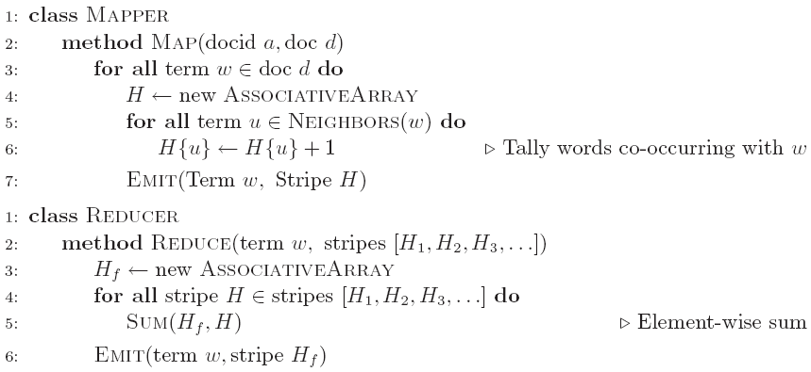
Stripes: Pseudo-Code

Slide 59
“Stripes” Analysis
Advantages
Far less sorting and shuffling of key-value pairs
Can make better use of combiners
Disadvantages
More difficult to implement
Underlying object more heavyweight
Fundamental limitation in terms of size of event space

Slide 60
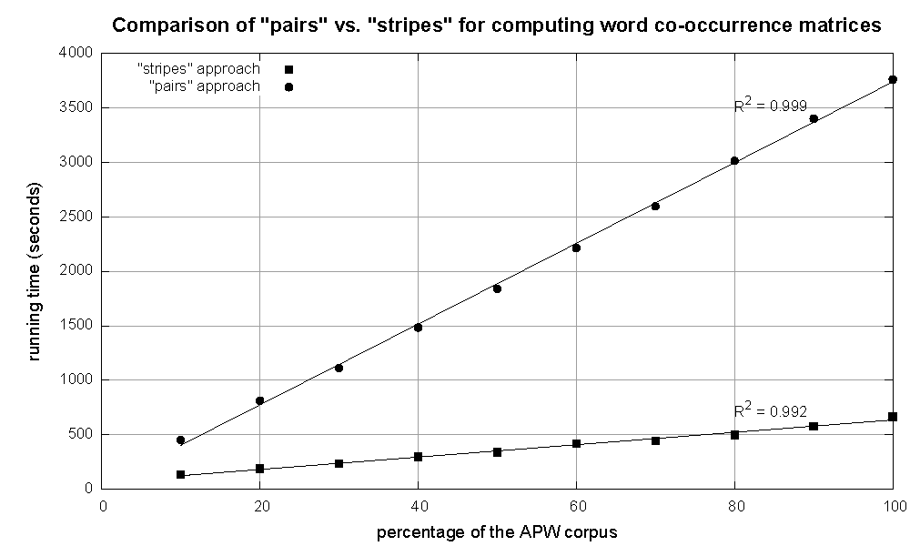
Cluster size: 38 cores
Data Source: Associated Press Worldstream (APW) of the English Gigaword Corpus (v3), which contains 2.27 million documents (1.8 GB compressed, 5.7 GB uncompressed)

Slide 61
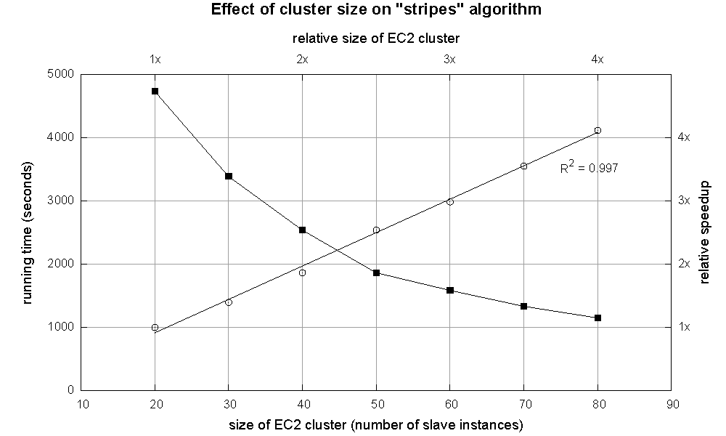

Slide 62
Relative Frequencies
How do we estimate relative frequencies from counts?
Why do we want to do this?
How do we do this with MapReduce?

Slide 63
f(B|A): “Stripes”
Easy!
One pass to compute (a, *)
Another pass to directly compute f(B|A)
a → {b₁:3, b₂ :12, b₃ :7, b₄ :1, … }

Slide 64
f(B|A): “Pairs”
(a, *) → 32
For this to work:
Must emit extra (a, *) for every b_{n} in mapper
Must make sure all a’s get sent to same reducer (use partitioner)
Must make sure (a, *) comes first (define sort order)
Must hold state in reducer across different key-value pairs
Reducer holds this value in memory
(a, b₁) → 3
(a, b₂) → 12
(a, b₃) → 7
(a, b₄) → 1
…
(a, b₁) → 3 / 32
(a, b₂) → 12 / 32
(a, b₃) → 7 / 32
(a, b₄) → 1 / 32
…

Slide 65
Issues and Tradeoffs
Number of key-value pairs
Object creation overhead
Time for sorting and shuffling pairs across the network
Size of each key-value pair
De/serialization overhead
Local aggregation
Opportunities to perform local aggregation varies
Combiners make a big difference
Combiners vs. in-mapper combining
RAM vs. disk vs. network

Slide 66
Debugging at Scale
Works on small datasets, won’t scale… why?
Memory management issues (buffering and object creation)
Too much intermediate data
Mangled input records
Real-world data is messy!
Word count: how many unique words in Wikipedia?
There’s no such thing as “consistent data”
Watch out for corner cases
Isolate unexpected behavior, bring local

Slide 67
Question?

