Slide 1
并行和分布式计算 Parallel and Distributed Computing 第 13 讲 MAPREDUCE信息检索任务算法
张 奇
复旦大学 计算机科学技术学院

Slide 2
目录
13.1 文本检索算法
13.2 语言模型

Slide 3
Text Retrieval Algorithms

Slide 4
Today’s Agenda
Introduction to information retrieval
Basics of indexing and retrieval
Inverted indexing in MapReduce
Retrieval at scale

Slide 5
First, nomenclature…
Information retrieval (IR)
Focus on textual information (= text/document retrieval)
Other possibilities include image, video, music, …
What do we search?
Generically, “collections”
Less-frequently used, “corpora”
What do we find?
Generically, “documents”
Even though we may be referring to web pages, PDFs, PowerPoint slides, paragraphs, etc.

Slide 6
Information Retrieval Cycle
Source
Selection
Resource
Query
Formulation
Query
Search
Results
Selection
Documents
System discovery
Vocabulary discovery
Concept discovery
Document discovery
Examination
Information
source reselection
Delivery

Slide 7
The Central Problem in Search
Author
Searcher
Concepts
Concepts
Query Terms
Document Terms
“tragic love story”
“fateful star-crossed romance”
Do these represent the same concepts?
Notes:
Why is IR hard? Because language is hard!

Slide 8
Abstract IR Architecture
Documents
Query
document acquisition (e.g., web crawling)
online
offline
Representation
Function
Representation
Function
Query Representation
Document Representation
Index
Comparison
Function
Hits

Slide 9
How do we represent text?
Remember: computers don’t “understand” anything!
“Bag of words”
Treat all the words in a document as index terms
Assign a “weight” to each term based on “importance” (or, in simplest case, presence/absence of word)
Disregard order, structure, meaning, etc. of the words
Simple, yet effective!
Assumptions
Term occurrence is independent
Document relevance is independent
“Words” are well-defined

Slide 10
What’s a word?
天主教教宗若望保祿二世因感冒再度住進醫院。這是他今年第二度因同樣的病因住院。
وقال مارك ريجيف - الناطق باسم
الخارجية الإسرائيلية - إن شارون قبل
الدعوة وسيقوم للمرة الأولى بزيارة
تونس، التي كانت لفترة طويلة المقر
الرسمي لمنظمة التحرير الفلسطينية بعد خروجها من لبنان عام 1982.
Выступая в Мещанском суде Москвы экс-глава ЮКОСа заявил не совершал ничего противозаконного, в чем обвиняет его генпрокуратура России.
भारत सरकार ने आर्थिक सर्वेक्षण में वित्तीय वर्ष 2005-06 में सात फ़ीसदी विकास दर हासिल करने का आकलन किया है और कर सुधार पर ज़ोर दिया है
日米連合で台頭中国に対処…アーミテージ前副長官提言
조재영 기자= 서울시는 25일 이명박 시장이 `행정중심복합도시'' 건설안에 대해 `군대라도 동원해 막고싶은 심정''이라고 말했다는 일부 언론의 보도를 부인했다.

Slide 11
Sample Document
McDonald's slims down spuds
Fast-food chain to reduce certain types of fat in its french fries with new cooking oil.
NEW YORK (CNN/Money) - McDonald's Corp. is cutting the amount of "bad" fat in its french fries nearly in half, the fast-food chain said Tuesday as it moves to make all its fried menu items healthier.
But does that mean the popular shoestring fries won't taste the same? The company says no. "It's a win-win for our customers because they are getting the same great french-fry taste along with an even healthier nutrition profile," said Mike Roberts, president of McDonald's USA.
But others are not so sure. McDonald's will not specifically discuss the kind of oil it plans to use, but at least one nutrition expert says playing with the formula could mean a different taste.
Shares of Oak Brook, Ill.-based McDonald's (MCD: down $0.54 to $23.22, Research, Estimates) were lower Tuesday afternoon. It was unclear Tuesday whether competitors Burger King and Wendy's International (WEN: down $0.80 to $34.91, Research, Estimates) would follow suit. Neither company could immediately be reached for comment.
…
“Bag of Words”
14 × McDonalds
12 × fat
11 × fries
8 × new
7 × french
6 × company, said, nutrition
5 × food, oil, percent, reduce, taste, Tuesday
…

Slide 12
Counting Words…
Documents
case folding, tokenization, stopword removal, stemming
Bag of Words
syntax, semantics, word knowledge, etc.
Inverted
Index

Slide 13
Boolean Retrieval
Users express queries as a Boolean expression
AND, OR, NOT
Can be arbitrarily nested
Retrieval is based on the notion of sets
Any given query divides the collection into two sets: retrieved, not-retrieved
Pure Boolean systems do not define an ordering of the results

Slide 14
Inverted Index: Boolean Retrieval
Doc 1
Doc 2
Doc 3
Doc 4
one fish, two fish
red fish, blue fish
cat in the hat
green eggs and ham
1
2
3
4
blue
1
blue
2
cat
1
cat
3
egg
1
egg
4
fish
1
1
fish
1
2
green
1
green
4
ham
1
ham
4
hat
1
hat
3
one
1
one
1
red
1
red
2
two
1
two
1

Slide 15
Boolean Retrieval
To execute a Boolean query:
Build query syntax tree
For each clause, look up postings
Traverse postings and apply Boolean operator
Efficiency analysis
Postings traversal is linear (assuming sorted postings)
Start with shortest posting first
OR
( blue AND fish ) OR ham
ham
AND
blue
fish
blue
2
fish
1
2

Slide 16
Strengths and Weaknesses
Strengths
Precise, if you know the right strategies
Precise, if you have an idea of what you’re looking for
Implementations are fast and efficient
Weaknesses
Users must learn Boolean logic
Boolean logic insufficient to capture the richness of language
No control over size of result set: either too many hits or none
When do you stop reading? All documents in the result set are considered “equally good”
What about partial matches? Documents that “don’t quite match” the query may be useful also

Slide 17
Ranked Retrieval
Order documents by how likely they are to be relevant to the information need
Estimate relevance(q, d_{i})
Sort documents by relevance
Display sorted results
User model
Present hits one screen at a time, best results first
At any point, users can decide to stop looking
How do we estimate relevance?
Assume document is relevant if it has a lot of query terms
Replace relevance(q, d_{i}) with sim(q, d_{i})
Compute similarity of vector representations

Slide 18
Vector Space Model
t₃
d₂
d₃
d₁
θ
φ
t₁
d₅
t₂
d₄
Assumption: Documents that are “close together” in vector space “talk about” the same things
Therefore, retrieve documents based on how close the document is to the query (i.e., similarity ~ “closeness”)

Slide 19
Similarity Metric
Use “angle” between the vectors:
Or, more generally, inner products:

Slide 20
Term Weighting
Term weights consist of two components
Local: how important is the term in this document?
Global: how important is the term in the collection?
Here’s the intuition:
Terms that appear often in a document should get high weights
Terms that appear in many documents should get low weights
How do we capture this mathematically?
Term frequency (local)
Inverse document frequency (global)

Slide 21
TF.IDF Term Weighting
weight assigned to term i in document j
number of occurrence of term i in document j
number of documents in entire collection
number of documents with term i

Slide 22
Inverted Index: TF.IDF
Doc 1
Doc 2
Doc 3
Doc 4
one fish, two fish
red fish, blue fish
cat in the hat
green eggs and ham
tf
1
2
3
4
df
blue
1
1
blue
1
2
1
cat
1
1
cat
1
3
1
egg
1
1
egg
1
4
1
fish
2
2
2
fish
2
1
2
2
2
green
1
1
green
1
4
1
ham
1
1
ham
1
4
1
hat
1
1
hat
1
3
1
one
1
1
one
1
1
1
red
1
1
red
1
2
1
two
1
1
two
1
1
1

Slide 23
Positional Indexes
Store term position in postings
Supports richer queries (e.g., proximity)
Naturally, leads to larger indexes…

Slide 24
Inverted Index: Positional Information
Doc 1
Doc 2
Doc 3
Doc 4
one fish, two fish
red fish, blue fish
cat in the hat
green eggs and ham
tf
1
2
3
4
df
blue
1
1
blue
1
2
1
[3]
cat
1
1
cat
1
3
1
[1]
egg
1
1
egg
1
4
1
[2]
fish
2
2
2
fish
2
1
2
[2,4]
2
2
[2,4]
green
1
1
green
1
4
1
[1]
ham
1
1
ham
1
4
1
[3]
hat
1
1
hat
1
3
1
[2]
one
1
1
one
1
1
1
[1]
red
1
1
red
1
2
1
[1]
two
1
1
two
1
1
1
[3]

Slide 25
Retrieval in a Nutshell
Look up postings lists corresponding to query terms
Traverse postings for each query term
Store partial query-document scores in accumulators
Select top k results to return

Slide 26
Retrieval: Document-at-a-Time
Evaluate documents one at a time (score all query terms)
Tradeoffs
Small memory footprint (good)
Must read through all postings (bad), but skipping possible
More disk seeks (bad), but blocking possible
blue
9
2
21
1
35
1
…
fish
1
2
9
1
21
3
34
1
35
2
80
3
…
Accumulators
(e.g. priority queue)
Document score in top k?
Yes: Insert document score, extract-min if queue too large
No: Do nothing

Slide 27
Retrieval: Query-At-A-Time
Evaluate documents one query term at a time
Usually, starting from most rare term (often with tf-sorted postings)
Tradeoffs
Early termination heuristics (good)
Large memory footprint (bad), but filtering heuristics possible
blue
9
2
21
1
35
1
…
Accumulators (e.g., hash)
Score_{{q=x}}(doc n) = s
fish
1
2
9
1
21
3
34
1
35
2
80
3
…

Slide 28
MapReduce it?
The indexing problem
Scalability is critical
Must be relatively fast, but need not be real time
Fundamentally a batch operation
Incremental updates may or may not be important
For the web, crawling is a challenge in itself
The retrieval problem
Must have sub-second response time
For the web, only need relatively few results
Perfect for MapReduce!
Uh… not so good…

Slide 29
Indexing: Performance Analysis
Fundamentally, a large sorting problem
Terms usually fit in memory
Postings usually don’t
How is it done on a single machine?
How can it be done with MapReduce?
First, let’s characterize the problem size:
Size of vocabulary
Size of postings

Slide 30
Vocabulary Size: Heaps’ Law
Heaps’ Law: linear in log-log space
Vocabulary size grows unbounded!
M is vocabulary size
T is collection size (number of documents)
k and b are constants
Typically, k is between 30 and 100, b is between 0.4 and 0.6
Notes:
22

Slide 31
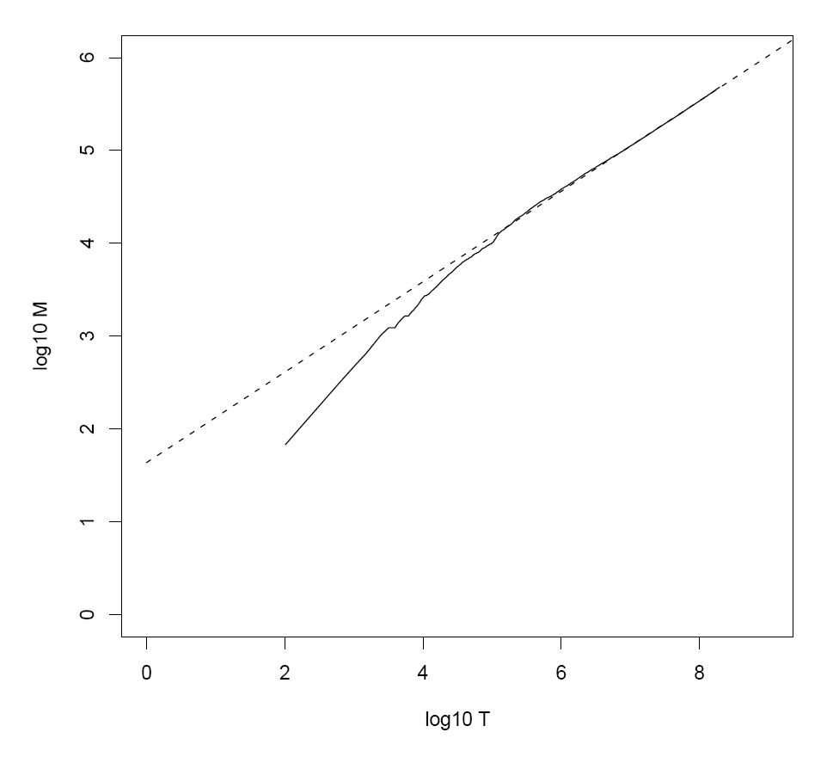
Heaps’ Law for RCV1
k = 44
b = 0.49
First 1,000,020 terms:
Predicted = 38,323
Actual = 38,365
Reuters-RCV1 collection: 806,791 newswire documents (Aug 20, 1996-August 19, 1997)
Manning, Raghavan, Schütze, Introduction to Information Retrieval (2008)

Slide 32
Postings Size: Zipf’s Law
Zipf’s Law: (also) linear in log-log space
Specific case of Power Law distributions
In other words:
A few elements occur very frequently
Many elements occur very infrequently
cf is the collection frequency of i-th common term
c is a constant
Notes:
22

Slide 33
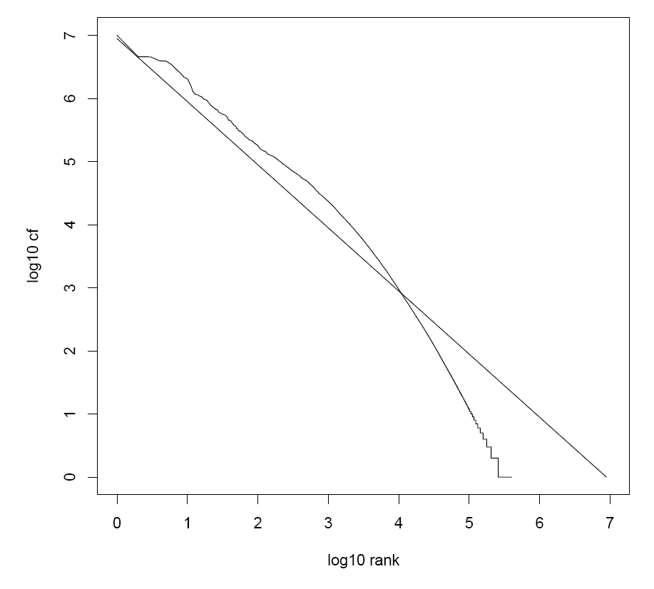
Zipf’s Law for RCV1
Fit isn’t that good… but good enough!
Reuters-RCV1 collection: 806,791 newswire documents (Aug 20, 1996-August 19, 1997)
Manning, Raghavan, Schütze, Introduction to Information Retrieval (2008)

Slide 34
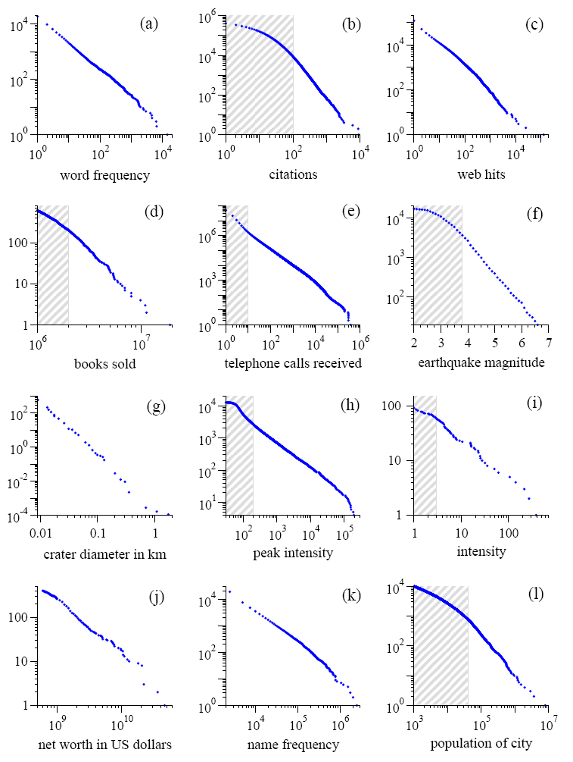
Power Laws are everywhere!
Figure from: Newman, M. E. J. (2005) “Power laws, Pareto distributions and Zipf's law.” Contemporary Physics 46:323–351.

Slide 35
MapReduce: Recap
Programmers must specify:
map (k, v) → <k’, v’>*
reduce (k’, v’) → <k’, v’>*
All values with the same key are reduced together
Optionally, also:
partition (k’, number of partitions) → partition for k’
Often a simple hash of the key, e.g., hash(k’) mod n
Divides up key space for parallel reduce operations
combine (k’, v’) → <k’, v’>*
Mini-reducers that run in memory after the map phase
Used as an optimization to reduce network traffic
The execution framework handles everything else…

Slide 36
k₁
v₁
k₂
v₂
k₃
v₃
k₄
v₄
k₅
v₅
k₆
v₆
map
map
map
map
a
1
b
2
c
3
c
6
a
5
c
2
b
7
c
8
combine
combine
combine
combine
a
1
b
2
c
9
a
5
c
2
b
7
c
8
partition
partition
partition
partition
Shuffle and Sort: aggregate values by keys
a
1
5
b
2
7
c
2
9
8
reduce
reduce
reduce
r₁
s₁
r₂
s₂
r₃
s₃

Slide 37
Inverted Index: TF.IDF
Doc 1
Doc 2
Doc 3
Doc 4
one fish, two fish
red fish, blue fish
cat in the hat
green eggs and ham
tf
1
2
3
4
df
blue
1
1
blue
1
2
1
cat
1
1
cat
1
3
1
egg
1
1
egg
1
4
1
fish
2
2
2
fish
2
1
2
2
2
green
1
1
green
1
4
1
ham
1
1
ham
1
4
1
hat
1
1
hat
1
3
1
one
1
1
one
1
1
1
red
1
1
red
1
2
1
two
1
1
two
1
1
1

Slide 38
Inverted Index: Positional Information
Doc 1
Doc 2
Doc 3
Doc 4
one fish, two fish
red fish, blue fish
cat in the hat
green eggs and ham
tf
1
2
3
4
df
blue
1
1
blue
1
2
1
[3]
cat
1
1
cat
1
3
1
[1]
egg
1
1
egg
1
4
1
[2]
fish
2
2
2
fish
2
1
2
[2,4]
2
2
[2,4]
green
1
1
green
1
4
1
[1]
ham
1
1
ham
1
4
1
[3]
hat
1
1
hat
1
3
1
[2]
one
1
1
one
1
1
1
[1]
red
1
1
red
1
2
1
[1]
two
1
1
two
1
1
1
[3]

Slide 39
MapReduce: Index Construction
Map over all documents
Emit term as key, (docno, tf) as value
Emit other information as necessary (e.g., term position)
Sort/shuffle: group postings by term
Reduce
Gather and sort the postings (e.g., by docno or tf)
Write postings to disk
MapReduce does all the heavy lifting!

Slide 40
Inverted Indexing with MapReduce
Doc 1
Doc 2
Doc 3
one fish, two fish
red fish, blue fish
cat in the hat
one
1
1
red
2
1
cat
3
1
Map
two
blue
hat
1
1
2
1
3
1
fish
1
2
fish
2
2
Shuffle and Sort: aggregate values by keys
cat
3
1
Reduce
blue
2
1
fish
1
2
2
2
hat
3
1
one
1
1
two
1
1
red
2
1

Slide 41
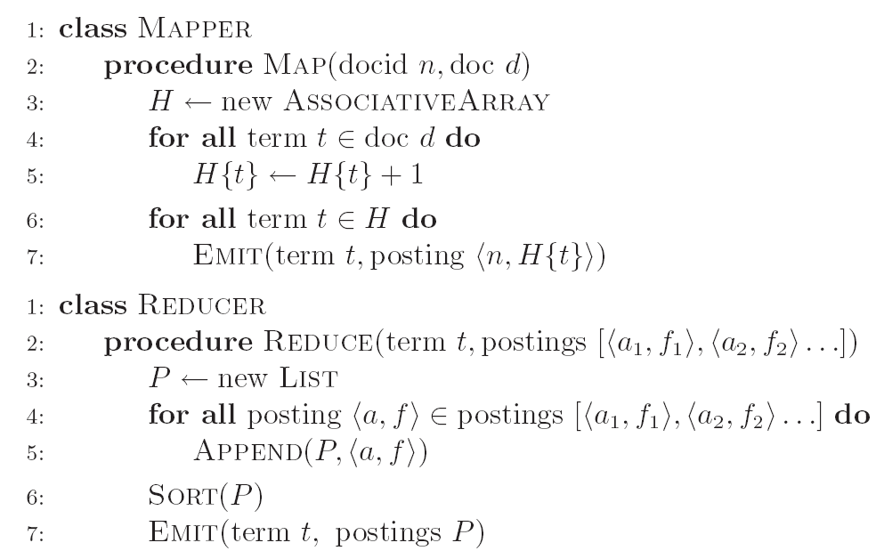
Inverted Indexing: Pseudo-Code

Slide 42
Positional Indexes
Doc 1
Doc 2
Doc 3
one fish, two fish
red fish, blue fish
cat in the hat
one
1
1
[1]
red
2
1
[1]
cat
3
1
[1]
Map
two
blue
hat
1
1
[3]
2
1
[3]
3
1
[2]
fish
1
2
[2,4]
fish
2
2
[2,4]
Shuffle and Sort: aggregate values by keys
cat
3
1
[1]
Reduce
blue
2
1
[3]
fish
1
2
[2,4]
2
2
[2,4]
hat
3
1
[2]
one
1
1
[1]
two
1
1
[3]
red
2
1
[1]

Slide 43
Inverted Indexing: Pseudo-Code
What’s the problem?

Slide 44
Scalability Bottleneck
Initial implementation: terms as keys, postings as values
Reducers must buffer all postings associated with key (to sort)
What if we run out of memory to buffer postings?
Uh oh!

Slide 45
Another Try…
(key)
(values)
(keys)
(values)
fish
1
2
[2,4]
fish
1
[2,4]
34
1
[23]
fish
9
[9]
21
3
[1,8,22]
fish
21
[1,8,22]
35
2
[8,41]
fish
34
[23]
80
3
[2,9,76]
fish
35
[8,41]
9
1
[9]
fish
80
[2,9,76]
How is this different?
Let the framework do the sorting
Term frequency implicitly stored
Directly write postings to disk!
Where have we seen this before?

Slide 46
Postings Encoding
Conceptually:
fish
1
2
9
1
21
3
34
1
35
2
80
3
…
In Practice:
Don’t encode docnos, encode gaps (or d-gaps)
But it’s not obvious that this save space…
fish
1
2
8
1
12
3
13
1
1
2
45
3
…

Slide 47
MapReduce it?
The indexing problem
Scalability is paramount
Must be relatively fast, but need not be real time
Fundamentally a batch operation
Incremental updates may or may not be important
For the web, crawling is a challenge in itself
The retrieval problem
Must have sub-second response time
For the web, only need relatively few results
Just covered
Now

Slide 48
Retrieval with MapReduce?
MapReduce is fundamentally batch-oriented
Optimized for throughput, not latency
Startup of mappers and reducers is expensive
MapReduce is not suitable for real-time queries!
Use separate infrastructure for retrieval…

Slide 49
Important Ideas
Partitioning (for scalability)
Replication (for redundancy)
Caching (for speed)
Routing (for load balancing)
The rest is just details!

Slide 50
Term vs. Document Partitioning
D
T₁
D
T₂
Term Partitioning
…
T₃
T
Document Partitioning
…
T
D₁
D₂
D₃

Slide 51
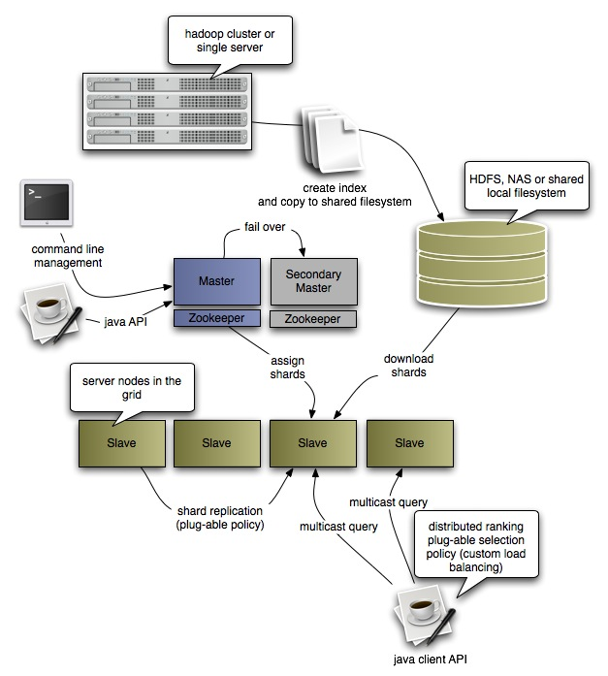
Katta Architecture (Distributed Lucene)
http://katta.sourceforge.net/

Slide 52
Language Models

Slide 53
Today’s Agenda
What are Language Models?
Mathematical background and motivation
Dealing with data sparsity (smoothing)
Evaluating language models
Large Scale Language Models using MapReduce

Slide 54
N-Gram Language Models
What?
LMs assign probabilities to sequences of tokens
How?
Based on previous word histories
n-gram = consecutive sequences of tokens
Why?
Speech recognition
Handwriting recognition
Predictive text input
Statistical machine translation
Notes:
What does modeling a language, say, English actually mean ?
Explain Noisy Channel Model for SMT to show the language model utility

Slide 55
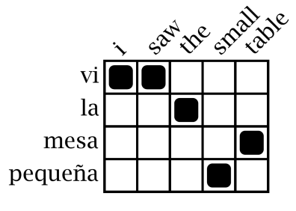
Statistical Machine Translation
Training Data
Word Alignment
Phrase Extraction
i saw the small table
(vi, i saw)
(la mesa pequeña, the small table)
…
vi la mesa pequeña
Parallel Sentences
he sat at the table
the service was good
Language Model
Translation Model
Target-Language Text
Decoder
maria no daba una bofetada a la bruja verde
mary did not slap the green witch
Foreign Input Sentence
English Output Sentence

Slide 56
SMT: The role of the LM
Maria
no
dio
una
bofetada
a
la
bruja
verde
Mary
not
give
a
slap
to
the
witch
green
did not
a slap
by
green witch
no
slap
to the
did not give
to
the
slap
the witch

Slide 57
N-Gram Language Models
N=1 (unigrams)
This is a sentence
Unigrams:
This,
is,
a,
sentence
Sentence of length s, how many unigrams?
Notes:
What are n-grams ? We already saw what they are sort of when we looked at NgramTaggers.

Slide 58
N-Gram Language Models
N=2 (bigrams)
This is a sentence
Bigrams:
This is,
is a,
a sentence
Sentence of length s, how many bigrams?
Notes:
What are n-grams ? We already saw what they are sort of when we looked at NgramTaggers.

Slide 59
N-Gram Language Models
N=3 (trigrams)
This is a sentence
Trigrams:
This is a,
is a sentence
Sentence of length s, how many trigrams?
Notes:
What are n-grams ? We already saw what they are sort of when we looked at NgramTaggers.

Slide 60

Computing Probabilities
[chain rule]
Is this practical?
No! Can’t keep track of all possible histories of all words!
Notes:
Sentence with T words - assign a probability to it

Slide 61
Approximating Probabilities
Basic idea: limit history to fixed number of words N
(Markov Assumption)
N=1: Unigram Language Model

Slide 62
Approximating Probabilities
Basic idea: limit history to fixed number of words N
(Markov Assumption)
N=2: Bigram Language Model
Notes:
Since we also want to include the first word in the bigram model, we need a dummy beginning of sentence marker <s>. We usually also have an end of sentence marker but for the sake of brevity, I don’t show that here.

Slide 63
Approximating Probabilities
Basic idea: limit history to fixed number of words N
(Markov Assumption)
N=3: Trigram Language Model

Slide 64
Building N-Gram Language Models
Use existing sentences to compute n-gram probability estimates (training)
Terminology:
N = total number of words in training data (tokens)
V = vocabulary size or number of unique words (types)
C(w₁,...,w_{k}) = frequency of n-gram w₁, ..., w_{k} in training data
P(w₁, ..., w_{k}) = probability estimate for n-gram w₁ ... w_{k}
P(w_{k}|w₁, ..., w_{k-1}) = conditional probability of producing w_{k} given the history w₁, ... w_{k-1}

Slide 65



Building N-Gram Models
Start with what’s easiest!
Compute maximum likelihood estimates for individual n-gram probabilities
Unigram:
Bigram:
Uses relative frequencies as estimates
Maximizes the likelihood of the data given the model P(D|M)
Notes:
N-gram probability estimates. Derive the conditional probability expression on board ! Given that the occurrence of an n-gram is a random variable with a binomial distribution i.e. each n-gram is independent of the next. Untrue: (a) n-grams are overlapping (b) content words tend to clump (used once, likely to get used again)

Slide 66
Example: Bigram Language Model
<s>
I am Sam Sam I am
I do not like green eggs and ham
</s>
<s>
</s>
<s>
</s>
Training Corpus
P( I | <s> ) = 2/3 = 0.67 P( Sam | <s> ) = 1/3 = 0.33
P( am | I ) = 2/3 = 0.67 P( do | I ) = 1/3 = 0.33
P( </s> | Sam )= 1/2 = 0.50 P( Sam | am) = 1/2 = 0.50
...
Bigram Probability Estimates
Note: We don’t ever cross sentence boundaries

Slide 67
Building N-Gram Models
Start with what’s easiest!
Compute maximum likelihood estimates for individual n-gram probabilities
Unigram:
Bigram:
Uses relative frequencies as estimates
Maximizes the likelihood of the data given the model P(D|M)
Let’s revisit this issue…
Why not just substitute P(wi)?
Notes:
N-gram probability estimates. Derive the conditional probability expression on board ! Given that the occurrence of an n-gram is a random variable with a binomial distribution i.e. each n-gram is independent of the next. Untrue: (a) n-grams are overlapping (b) content words tend to clump (used once, likely to get used again)

Slide 68
More Context, More Work
Larger N = more context
Lexical co-occurrences
Local syntactic relations
More context is better?
Larger N = more complex model
For example, assume a vocabulary of 100,000
How many parameters for unigram LM? Bigram? Trigram?
Larger N has another more serious problem!

Slide 69
Data Sparsity
P( I | <s> ) = 2/3 = 0.67 P( Sam | <s> ) = 1/3 = 0.33
P( am | I ) = 2/3 = 0.67 P( do | I ) = 1/3 = 0.33
P( </s> | Sam )= 1/2 = 0.50 P( Sam | am) = 1/2 = 0.50
...
Bigram Probability Estimates
P(I like ham)
= P( I | <s> ) P( like | I ) P( ham | like ) P( </s> | ham )
= 0
Why?
Why is this bad?
Notes:
Why is the 0 bad ?

Slide 70
Data Sparsity
Serious problem in language modeling!
Becomes more severe as N increases
What’s the tradeoff?
Solution 1: Use larger training corpora
Can’t always work... Blame Zipf’s Law (Looong tail)
Solution 2: Assign non-zero probability to unseen n-grams
Known as smoothing
Notes:
Explain what Zipf’s law is and ask the students if they understand how it bears on this discussion.

Slide 71
Smoothing
Zeros are bad for any statistical estimator
Need better estimators because MLEs give us a lot of zeros
A distribution without zeros is “smoother”
The Robin Hood Philosophy: Take from the rich (seen n-grams) and give to the poor (unseen n-grams)
And thus also called discounting
Critical: make sure you still have a valid probability distribution!
Language modeling: theory vs. practice

Slide 72
Laplace’s Law
Simplest and oldest smoothing technique
Just add 1 to all n-gram counts including the unseen ones
So, what do the revised estimates look like?

Slide 73







Laplace’s Law: Probabilities
Unigrams
Bigrams
Careful, don’t confuse the N’s!
Notes:
You have to make sure that the joint is well-formed and understand how the conditional probability formula is derived.

Slide 74

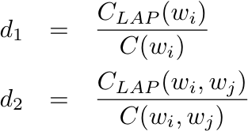
Laplace’s Law: Frequencies
Expected Frequency Estimates
Relative Discount

Slide 75
Scaling Language Models with MapReduce

Slide 76
Language Modeling Recap
Interpolation: Consult all models at the same time to compute an interpolated probability estimate.
Backoff: Consult the highest order model first and backoff to lower order model only if there are no higher order counts.
Interpolated Kneser Ney (state-of-the-art)
Use absolute discounting to save some probability mass for lower order models.
Use a novel form of lower order models (count unique single word contexts instead of occurrences)
Combine models into a true probability model using interpolation

Slide 77
Questions for today
Can we efficiently train an IKN LM with terabytes of data?
Does it really matter?

Slide 78
Using MapReduce to Train IKN
Step 0: Count words [MR]
Step 0.5: Assign IDs to words [vocabulary generation] (more frequent → smaller IDs)
Step 1: Compute n-gram counts [MR]
Step 2: Compute lower order context counts [MR]
Step 3: Compute unsmoothed probabilities and interpolation weights [MR]
Step 4: Compute interpolated probabilities [MR]
[MR] = MapReduce job

Slide 79
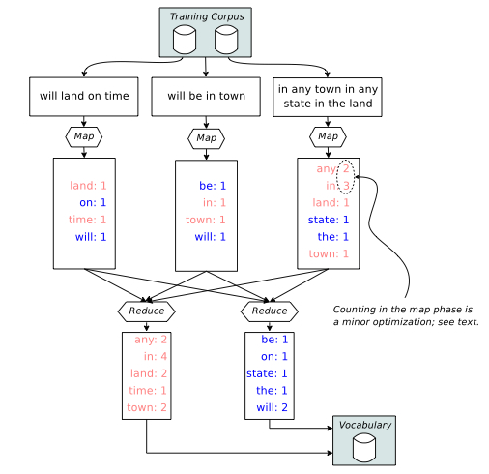
Steps 0 & 0.5
Step 0
Step 0.5

Slide 80
Steps 1-4
 | Step 1 | Step 2 | Step 3 | Step 4
Input Key | DocID | n-grams “a b c” | “a b c” | “a b”
Input Value | Document | C_{total}(“a b c”) | C_{KN}(“a b c”) | _Step 3 Output_
Intermediate Key | n-grams “a b c” | “a b c” | “a b” (history) | “c b a”
Intermediate Value | C_{doc}(“a b c”) | C’_{KN}(“a b c”) | (“c”, C_{KN}(“a b c”)) | (P’(“a b c”), λ(“a b”))
Partitioning | “a b c” | “a b c” | “a b” | “c b”
Output Value | C_{total}(“a b c”) | C_{KN}(“a b c”) | (“c”, P’(“a b c”), λ(“a b”)) | (P_{KN}(“a b c”), λ(“a b”))
Mapper Input
Mapper Output
Reducer Input
Reducer
Output
Count
n-grams
Count
contexts
Compute unsmoothed probs AND interp. weights
Compute
Interp. probs
All output keys are always the same as the intermediate keys
I only show trigrams here but the steps operate on bigrams and unigrams as well

Slide 81
Steps 1-4
 | Step 1 | Step 2 | Step 3 | Step 4
Input Key | DocID | n-grams “a b c” | “a b c” | “a b”
Input Value | Document | C_{total}(“a b c”) | C_{KN}(“a b c”) | _Step 3 Output_
Intermediate Key | n-grams “a b c” | “a b c” | “a b” (history) | “c b a”
Intermediate Value | C_{doc}(“a b c”) | C’_{KN}(“a b c”) | (“c”, C_{KN}(“a b c”)) | (P’(“a b c”), λ(“a b”))
Partitioning | “a b c” | “a b c” | “a b” | “c b”
Output Value | C_{total}(“a b c”) | C_{KN}(“a b c”) | (“c”, P’(“a b c”), λ(“a b”)) | (P_{KN}(“a b c”), λ(“a b”))
Mapper Input
Details are not important!
5 MR jobs to train IKN (expensive)!
IKN LMs are big!
(interpolation weights are context dependent)
Can we do something that has better
behavior at scale in terms of time and space?
Mapper Output
Reducer Input
Reducer
Output
Count
n-grams
Count
contexts
Compute unsmoothed probs AND interp. weights
Compute
Interp. probs
All output keys are always the same as the intermediate keys
I only show trigrams here but the steps operate on bigrams and unigrams as well

Slide 82
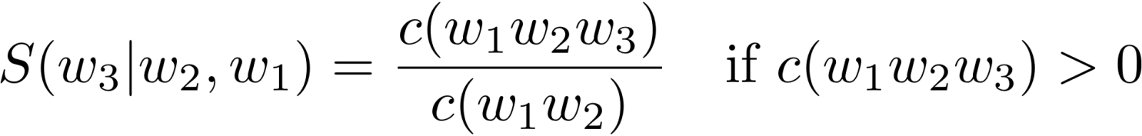
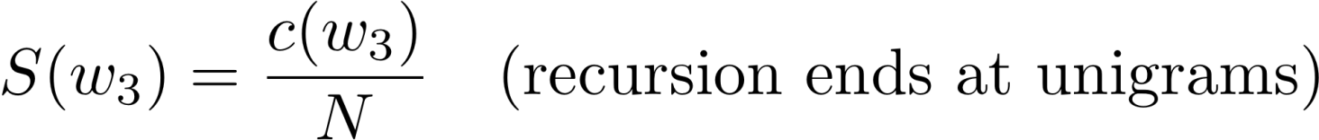
Let’s try something stupid!
Simplify backoff as much as possible!
Forget about trying to make the LM be a true probability distribution!
Don’t do any discounting of higher order models!
Have a single backoff weight independent of context! [α(•) = α]
“Stupid Backoff (SB)”

Slide 83
Using MapReduce to Train SB
Step 0: Count words [MR]
Step 0.5: Assign IDs to words [vocabulary generation] (more frequent → smaller IDs)
Step 1: Compute n-gram counts [MR]
Step 2: Generate final LM “scores” [MR]
[MR] = MapReduce job

Slide 84
Steps 0 & 0.5
Step 0
Step 0.5

Slide 85
Steps 1 & 2
 | Step 1 | Step 2
Input Key | DocID | First two words of n-grams “a b c” and “a b” (“a b”)
Input Value | Document | C_{total}(“a b c”)
Intermediate Key | n-grams “a b c” | “a b c”
Intermediate Value | C_{doc}(“a b c”) | S(“a b c”)
Partitioning | first two words (why?) “a b” | last two words “b c”
Output Value | “a b c”, C_{total}(“a b c”) | S(“a b c”) [write to disk]
Mapper Input
Mapper Output
Reducer Input
Reducer
Output
Count
n-grams
Compute
LM scores
All unigram counts are replicated in all partitions in both steps
The clever partitioning in Step 2 is the key to efficient use at runtime!
The trained LM model is composed of partitions written to disk
Notes:
recall that the reducer wrote out actual "S" scores for each n-gram and not the counts. Therefore, we don't need to do *any• computation for the trigram score; the partition will already have the score S("e f g") and all we need to do is just take that score and multiply it by \alpha. Of course, if it the partition doesn't have S("e f g"), it may have S("f g") so we can take that and multiply it by \alpha². And if it doesn't have S("f g"), we *know* it will have S("g") because unigram counts are replicated across all partitions. So, we take S("g") and multiply it by \alpha³.

Slide 86
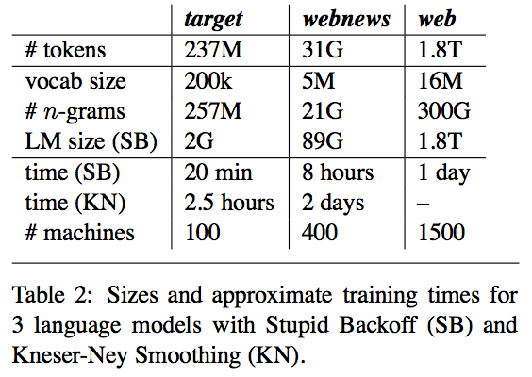
Which one wins?

Slide 87
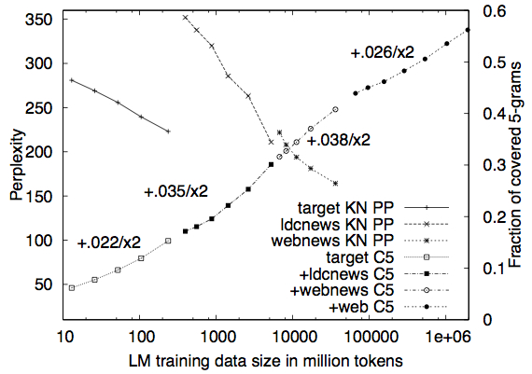
Which one wins?
Can’t compute perplexity for SB. Why?
Why do we care about 5-gram coverage for a test set?

Slide 88
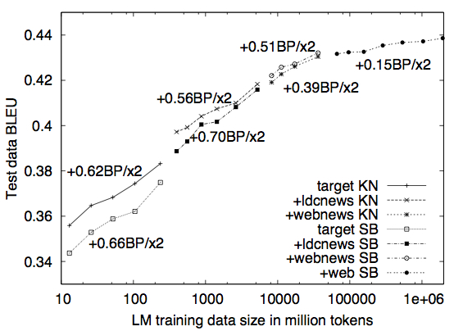
Which one wins?
SB overtakes IKN
BLEU is a measure of MT performance.
Not as stupid as you thought, huh?

Slide 89
Take away
The MapReduce paradigm and infrastructure make it simple to scale algorithms to web scale data
At Terabyte scale, efficiency becomes really important!
When you have a lot of data, a more scalable technique (in terms of speed and memory consumption) can do better than the state-of-the-art even if it’s stupider!
“The difference between genius and stupidity is that genius has its limits.”
- Oscar Wilde
“The dumb shall inherit the cluster”
- Nitin Madnani

Slide 90

Questions?
Source: Wikipedia (Japanese rock garden)

