Slide 1
并行和分布式计算 Parallel and Distributed Computing 第 14 讲 MAPREDUCE图算法与数据库
张 奇
复旦大学 计算机科学技术学院

Slide 2
目录
14.1 图算法
14.2 MapReduce与数据库

Slide 3
Graph Algorithms

Slide 4
Today’s Agenda
Graph problems and representations
Parallel breadth-first search
PageRank

Slide 5
What’s a graph?
G = (V,E), where
V represents the set of vertices (nodes)
E represents the set of edges (links)
Both vertices and edges may contain additional information
Different types of graphs:
Directed vs. undirected edges
Presence or absence of cycles
Graphs are everywhere:
Hyperlink structure of the Web
Physical structure of computers on the Internet
Interstate highway system
Social networks

Slide 6
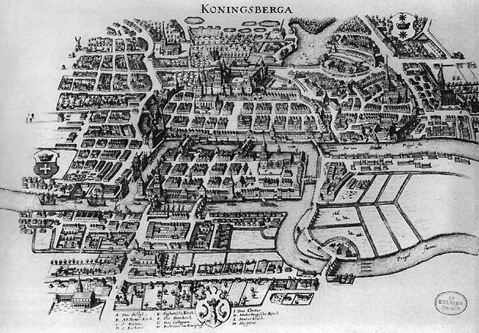
Source: Wikipedia (Königsberg)

Slide 7
Some Graph Problems
Finding shortest paths
Routing Internet traffic and UPS trucks
Finding minimum spanning trees
Telco laying down fiber
Finding Max Flow
Airline scheduling
Identify “special” nodes and communities
Breaking up terrorist cells, spread of avian flu
Bipartite matching
Monster.com, Match.com
And of course... PageRank

Slide 8
Graphs and MapReduce
Graph algorithms typically involve:
Performing computations at each node: based on node features, edge features, and local link structure
Propagating computations: “traversing” the graph
Key questions:
How do you represent graph data in MapReduce?
How do you traverse a graph in MapReduce?

Slide 9
Representing Graphs
G = (V, E)
Two common representations
Adjacency matrix
Adjacency list

Slide 10
Adjacency Matrices
Represent a graph as an n x n square matrix M
n = |V|
M_{ij} = 1 means a link from node i to j
2
 | 1 | 2 | 3 | 4
1 | 0 | 1 | 0 | 1
2 | 1 | 0 | 1 | 1
3 | 1 | 0 | 0 | 0
4 | 1 | 0 | 1 | 0
1
3
4

Slide 11
Adjacency Matrices: Critique
Advantages:
Amenable to mathematical manipulation
Iteration over rows and columns corresponds to computations on outlinks and inlinks
Disadvantages:
Lots of zeros for sparse matrices
Lots of wasted space

Slide 12
Adjacency Lists
Take adjacency matrices… and throw away all the zeros
 | 1 | 2 | 3 | 4
1 | 0 | 1 | 0 | 1
2 | 1 | 0 | 1 | 1
3 | 1 | 0 | 0 | 0
4 | 1 | 0 | 1 | 0
1: 2, 4
2: 1, 3, 4
3: 1
4: 1, 3

Slide 13
Adjacency Lists: Critique
Advantages:
Much more compact representation
Easy to compute over outlinks
Disadvantages:
Much more difficult to compute over inlinks

Slide 14
Single Source Shortest Path
Problem: find shortest path from a source node to one or more target nodes
Shortest might also mean lowest weight or cost
First, a refresher: Dijkstra’s Algorithm

Slide 15
Dijkstra’s Algorithm Example
∞
1
∞
10
0
2
3
9
4
6
5
7
∞
∞
2
Example from CLR

Slide 16
Dijkstra’s Algorithm Example
10
1
∞
10
0
2
3
9
4
6
5
7
5
∞
2
Example from CLR

Slide 17
Dijkstra’s Algorithm Example
8
1
14
10
0
2
3
9
4
6
5
7
5
7
2
Example from CLR

Slide 18
Dijkstra’s Algorithm Example
8
1
13
10
0
2
3
9
4
6
5
7
5
7
2
Example from CLR

Slide 19
Dijkstra’s Algorithm Example
8
1
9
1
10
0
2
3
9
4
6
5
7
5
7
2
Example from CLR

Slide 20
Dijkstra’s Algorithm Example
8
1
9
10
0
2
3
9
4
6
5
7
5
7
2
Example from CLR

Slide 21
Single Source Shortest Path
Problem: find shortest path from a source node to one or more target nodes
Shortest might also mean lowest weight or cost
Single processor machine: Dijkstra’s Algorithm
MapReduce: parallel Breadth-First Search (BFS)

Slide 22
Finding the Shortest Path
Consider simple case of equal edge weights
Solution to the problem can be defined inductively
Here’s the intuition:
Define: b is reachable from a if b is on adjacency list of a
DistanceTo(s) = 0
For all nodes p reachable from s, DistanceTo(p) = 1
For all nodes n reachable from some other set of nodes M, DistanceTo(n) = 1 + min(DistanceTo(m), m ∈ M)
d₁
m₁
…
d₂
s
…
n
m₂
…
d₃
m₃

Slide 23

Source: Wikipedia (Wave)

Slide 24
Visualizing Parallel BFS
n₇
n₀
n₁
n₃
n₂
n₆
n₅
n₄
n₈
n₉

Slide 25
From Intuition to Algorithm
Data representation:
Key: node n
Value: d (distance from start), adjacency list (list of nodes reachable from n)
Initialization: for all nodes except for start node, d = ∞
Mapper:
∀m ∈ adjacency list: emit (m, d + 1)
Sort/Shuffle
Groups distances by reachable nodes
Reducer:
Selects minimum distance path for each reachable node
Additional bookkeeping needed to keep track of actual path

Slide 26
Multiple Iterations Needed
Each MapReduce iteration advances the “known frontier” by one hop
Subsequent iterations include more and more reachable nodes as frontier expands
Multiple iterations are needed to explore entire graph
Preserving graph structure:
Problem: Where did the adjacency list go?
Solution: mapper emits (n, adjacency list) as well

Slide 27
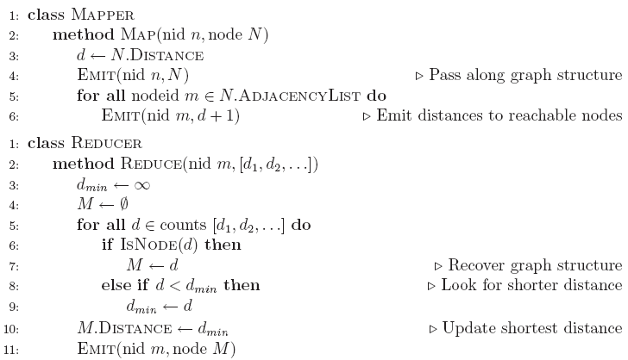
BFS Pseudo-Code

Slide 28
Stopping Criterion
How many iterations are needed in parallel BFS (equal edge weight case)?
Convince yourself: when a node is first “discovered”, we’ve found the shortest path
Now answer the question...
Six degrees of separation?
Practicalities of implementation in MapReduce

Slide 29
Comparison to Dijkstra
Dijkstra’s algorithm is more efficient
At any step it only pursues edges from the minimum-cost path inside the frontier
MapReduce explores all paths in parallel
Lots of “waste”
Useful work is only done at the “frontier”
Why can’t we do better using MapReduce?

Slide 30
Weighted Edges
Now add positive weights to the edges
Why can’t edge weights be negative?
Simple change: adjacency list now includes a weight w for each edge
In mapper, emit (m, d + w_{p}) instead of (m, d + 1) for each node m
That’s it?

Slide 31
Stopping Criterion
How many iterations are needed in parallel BFS (positive edge weight case)?
Convince yourself: when a node is first “discovered”, we’ve found the shortest path
Not true!

Slide 32
Additional Complexities
search frontier
1
n₆
1
n₇
1
n₈
r
10
1
n₅
n₉
n₁
s
1
1
p
q
n₄
1
n₂
1
n₃

Slide 33
Stopping Criterion
How many iterations are needed in parallel BFS (positive edge weight case)?
Practicalities of implementation in MapReduce

Slide 34
Graphs and MapReduce
Graph algorithms typically involve:
Performing computations at each node: based on node features, edge features, and local link structure
Propagating computations: “traversing” the graph
Generic recipe:
Represent graphs as adjacency lists
Perform local computations in mapper
Pass along partial results via outlinks, keyed by destination node
Perform aggregation in reducer on inlinks to a node
Iterate until convergence: controlled by external “driver”
Don’t forget to pass the graph structure between iterations

Slide 35
Random Walks Over the Web
Random surfer model:
User starts at a random Web page
User randomly clicks on links, surfing from page to page
PageRank
Characterizes the amount of time spent on any given page
Mathematically, a probability distribution over pages
PageRank captures notions of page importance
Correspondence to human intuition?
One of thousands of features used in web search
Note: query-independent

Slide 36
PageRank: Defined
Given page x with inlinks t₁…t_{n}, where
C(t) is the out-degree of t
α is probability of random jump
N is the total number of nodes in the graph
t₁
X
t₂
…
t_{n}

Slide 37
Computing PageRank
Properties of PageRank
Can be computed iteratively
Effects at each iteration are local
Sketch of algorithm:
Start with seed PR_{i} values
Each page distributes PR_{i} “credit” to all pages it links to
Each target page adds up “credit” from multiple in-bound links to compute PR_{i+1}
Iterate until values converge

Slide 38
Simplified PageRank
First, tackle the simple case:
No random jump factor
No dangling links
Dangling node: A node with no outgoing edges.
Then, factor in these complexities…
Why do we need the random jump?
Where do dangling links come from?

Slide 39
Sample PageRank Iteration (1)
Iteration 1
n₂ (0.2)
n₂ (0.166)
n₁ (0.2)
0.1
0.1
0.1
n₁ (0.066)
0.1
0.066
0.066
0.066
n₅ (0.2)
n₃ (0.2)
n₅ (0.3)
n₃ (0.166)
0.2
0.2
n₄ (0.2)
n₄ (0.3)

Slide 40
Sample PageRank Iteration (2)
Iteration 2
n₂ (0.166)
n₂ (0.133)
n₁ (0.066)
0.033
0.083
0.083
n₁ (0.1)
0.033
0.1
0.1
0.1
n₅ (0.3)
n₃ (0.166)
n₅ (0.383)
n₃ (0.183)
0.3
0.166
n₄ (0.3)
n₄ (0.2)

Slide 41
PageRank in MapReduce
n₁ [n₂, n₄]
n₂ [n₃, n₅]
n₃ [n₄]
n₄ [n₅]
n₅ [n₁, n₂, n₃]
Map
n₂
n₄
n₃
n₅
n₄
n₅
n₁
n₂
n₃
n₁
n₂
n₂
n₃
n₃
n₄
n₄
n₅
n₅
Reduce
n₁ [n₂, n₄]
n₂ [n₃, n₅]
n₃ [n₄]
n₄ [n₅]
n₅ [n₁, n₂, n₃]

Slide 42
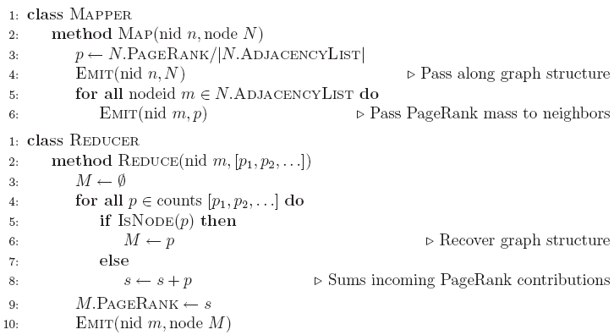
PageRank Pseudo-Code

Slide 43
Complete PageRank
Two additional complexities
What is the proper treatment of dangling nodes?
How do we factor in the random jump factor?
Solution:
Second pass to redistribute “missing PageRank mass” and account for random jumps
p is PageRank value from before, p' is updated PageRank value
|G| is the number of nodes in the graph
m is the missing PageRank mass

Slide 44
PageRank Convergence
Alternative convergence criteria
Iterate until PageRank values don’t change
Iterate until PageRank rankings don’t change
Fixed number of iterations
Convergence for web graphs?

Slide 45
Beyond PageRank
Link structure is important for web search
PageRank is one of many link-based features: HITS, SALSA, etc.
One of many thousands of features used in ranking…
Adversarial nature of web search
Link spamming
Spider traps
Keyword stuffing
…

Slide 46
Efficient Graph Algorithms
Sparse vs. dense graphs
Graph topologies

Slide 47
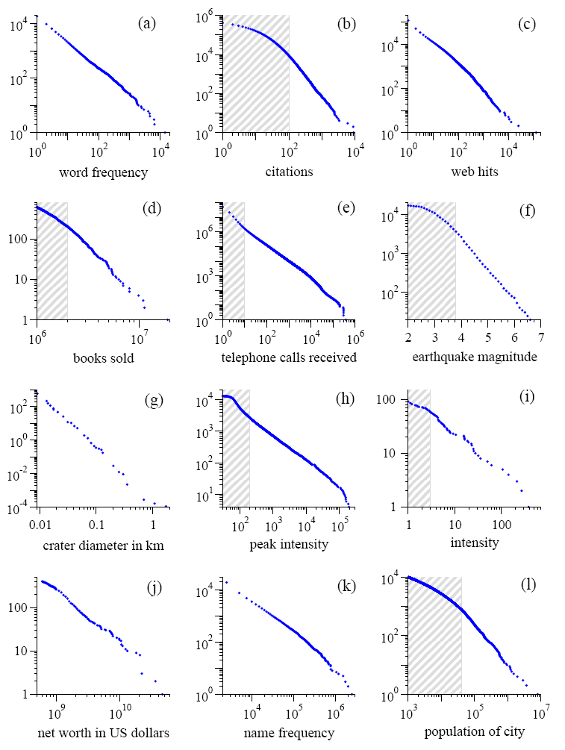
Power Laws are everywhere!
Figure from: Newman, M. E. J. (2005) “Power laws, Pareto distributions and Zipf's law.” Contemporary Physics 46:323–351.

Slide 48
Local Aggregation
Use combiners!
In-mapper combining design pattern also applicable
Maximize opportunities for local aggregation
Simple tricks: sorting the dataset in specific ways

Slide 49

Questions?
Source: Wikipedia (Japanese rock garden)

Slide 50
MapReduce and databases

Slide 51
Today’s Agenda
Role of relational databases in today’s organizations
Where does MapReduce fit in?
MapReduce algorithms for processing relational data
How do I perform a join, etc.?
Evolving roles of relational databases and MapReduce
What’s in store for the future?

Slide 52
Big Data Analysis
Peta-scale datasets are everywhere:
Facebook has 2.5 PB of user data + 15 TB/day (4/2009)
eBay has 6.5 PB of user data + 50 TB/day (5/2009)
…
A lot of these datasets are (mostly) structured
Query logs
Point-of-sale records
User data (e.g., demographics)
…
How do we perform data analysis at scale?
Relational databases and SQL
MapReduce (Hadoop)

Slide 53
Relational Databases vs. MapReduce
Relational databases:
Multipurpose: analysis and transactions; batch and interactive
Data integrity via ACID transactions
Lots of tools in software ecosystem (for ingesting, reporting, etc.)
Supports SQL (and SQL integration, e.g., JDBC)
Automatic SQL query optimization
MapReduce (Hadoop):
Designed for large clusters, fault tolerant
Data is accessed in “native format”
Supports many query languages
Programmers retain control over performance
Open source
Source: O’Reilly Blog post by Joseph Hellerstein (11/19/2008)

Slide 54
Database Workloads
OLTP (online transaction processing)
Typical applications: e-commerce, banking, airline reservations
User facing: real-time, low latency, highly-concurrent
Tasks: relatively small set of “standard” transactional queries
Data access pattern: random reads, updates, writes (involving relatively small amounts of data)
OLAP (online analytical processing)
Typical applications: business intelligence, data mining
Back-end processing: batch workloads, less concurrency
Tasks: complex analytical queries, often ad hoc
Data access pattern: table scans, large amounts of data involved per query

Slide 55
One Database or Two?
Downsides of co-existing OLTP and OLAP workloads
Poor memory management
Conflicting data access patterns
Variable latency
Solution: separate databases
User-facing OLTP database for high-volume transactions
Data warehouse for OLAP workloads
How do we connect the two?

Slide 56
OLTP/OLAP Architecture
OLTP
OLAP
ETL (Extract, Transform, and Load)

Slide 57
OLTP/OLAP Integration
OLTP database for user-facing transactions
Retain records of all activity
Periodic ETL (e.g., nightly)
Extract-Transform-Load (ETL)
Extract records from source
Transform: clean data, check integrity, aggregate, etc.
Load into OLAP database
OLAP database for data warehousing
Business intelligence: reporting, ad hoc queries, data mining, etc.
Feedback to improve OLTP services

Slide 58
Business Intelligence
Premise: more data leads to better business decisions
Periodic reporting as well as ad hoc queries
Analysts, not programmers (importance of tools and dashboards)
Examples:
Slicing-and-dicing activity by different dimensions to better understand the marketplace
Analyzing log data to improve OLTP experience
Analyzing log data to better optimize ad placement
Analyzing purchasing trends for better supply-chain management
Mining for correlations between otherwise unrelated activities

Slide 59
OLTP/OLAP Architecture: Hadoop?
OLTP
OLAP
What about here?
ETL (Extract, Transform, and Load)
Hadoop here?

Slide 60
OLTP/OLAP/Hadoop Architecture
OLTP
Hadoop
OLAP
ETL (Extract, Transform, and Load)
Why does this make sense?

Slide 61
ETL Bottleneck
Reporting is often a nightly task:
ETL is often slow: why?
What happens if processing 24 hours of data takes longer than 24 hours?
Hadoop is perfect:
Most likely, you already have some data warehousing solution
Ingest is limited by speed of HDFS
Scales out with more nodes
Massively parallel
Ability to use any processing tool
Much cheaper than parallel databases
ETL is a batch process anyway!

Slide 62
MapReduce algorithms for processing relational data

Slide 63
Design Pattern: Secondary Sorting
MapReduce sorts input to reducers by key
Values are arbitrarily ordered
What if want to sort value also?
E.g., k → (v₁, r), (v₃, r), (v₄, r), (v₈, r)…

Slide 64
Secondary Sorting: Solutions
Solution 1:
Buffer values in memory, then sort
Why is this a bad idea?
Solution 2:
“Value-to-key conversion” design pattern: form composite intermediate key, (k, v₁)
Let execution framework do the sorting
Preserve state across multiple key-value pairs to handle processing
Anything else we need to do?

Slide 65
Value-to-Key Conversion
Before
k → (v₁, r), (v₄, r), (v₈, r), (v₃, r)…
Values arrive in arbitrary order…
After
(k, v₁) → (v₁, r)
Values arrive in sorted order…
(k, v₃) → (v₃, r)
Process by preserving state across multiple keys
(k, v₄) → (v₄, r)
Remember to partition correctly!
(k, v₈) → (v₈, r)
…

Slide 66
Working Scenario
Two tables:
User demographics (gender, age, income, etc.)
User page visits (URL, time spent, etc.)
Analyses we might want to perform:
Statistics on demographic characteristics
Statistics on page visits
Statistics on page visits by URL
Statistics on page visits by demographic characteristic
…

Slide 67
Relational Algebra
Primitives
Projection (π)
Selection (σ)
Cartesian product (×)
Set union (∪)
Set difference (−)
Rename (ρ)
Other operations
Join (⋈)
Group by… aggregation
…

Slide 68
Projection
R₁
R₁
R₂
R₂
R₃
R₃
R₄
R₄
R₅
R₅

Slide 69
Projection in MapReduce
Easy!
Map over tuples, emit new tuples with appropriate attributes
No reducers, unless for regrouping or resorting tuples
Alternatively: perform in reducer, after some other processing
Basically limited by HDFS streaming speeds
Speed of encoding/decoding tuples becomes important
Relational databases take advantage of compression
Semistructured data? No problem!

Slide 70
Selection
R₁
R₂
R₁
R₃
R₃
R₄
R₅

Slide 71
Selection in MapReduce
Easy!
Map over tuples, emit only tuples that meet criteria
No reducers, unless for regrouping or resorting tuples
Alternatively: perform in reducer, after some other processing
Basically limited by HDFS streaming speeds
Speed of encoding/decoding tuples becomes important
Relational databases take advantage of compression
Semistructured data? No problem!

Slide 72
Group by… Aggregation
Example: What is the average time spent per URL?
In SQL:
SELECT url, AVG(time) FROM visits GROUP BY url
In MapReduce:
Map over tuples, emit time, keyed by url
Framework automatically groups values by keys
Compute average in reducer
Optimize with combiners

Slide 73
Relational Joins
R₁
S₁
R₂
S₂
R₃
S₃
R₄
S₄
R₁
S₂
R₂
S₄
R₃
S₁
R₄
S₃

Slide 74
Types of Relationships
Many-to-Many
One-to-Many
One-to-One

Slide 75
Join Algorithms in MapReduce
Reduce-side join
Map-side join
In-memory join
Striped variant
Memcached variant

Slide 76
Reduce-side Join
Basic idea: group by join key
Map over both sets of tuples
Emit tuple as value with join key as the intermediate key
Execution framework brings together tuples sharing the same key
Perform actual join in reducer
Similar to a “sort-merge join” in database terminology
Two variants
1-to-1 joins
1-to-many and many-to-many joins

Slide 77
Reduce-side Join: 1-to-1
Map
keys
values
R₁
R₁
R₄
R₄
S₂
S₂
S₃
S₃
Reduce
keys
values
R₁
S₂
S₃
R₄
Note: no guarantee if R is going to come first or S

Slide 78
Reduce-side Join: 1-to-many
Map
keys
values
R₁
R₁
S₂
S₂
S₃
S₃
S₉
S₉
Reduce
keys
values
R₁
S₂
S₃
…
What’s the problem?
Notes:
We have no idea when the value corresponding to the tuple from S will be encountered, since values are arbitrarily ordered. The easiest solution is to buer all values in memory, pick out the tuple from S, and then cross it with every tuple from T to perform the join.
memory

Slide 79
Reduce-side Join: V-to-K Conversion
In reducer…
keys
values
R₁
New key encountered: hold in memory
S₂
Cross with records from other set
S₃
S₉
R₄
New key encountered: hold in memory
S₃
Cross with records from other set
S₇

Slide 80
Reduce-side Join: many-to-many
In reducer…
keys
values
R₁
R₅
Hold in memory
R₈
S₂
Cross with records from other set
S₃
S₉
What’s the problem?
Notes:
As the reducer processes each tuple from T, it is crossed with all the tuples from S. Of course, we are assuming that the tuples from S (with the same join key) will t into memory, which is a limitation of this algorithm (and why we want to control the sort order so that the smaller dataset comes rst).

Slide 81
Map-side Join: Basic Idea
Assume two datasets are sorted by the join key:
R₁
S₂
R₂
S₄
R₄
S₃
R₃
S₁
A sequential scan through both datasets to join (called a “merge join” in database terminology)

Slide 82
Map-side Join: Parallel Scans
If datasets are sorted by join key, join can be accomplished by a scan over both datasets
How can we accomplish this in parallel?
Partition and sort both datasets in the same manner
In MapReduce:
Map over one dataset, read from other corresponding partition
No reducers necessary (unless to repartition or resort)
Consistently partitioned datasets: realistic to expect?

Slide 83
In-Memory Join
Basic idea: load one dataset into memory, stream over other dataset
Works if R << S and R fits into memory
Called a “hash join” in database terminology
MapReduce implementation
Distribute R to all nodes
Map over S, each mapper loads R in memory, hashed by join key
For every tuple in S, look up join key in R
No reducers, unless for regrouping or resorting tuples

Slide 84
In-Memory Join: Variants
Striped variant:
R too big to fit into memory?
Divide R into R₁, R₂, R₃, … s.t. each R_{n} fits into memory
Perform in-memory join: ∀n, R_{n} ⋈ S
Take the union of all join results
Memcached join:
Load R into memcached
Replace in-memory hash lookup with memcached lookup

Slide 85
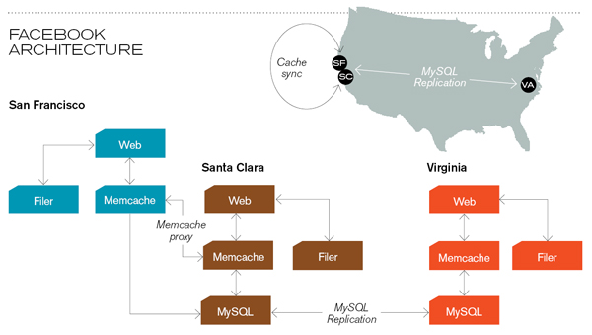
Memcached
Caching servers: 15 million requests per second, 95% handled by memcache (15 TB of RAM)
Database layer: 800 eight-core Linux servers running MySQL (40 TB user data)
Source: Technology Review (July/August, 2008)

Slide 86
Memcached Join
Memcached join:
Load R into memcached
Replace in-memory hash lookup with memcached lookup
Capacity and scalability?
Memcached capacity >> RAM of individual node
Memcached scales out with cluster
Latency?
Memcached is fast (basically, speed of network)
Batch requests to amortize latency costs
Source: See tech report by Lin et al. (2009)

Slide 87
Which join to use?
In-memory join > map-side join > reduce-side join
Why?
Limitations of each?
In-memory join: memory
Map-side join: sort order and partitioning
Reduce-side join: general purpose

Slide 88
Processing Relational Data: Summary
MapReduce algorithms for processing relational data:
Group by, sorting, partitioning are handled automatically by shuffle/sort in MapReduce
Selection, projection, and other computations (e.g., aggregation), are performed either in mapper or reducer
Multiple strategies for relational joins
Complex operations require multiple MapReduce jobs
Example: top ten URLs in terms of average time spent
Opportunities for automatic optimization

Slide 89
Evolving roles for relational database and MapReduce

Slide 90
OLTP/OLAP/Hadoop Architecture
OLTP
Hadoop
OLAP
ETL (Extract, Transform, and Load)
Why does this make sense?

Slide 91
Need for High-Level Languages
Hadoop is great for large-data processing!
But writing Java programs for everything is verbose and slow
Analysts don’t want to (or can’t) write Java
Solution: develop higher-level data processing languages
Hive: HQL is like SQL
Pig: Pig Latin is a bit like Perl

Slide 92


Hive and Pig
Hive: data warehousing application in Hadoop
Query language is HQL, variant of SQL
Tables stored on HDFS as flat files
Developed by Facebook, now open source
Pig: large-scale data processing system
Scripts are written in Pig Latin, a dataflow language
Developed by Yahoo!, now open source
Roughly 1/3 of all Yahoo! internal jobs
Common idea:
Provide higher-level language to facilitate large-data processing
Higher-level language “compiles down” to Hadoop jobs

Slide 93
Hive: Example
Hive looks similar to an SQL database
Relational join on two tables:
Table of word counts from Shakespeare collection
Table of word counts from the bible
SELECT s.word, s.freq, k.freq FROM shakespeare s
JOIN bible k ON (s.word = k.word) WHERE s.freq >= 1 AND k.freq >= 1 ORDER BY s.freq DESC LIMIT 10;
the 25848 62394
I 23031 8854
and 19671 38985
to 18038 13526
of 16700 34654
a 14170 8057
you 12702 2720
my 11297 4135
in 10797 12445
is 8882 6884
Source: Material drawn from Cloudera training VM

Slide 94
Hive: Behind the Scenes
SELECT s.word, s.freq, k.freq FROM shakespeare s
JOIN bible k ON (s.word = k.word) WHERE s.freq >= 1 AND k.freq >= 1 ORDER BY s.freq DESC LIMIT 10;
(Abstract Syntax Tree)
(TOK_QUERY (TOK_FROM (TOK_JOIN (TOK_TABREF shakespeare s) (TOK_TABREF bible k) (= (. (TOK_TABLE_OR_COL s) word) (. (TOK_TABLE_OR_COL k) word)))) (TOK_INSERT (TOK_DESTINATION (TOK_DIR TOK_TMP_FILE)) (TOK_SELECT (TOK_SELEXPR (. (TOK_TABLE_OR_COL s) word)) (TOK_SELEXPR (. (TOK_TABLE_OR_COL s) freq)) (TOK_SELEXPR (. (TOK_TABLE_OR_COL k) freq))) (TOK_WHERE (AND (>= (. (TOK_TABLE_OR_COL s) freq) 1) (>= (. (TOK_TABLE_OR_COL k) freq) 1))) (TOK_ORDERBY (TOK_TABSORTCOLNAMEDESC (. (TOK_TABLE_OR_COL s) freq))) (TOK_LIMIT 10)))
(one or more of MapReduce jobs)

Slide 95
Hive: Behind the Scenes
STAGE DEPENDENCIES:
Stage-1 is a root stage
Stage-2 depends on stages: Stage-1
Stage-0 is a root stage
STAGE PLANS:
Stage: Stage-1
Map Reduce
Alias -> Map Operator Tree:
s
TableScan
alias: s
Filter Operator
predicate:
expr: (freq >= 1)
type: boolean
Reduce Output Operator
key expressions:
expr: word
type: string
sort order: +
Map-reduce partition columns:
expr: word
type: string
tag: 0
value expressions:
expr: freq
type: int
expr: word
type: string
k
TableScan
alias: k
Filter Operator
predicate:
expr: (freq >= 1)
type: boolean
Reduce Output Operator
key expressions:
expr: word
type: string
sort order: +
Map-reduce partition columns:
expr: word
type: string
tag: 1
value expressions:
expr: freq
type: int
Stage: Stage-2
Map Reduce
Alias -> Map Operator Tree:
hdfs://localhost:8022/tmp/hive-training/364214370/10002
Reduce Output Operator
key expressions:
expr: _col1
type: int
sort order: -
tag: -1
value expressions:
expr: _col0
type: string
expr: _col1
type: int
expr: _col2
type: int
Reduce Operator Tree:
Extract
Limit
File Output Operator
compressed: false
GlobalTableId: 0
table:
input format: org.apache.hadoop.mapred.TextInputFormat
output format: org.apache.hadoop.hive.ql.io.HiveIgnoreKeyTextOutputFormat
Stage: Stage-0
Fetch Operator
limit: 10
Reduce Operator Tree:
Join Operator
condition map:
Inner Join 0 to 1
condition expressions:
0 {VALUE._col0} {VALUE._col1}
1 {VALUE._col0}
outputColumnNames: _col0, _col1, _col2
Filter Operator
predicate:
expr: ((_col0 >= 1) and (_col2 >= 1))
type: boolean
Select Operator
expressions:
expr: _col1
type: string
expr: _col0
type: int
expr: _col2
type: int
outputColumnNames: _col0, _col1, _col2
File Output Operator
compressed: false
GlobalTableId: 0
table:
input format: org.apache.hadoop.mapred.SequenceFileInputFormat
output format: org.apache.hadoop.hive.ql.io.HiveSequenceFileOutputFormat

Slide 96
Pig: Example
Task: Find the top 10 most visited pages in each category
Visits
Url Info
User | Url | Time
Amy | cnn.com | 8:00
Amy | bbc.com | 10:00
Amy | flickr.com | 10:05
Fred | cnn.com | 12:00
Url | Category | PageRank
cnn.com | News | 0.9
bbc.com | News | 0.8
flickr.com | Photos | 0.7
espn.com | Sports | 0.9
Pig Slides adapted from Olston et al. (SIGMOD 2008)

Slide 97
Pig Query Plan
Load Visits
Group by url
Foreach url
generate count
Load Url Info
Join on url
Group by category
Foreach category
generate top10(urls)
Pig Slides adapted from Olston et al. (SIGMOD 2008)

Slide 98
Pig Script
visits = load ‘/data/visits’ as (user, url, time);
gVisits = group visits by url;
visitCounts = foreach gVisits generate url, count(visits);
urlInfo = load ‘/data/urlInfo’ as (url, category, pRank);
visitCounts = join visitCounts by url, urlInfo by url;
gCategories = group visitCounts by category;
topUrls = foreach gCategories generate top(visitCounts,10);
store topUrls into ‘/data/topUrls’;
Pig Slides adapted from Olston et al. (SIGMOD 2008)

Slide 99
Pig Script in Hadoop
Map₁
Load Visits
Group by url
Reduce₁
Map₂
Foreach url
generate count
Load Url Info
Join on url
Reduce₂
Map₃
Group by category
Reduce₃
Foreach category
generate top10(urls)
Pig Slides adapted from Olston et al. (SIGMOD 2008)

Slide 100
Parallel Databases ↔ MapReduce
Lots of synergy between parallel databases and MapReduce
Communities have much to learn from each other
Bottom line: use the right tool for the job!

Slide 101
Questions?
Source: Wikipedia (Japanese rock garden)

