Slide 1
Analysis and modelling of the depression dataset.
Lawrence R

Slide 2
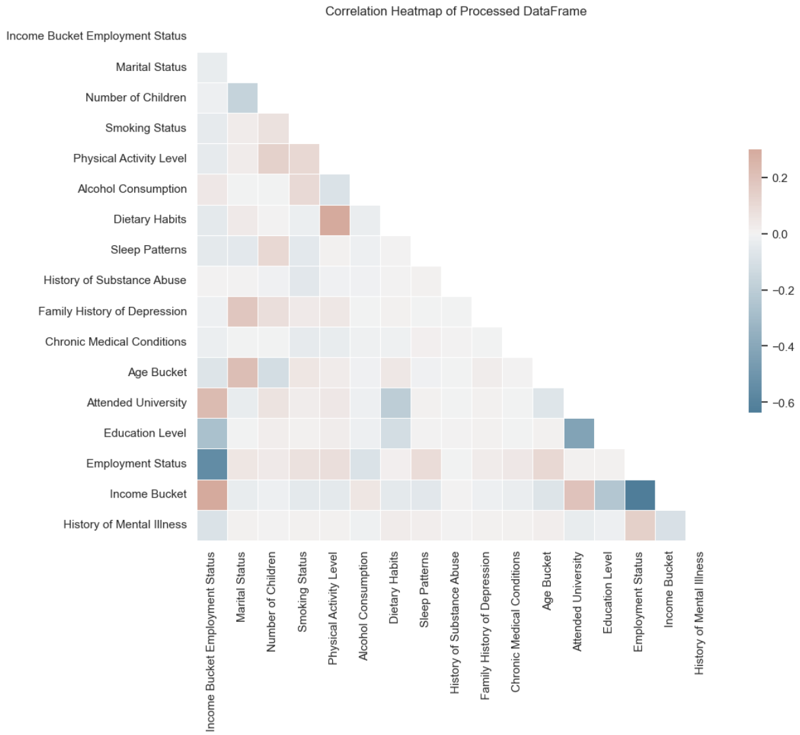
Problem, Key Findings and Next Steps
Goal: Predict individuals at risk of depression using lifestyle and socioeconomic factors.
Focused on recall to catch as many at-risk individuals as possible, even if accuracy was lower.
Dealt with imbalanced target ‘History of Mental Illness’ using model sample weights.
Model Performance (CatBoost, Weighted for Recall):
Accuracy: 47.76% - Recall: 80.92% - ROC-AUC: 57.1% - Precision: 34.64% - F1 Score: 48.51%
Main Insights from the Data:
Income, employment status, and education were the strongest predictors.
Employment and income were correlated, but kept separate for better performance.

Slide 3
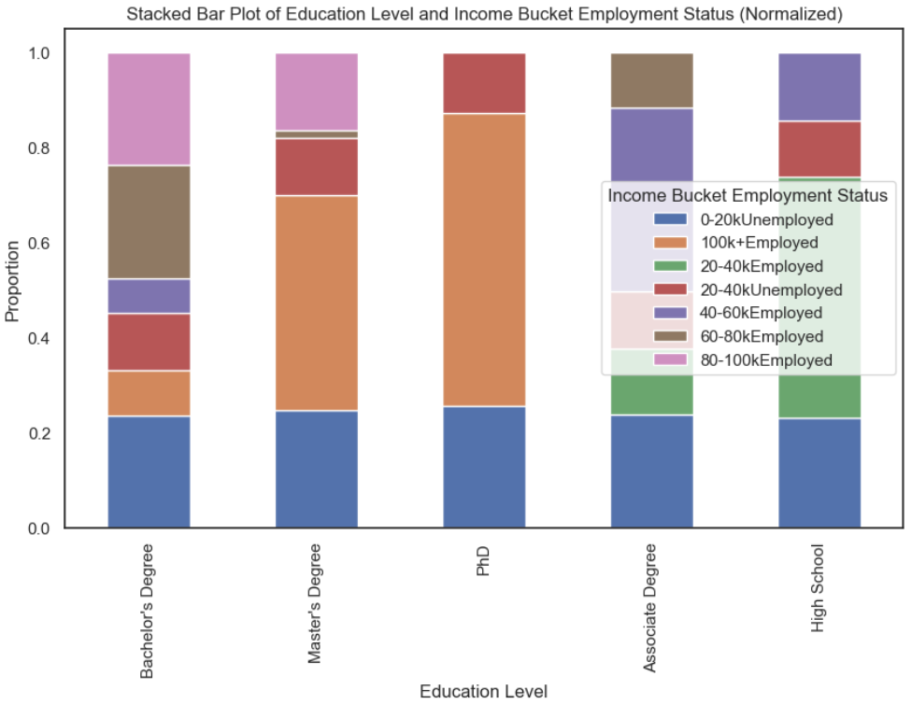
Problem, Key Findings and Next Steps
SHAP Analysis - Feature Importance
Most Important Features:
Income and Employment Status (highest impact)
Education Level and Smoking Status
Key SHAP Insights:
Lower income and unemployment increase the risk of depression.
Higher smoking frequency correlates with higher depression risk.
Further Work & Next Steps
Improve Model Performance
Test feature interactions (e.g., combine employment and income).
Try ensemble models (stacking CatBoost, LightGBM, AdaBoost).
Further tune hyperparameters.
Enhance Interpretability
Use SHAP visualisations to explain predictions.
Create an interactive dashboard for stakeholders.
Address Data Biases & Limitations
Investigate class imbalance (resampling, synthetic data).
Check for demographic biases in predictions.
Real-World Deployment Considerations
Monitor model drift over time.
Test in real-world settings to evaluate impact.

Slide 4
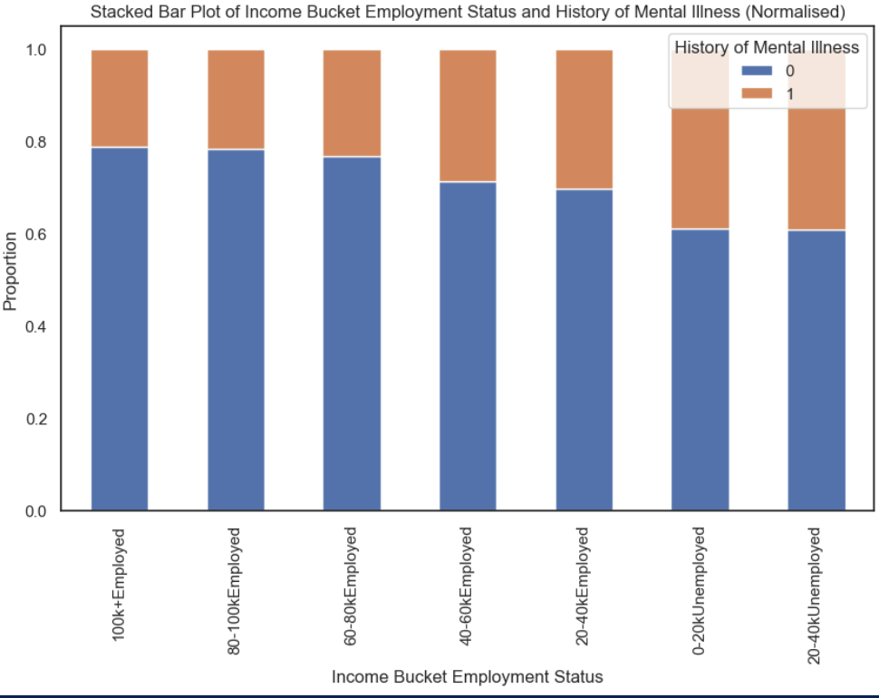
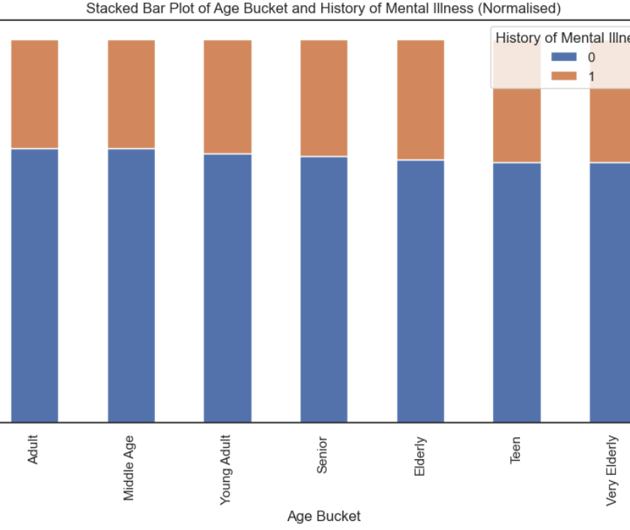
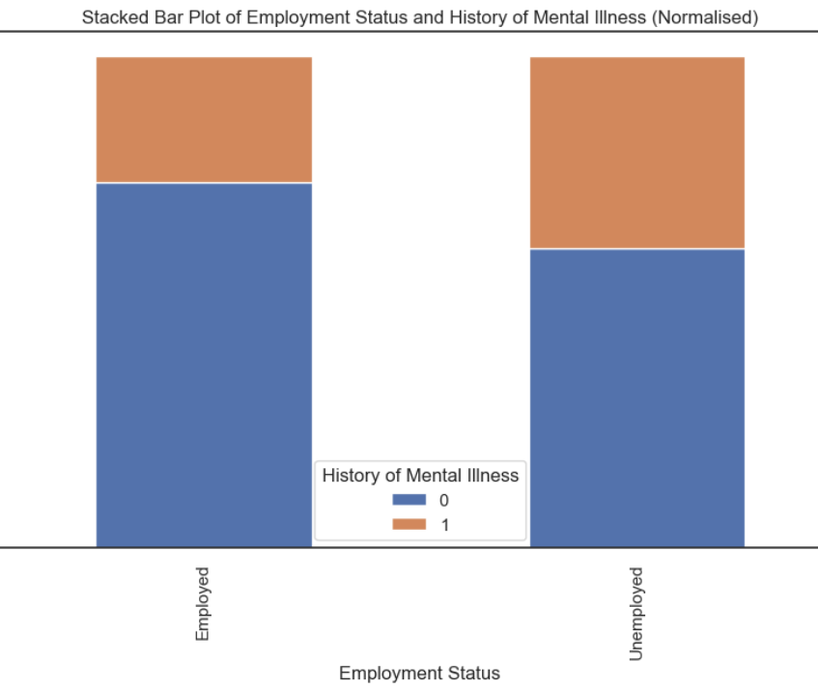
Key Findings from Data Analysis
Employment status, income, and education were strong predictors.
Employment & income were correlated (higher income = more stable employment).
Sedentary lifestyle & unhealthy diet were also correlated but left as separate factors.

Slide 5
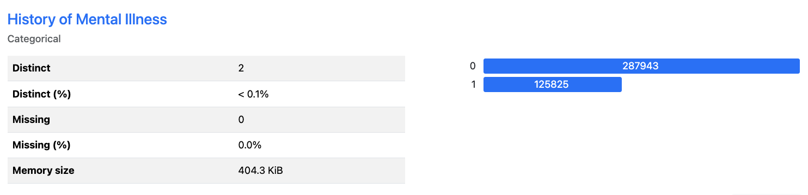
History of Mental Illness (Target Variable)
Binary classification: Predicting whether an individual has a history of mental illness (Yes/No).
Imbalanced dataset: More 0s (no history) than 1s (history of mental illness), making it harder to detect positive cases.
Balancing Techniques: Could use undersampling (removing majority class samples) or oversampling (duplicating minority class samples), but...
Our Approach: Used sample weight scaling instead, ensuring the model focused more on positive cases without artificially modifying the data.
Key Features: Strong correlations with income, employment status, education level, and smoking habits.
Model Focus: Maximised recall to reduce false negatives and capture as many at-risk individuals as possible.

Slide 6
Model & Approach
Why CatBoost?
Works well with categorical data (most of the dataset).
Fast on GPU, allowing efficient Optuna hyperparameter tuning.
Handles imbalanced data well using the scale_pos_weight parameter.
Hyperparameter Tuning with Optuna
Tuned iterations, depth, learning rate, and more to optimise recall.
Sample weight tuning helped push predictions towards identifying at-risk individuals.
Performance Metrics & Focus on Recall
Recall was prioritised to avoid missing individuals at risk of depression.
Trade-offs between AUC-ROC, F1-score, Precision, and Recall, but recall was key.

Slide 7
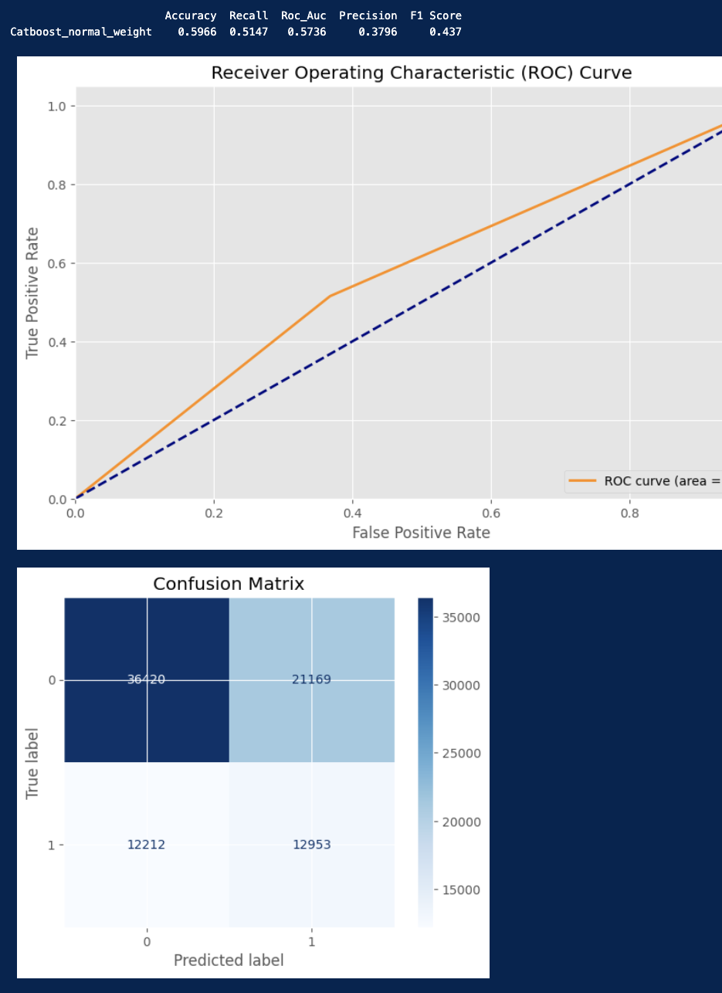
Modelling Results- normal weights
The first model produced fair results but precision and accuracy of the model could be better.
We would like to over predict depression cases so we don’t miss cases of depression.
We can increase the sample weights to do this.

Slide 8
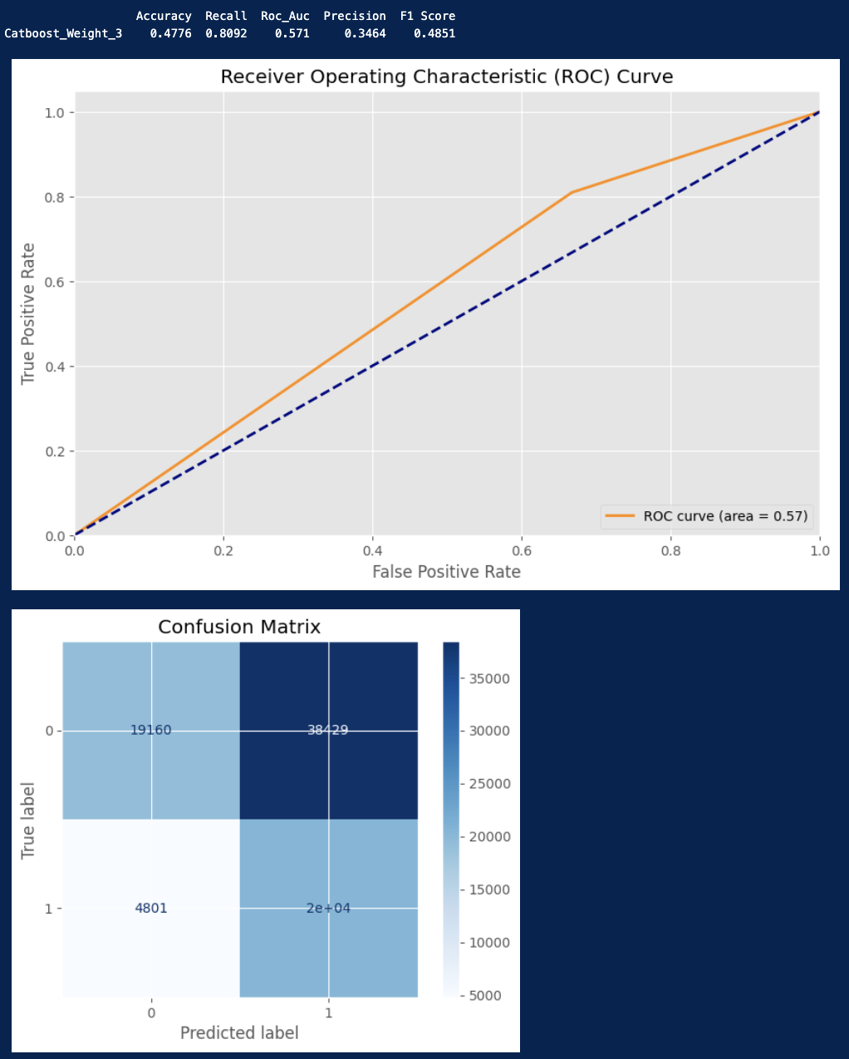
Modelling Results – extra weights
By adding extra weights we reduce the cases of depression missed but increase the false detections of depression sacrificing our Accuracy.

Slide 9
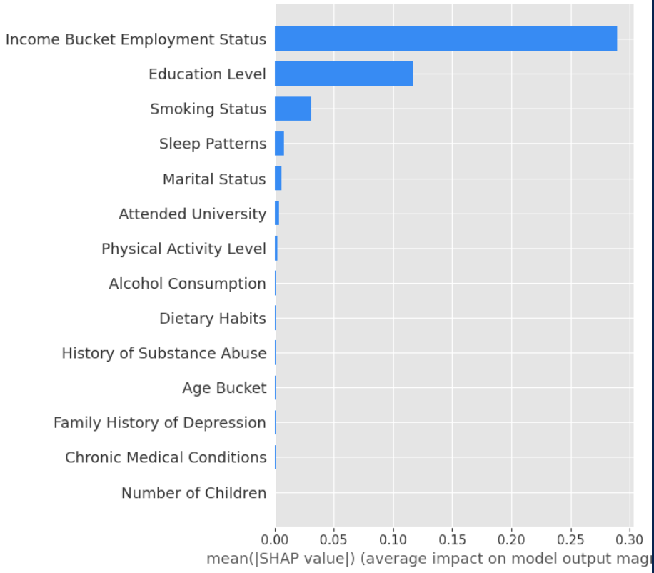
Modelling Results – Contributing Features
Using SHAP analysis on the model we can see that the combined income and employment status bucket has the greatest impact.
Education Level and Smoking Status have the next most impact.
Less income and being unemployed has a correlation with the increase in likelihood of depression.
Smoking increase correlates with increase in likelihood of Depression

Slide 10
Business Impact & Next Steps
Why This Matters?
Helps identify at-risk individuals early, allowing for interventions & support.
Prioritising recall means we minimize missed cases, even if some predictions are incorrect.
Next Steps
Improve explainability (so non-experts can understand why the model flags individuals).
Explore combining more correlated features (e.g., education level & income).
Consider real-world deployment and ongoing monitoring to reduce bias.
Obtain more data to help improve the model accuracy.

