Slide 1
Analysis and modelling of the depression dataset.
Lawrence R

Slide 3
Problem & Key Insights
What’s the goal?
Predict individuals at risk of depression based on lifestyle and socioeconomic factors.
Focus on recall (catching as many at-risk individuals as possible), even at the cost of some accuracy.
Use feature engineering and hyper parameter tuning to try and improve the model results.
Result were

Slide 4
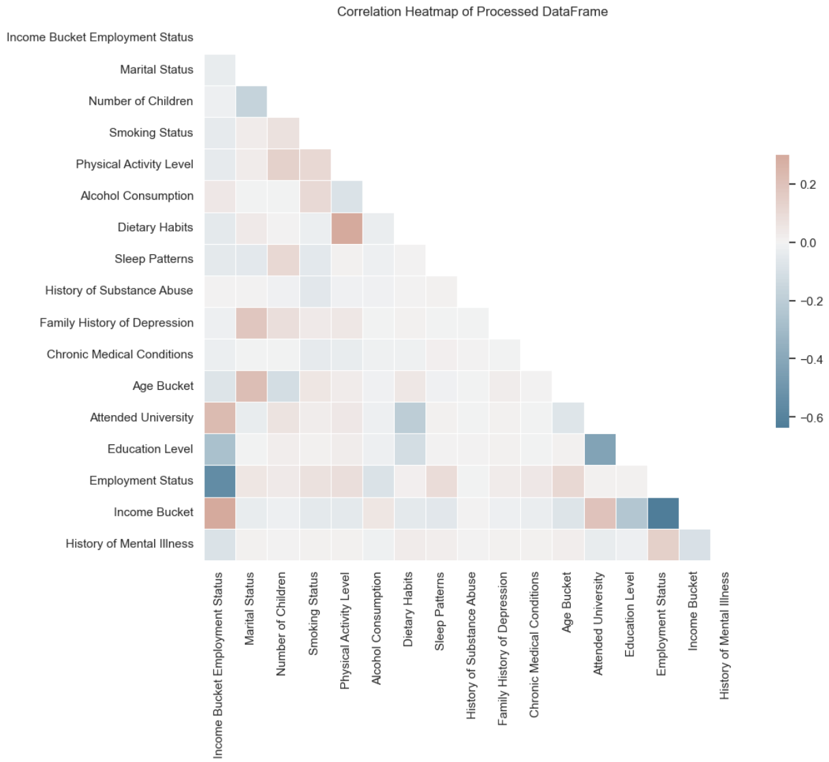
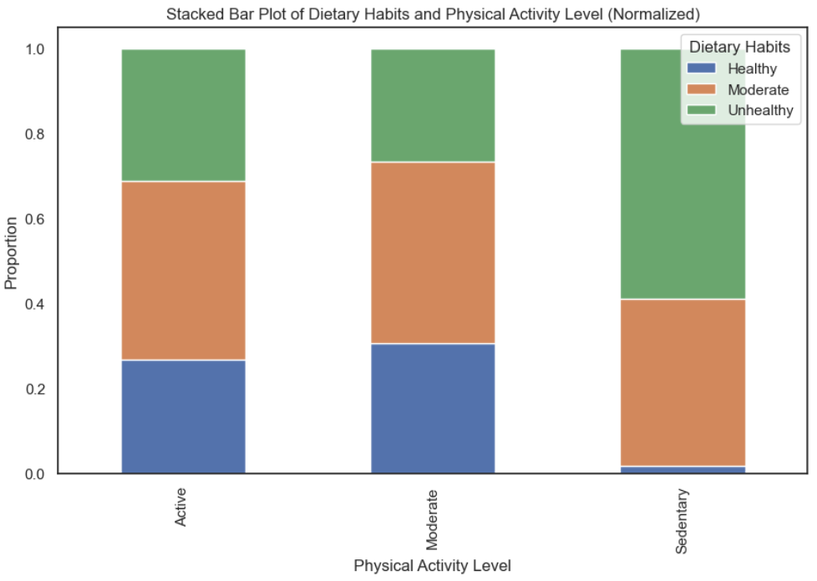
Key Findings from Data Analysis
Employment status, income, and education were strong predictors.
Employment & income were correlated (higher income = more stable employment).
Sedentary lifestyle & unhealthy diet were also correlated but left as separate factors.

Slide 5
Model & Approach
Why CatBoost?
Works well with categorical data (most of the dataset).
Fast on GPU (ran efficiently with Optuna hyperparameter tuning).
Handles imbalanced data well using scale_pos_weight.
Hyperparameter Tuning with Optuna
Adjusted iterations, depth, learning rate, and other parameters to optimise recall.
Sample weight tuning helped push predictions towards identifying at-risk individuals.
Performance Metrics
AUC-ROC, F1-score, Precision, Recall – showed a trade-off, but recall was prioritised.

Slide 6
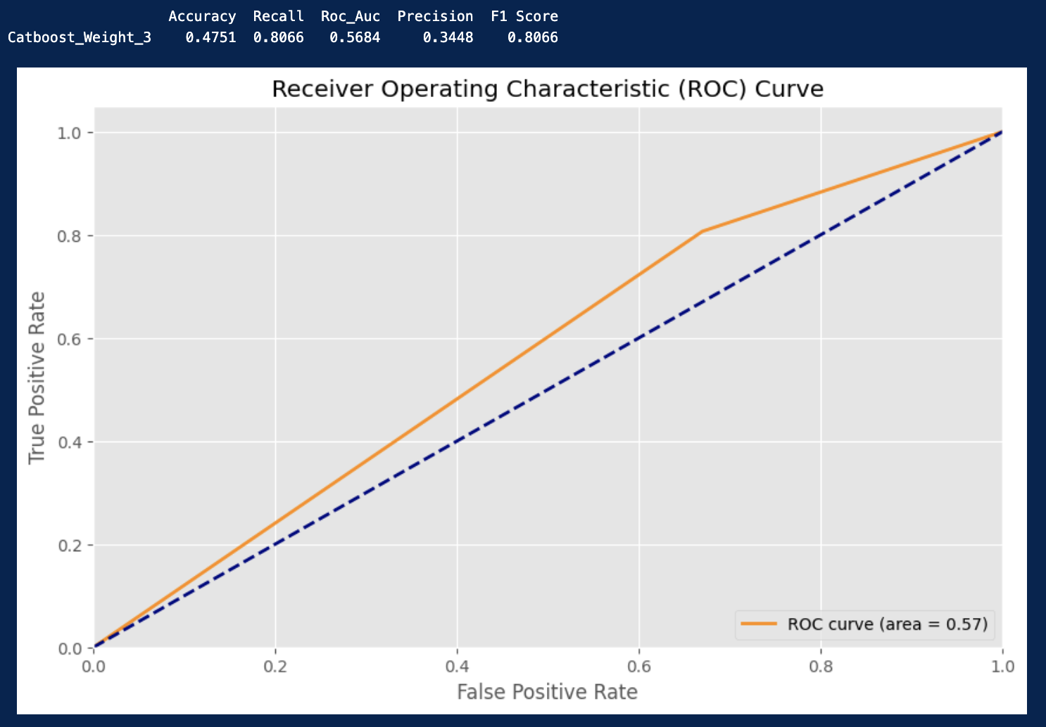
Modelling Results
The final model

Slide 7
Business Impact & Next Steps
Why This Matters?
Helps identify at-risk individuals early, allowing for interventions & support.
Prioritizing recall means we minimize missed cases, even if some predictions are incorrect.
Next Steps
Improve explainability (so non-experts can understand why the model flags individuals).
Explore combining correlated features (e.g., employment & income).
Consider real-world deployment and ongoing monitoring to reduce bias.

