Slide 1
Need to add
Lag the data 14 days
Combine season with some weather columns
Plot the year sign and hour sign against data maybe
Don’t need to onehot stuff like working day
Redo running model edit features

Slide 2
Bike Sharing Analysis and Modelling
Lawrence Rosen

Slide 3
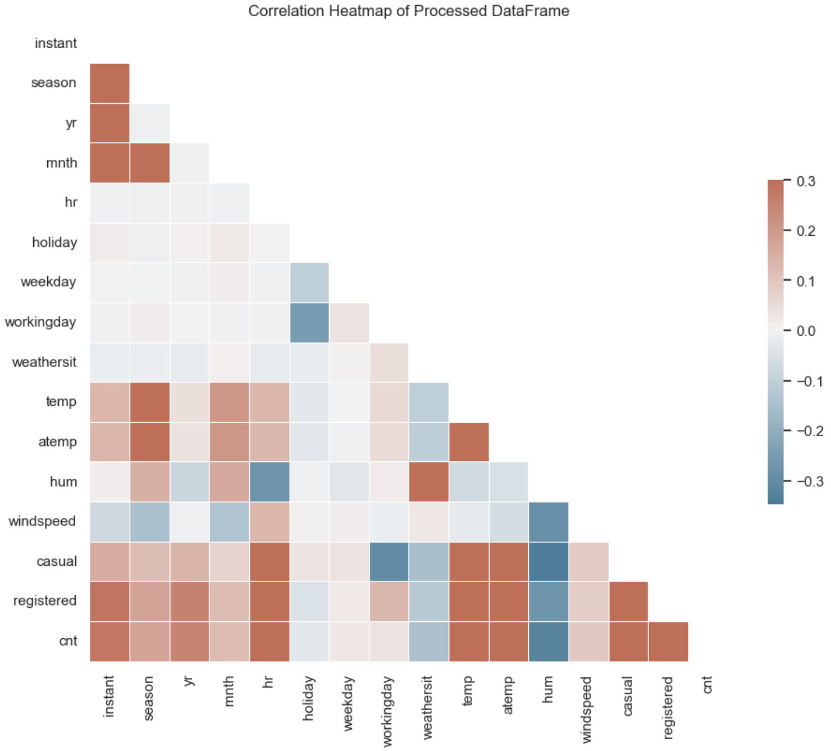
Executive Summary
Objective:
Find relationships between time, weather and other data on the demand of bike rentals.
Create predictions for a 2 week period based on these features including engineered features.
Key Findings:
Hour of day has the greatest effect on the rentals.
Ratio of registered to casual is less on weekends and also less in non-working hours.
Baseline model with no feature engineering achieved:
Predictive modelling (LightGBM) for rentals achieved an RMSE of 0.58 after feature engineering, recursive elimination of features and model hyperparameter tuning.
Holiday data seemed to not have an affect.
Recommendations:
More analysis into registered and casual usres. Promostions and other data could offer more insight into any anomalies and improve accuracy.
Inclusion of new featres such as price of rental, payday, alternative transportation cost, fuel costs, vehicle taxes, conjestion charges i.e. ulez enforcement in london etc.
Investigation of the quality of some features. Holidays didn’t seem to have an affect maybe this data is wrong.

Slide 4
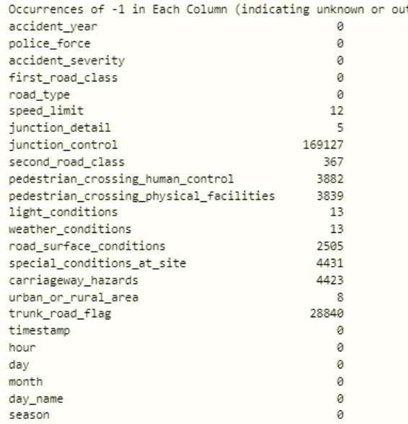
Data Overview
**instant**: record index
**dteday**: date
**season**: season (1: spring, 2: summer, 3: fall, 4: winter)
-**yr**: year (0: 2011, 1: 2012)
- **mnth**: month (1 to 12)
- **hr**: hour (0 to 23)
- **holiday**: whether the day is a holiday or not
- **day_of_week**: day of the week
- **workingday**: if the day is neither weekend nor holiday is 1, otherwise is 0
- **weathersit**:
- 1: Clear, Few clouds, Partly cloudy, Partly cloudy
- 2: Mist + Cloudy, Mist + Broken clouds, Mist + Few clouds, Mist
- 3: Light Snow, Light Rain + Thunderstorm + Scattered clouds, Light Rain + Scattered clouds
- 4: Heavy Rain + Ice Pallets + Thunderstorm + Mist, Snow + Fog
- **temp**: Normalized temperature in Celsius. The values are divided by 41 (max)
- **atemp**: Normalized feeling temperature in Celsius. The values are divided by 50 (max)
- **hum**: Normalized humidity. The values are divided by 100 (max)
- **windspeed**: Normalized wind speed. The values are divided by 67 (max)
- **casual**: count of casual users
- **registered**: count of registered users
- **cnt**: count of total rental bikes including both casual and registered

Slide 5
Data Overview
Dataset Details:
Rows: 35, Columns: ~100000 for 2023 data and 400000 for 4 years.
Key Features: Severity, speed limit, location, weather, time of day, etc.
-1 indicates unknown.
Preprocessing Steps
Data cleaning (handling missing values, removing duplicates).
Removed unnecessary columns and columns that may give information about the target which would not be present for predictions.
Feature engineering:
Creating a timestamp from the date and columns, other time columns such as hour, day, week, month and season)
Choosing a target, in this case severity and police response
Brought in extra data from previous years to help with yearly trends and more data.

Slide 6
Slide 4: Exploratory Data Analysis
Key Visualizations:
Correlation heat map to see how features interact and decide if they should be explored.
Daily, weekly, hourly accident trends.
Urban vs rural severity proportion.
Rush hour vs. non-rush hour comparison.
Severity by speed limit and light conditions and weather conditions.
Insights:
Rush hours see a higher accident frequency.
Severe accidents are more likely on rural roads and during nighttime.

Slide 7
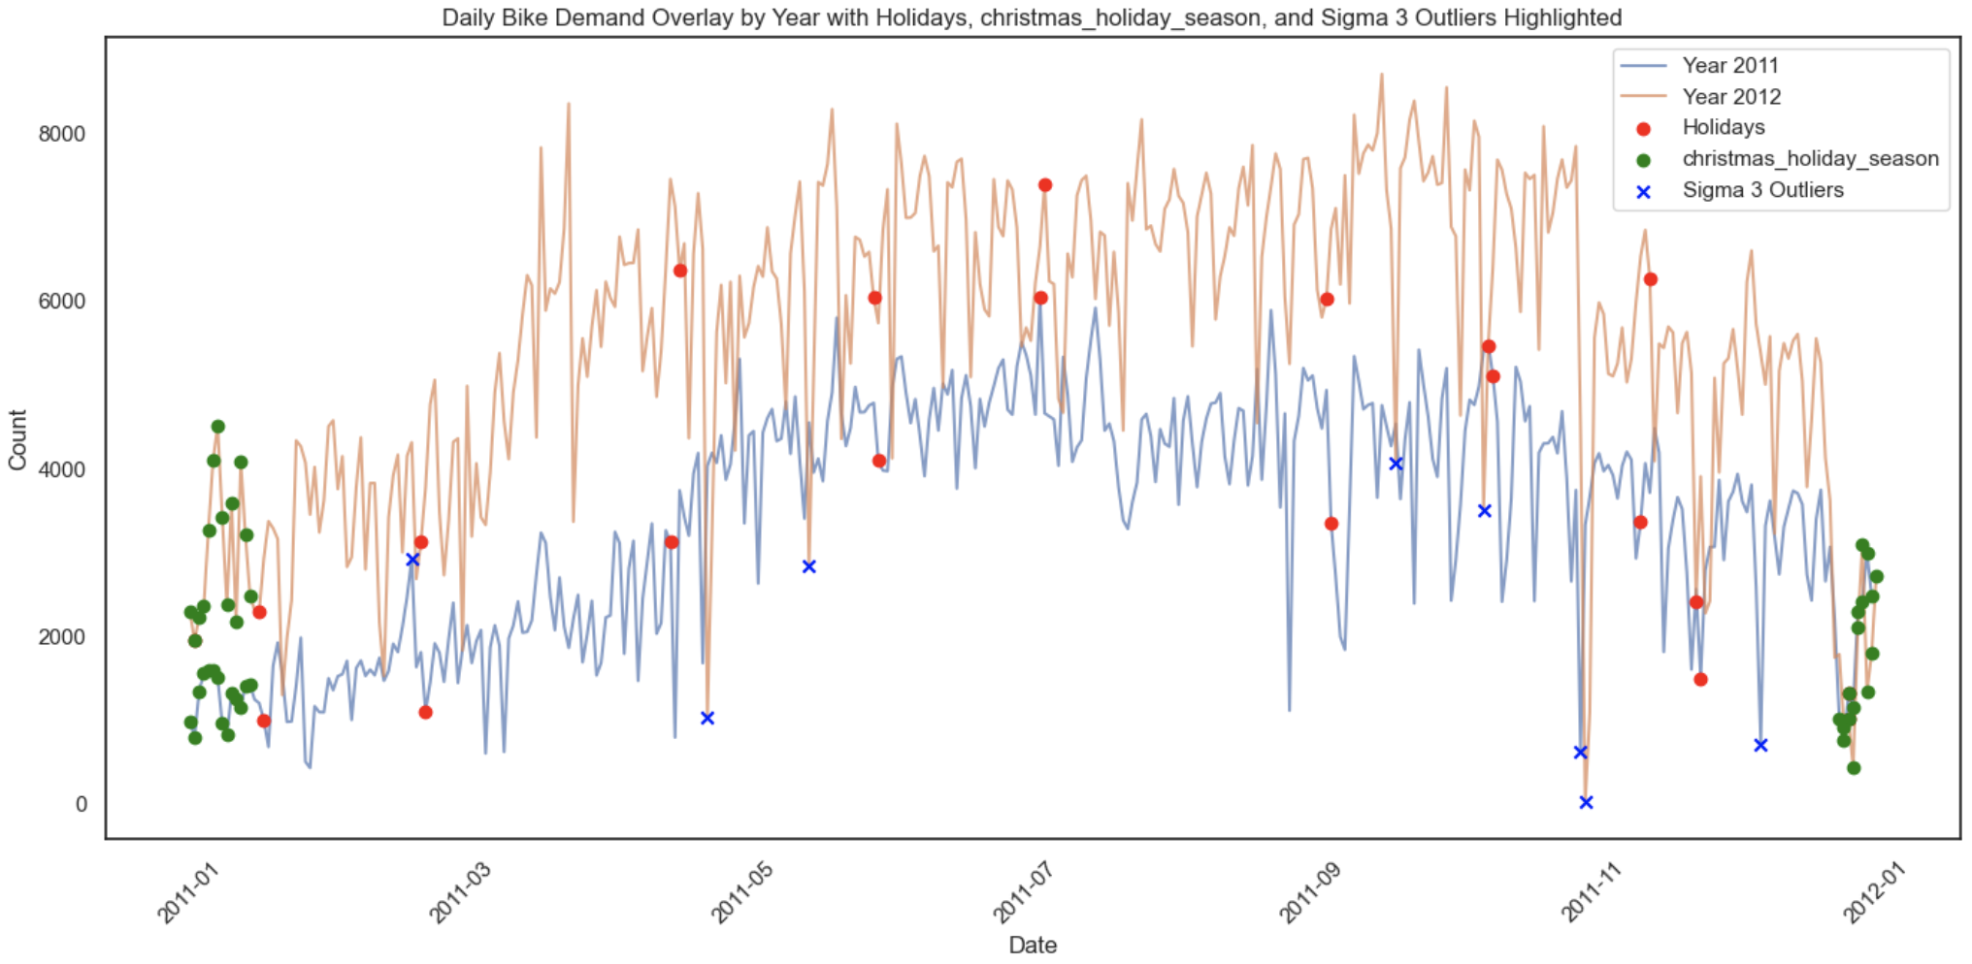
Hourly Profile of Collisions
Clear trend for working days with two peaks around rush hours.
Saturday and Sunday more smoothed and less travel.
Higher Peak for afternoon maybe work fatigue.
It would be interesting to see before and after covid difference in profiles due to work from home.

Slide 8
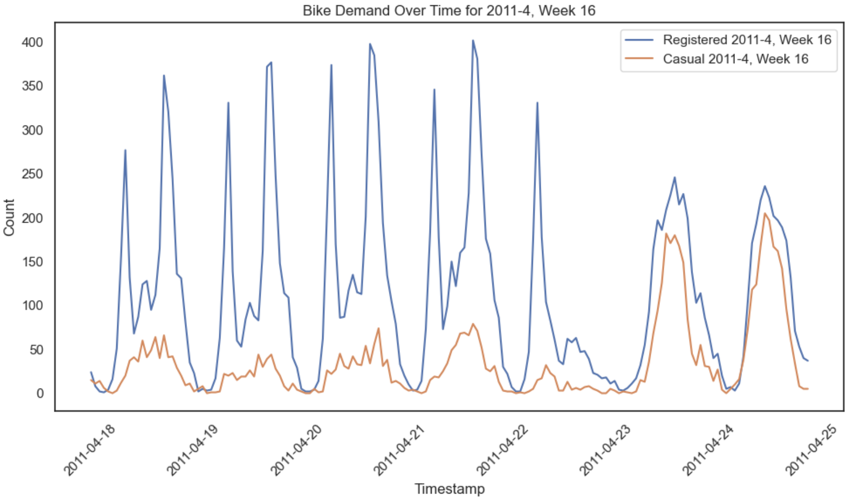
Hourly Profile of Collisions
Clear trend for working days with two peaks around rush hours.
Saturday and Sunday more smoothed and less travel.
Higher Peak for afternoon maybe work fatigue.
It would be interesting to see before and after covid difference in profiles due to work from home.

Slide 9
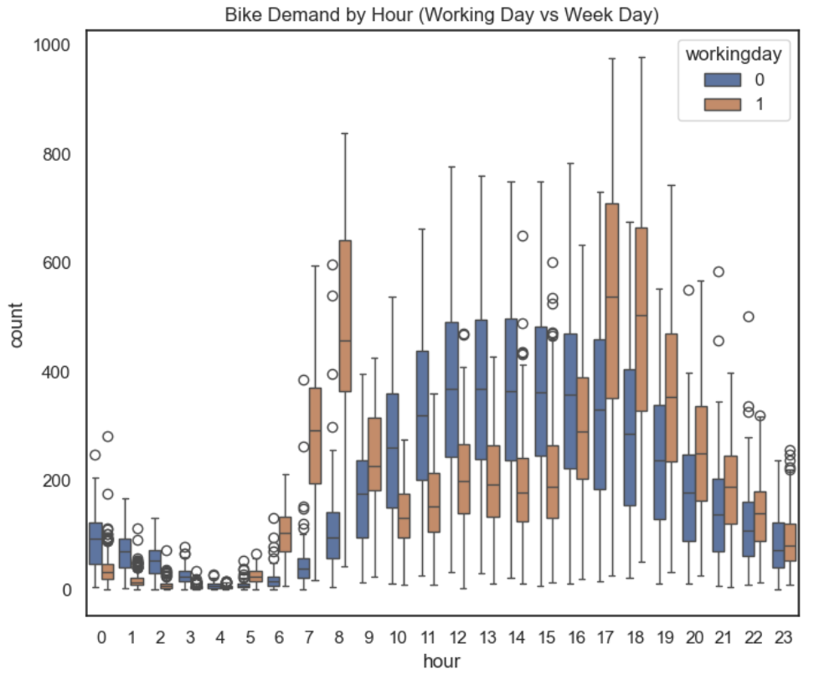
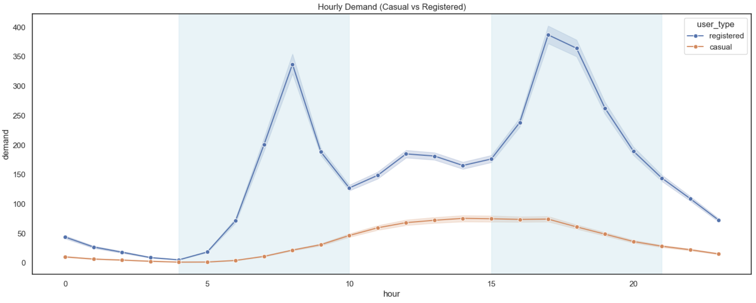
Hourly Profile of Collisions
Clear trend for working days with two peaks around rush hours.
Saturday and Sunday more smoothed and less travel.
Higher Peak for afternoon maybe work fatigue.
It would be interesting to see before and after covid difference in profiles due to work from home.

Slide 10
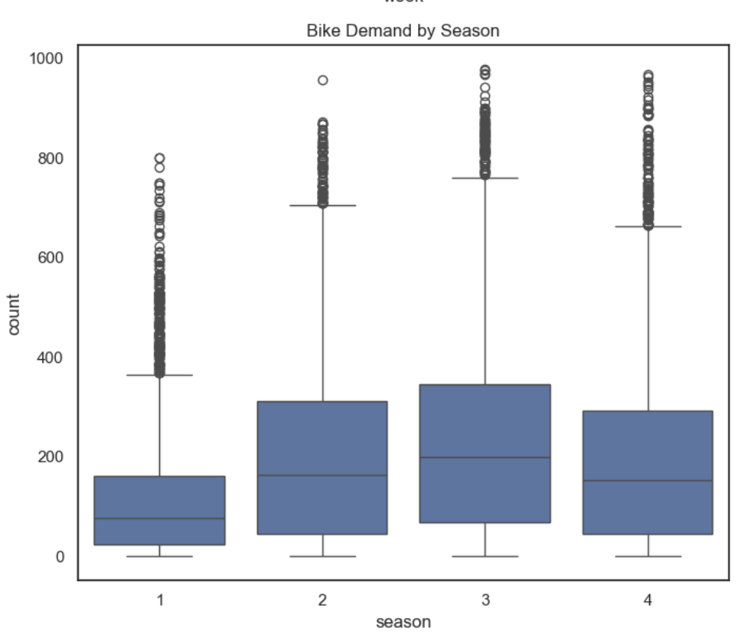
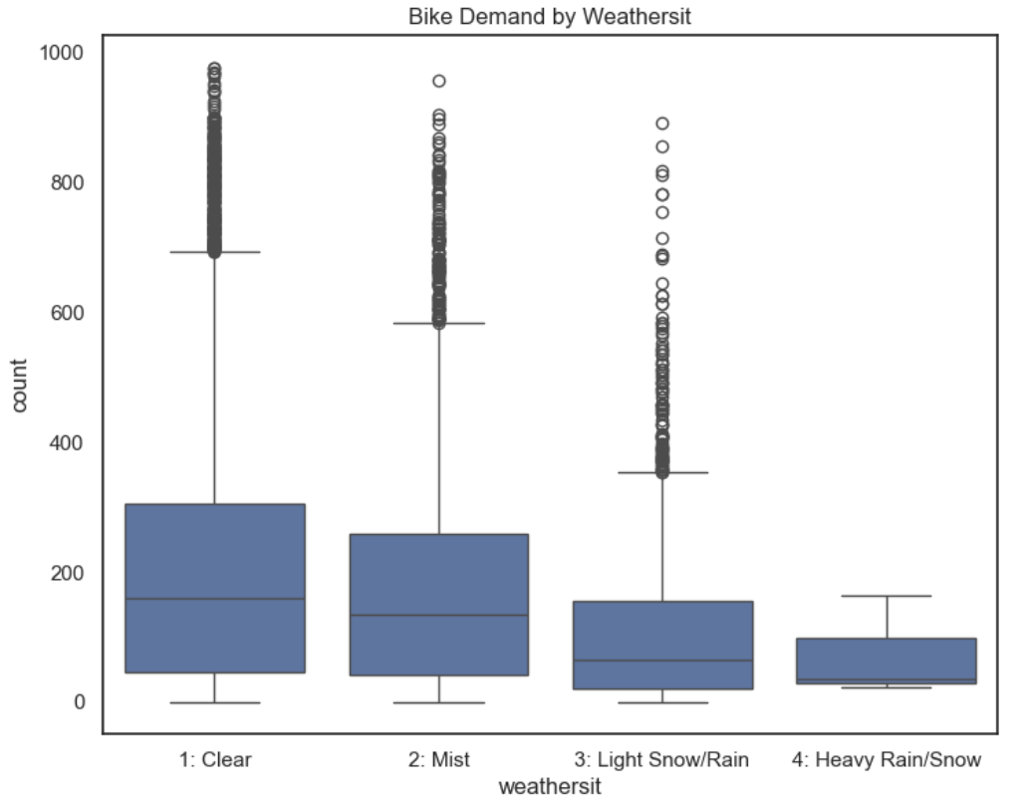
Weather and season
Clear trend for working days with two peaks around rush hours.
Saturday and Sunday more smoothed and less travel.
Higher Peak for afternoon maybe work fatigue.
It would be interesting to see before and after covid difference in profiles due to work from home.

Slide 11
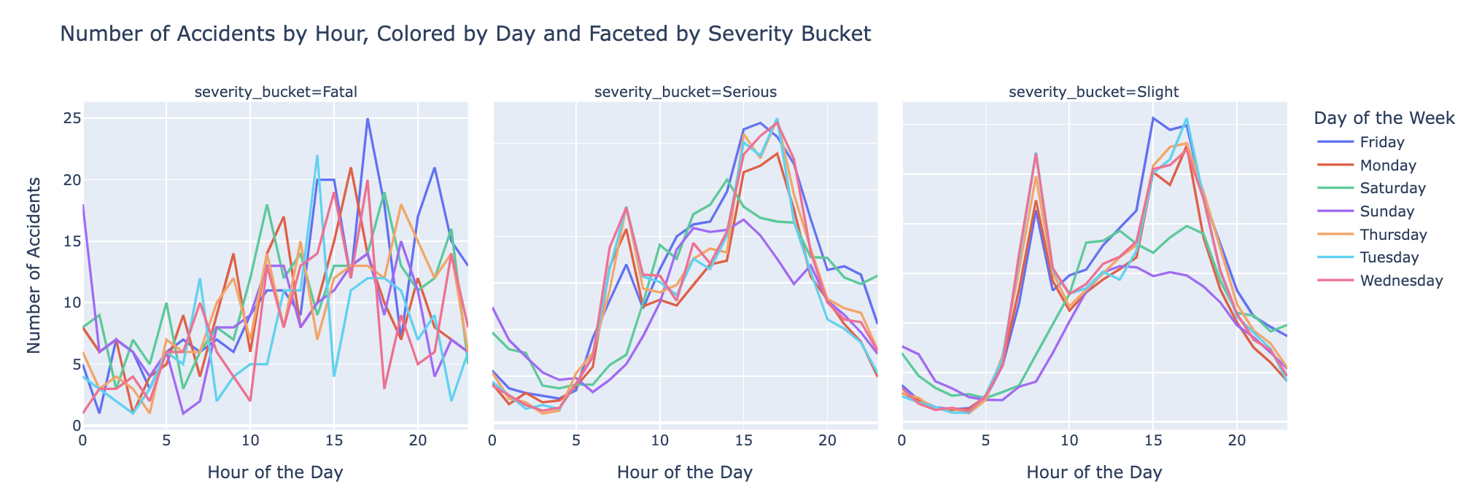
Hourly Profile of Collisions
Clear trend for working days with two peaks around rush hours.
Saturday and Sunday more smoothed and less travel.
Higher Peak for afternoon maybe work fatigue.
It would be interesting to see before and after covid difference in profiles due to work from home.

Slide 12
Feature Engineering
Although machine learning models can inherently figure out relationships between features, it has been shown in research that it is better to combine features to give the models help.
Features were created using combinations of weather.
Ratio of registered user features were also created for different time splits.
Any features that could cause data leakage were only made using the train data such as the registered and casual ratios.
Registered and casual columns were removed as this is equivalent to the amount of rentals each day.

Slide 13
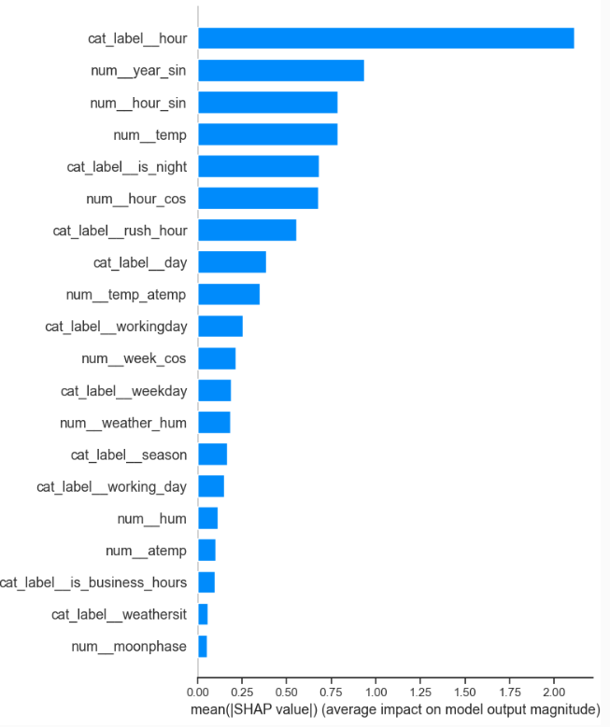
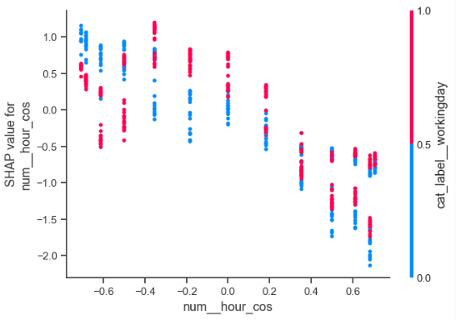
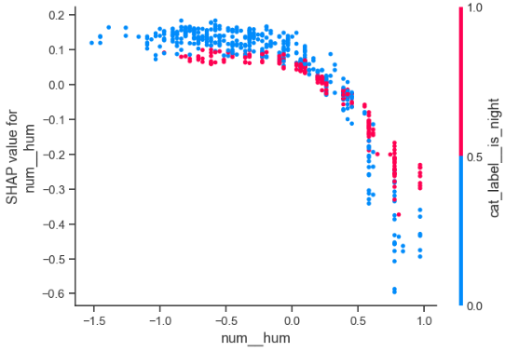
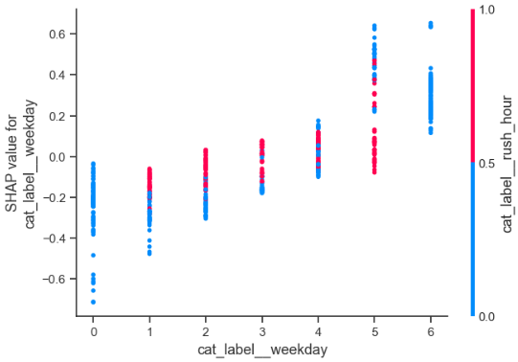
Shap analysis

Slide 14
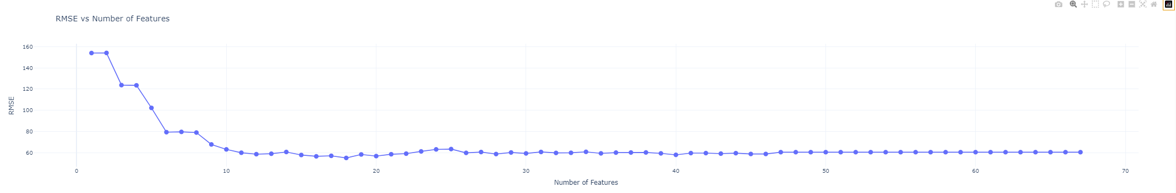
Feature Reduction
I ran the shap analysis multiple times removing the least important feature each time.
The figure shows how the RMSE of the model improves with more features.
At around 18 features we don’t seem to get much improvement.
We can use this to reduce the features and improve the speed of the model training.
It also gives us insight into the most important features.

Slide 15
Hyperparameter Optimisations
Optuna was used to test different model parameters around the defaults set by LightGBM.
n_estimators = 200
The number of boosting iterations (trees) in the model.
Higher values can lead to better accuracy but may cause overfitting.
learning_rate = 0.08
Controls the contribution of each tree to the final model.
Lower values make the model more robust but require more estimators.
max_depth = 4
The maximum depth of each tree.
A lower value prevents the model from becoming overly complex and overfitting.
num_leaves = 90
The maximum number of leaves per tree.
Larger values increase model complexity, while smaller values help control overfitting.
min_child_samples = 48
Minimum number of data points needed in a leaf.
Increasing this value can prevent the model from learning noise in the data.
subsample = 0.75
Proportion of data to randomly sample for each boosting iteration.
Helps prevent overfitting by adding randomness.
colsample_bytree = 0.55
Fraction of features to use for each tree.
Reduces overfitting by limiting the number of features each tree can use.
reg_alpha = 0.45
L1 regularisation term on weights.
Helps reduce model complexity and prevent overfitting by adding a penalty for large coefficients.
reg_lambda = 0.4
L2 regularisation term on weights.
Controls model complexity by penalising large weights, which helps prevent overfitting.

Slide 16
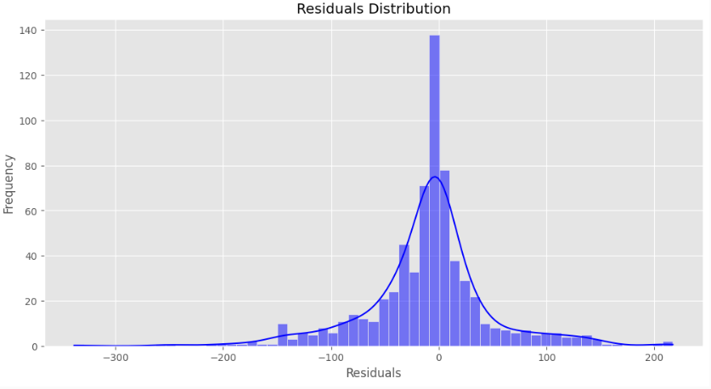
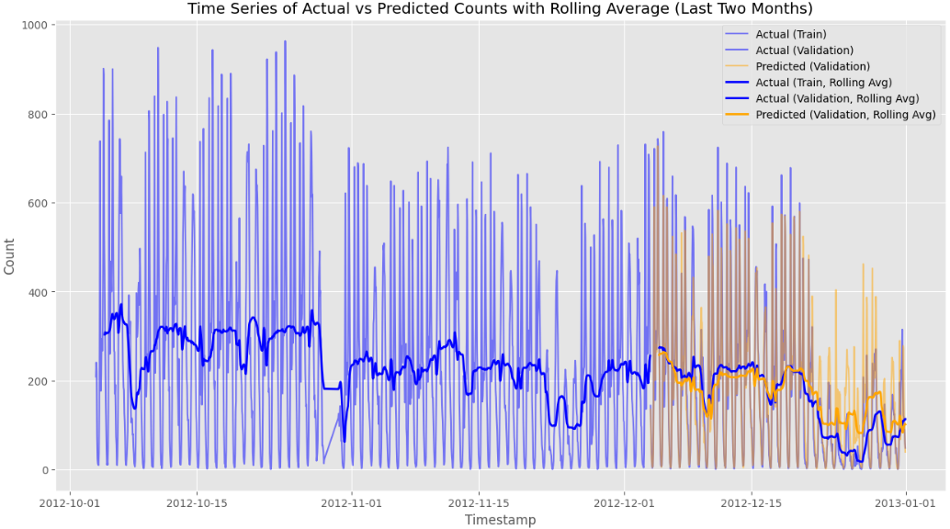
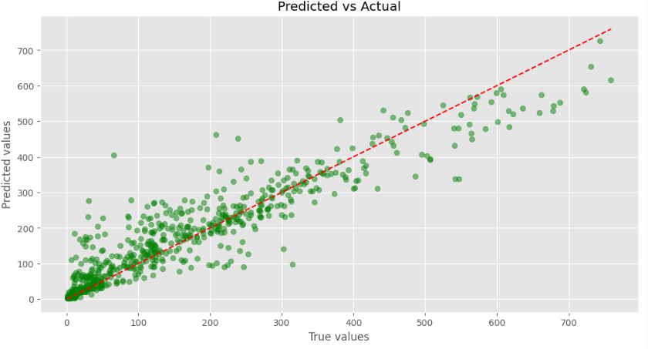
Final Model Results
The final RMSE was 59.2
This improved on a baseline model with original features RMSE of 65.3
The residuals are normally distributed.

