Slide 1
Bike Sharing Analysis and Modelling
Lawrence Rosen

Slide 2
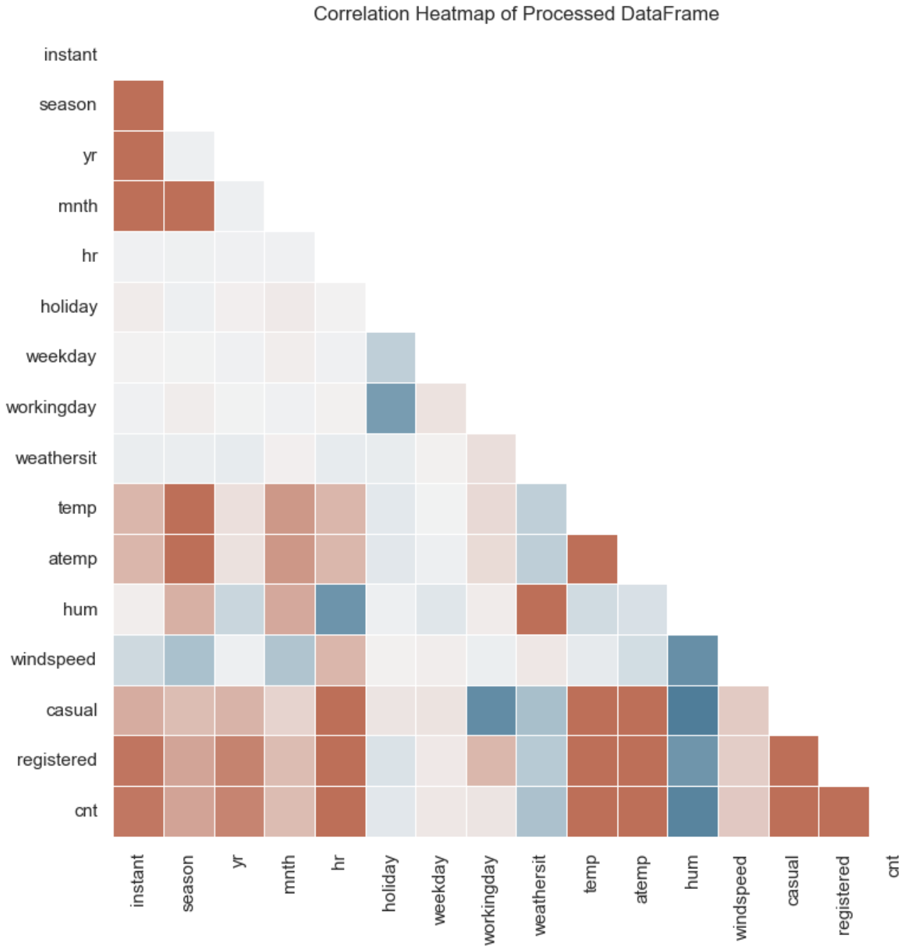
Executive Summary
Objective:
Find relationships between time, weather and other data on the demand of bike rentals.
Create predictions for a 4-week period based on these features including engineered features.
Key Findings:
Hour of day has the greatest effect on the rentals.
Ratio of registered to casual is less on weekends and also less in non-working hours.
Baseline model with no feature engineering achieved:
Predictive modelling (LightGBM) for rentals achieved an RMSE of 57.8 after feature engineering, recursive elimination of features and model hyperparameter tuning.
Holiday data seemed to not have an effect.
Casual users more influenced by weather and weekends — opportunity to target them differently with promotions.
Recommendations:
More analysis into registered and casual users. Promotions and other data could offer more insight into any anomalies and improve accuracy.
Inclusion of new features such as price of rental, payday, alternative transportation cost, fuel costs, vehicle taxes, congestion charges i.e. ULEZ enforcement in London etc.
Investigation of the quality of some features. Holidays didn’t seem to have an effect - maybe this data is wrong.
Location data of rentals – planning how many bikes in each location – can calculate missed revenue

Slide 3
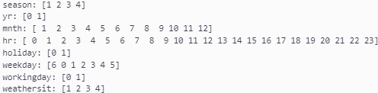
Data Overview
Dataset Details:
Columns: 17, Rows: 17379
No Missing Data
-
dteday – Date
season – Season
1: Spring
2: Summer
3: Fall
4: Winter
yr – Year
0: 2011
1: 2012
mnth – Month (1 to 12)
hr – Hour (0 to 23)
holiday – Whether the day is a holiday or not
day_of_week – Day of the week
workingday – If the day is neither weekend nor holiday = 1, otherwise = 0
weathersit – Weather situation
1: Clear, Few clouds, Partly cloudy
2: Mist + Cloudy, Mist + Broken clouds, Mist + Few clouds
3: Light Snow, Light Rain + Thunderstorm + Scattered clouds
4: Heavy Rain + Ice Pellets + Thunderstorm + Mist, Snow + Fog
temp – Normalised temperature in Celsius (divided by 41)
atemp – Normalised feeling temperature in Celsius (divided by 50)
hum – Normalised humidity (divided by 100)
windspeed – Normalised wind speed (divided by 67)
casual – Count of casual users
registered – Count of registered users

Slide 4
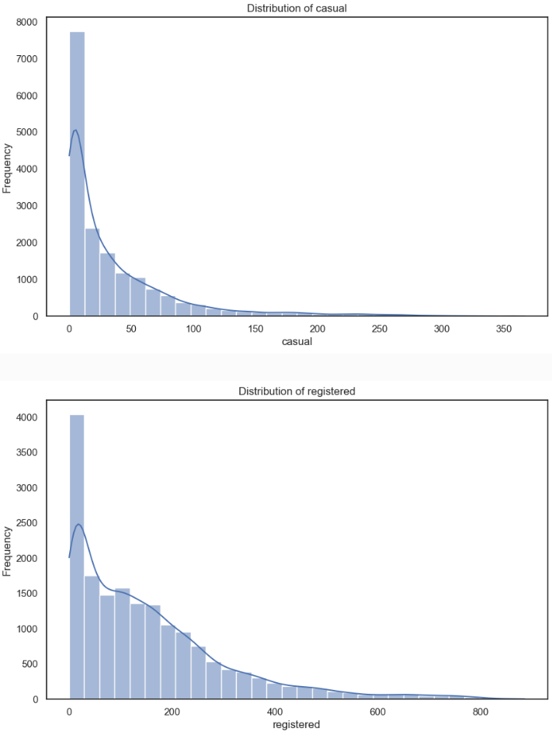
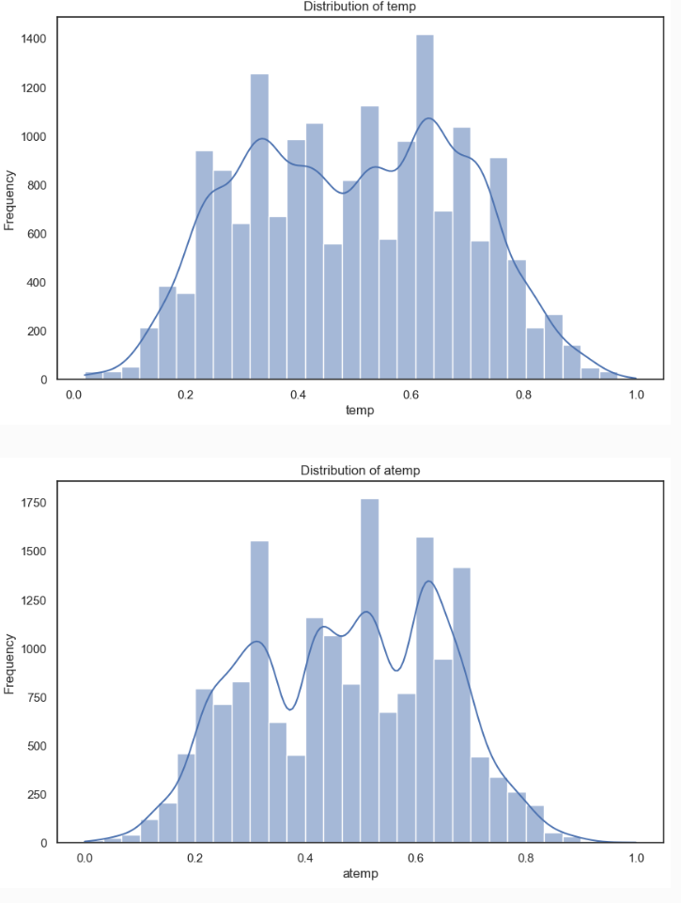
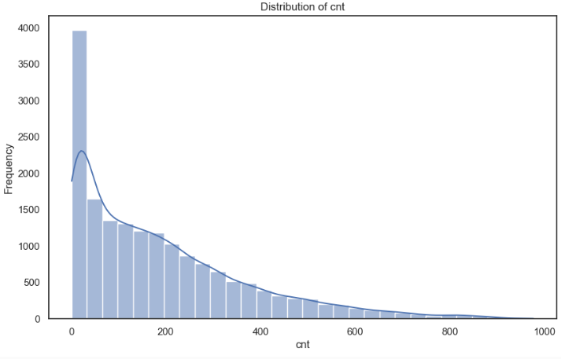
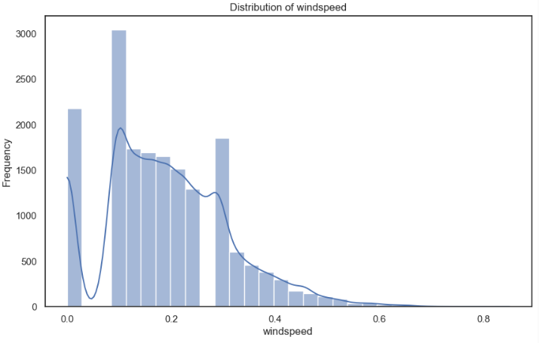
Data Overview
Count, Registered and Casual are ‘right skewed’
Weather features are normalised - windspeed is a bit skewed.
Windspeed also appears to miss some data – possibly the sensitivity of the measuring equipment?

Slide 5
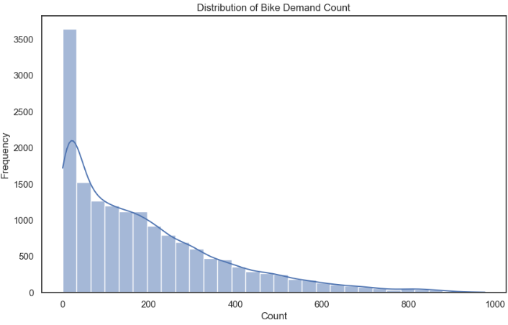
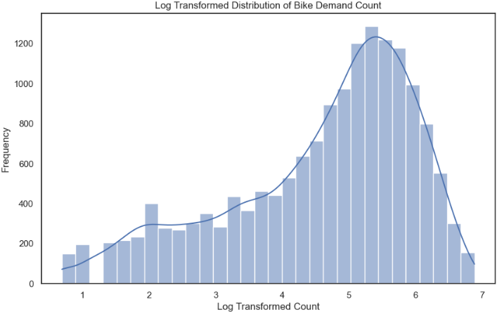
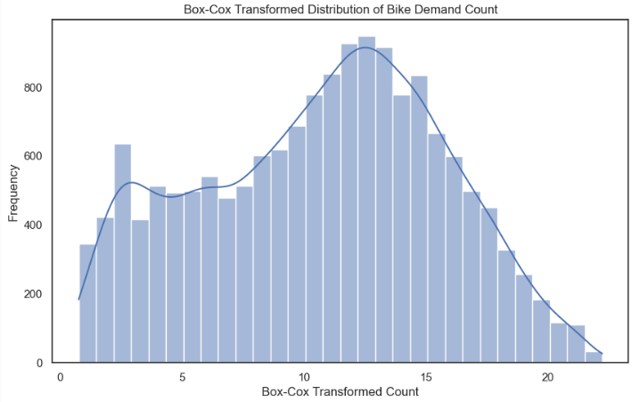
Target Variable - Count
The target count was ‘right skewed’
Many models, particularly linear regression, perform better with normally distributed data.
A logarithmic transformation is often used but I decided to use a box cox as it approximated normality better.
Normality is not crucial for tree-based models, but it can still be helpful for model interpretability and for testing other regressors.

Slide 6
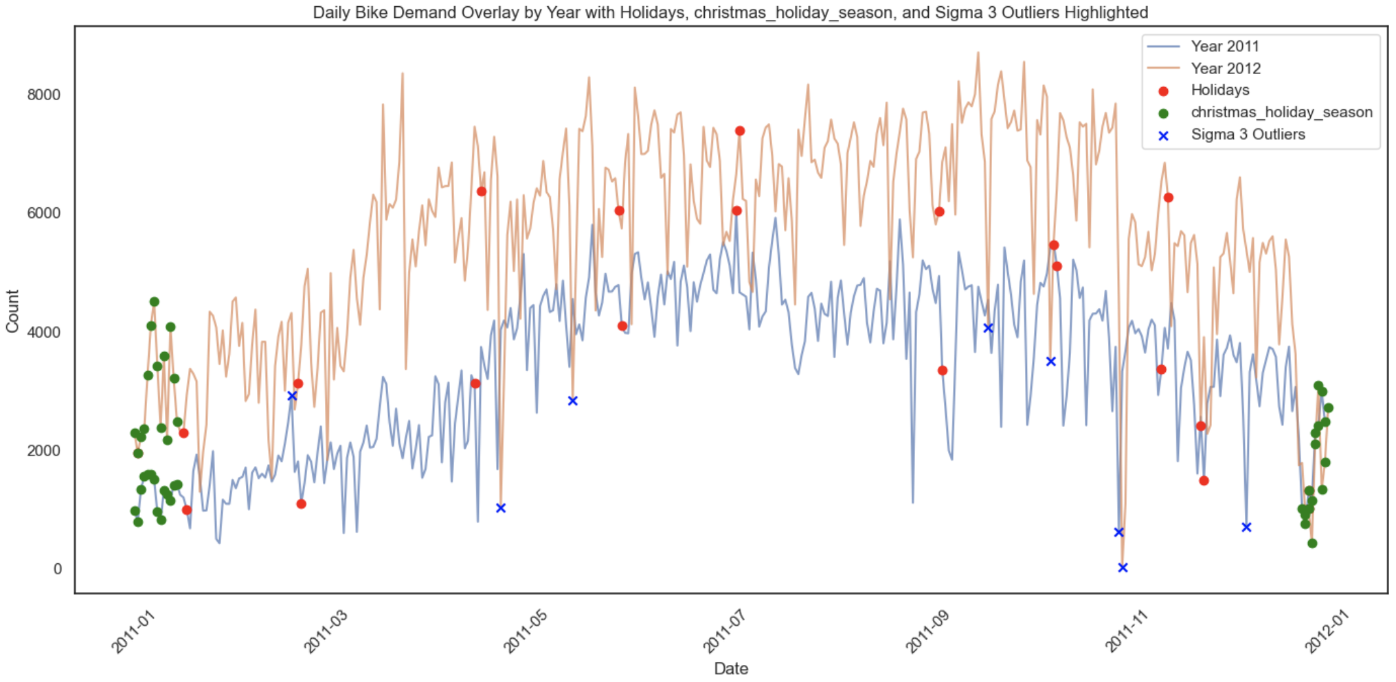
Yearly Profile
Yearly Seasonality
Increase over hotter parts of year.
Large effects from Christmas
Holidays do not seem to line up with any peaks
A few potential anomalies/big swings
April large swing – possible data logged on wrong day?)
November Two outliers align, maybe planned outage? Or a holiday which isn’t marked?

Slide 7
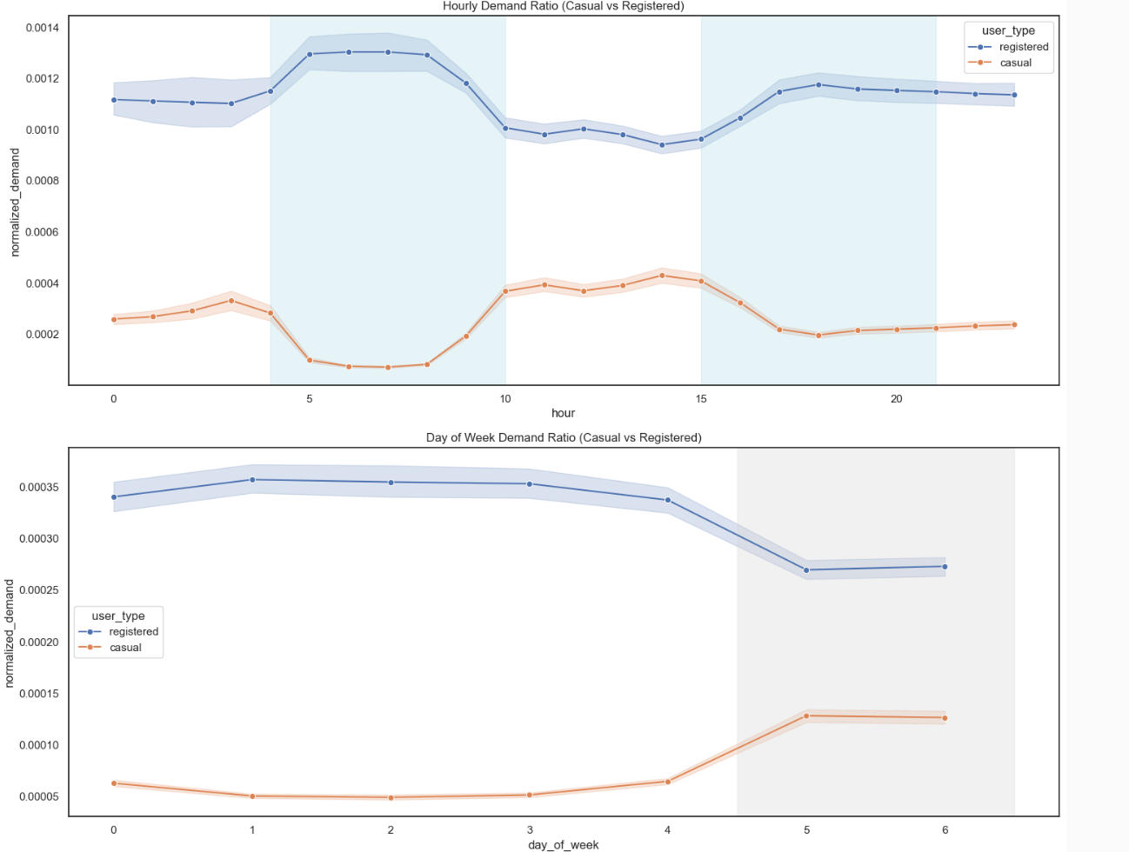
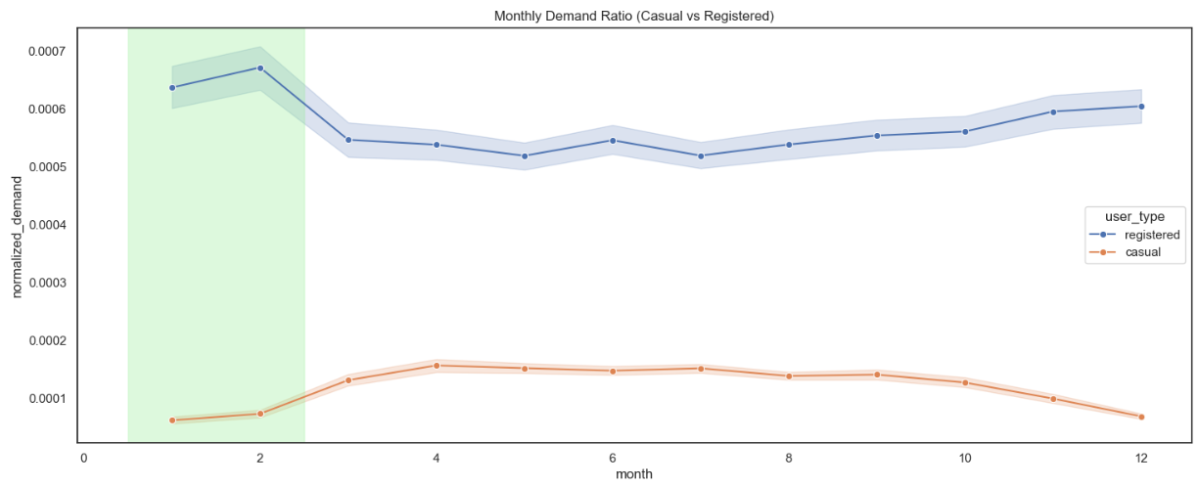
More Time Profiles
The ratio of registered to casual users increases in colder periods of the year.
This suggests casual users are more dependent on weather and registered users are more dependent on commuting features.
This is also demonstrated in the rush hour periods and weekend vs weekday comparisons.

Slide 8
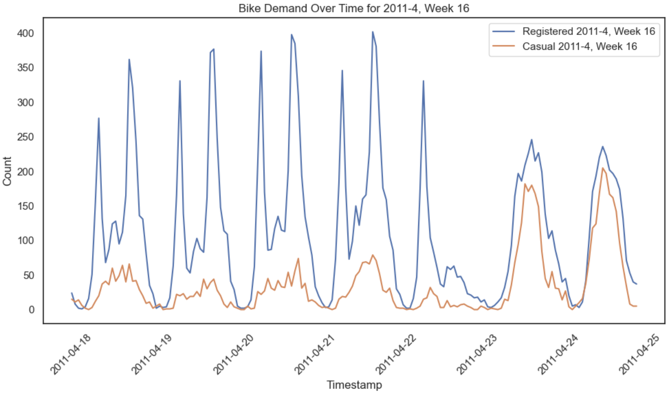
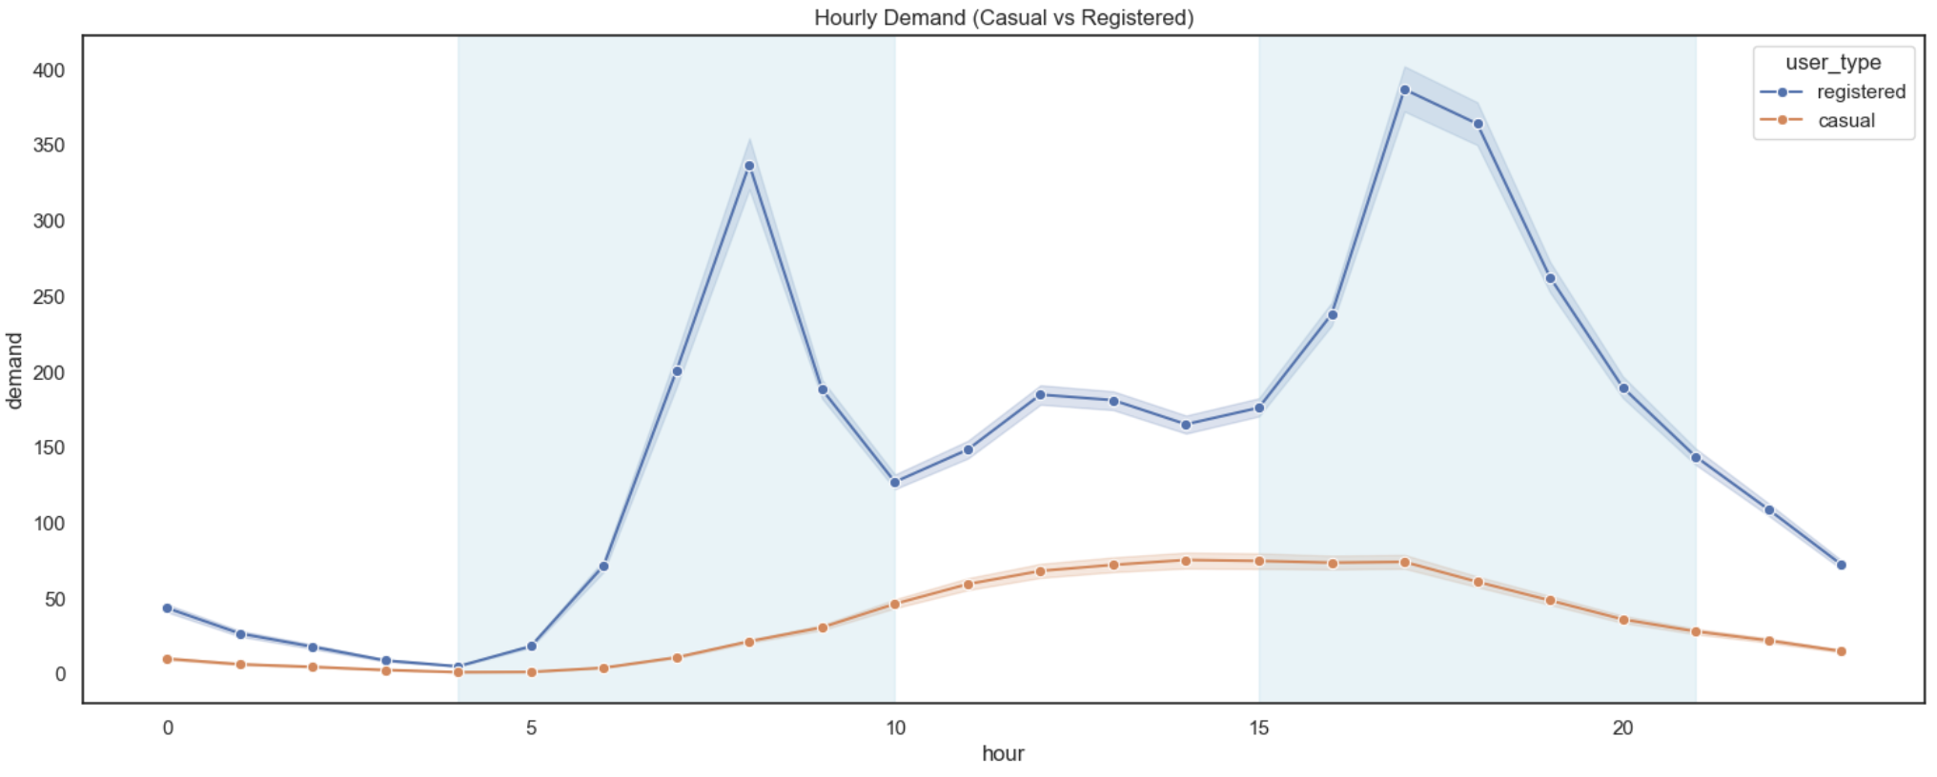
Hourly Profile of Collisions
Clear trend for working days with two peaks around rush hours.
Saturday and Sunday more smoothed and less travel.
Higher Peak for afternoon maybe work fatigue.
It would be interesting to see before and after covid difference in profiles due to work from home.

Slide 9
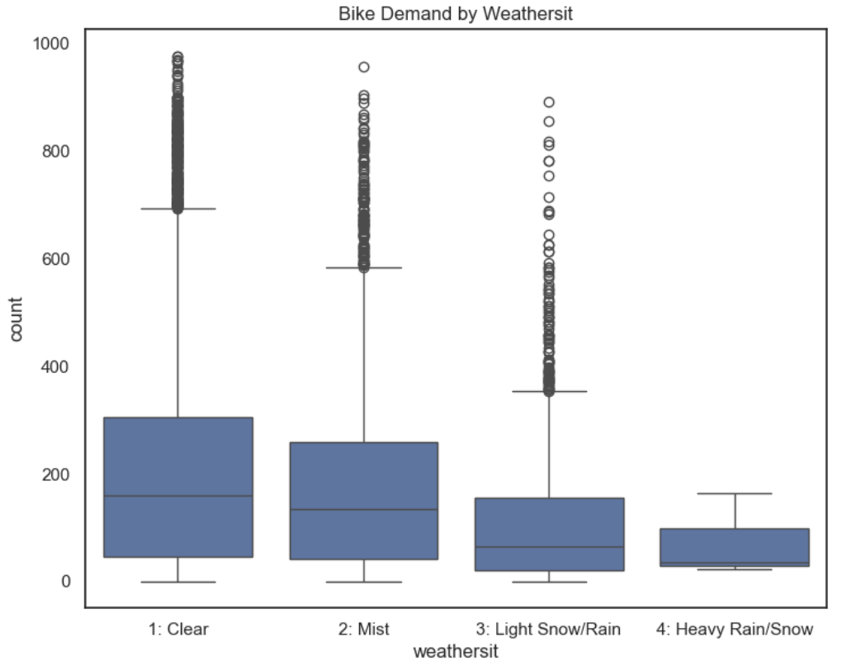
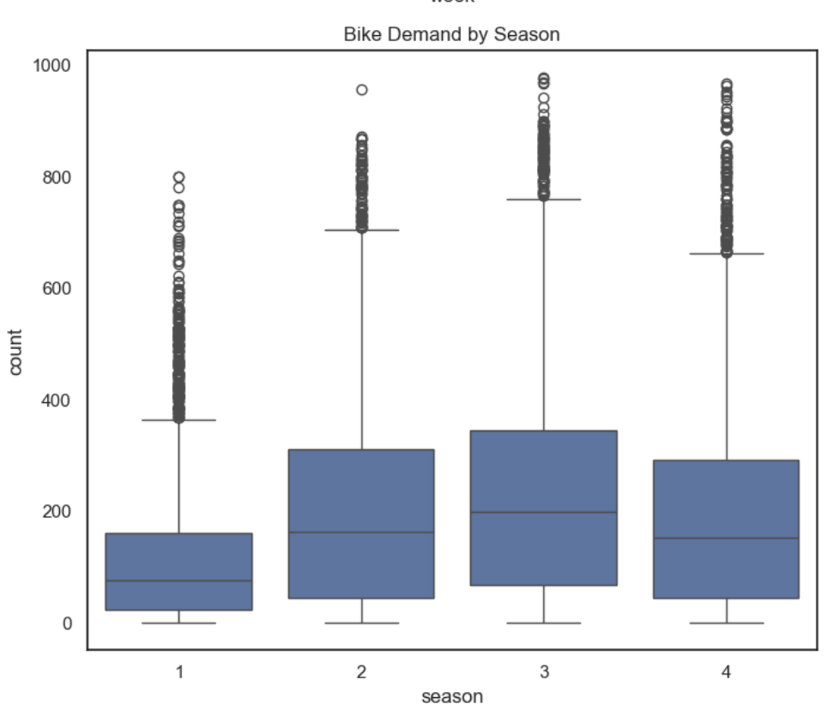
Weather and Season
Warmer Seasons = greater demand
Nicer weather = greater demand

Slide 10
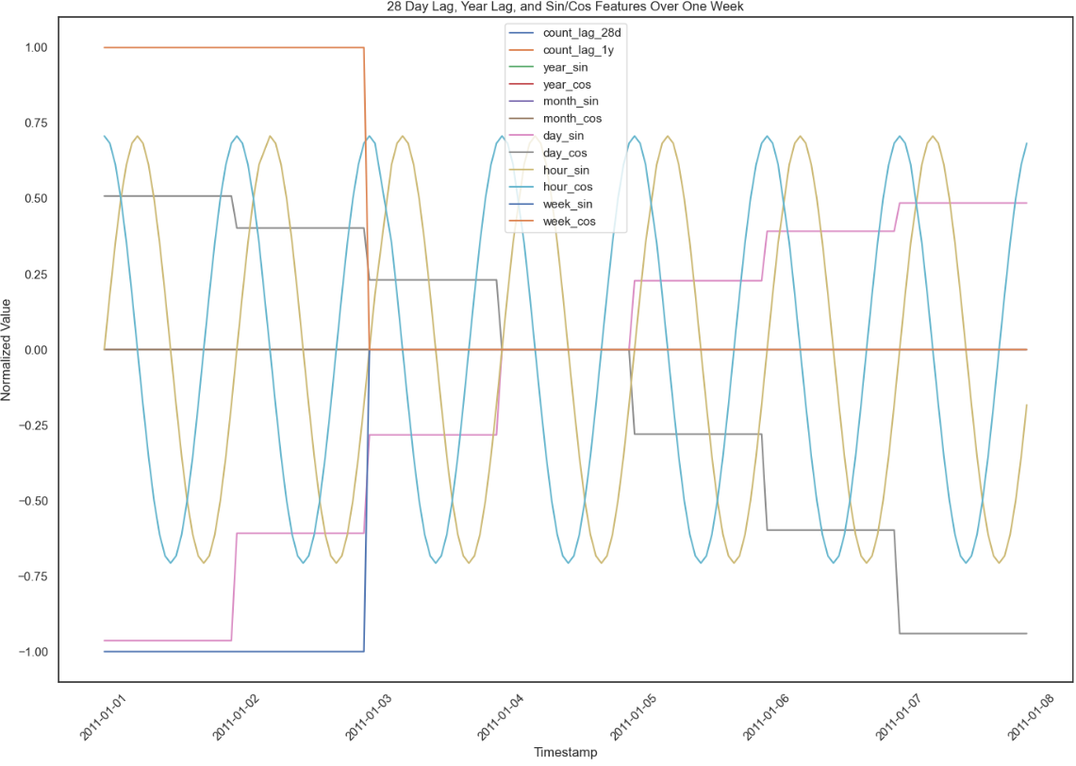
Feature Engineering
Although machine learning models can inherently figure out relationships between features, it has been shown in research that it is better to combine features to give the models help.
Features were created using combinations of weather.
Ratio of registered user features were also created for different time splits.
Any features that could cause data leakage were only made using the train data such as the registered and casual ratios.
Registered and casual columns were removed as this is equivalent to the amount of rentals each day.

Slide 11
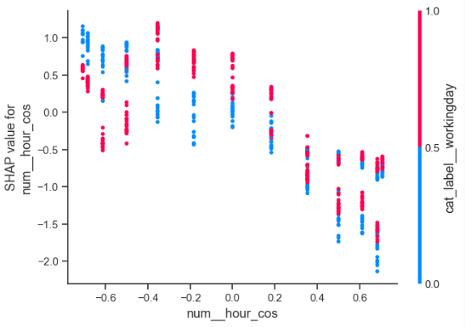
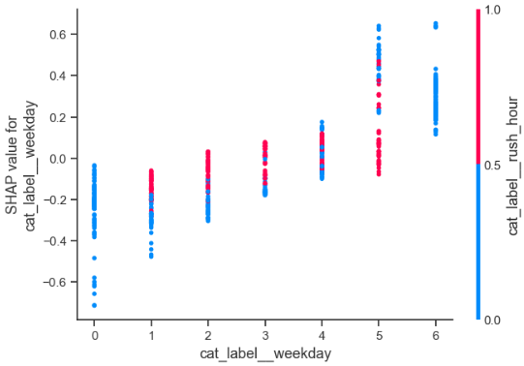
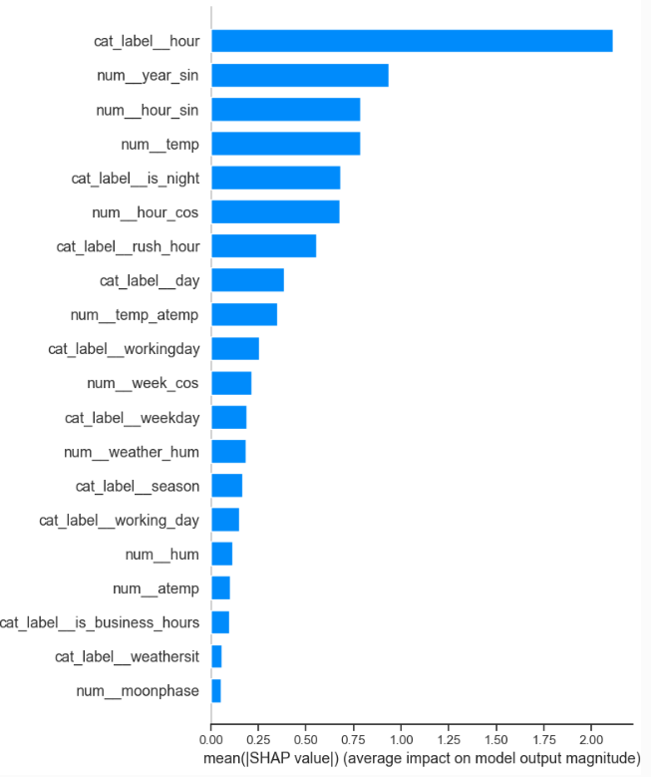
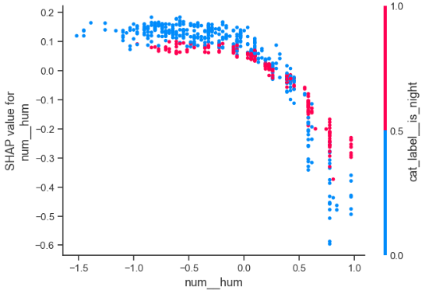
Shap analysis
SHAP values quantify each feature's contribution to the prediction of a specific instance.
Why Use SHAP for Feature Importances?
Accurate and Consistent: SHAP provides a consistent method of attributing feature importance, satisfying desirable properties like local accuracy and consistency.
Model-Agnostic: Works with any machine learning model, making it versatile for different algorithms (e.g., tree-based models, neural networks).
Interpretability: SHAP offers clear, interpretable insights into how individual features influence predictions, providing a deeper understanding of the model.
Global and Local Explanations: Not only shows overall feature importance but also allows for individual prediction insights, aiding in better decision-making.

Slide 12
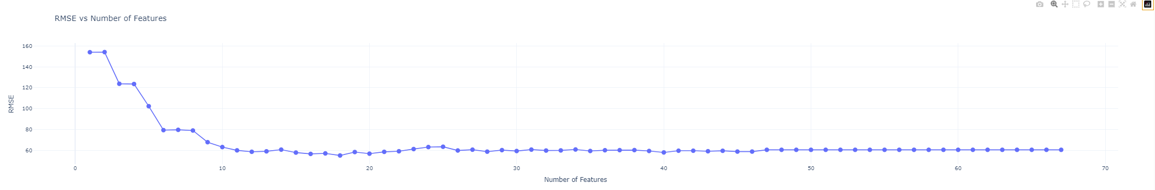
Feature Reduction with SHAP
Why Use SHAP for Recursive Feature Elimination (RFE)?
Improved Feature Selection: Using SHAP values for RFE allows for the identification of the most important features based on their actual contribution to the model, rather than relying on statistical measures alone.
More Reliable Results: SHAP-based RFE offers a more robust and data-driven approach to feature elimination compared to traditional methods, accounting for interactions between features.
Enhanced Model Performance: By removing irrelevant or less important features, SHAP RFE can help reduce overfitting, improve model interpretability, and increase overall performance.

Slide 13
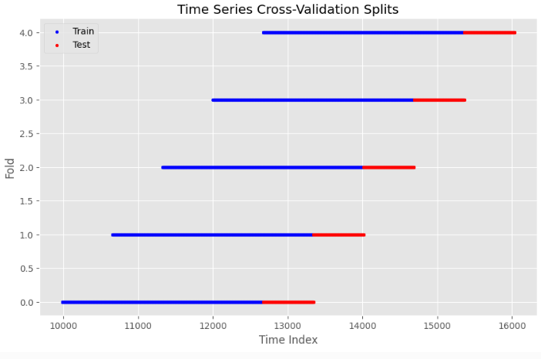
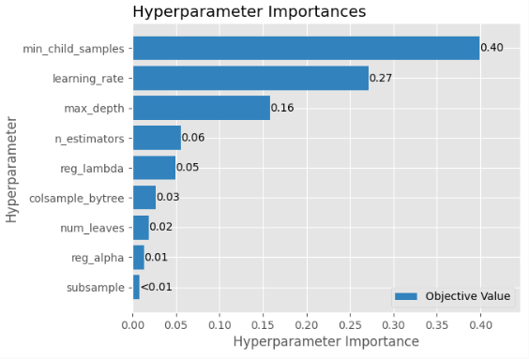
Hyperparameter Optimisations
A hyper-parameter optimiser called Optuna was used to test different model parameters for the LightGBM model using a 5 fold time series cross validation strategy.
Selected Features
n_estimators = 200
The number of boosting iterations (trees) in the model.
Higher values can lead to better accuracy but may cause overfitting.
learning_rate = 0.08
Controls the contribution of each tree to the final model.
Lower values make the model more robust but require more estimators.
max_depth = 4
The maximum depth of each tree.
A lower value prevents the model from becoming overly complex and overfitting.
num_leaves = 90
The maximum number of leaves per tree.
Larger values increase model complexity, while smaller values help control overfitting.
min_child_samples = 48
Minimum number of data points needed in a leaf.
Increasing this value can prevent the model from learning noise in the data.
subsample = 0.75
Proportion of data to randomly sample for each boosting iteration.
Helps prevent overfitting by adding randomness.
colsample_bytree = 0.55
Fraction of features to use for each tree.
Reduces overfitting by limiting the number of features each tree can use.
reg_alpha = 0.45
L1 regularisation term on weights.
Helps reduce model complexity and prevent overfitting by adding a penalty for large coefficients.
reg_lambda = 0.4
L2 regularisation term on weights.
Controls model complexity by penalising large weights, which helps prevent overfitting.

Slide 14
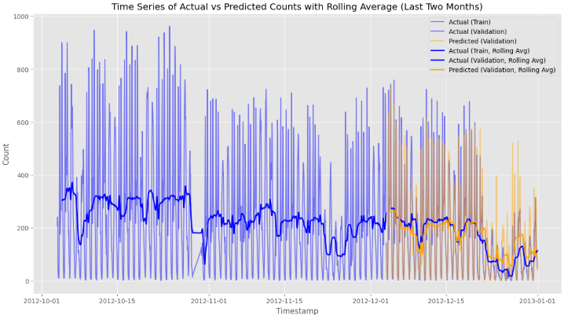
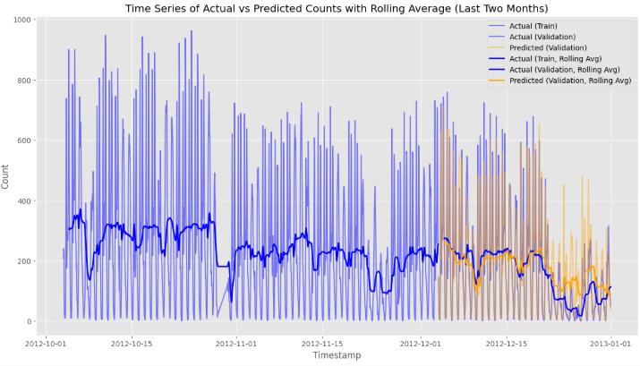
Final Model Results
Tuned Model RMSE of 57.8
The final RMSE was 57.8
This improved on a baseline model with original features RMSE of 65.3
The tuned model judges the tough Christmas period better than the basic model.
Base Model RMSE of 65.3

Slide 15
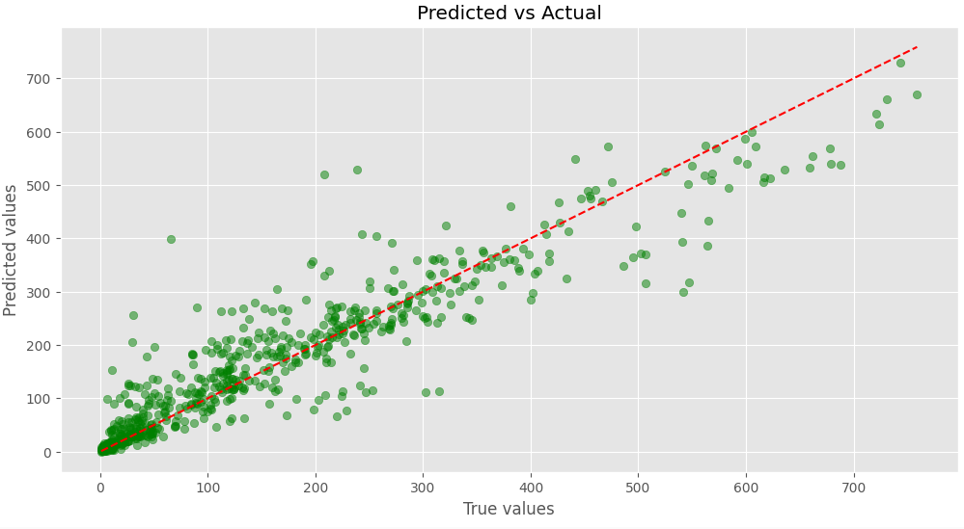
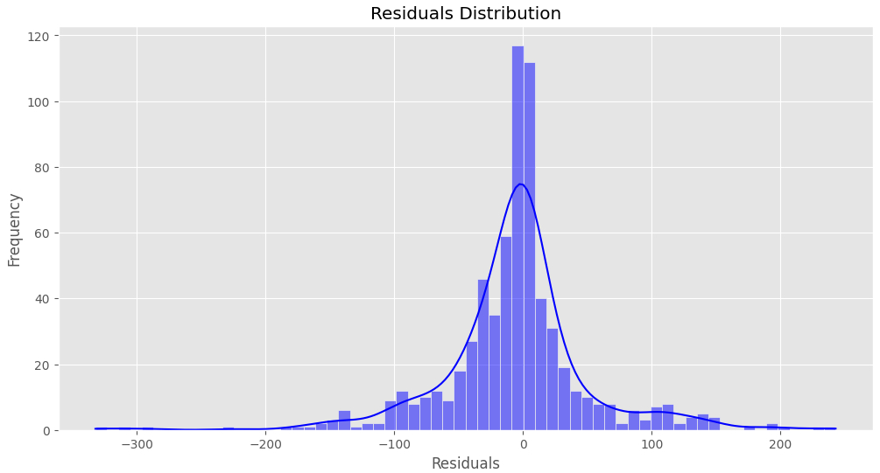
Final Model Results

Slide 16
Next Steps
Further Analysis of User Types:
Deepen the investigation into the behaviour of registered vs. casual users, focusing on variations across time (weekdays vs. weekends).
Explore additional factors that could influence casual user behaviour, such as specific events, local festivals, or school holidays.
Refine and Add Features:
Incorporate features such as rental price, payday, alternative transport costs, fuel prices, and congestion charges (e.g., ULEZ enforcement).
Investigate location-specific demand, allowing for targeted planning of bike distribution and capacity management.
Quality and Completeness of Data:
Examine holidays data further to ensure accuracy or potentially remove it if it’s unreliable.
Assess weather data quality (e.g., missing or incorrect data) to improve model robustness.
Model Improvement and Monitoring:
Continue model tuning and validation by testing additional machine learning models and advanced techniques like ensemble models and combining SARIMA models.
Develop predictive models for different time frames (e.g., next 4 weeks, seasonal predictions) and assess long-term performance.
Explore Business Impact:
Evaluate the effect of targeted promotions on demand, especially for casual users.
Consider implementing a location-based bike distribution system to maximise revenue opportunities and reduce missed rentals.

