Slide 1
Similar Product Recommendations
Lawrence Rosen

Slide 2
Task
Create a similar products algorithm
Output the four most similar Items for each Item
Example Given:
100 mL JS full-fat cream - Original Item
Recommended Items
100 mL JS low-fat cream
250 mL JS full-fat cream
100 mL taste the difference cream
100 mL branded cream
The algorithm does not need to personalise the output to a customer
I chose not to explore collaborative filtering or basket analysis
More simple, efficient and explainable method fitting in with the business’ current category framework
Adding a hugging face sentence transformer to place items without good categories

Slide 3

Plan
Combine department and item names to find similar SKUs using:
Fuzzy matching
Cosine similarity
TF-IDF vectorization
Leverage existing categorisations to group similar items.
Determine the best ordering for recommendations using:
Cosine similarity
Fuzzy matching
Transaction counts (popularity-based ranking)
A combination of the above
Final Approach Chosen:
Use existing groupings and rank items by transaction volume (popularity).
For items with insufficient recommendations, apply cosine similarity to find the most similar item and copy its recommendations.
Allows utilisation of a pretrained model.

Slide 4
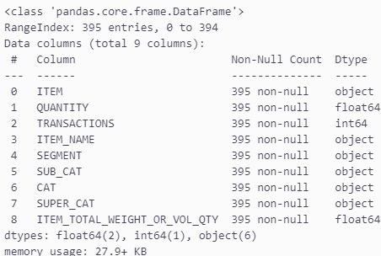
Data Overview – Item Data

Slide 5
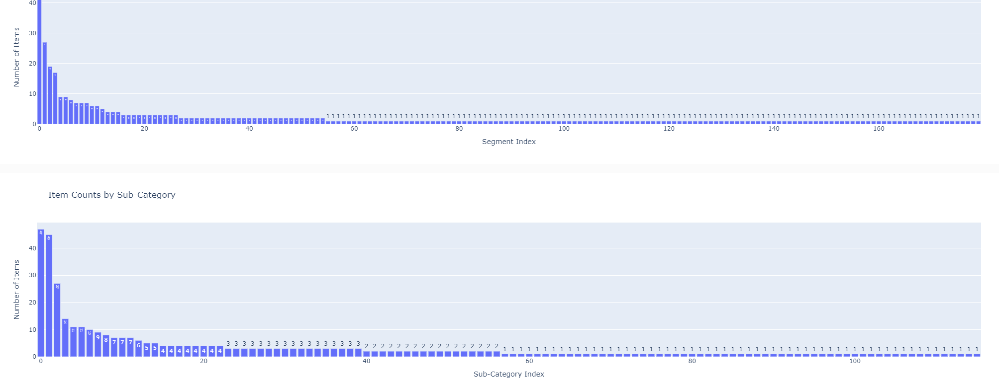
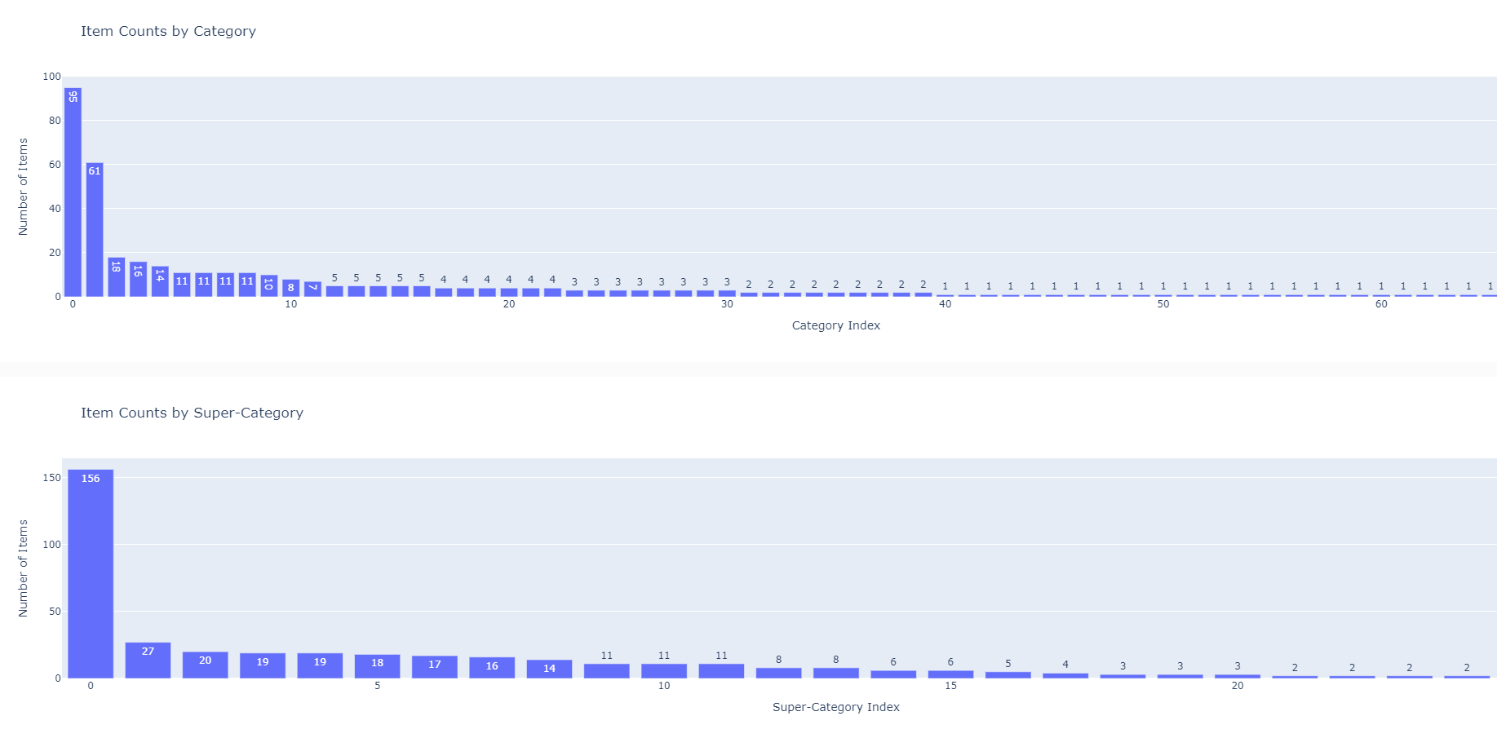
Data Overview – Item Data
Items are very skewed to single groups
Even at Super Category level some groups only have one item
These items need to be matched to other items with large enough groups

Slide 6
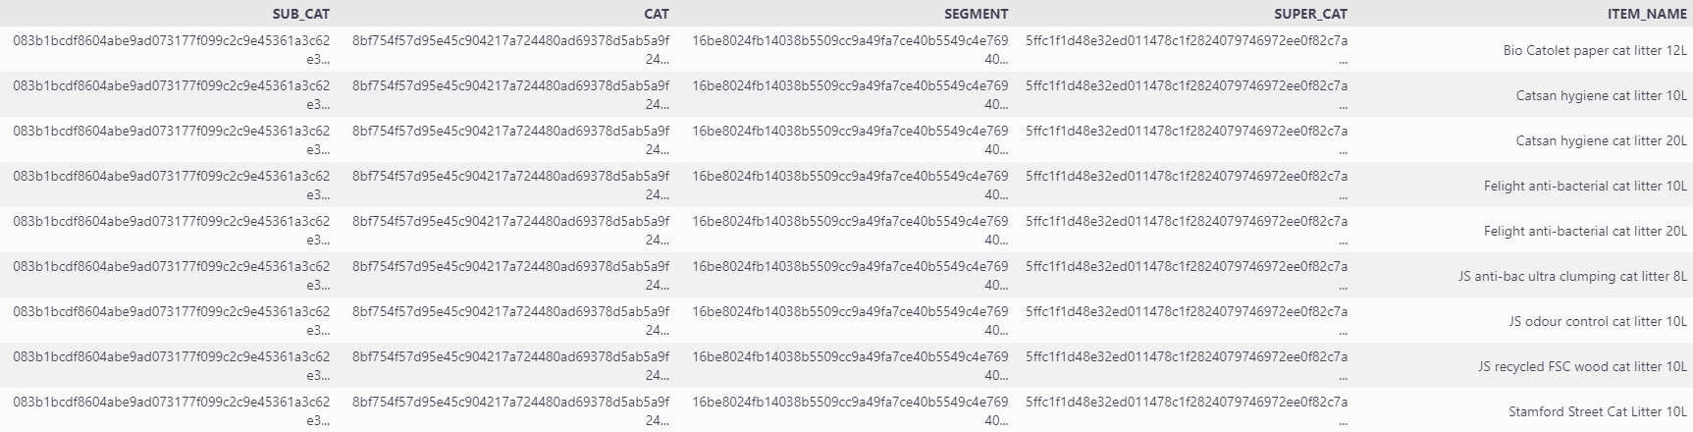
ITEM DATA
Looking at specific items it was clear that they were well organised.
Idea spurred to take an item, look in similar categories and obtain the four the most bought items
For items that four cannot be found we can relate the item to a similar item with four already and copy the recommended items.

Slide 7
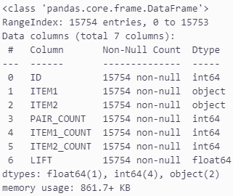
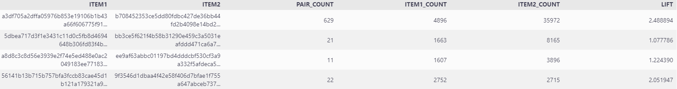
Data Overview – Lift

Slide 8
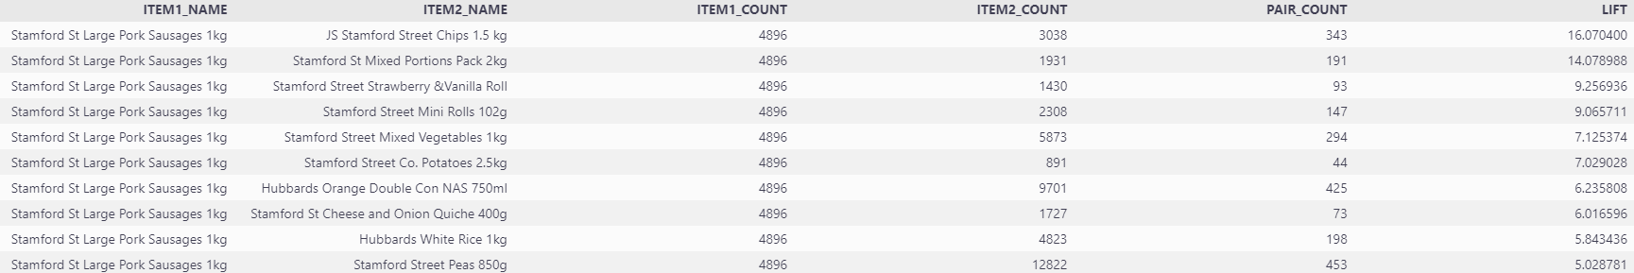
Lift
The lift data is interesting for basket recommendations that are different but not very helpful for our specific problem
Another thing to be aware of is the lift could be heavily influenced by promotions
Stamford Street items have large lift on each other, this suggests there could be a promo between Stamford Street items..

Slide 9
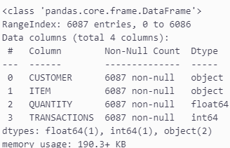
Data Overview – Customer Data

Slide 10
Customer
Customer data could be useful for personalised recommendations and recommendations based on similar customer profiles – collaborative filtering
Model could be improved by using the customers transactions first before using the overall transactions for recommendations.

Slide 11

Validating the output
ITEM_NAME | RECOMMENDATION 1 | RECOMMENDATION 2 | RECOMMENDATION 3 | RECOMMENDATION 4
Young's Salmon Fillet Dinner 380g | Roast Lamb Dinner 400g | chicken hotpot dinner 400g | Large Pork Sausages 1kg | Beef Burgers x8 397g
yoghurts 4x125g | TTD COFFEE MOUSSE 100G | Activia Fibre Walnut & Oat Breakfast Gu | Activia Fusion Blueberry 4x120g | Activia Fibre Apple Cereals Breakfast G
Yeo Valley Natural Kefir Yoghurt 950g | ACTIVIA FUSIONS PRUNE YOGURT 4x120g | Activia Fusion Blueberry 4x120g | Activia Fibre Apple Cereals Breakfast G | Actimel Blueberry 8x100g
Xmas Mixed Nuts 225g | Xmas Brazil Nuts 250g | Large Kiwi Fruit | Easy Peelers 600g | Easy Peeler Single
Xmas Brazil Nuts 250g | Xmas Mixed Nuts 225g | Large Kiwi Fruit | Easy Peelers 600g | Easy Peeler Single
WS Mulled Wine 75cl | Caminada Malbec 75cl | House Sauvignon Blanc 75cl | House Malbec 225cl | House Soave 75cl
Wotsits Crunchy Cheese | Walkers Meaty 20pk | Walkers Variety 20pk | Walkers Cheese&Onion 12pk | Mini Cheds Nibblies Cheese & Chive 6pk
Wotsits 20pk | WALKERS MONSTER MUNCH 12pk | Walkers Squares Variety pack 12pk | KP Hula Hoops Original 12x24g | KP Skips Prawn Cocktail 14x13.1g
Winders Strawberry Blackcurrant 5x17g | AHarriott Spice Sensation Couscous 100g | BEANS IN TOMATO SAUCE 400G | Hubbards Spaghetti Rings 400g | Hubbards White Rice 1kg
Winalot shapes 800g | Bonio original 1.2kg | biscuit selection for dogs 800g | meaty rolls x15 135g | Good Boy chicken bites 65g
Winalot perfect portions pouches 40x100g | Cesar classic terrine mix 8x150g | Lily's Kitchen chkn trky casserole 150g | Cesar country stew selection 8x150g | comn for seniors meat in jelly 6x400g
wildbird suet balls x10 | wildbird seed mix 4kg | wildbird seed mix 750g | wildbird peanuts 750g | Felix AGAIL senior meat selectn 12x100g
wildbird seed mix 750g | wildbird suet balls x10 | wildbird seed mix 4kg | wildbird peanuts 750g | Felix AGAIL senior meat selectn 12x100g
wildbird seed mix 4kg | wildbird suet balls x10 | wildbird seed mix 750g | wildbird peanuts 750g | Felix AGAIL senior meat selectn 12x100g
wildbird peanuts 750g | wildbird suet balls x10 | wildbird seed mix 4kg | wildbird seed mix 750g | Felix AGAIL senior meat selectn 12x100g
Wholemeal Medium 800g | White Bread Medium 800g | Soft White Farmhouse 800g | 6 Wholemeal Muffins | 8 Wholemeal Tortilla Wraps
White Fish Fillets 520g | Roast Lamb Dinner 400g | chicken hotpot dinner 400g | Large Pork Sausages 1kg | Beef Burgers x8 397g
White Bread Medium 800g | Soft White Farmhouse 800g | Wholemeal Medium 800g | 6 Wholemeal Muffins | 8 Wholemeal Tortilla Wraps
Whiskas temptations chicken & cheese 60g | Webbox Lick-e-Lix liver & grass 5x15g | Webbox chckn & liver tasty sticks x6 30g | Dreamies cat treats chicken 60g | Webbox turkey & lamb tasty sticks x6 30g
Whiskas dentabites chicken 50g | Webbox Lick-e-Lix liver & grass 5x15g | Whiskas temptations chicken & cheese 60g | Webbox chckn & liver tasty sticks x6 30g | Dreamies cat treats chicken 60g
Whiskas 7+ complete chicken 1.9kg | Whiskas 1+ complete with chicken 1.9kg | Go Cat senior chicken rice & veg 750g | Go-Cat adult tuna herring & veg 750g | Go-Cat adult chicken & duck 2kg
Whiskas 7+ Cat Pouch Poultry JEL 12x85g | Whiskas 2-12mths Kit Pouch fish 12x85g | 1+ meat &fish selctn in jelly 48x100g | 7+ meat&fish selctn in jelly 12x100g | Whiskas 1+ Cat Pouch Poultry jel 40x85g
Whiskas 7+ Cat Pouch fish jelly 12x85g | Whiskas 2-12mths Kit Pouch fish 12x85g | 1+ meat &fish selctn in jelly 48x100g | Whiskas 7+ Cat Pouch Poultry JEL 12x85g | 7+ meat&fish selctn in jelly 12x100g
Whiskas 2-12mths Kit Pouch fish 12x85g | 1+ meat &fish selctn in jelly 48x100g | Whiskas 7+ Cat Pouch Poultry JEL 12x85g | 7+ meat&fish selctn in jelly 12x100g | Whiskas 1+ Cat Pouch Poultry jel 40x85g
Whiskas 1+ dry cat food chicken 800g | Whiskas 1+ complete with chicken 1.9kg | Go Cat senior chicken rice & veg 750g | Whiskas 7+ complete chicken 1.9kg | Go-Cat adult tuna herring & veg 750g
Whiskas 1+ complete with chicken 1.9kg | Go Cat senior chicken rice & veg 750g | Whiskas 7+ complete chicken 1.9kg | Go-Cat adult tuna herring & veg 750g | Go-Cat adult chicken & duck 2kg
Randomly sample and visually inspect recommendations.
The categorical selections work well and will work better with scale.
Test the sentence transformer robustness by predicting current categorised items
Monitor click through rate of recommendations when productions.

Slide 12
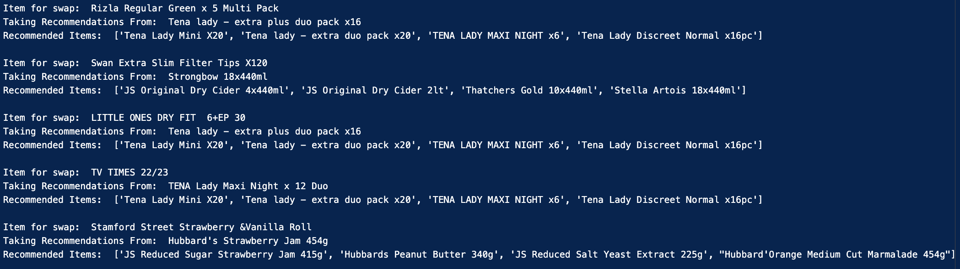
Validating the output
Some recommendations are ok but the model suffers from a low amount of similar products and not having proper category descriptions.
Model suffers from low data.

Slide 13
Next Steps –improvements
Replace Hexcode categories with a ‘most common word’
Use cosine similarity to choose the recommendations rather than transactions or use a combination.
Fine Tuning model on our own data.
Better product names not 'TAKE A BREAK'

Slide 14

Next Steps - including customer personalisation
Maintaining replacement item framework – use customer transactions first before overall transactions
1
Using a recommended item framework – could use other customers with similar transactions to recommend alternative or similar products
‘similar shopper also bought this other item’
Or
‘similar shopper bought this other item in the same category’
2

Slide 15

Next Steps - How this approach could be productionised to the website
Clean up code and add tests to ensure data quality and alerts if data is missing or problematic
1
Create a main and dev repository and only work on branches pushed to dev testing before pushing dev to main.
2
Monitor the model to ensure robustness.
3
Run daily with automated workflows, either Databricks or Airflow or other frameworks available.
4
Monitor the click throughs to see if the recommendations are working well.
5
Multi Armed Bandit - reinforcement learning method to direct traffic at different versions and learn which is best
6
Any Questions?

