Slide 1
Procedural meaning: problems and perspectives
UNED, Madrid, October 2009
Prosody:
conceptual and procedural meaning;
natural and non-natural meaning
Billy Clark
b.clark@mdx.ac.uk
Tim Wharton
twharton@clara.co.uk

Slide 2
Structure of the talk
Introduction
Procedural meaning
Prosody
Prosody and other meanings
Questions

Slide 3
introduction - procedural meaning - prosody - prosody and other meanings - questions
Our work on prosody forms part of a wider goal: to try to develop an account of how linguistic and non-linguistic behaviours interact in the interpretation of utterances.
Any analysis must focus on one aspect of meaning at a time. Ultimately, though, we aim to integrate analyses in order to account for overall interpretations in context.

Slide 4
introduction - procedural meaning - prosody - prosody and other meanings - questions
Here’s an example:
‘You stop talking when I tell you to stop talking. We’ve had a complaint from the teacher across the hall about how much noise you’ve been making. I’ve been busy doing something… You’ve been getting out of hand here. You will settle down now and you will stay that way…’

Slide 5

The complexity of utterances
introduction - procedural meaning - prosody - prosody and other meanings - questions
http://www.youtube.com/watch?v=3aGSl6tCQM0

Slide 6
introduction - procedural meaning - prosody - prosody and other meanings - questions
Our research aims to explore:
The meanings of prosody.
How conceptual and procedural meanings interact in the interpretation of utterances, with reference to prosody and to other linguistic and non-linguistic behaviour.
(3) General theoretical questions about the nature of conceptual and procedural meaning, and about natural and non-natural meanings involved in linguistic and non-linguistic communication.

Slide 7
Procedural meanings have been described as instructions:
introduction - procedural meaning - prosody - prosody and other meanings - questions
Procedural lexical items “encode instructions for processing propositional representations”
(Blakemore 1992: 151).
An analysis of although:
‘what follows (i.e. P) contradicts, but does not eliminate, X. X is an aspect of the interpretation of Q.’
(Iten 1998: 20)

Slide 8
Procedural meaning has also been described as a guide
introduction - procedural meaning - prosody - prosody and other meanings - questions
[Prosodic procedural information] ‘…guides the listener in how to proceed: how to access the relevant cognitive context within which to interpret the speaker’s contribution, how to evaluate that contribution, and how to construct the interaction itself, to enable the communication to take place.’
(House 2007)

Slide 9
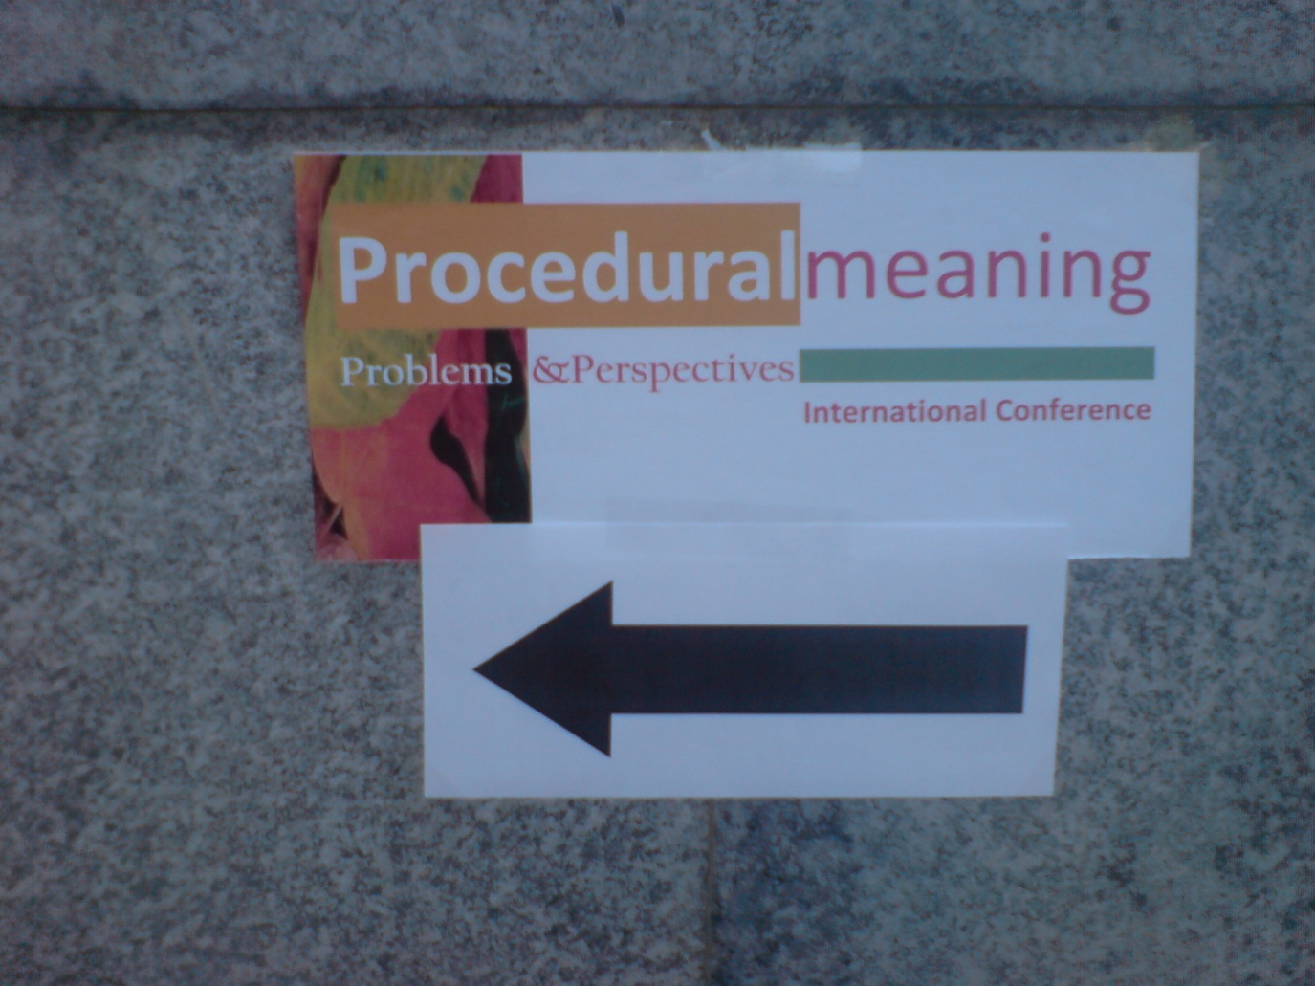
introduction - procedural meaning - prosody - prosody and other meanings - questions

Slide 10
introduction - procedural meaning - prosody - prosody and other meanings - questions
Wilson and Wharton (2006) suggest that there are three varieties of prosodic meaning:
Prosodic inputs
‘Natural’
Linguistic
Signs
Signals
Inference
Coding
Coding (plus inference)

Slide 11
introduction - procedural meaning - prosody - prosody and other meanings - questions
‘Natural’ meaning (Grice 1957) arises because of a causal connection between the phenomenon and its meaning (smoke ‘means’ fire).
A distinction between natural signs and natural signals is based on a distinction made by Hauser (1996) in looking at animal communication.

Slide 12
introduction - procedural meaning - prosody - prosody and other meanings - questions
Natural signs: are not inherently communicative (this is not their main function) and are understood by inference.
e.g. chimpanzee nests provide evidence (to forest monkeys) of the presence of chimpanzees but they are not built in order to communicate this (they would still build them even if there were no forest monkeys to interpret this evidence)…
Tree rings are another example…

Slide 13
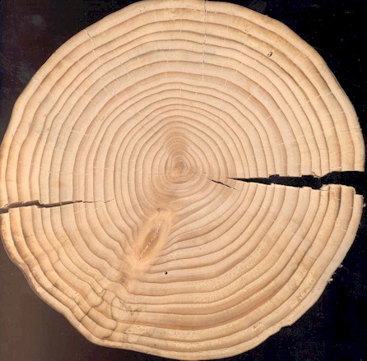
introduction - procedural meaning - prosody - prosody and other meanings - questions

Slide 14
introduction - procedural meaning - prosody - prosody and other meanings - questions
Natural signals: are inherently communicative (this is their main function) and are understood by a process of decoding.
e.g. honeybee dances provide information about the location of nectar (there is no reason to assume the dances would exist if they did not have this communicative function)
The alarm calls of vervet monkeys are another example…

Slide 15

introduction - procedural meaning - prosody - prosody and other meanings - questions
Natural signals: are inherently communicative (this is their main function) and are understood by a process of decoding.

Slide 16
introduction - procedural meaning - prosody - prosody and other meanings - questions
Wharton (2003, 2009) illustrates the sign-signal distinction in human behaviour by considering shivering and smiling.
Shivering might provide evidence that someone is cold but its main function is to provide heat through rapid muscle movement.
Smiling, on the other hand, seems to have evolved to fulfil a communicative function.
Wilson and Wharton claim that there are prosodic inputs which count as examples of natural signs and natural signals, as well as linguistic prosodic inputs.

Slide 17
introduction - procedural meaning - prosody - prosody and other meanings - questions
To summarise, then, there are three types of prosodic inputs:
Natural signs: (comparable to shivering) provide evidence for a conclusion but are not designed to be communicative, e.g. prosody affected by tiredness/nervousness/
drunkenness, etc.
Natural signals: (comparable to smiling) reveal information via innately determined interpretive codes, e.g. affective tones of voice
Linguistic prosody: (comparable to other linguistic expressions) provide coded information which is the starting point for inferential interpretation

Slide 18
introduction - procedural meaning - prosody - prosody and other meanings - questions
We’ve been developing a proposal for some tones (fall, rise, fall-rise, level) of an idealised version of a variety of ‘Southern British English’ (Clark 2007).
In each case, we’re assuming an idealised speaker with no variation and ignoring both the fact that there are a range of different ways of realising each of the different tones and the effects of different tonicity.

Slide 19
introduction - procedural meaning - prosody - prosody and other meanings - questions
In developing our account, we aim to account for the intuitions/observations that:
Falls seem to be ‘default’ tones, in some sense
Intonational meaning seems to be ‘natural’ in some sense (can be understood as having a large ‘pragmatic’ component)

Slide 20
introduction - procedural meaning - prosody - prosody and other meanings - questions
We followed previous approaches (e.g. Fretheim 1998, Escandell-Vidal 2002) in assuming that the tones guide hearers in constructing higher-level explicatures (explicatures which contain other embedded explicatures).
At each stage we proposed as little linguistic encoding as we felt was needed in order to help account for the interpretation of utterances with the tone we were looking at.

Slide 21

introduction - procedural meaning - prosody - prosody and other meanings - questions
FALL:
‘The proposition expressed is entertained as either a description of a state of affairs or as an interpretation of a thought of someone other than the speaker at the time of utterance.’
There is a sense in which this is a ‘default’ tone (in this variety of English) and this proposed analysis could be understood as a rather complex way of actually not stating very much (since all utterances could be understood either as descriptions or interpretations like this).

Slide 22
introduction - procedural meaning - prosody - prosody and other meanings - questions
FALL:
‘The proposition expressed is entertained as either a description of a state of affairs or as an interpretation of a thought of someone other than the speaker at the time of utterance.’
This is consistent with a wide range of uses, including statements, questions, attributed speech and thought…

Slide 23
introduction - procedural meaning - prosody - prosody and other meanings - questions
RISE:
‘An explicature of the utterance is entertained as an interpretation of a thought not entertained by the speaker at the time of utterance.’
This encodes something quite specific but only about one explicature of the utterance and so this is consistent with a wide range of interpretations (including some that seem very similar to what is possible for falls, e.g. ‘uptalk’).

Slide 24
introduction - procedural meaning - prosody - prosody and other meanings - questions
FALL RISE :
‘The proposition expressed is entertained as either a description of a state of affairs or as an interpretation of a thought of someone other than the speaker at the time of utterance AND an explicature of the utterance is entertained as an interpretation of a thought not entertained by the speaker at the time of utterance.’
This sees fall-rise as amounting roughly to what might have been compositionally derived from the combination of a fall and a rise.

Slide 25
introduction - procedural meaning - prosody - prosody and other meanings - questions
Interaction between conceptual and procedural meaning:
‘disappointed’ encodes a general concept: DISAPPOINTED
(covering a range of degrees and types of disappointment).
What the speaker may intend to express is a narrower concept, indicated by her tone of voice, facial expression, etc. Thus, the hearer will understand the speaker as expressing a narrowed concept – DISAPPOINTED* – commensurate with the degree and type of disappointment the speaker intends to convey.

Slide 26
introduction - procedural meaning - prosody - prosody and other meanings - questions
Interaction between conceptual and procedural meaning:
Sometimes, the speaker might be less disappointed.

Slide 27
introduction - procedural meaning - prosody - prosody and other meanings - questions
Any coding that functions to narrow down the search space for contextual assumptions during the inferential phase of comprehension is a candidate for procedural encoding.
Questions:
Can/should we distinguish guides from instructions?
Procedures from meta-procedures?

Slide 28
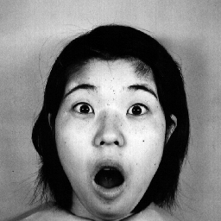
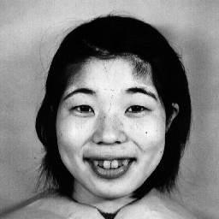
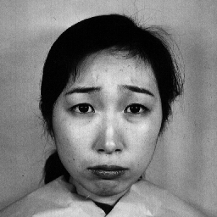
introduction - procedural meaning - prosody - prosody and other meanings - questions
Facial expressions:
Smiling and other spontaneous facial expressions “have been selected and refined over the course of evolution for their role in social communication”, (Ekman 1999, 51)

Slide 29


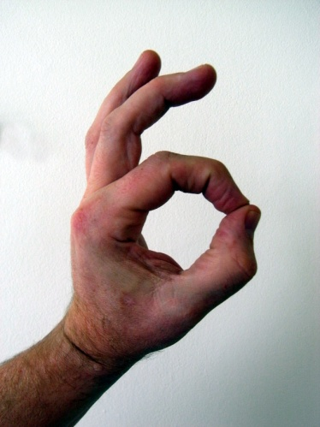
introduction - procedural meaning - prosody - prosody and other meanings - questions
Gestures:

Slide 30
introduction - procedural meaning - prosody - prosody and other meanings - questions
Ultimate aim: to account for the interaction of all kinds of linguistic and non-linguistic communication:

Slide 31
introduction - procedural meaning - prosody - prosody and other meanings - questions
Questions:
How can we decide which elements of prosody are linguistic and which are not?
How can we draw distinctions between linguistic coding, natural coding and purely cultural coding?

Slide 32
introduction - procedural meaning - prosody - prosody and other meanings - questions
There are still many questions to explore, including empirical questions about the existence of these different kinds of coding, how well the proposal handles existing data and how it might be tested by informant judgements, perceptual experiments, etc.
Our idealised analyses of tones are consistent with a wide range of interpretations of utterances. Can we show that they make it possible to explain how interpretations are actually inferred in context?

Slide 33
THE END — THANK YOU!
b.clark@mdx.ac.uk
twharton@clara.co.uk

