Slide 1
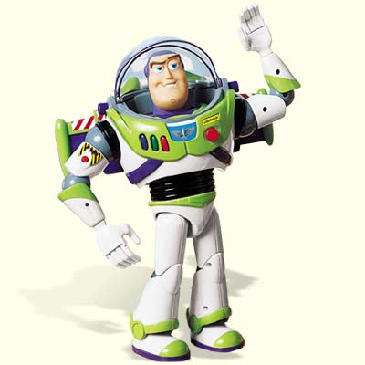

St Francis Xavier College, July 2009
Falling With Style:
Linguistic meaning in the classroom and beyond
Billy Clark, Middlesex University
b.clark@mdx.ac.uk

Slide 2
Before We Start
Discuss each of the following examples with a partner. Indicate whether you think each one sounds like a reasonable and unsurprising thing to say or whether you think there would be something odd about them. If any of them do they _x0008_sound odd, say in what way you think they might be odd.
’I was not cheated. You cheated me.’
‘That medicine you gave me was bogus’
‘Some elephants are mammals’
‘I’m just saying’
‘There’s a pub’

Slide 3
Before We Start
Here’s a little more info about each of these examples:
’I was not cheated. You cheated me.’
http://languagelog.ldc.upenn.edu/nll/?p=1540
‘That medicine you gave me was bogus’
http://billydug.typepad.com/londonlanguage/2009/06/the-meaning-of-bogus.html
‘Some elephants are mammals’
http://ling.ucsd.edu/events/colloquia/06-07/061113crain.html
‘I’m just saying’ (MEANING DEPENDS ON THE CONTEXT)
‘There’s a pub’ (MEANING DEPENDS ON THE CONTEXT)

Slide 4
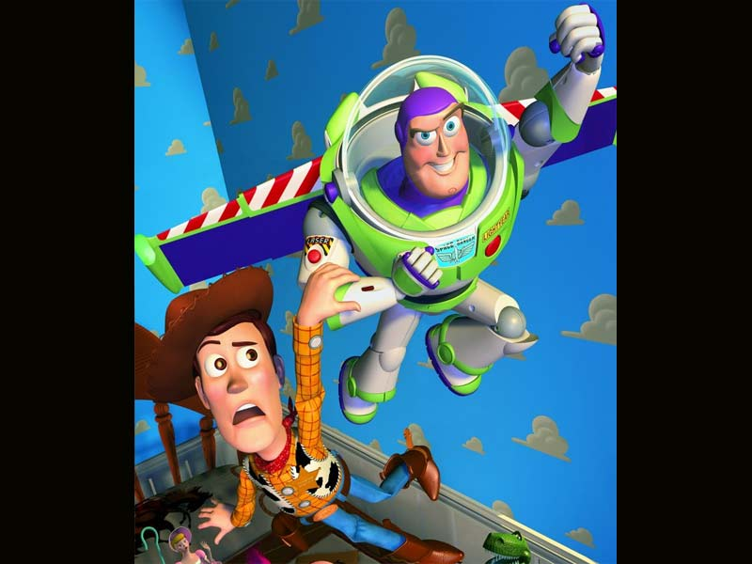
This Session
In this session, we’ll begin by thinking about what kinds of things contribute to linguistic meaning, focusing in particular on the difference between meanings that depend largely on the words used and meanings that depend on the context and assumptions we make about the speaker’s intentions. We’ll then think about how an understanding of some of these things might be useful more generally.
First, we’ll think about the meaning of ‘falling with style’: ...

Slide 5
‘Falling With Style’
A question: what does ‘falling with style’ mean?
Discuss this question in groups of 2 or 3

Slide 6
‘Falling With Style’
What do your answers suggest?
In particular, what do these answers suggest about how ‘falling with style’ has the meaning it does?

Slide 7

Another Example: ‘Seagulls’
http://www.youtube.com/watch?v=bTq6aApCBnA

Slide 8
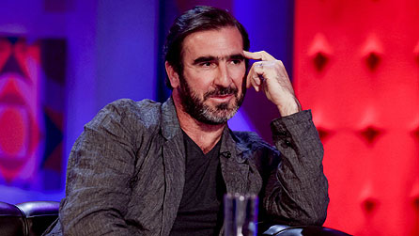
Another Example: ‘Sense and Situations’
http://www.youtube.com/watch?v=AO0k3j7W1zU&feature=related

Slide 9
Semantics and Pragmatics
To find out more about, and maybe even explain, these examples we need to be systematic.
Being systematic in looking at tricky data is one of the distinctive feature of work on language and linguistics.
In looking at linguistic meaning, part of this is about separating ‘what the language means’ (linguistic semantics) from what we work out in a particular context (pragmatics).

Slide 10
Linguistic Meanings (Semantics)
Linguistic semantics looks at the meanings ‘encoded’ by linguistic expressions. We can say, for example, that the word bat encodes at least two meanings and the word gay at least four:
  bat: 1. ‘flying rodent’; 2. ‘piece of sports equipment’
  gay: 1. ‘bright/colourful’; 2. ‘happy’ 3. ‘homosexual’;
  4. ‘unfashionable, uncool’
We can explain some variation among speakers in terms of how many senses of particular terms they are aware of.

Slide 11
‘Contextual’ Meanings (Pragmatics)
Pragmatics looks at how we work out meanings in particular contexts. Here are two examples:
‘Ozzy’:
A: Ozzy Osbourne’s coming to dinner
B: I’ll bring a bat
‘coffee?’:
Gloria: Do you want to come up for a coffee?
Andy: I don’t drink coffee
Gloria: I haven’t got any
(from the film Brassed Off dir. Mark Herman, 1996)

Slide 12
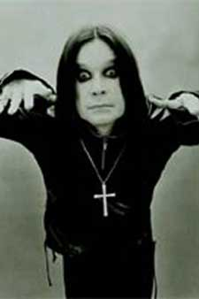
‘Contextual’ Meanings (Pragmatics)
To understand the first of these, one thing you need to know is that Ozzy Osbourne once bit the head off a live bat during a performance. Read about it here:
http://www.femalefirst.co.uk/celebrity/Ozzy+Osbourne-3925.html

Slide 13
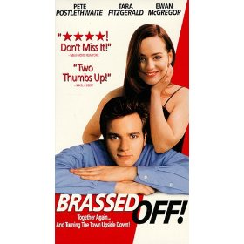
‘Contextual’ Meanings (Pragmatics)
To understand the ‘coffee’ example, you need to know that there is a standard assumption that an invitation for coffee at the end of a date often implies something more than coffee. The humour is based on Andy’s innocent response and Gloria’s response to that which makes clear that coffee was not really relevant to her main intentions.

Slide 14
Distinguishing Semantics and Pragmatics
In groups of 2 or 3, see if you can separate the linguistic from the contextual meaning in the examples below. One way to approach this is to make a list of questions you’d need to know the answer to in order to understand it. Each of these questions will represent an aspect of ‘contextual’ meaning (i.e. pragmatics).
  ‘It’s the same’
  ‘You’re not going to die’
  ‘It’s too hot’

Slide 15
Distinguishing Semantics and Pragmatics
Now look at the same examples but imagining the kind of context outlined for each one:
  ‘It’s the same’
  (Context: Billy has just asked Sylvia whether she can play 12-string guitar and Sylvia replies like this)
  ‘You’re not going to die’
  (Context: a child has cut herself and her mother says this)
  ‘It’s too hot’
  (Context: you’ve invited me to play tennis with you)

Slide 16
Back To Some Earlier Examples
Can you see how distinguishing semantics from pragmatics might help you to explain the examples we looked at before?
’I was not cheated. You cheated me.’
‘That medicine you gave me was bogus’
‘Some elephants are mammals’
‘I’m just saying’
‘There’s a pub’

Slide 17
Applying Linguistic Semantics and Pragmatics
Understanding how linguistic meaning works can help us to understand communication in a wide range of situations, including:
Classroom exchanges
‘Contested meanings’ (legal and other)
Stylistics (explaining the effects of texts)
Acquisition/development
Untypical communication (e.g. autistic spectrum, asperger’s syndrome, Williams syndrome)

Slide 18
Classroom Exchanges
Can you see how understanding semantics and pragmatics might be useful in explaining this example?
Student: What do you think of my draft essay?
Teacher: How long did you work on it?
Or in explaining what would be the best response to a student who gives an unexpected answer in a classroom discussion?

Slide 19
‘Contested Meanings’
Can you see how understanding semantics and pragmatics might be useful in discussing the libel case mentioned above?
‘The British Chiropractic Association claims that their members can help treat children with colic, sleeping and feeding problems, frequent ear infections, asthma and prolonged crying, even though there is not a jot of evidence. This organisation is the respectable face of the chiropractic profession and yet it happily promotes bogus treatments.’
(from Simon Singh’s article, ‘Beware the Spinal Trap’, Comment Is Free, The Guardian, April 19 2008)
Or in other disputes about meaning in media and other communication? (e.g. ‘Let him have it’)

Slide 20
Stylistics
Can you see how understanding semantics and pragmatics might be useful in explaining this example?
This is just to say
I have eaten the plums in the icebox
Which you were probably saving
They were delicious
So cold and so fresh
(William Carlos Williams, 1934)
Or in explaining the effects of other literary and non-literary texts?

Slide 21
Acquisition/Development
Can you see how understanding semantics and pragmatics might be useful in explaining this exchange?
Grownup: I don’t suppose any of you would fancy an ice cream right now, would you?
Child: Yes, we do! We do!
Or in explaining other ways in which children understand language at different ages?

Slide 22
Untypical Development
Can you see how understanding semantics and pragmatics might be useful in explaining this example?
The ‘Sally Anne Test’
(http://www.garysturt.free-online.co.uk/baron.htm)
Children are asked individually to respond to this test, while sitting across a desk from the experimenter. They are introduced to two dolls, Sally and Anne. Sally has a basket in front of her. Anne has a box. Sally places a marble in her basket and then goes for a walk. While she is away, Anne moves the marble from Sally’s basket to Anne’s box. Sally comes back. The experimenter asks the child:
‘Where will Sally look for her marble?’
Autistic children tend to reply: ‘In Anne’s box’

Slide 23

Where to find out more
Blakemore, D. 1992. Understanding Utterances. Blackwell, Oxford (good on the distinction between linguistic and contextual meaning).

Slide 24
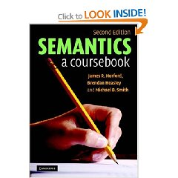
Where to find out more
Hurford, J. Heasley, B. and M. Smith. 2007. Semantics: A Coursebook, 2nd edition. CUP, Cambridge (good on linguistic meaning in general).

Slide 25
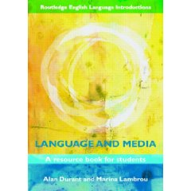
Where to find out more
Durant, A. and M. Lambrou. 2009. Language and Media. Routledge, London (on language and media in general, with an extract from Alan Durant’s forthcoming book on meaning controversies).

Slide 26
THE END (of the session)
Email me for a copy of this presentation or if you have any other questions:
b.clark@mdx.ac.uk

