Slide 1
Boosting Algorithms

Slide 2
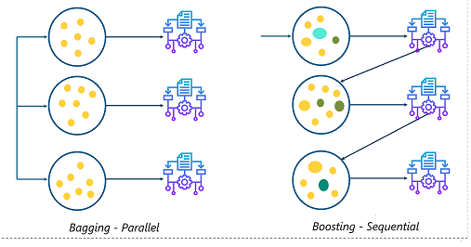
Basics of Machine Learning Algorithm

Slide 3
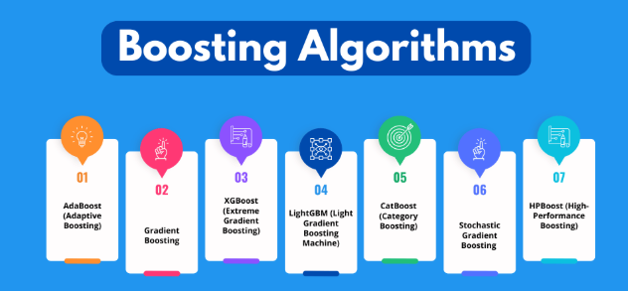

Slide 4
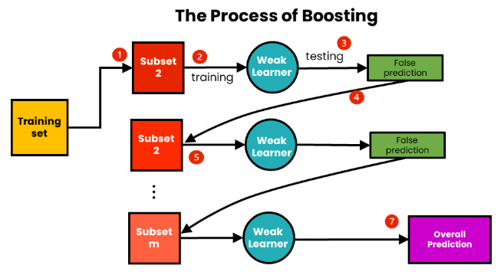

Slide 5
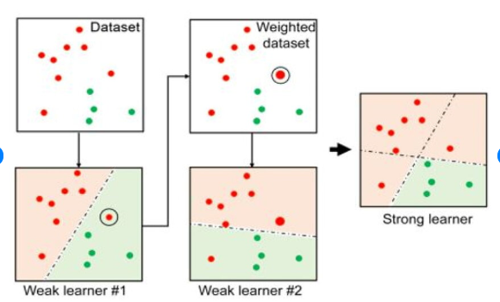
Ada Boost Regression Algorithm Flow

Slide 6
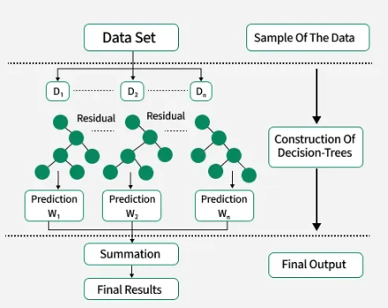
XGBoost Regression Alogrithm Flow

Slide 7
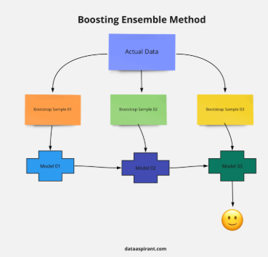
LGBoost Regression Algorithm

