Slide 1
Linguistic Discrimination &
How to Organize Qualitative Data
- The Institute for Computing in Research -
Lucy Evans

Slide 2
Overview
What is linguistic discrimination?
Qualtrics Survey
What is qualitative data?
Organizing qualitative data
What is data binning?
Problems
Questions
Conclusion

Slide 3
What is linguistic discrimination?
Linguistic discrimination is the prejudice against those who speak a certain language, accent, and vocabulary. It’s a common type of discrimination, yet it is not talked about enough.
It’s very important that it is acknowledged more because in a country like America that doesn’t have an “official” language there is tons of discrimination of language’s other than English within America’s systems, societies and the media. We have so many languages that make us a diverse country, yet we punish that diversity.

Slide 4
What is linguistic discrimination?
Linguistic discrimination is the prejudice against those who speak a certain language, accent, and vocabulary. It’s a common type of discrimination, yet it is not talked about enough.
It’s very important that it is acknowledged more because in a country like America that doesn’t have an “official” language there is tons of discrimination of language’s other than English within America’s systems, societies and the media. We have so many languages that make us a diverse country, yet we punish that diversity.

Slide 5
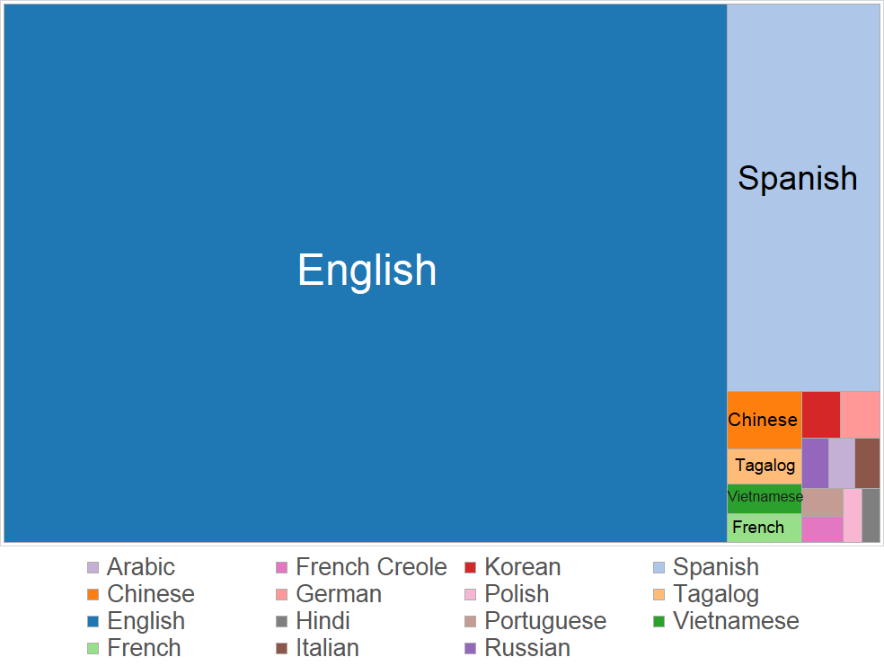
From: Wikipedia Commons

Slide 6
Reed College Linguistic Department Survey
The linguistic department developed a survey using Qualtrics (a survey based program) and the survey consisted of 4 speakers discussing their Reed experience. The speakers all were tagged with questions along the lines of “How would you describe this voice?”, “What grade do you think they are in?” and rating scales between two voice adjectives (like “intelligent” or “pretentious”). The survey’s answers ranged from describing their appearance, voice, and assumed traits. There were thousands of answers to questions that were compiled into a spreadsheet like format into R.

Slide 7
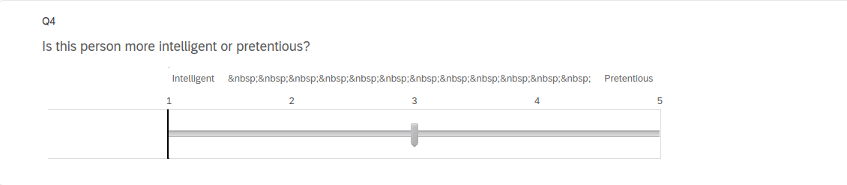

Slide 8
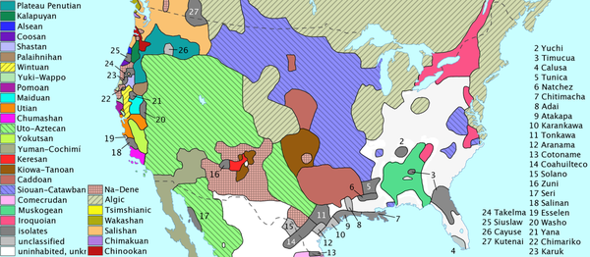
Language’s of the United States

Slide 9
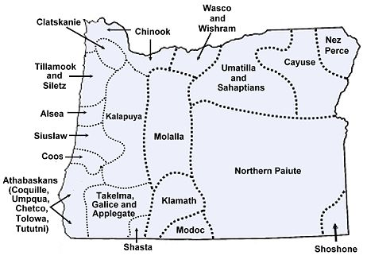
Indigenous History of Oregon Lands

Slide 10
What is qualitative data?
Qualitative data is data that is non-numerical and more descriptive. Like names, locations, and or in the case of the linguistic survey: adjectives.
Qualitative Data | Quantitative Data
Uses non-numerical data like locations, adjectives and names | Uses numerical data like ages, temperatures, and population counts.

Slide 11
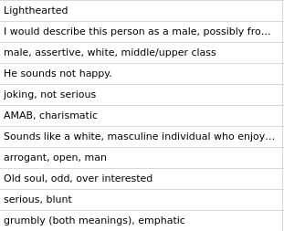
Organizing Qualitative Data
In the survey there is a column dedicated to what the listeners said in regards to the speakers.
Categorizing data based on what adjectives were used and their synonyms.
Using that information to explain the commonalities and differences between Reedies interpretation.

Slide 12
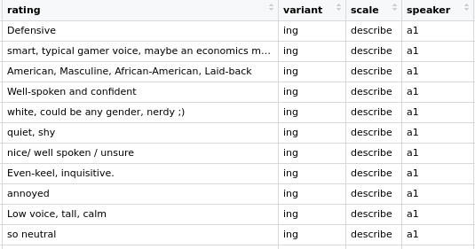

Slide 13
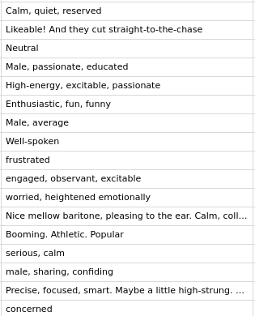

Slide 14
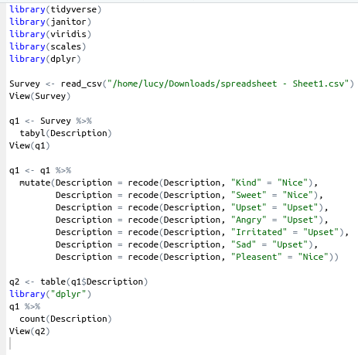
Data Binning
An important aspect of R is it’s ability to conduct data binning. A useful tool for qualitative data as it organizes the data to make it easier to understand.
Data binning is putting similar data into a category that encapsulates both the data points. For example “Sweet” and “Kind” are similar adjectives so they would be put into a category titled “Nice” so that both data points are represented and the data can be more concise and neat.

Slide 15
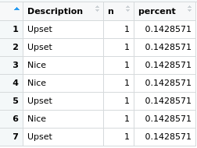


Slide 16
Questions to think about...
Have you ever had an experience with linguistic discrimination, or have you seen linguistic discrimination in place?
If America’s official language is none, then why is English forced upon our society and systems?
What can those who are privileged within linguistic discrimination do to help those who aren’t feel more accepted and free to speak whatever language they want to?

Slide 17
Citations
“Category:Maps of the United States.” Wikimedia Commons, https://commons.wikimedia.org/wiki/Category:Maps_of_the_United_States.
editor, L. to the. (2017, December 13). Linguistic discrimination: Speak English by force or by choice? The Collegian. Retrieved August 3, 2022, from https://collegian.csufresno.edu/2017/12/linguistic-discrimination-speak-english-by-force-or-by-choice/#.YuRgDdLMJkg
Erik Marsja. (2021, July 1). R count the number of occurrences in a column using dplyr. Erik Marsja. Retrieved August 3, 2022, from https://www.marsja.se/r-count-the-number-of-occurrences-in-a-column-using-dplyr/
“Indigenous History of Oregon: Languages.” LibGuides, https://pacificu.libguides.com/c.php?g=1050460&amp;p=7789896#:~:text=Indigenous%20Languages%20of%20Oregon&amp;text=Athabaskan%20(includes%20Clatskanie),Chinuk%20Wawa.
LX Diversity and Discrimination Google Drive from the Reed Linguistic Department // Kara Becker
Midwest New Media, LLC - http://www.midwestnewmedia.com - (513) 742-9150. “Workplace Fairness.” Language Discrimination, //Www.workplacefairness.org, https://www.workplacefairness.org/language-discrimination.
“Open Source &amp; Professional Software for Data Science Teams.” RStudio, 2 Aug. 2022, https://www.rstudio.com/.
“What Is R?” R, https://www.r-project.org/about.html.
Wikimedia Foundation. (2022, May 15). Data binning. Wikipedia. Retrieved August 3, 2022, from https://en.wikipedia.org/wiki/Data_binning
“Word Form and Numerical Form (Solutions, Examples, Videos, Worksheets, Lesson Plans).” Www.onlinemathlearning.com, https://www.onlinemathlearning.com/word-form-numerical-ny.html.

