Slide 1
Linguistic Discrimination &
How to Organize Qualitative Data
- The Institute for Computing in Research -
Lucy Evans

Slide 2
Special Thanks To...
Montreal Benesch, He Bai, Satchel Petty, Parker Scarpa, Leo Latimer and Kara Becker for all the research you shared with me.
Mark Galassi and the Software Freedom Conservancy for this opportunity.
Maria De Hoyos for being an amazing director and all the help in completing this internship.

Slide 3
Overview
What is linguistic discrimination?
Qualtrics Survey
What is qualitative data?
Organizing qualitative data
What is data binning?
Problems
Questions
Conclusion

Slide 4
What is linguistic discrimination?
Linguistic discrimination is the prejudice against those who speak a certain language, accent, and vocabulary. It’s a common type of discrimination, yet it is not talked about enough.
It’s very important that it is acknowledged more because in a country like America that doesn’t have an “official” language there is tons of discrimination of language’s other than English within America’s systems, societies and the media.

Slide 5
Reed College Linguistic Department Survey
The linguistic department developed a survey using Qualtrics (a survey based program) and the survey consisted of 4 speakers discussing their Reed experience. The speakers all were tagged with questions along the lines of “How would you describe this voice?”, “What grade do you think they are in?” and rating scales between two voice adjectives (like “intelligent” or “pretentious”). The survey’s answers ranged from describing their appearance, voice, and assumed traits. There were thousands of answers to questions that were compiled into a spreadsheet like format into RStudio.

Slide 6
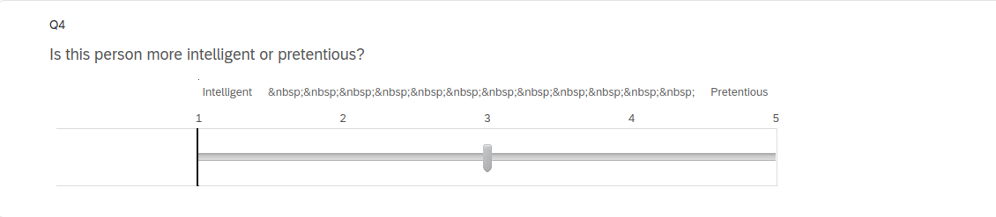

Slide 7
What is qualitative data?
Qualitative data is data that is non-numerical and more descriptive. Like names, locations, and or in the case of the linguistic survey: adjectives.
Qualitative Data | Quantitative Data
Uses non-numerical data like locations, adjectives and names | Uses numerical data like ages, temperatures, and population counts.

Slide 8
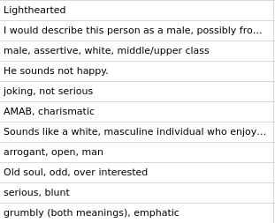
RStudio & Organizing Qualitative Data
RStudio is a editing program for the coding language R. It is used by data scientists and those that are conducting surveys to organize the data in a more understandable way.
The data from the Reed Qualtrics survey was put into RStudio with 40 columns of data organized by each question.
A column I mainly focused on was the “rating”column that had the listeners describe the voices.

Slide 9
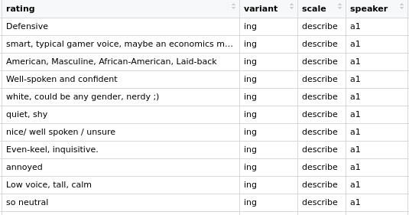


Slide 10
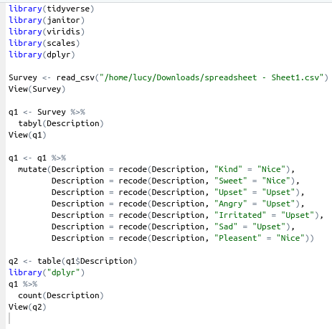
Data Binning
An important aspect of RStudio is it’s ability to conduct data binning. A useful tool for qualitative data as it organizes the data to make it easier to understand.
Data binning is putting similar data into a category that encapsulates both the data points. For example “Sweet” and “Kind” are similar adjectives so they would be put into a category titled “Nice” so that both data points are represented and the data can be more concise and neat.

Slide 11
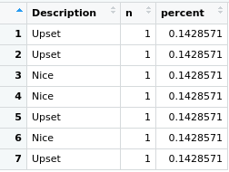


Slide 12
My Dilemma
Within RStudio my goal was to bin the survey data into categories that would create more of an understanding of the results and concise the data so that it isn’t so daunting when it is first seen. However, my main issue was trying to split up single cells that had more than one variable within them. For example some answers from students had: “rude, sounds like a jock, tall” in a single cell. For this type of data I can’t just change the entire cell into “Rude” because that would erase the two other variables within the single cell. So, I could only continue with recoding single cell data with 1 variable like “Upset” or “Very nice”. Hopefully, if I continue messing around with the data I can figure out a better solution to my problem.

Slide 13
Questions to think about...
Have you ever had an experience with linguistic discrimination, or have you seen linguistic discrimination in place?
If America’s official language is none, then why is English forced upon our society and systems?
What can those who are privileged within linguistic discrimination do to help those who aren’t feel more accepted and free to speak whatever language they want to?

Slide 14
Conclusion
I really like using RStudio, and I hope to continue to use it in college for projects.
Hopefully with more practice I’ll be able to successfully bin the data the way its intended to be binned.
Using RStudio is a great tool for exploring qualitative data.

Slide 15
Citations
LX Diversity and Discrimination Google Drive from the Reed Linguistic Department // Kara Becker
editor, L. to the. (2017, December 13). Linguistic discrimination: Speak English by force or by choice? The Collegian. Retrieved August 3, 2022, from https://collegian.csufresno.edu/2017/12/linguistic-discrimination-speak-english-by-force-or-by-choice/#.YuRgDdLMJkg
Erik Marsja. (2021, July 1). R count the number of occurrences in a column using dplyr. Erik Marsja. Retrieved August 3, 2022, from https://www.marsja.se/r-count-the-number-of-occurrences-in-a-column-using-dplyr/
Wikimedia Foundation. (2022, July 28). R (programming language). Wikipedia. Retrieved August 3, 2022, from https://en.wikipedia.org/wiki/R_(programming_language)
Wikimedia Foundation. (2022, July 28). RStudio. Wikipedia. Retrieved August 3, 2022, from https://en.wikipedia.org/wiki/RStudio
Wikimedia Foundation. (2022, June 29). Linguistic discrimination. Wikipedia. Retrieved August 3, 2022, from https://en.wikipedia.org/wiki/Linguistic_discrimination#:~:text=Linguistic%20discrimination%20(also%20called%20glottophobia,)%2C%20modality%2C%20and%20syntax.
Wikimedia Foundation. (2022, May 15). Data binning. Wikipedia. Retrieved August 3, 2022, from https://en.wikipedia.org/wiki/Data_binning

