Slide 1
Boolean Operators

Slide 2
Operators
&& (AND)
|| (OR, two pipes, above the enter button)
! (NOT) Only operates on a single value
>, >=, <, <=, !=, ==

Slide 3
&& (Conditional AND)
Let’s consider these English statements
The sky is blue. (true)
The grass is green. (true)
The sun is purple. (false)
What if we wanted to compare multiple sentences at once?
The sky is blue AND the grass is green. (true)
The grass is green AND the sun is purple. (false)

Slide 4
&& (Conditional AND) Continued...
With && (AND), all statements have to be true.
(The sky is blue) && (the grass is green)
(true) && (true)
True
(The grass is green) && (the sun is purple)
(true) && (false)
False

Slide 5
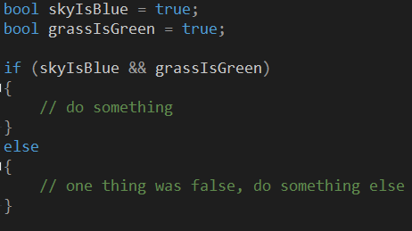
&& (Conditional AND) Continued...
Code Example:

Slide 6
|| (Conditional OR)
Let’s consider these same English statements
The sky is blue. (true)
The grass is green. (true)
The sun is purple. (false)
The dirt is red. (false)
What if we wanted to compare multiple sentences at once?
The sky is blue OR the grass is green. (true)
The grass is green OR the sun is purple. (true)
The sun is purple OR the dirt is pink. (false)

Slide 7
With || (OR), only one statement has to be true.
(The sky is blue) || (the grass is green)
(true) || (true)
True
(The grass is green) || (the sun is purple)
(true) || (false)
True (because one statement was true)
(The sun is purple) || (the dirt is pink)
(false) || (false)
False (because both were false)

Slide 8
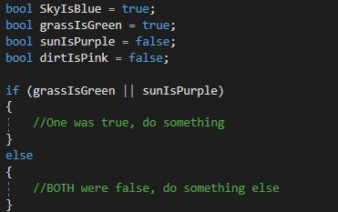
|| (Conditional OR) Continued...
Code Example:

Slide 9
! NOT
Not evaluates as it’s opposite
!true - this value evaluates as false
!false – it’s funny coz its true!

Slide 10
AND, OR and NOT combined
Single conditional statements can be combined
How would you determine if a pitch was a strike?
inStrikeZone || isSwinging
|| (foulBall && numStrikes < 2);

Slide 11
Others
< - Less than
> - Greater than
<= - Less than or equal to
>= - Greater than or equal to
!= - Not equal
== - Equal

Slide 12
Others Continued...
Examples:
5 == 5
9 > 5
4 >= 4
skyIsBlue == grassIsGreen
sunIsPurple != dirtIsPink

Slide 13
Translate to English
if( color == “blue” && size >= 4);
If the color is equal to “blue” and the size is greater than or equal to 4.
if( working != true || hourOfDay < 18)
if( (animal == “dog” || animal != “cat”) && age > 7)

