Slide 1
For/While loops

Slide 2
For loops
Used for repeating an piece of code multiple times
Syntax:
for ( variable; comparison; modifier ) { // code }

Slide 3

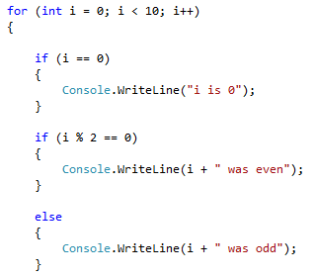
For loops continued...
Code Example:

Slide 4
While loops
Used for repeating an piece of code multiple times, when the value is a conditional statement
Syntax:
while ( comparison ) { // code }

Slide 5
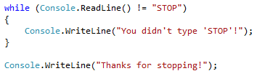

While loops continued
Code Example:

Slide 6
Break && Continue
continue
The continue statement passes control to the next iteration of the enclosing while, for, or foreach statement in which it appears.
break
The break statement terminates the closest enclosing loop in which it appears.

