Slide 1
Case Presentation: Postural Orthostatic Tachycardia Syndrome (POTS)
Lawrence Richer

Slide 2
Clinical History

Slide 3

Dizzy Man

Slide 4
Presenting Complaint
16-year-old girl with dizziness, palpitations, and fatigue, especially upon standing.

Slide 5
History of Present Illness
Symptoms began six months ago, progressively worsening.
Increased dizziness and palpitations in the morning.
Fatigue most days, affecting focus in school.
Near-syncope episodes without loss of consciousness.
Episodes last from seconds to minutes, relieved by lying down.

Slide 6
Past Medical History

Slide 7
History of anxiety, no other significant medical conditions.
No syncope, seizure, or head trauma.

Slide 8
Family History

Slide 9
Mother has migraines; sibling with anxiety.

Slide 10
Social History

Slide 11
High-achieving student; recent cutback in sports due to fatigue.

Slide 12
Review of Systems

Slide 13
Denies chest pain, shortness of breath, or visual changes.
Reports occasional abdominal discomfort and constipation.

Slide 14
Physical Examination

Slide 15
Vital Signs
Supine Vital Signs: HR 78 bpm, BP 110/70 mmHg
Standing (after 10 min): HR 130 bpm, BP 108/68 mmHg
Heart rate increase > 40 bpm from supine to standing.

Slide 16
Physical Findings
Normal cardiac and respiratory exam.
Neurological exam is normal.
Skin: mildly cool extremities, no rash.

Slide 17
Illustrative Questions and Answers

Slide 18
Question 1: Most Likely Diagnosis?
Answer: Postural Orthostatic Tachycardia Syndrome (POTS)
Characterized by heart rate increase upon standing without significant hypotension.
Common symptoms include dizziness, fatigue, and palpitations.

Slide 19
Question 2: Diagnostic Criteria for POTS
Heart rate increase: ≥30 bpm (or ≥40 bpm in adolescents) within 10 minutes of standing.
Symptoms: Lasting ≥6 months.
Exclusion of other causes: Rule out dehydration, medications, etc.

Slide 20
Question 3: Initial Diagnostic Tests
Orthostatic Vital Signs
Head-Up Tilt Test (HUTT)
Blood Tests: Rule out anemia, electrolyte imbalances, thyroid dysfunction.
ECG: Rule out arrhythmias or structural abnormalities.

Slide 21
Question 4: Role of Head-Up Tilt Test (HUTT)
Answer: Confirms diagnosis by showing HR increase without BP drop when tilted to 60–70 degrees.

Slide 22
Question 5: Common Comorbid Conditions with POTS
Anxiety, migraines, irritable bowel syndrome (IBS), chronic fatigue syndrome.
Recognizing comorbidities aids holistic management.

Slide 23
Question 6: Non-Pharmacologic Management
Hydration and salt: 2–3 liters of fluid and salt supplementation.
Physical reconditioning: Lower body strengthening exercises.
Compression garments: Supports venous return.
Small, frequent meals: Prevents postprandial symptoms.
Sleep hygiene and stress management.

Slide 24
Question 7: Pharmacologic Management
Consider if significant symptoms persist.
Beta-blockers (e.g., propranolol) for tachycardia.
Midodrine for vasoconstriction support.
Fludrocortisone for volume expansion.
SSRIs/SNRIs for anxiety or dysautonomia symptoms.

Slide 25
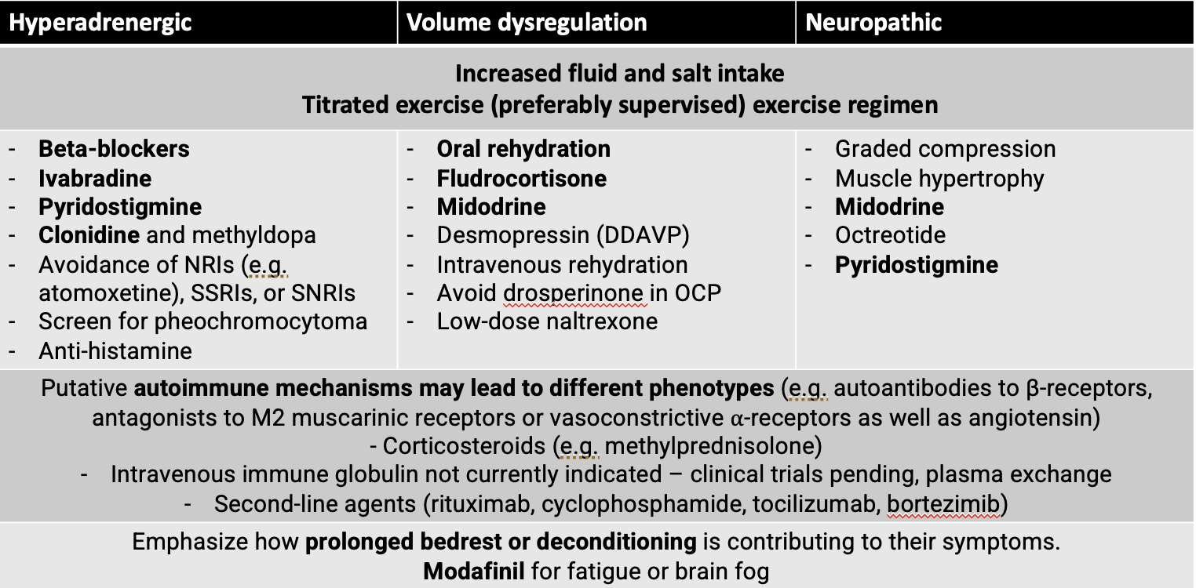
Management
Management

Slide 26
Question 8: Prognosis for Adolescents with POTS
Many improve with non-pharmacologic interventions.
Some experience symptom reduction or resolution by adulthood.

Slide 27
Summary Points for Teaching

Slide 28
POTS is a form of orthostatic intolerance with a hallmark HR increase upon standing.
More common in adolescents, particularly females.
Emphasis on hydration, salt intake, physical reconditioning, and adjunct medications if needed.
Educate on avoiding prolonged standing and rapid positional changes.

