Slide 1
Tech Team Semester Goals

Slide 2
Workshops
Hacking
Computer Science Resources
BU Classes Overview
Extra curricular activities
Job Hunting & Interview Preparation
Agile Development
Machine Learning
Semester Long Project
Teamwork
Overcoming difficulties
Use top tech company api’s
Use trending frameworks and libraries
Utilize agile development methodologies
Solving real world business problems by identifying a current problem and developing a working solution

Slide 3
http://pct-tech-team-spring-2019.s3-website-us-east-1.amazonaws.com/

Slide 4
Why tf are we building a project

Slide 5
Gain “industry” experience
Companies look for work beyond the classroom
Solve a real world business problem
Learn cutting edge frameworks and technologies
Teamwork!

Slide 6
Famous Behavioral Questions by Tech Companies
Talk about a time when you had to work closely with someone whose personality was very different from yours.
Give me an example of a time you faced a conflict while working on a team. How did you handle that?
Tell me about a time you were under a lot of pressure. What was going on, and how did you get through it?
Tell me about a time you failed. How did you deal with the situation?
Describe a long-term project that you managed. How did you keep everything moving along in a timely manner?

Slide 7
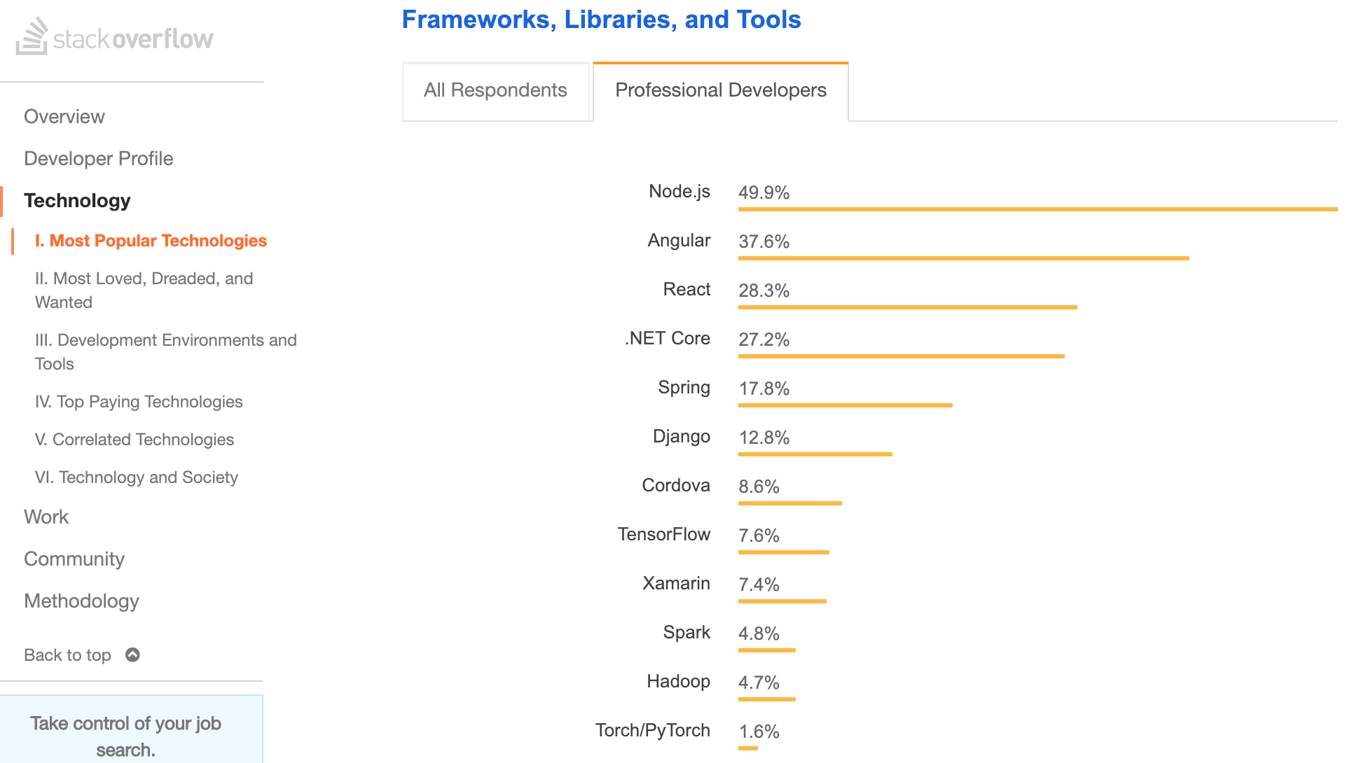
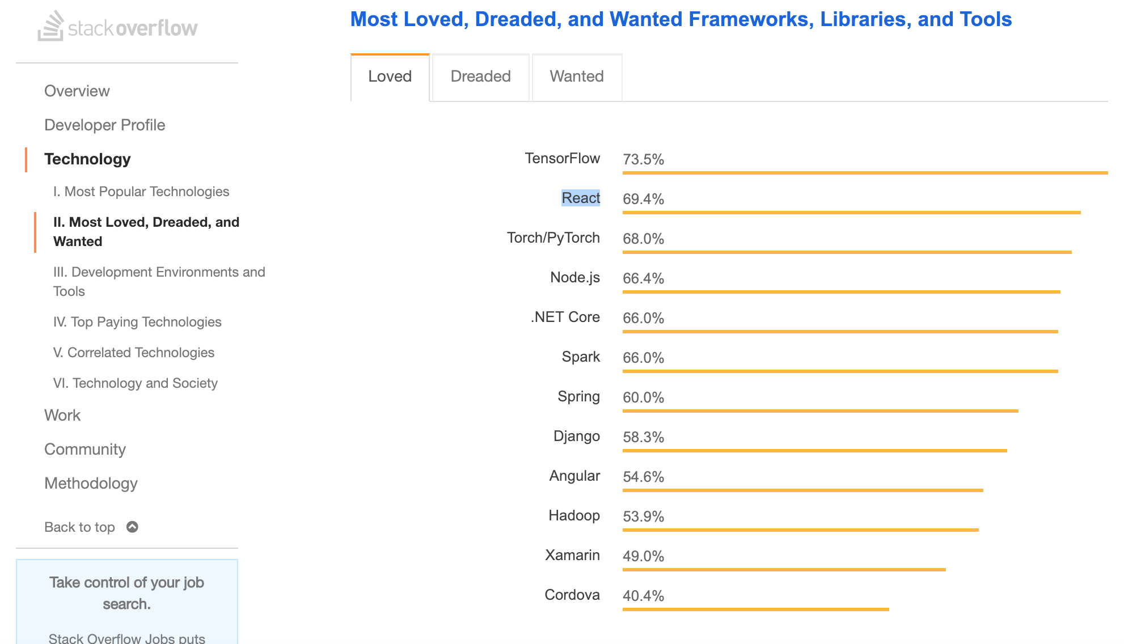
Why React

Slide 8
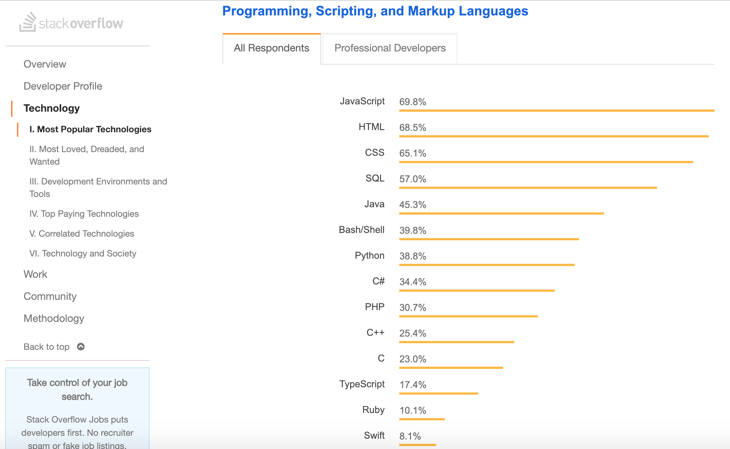
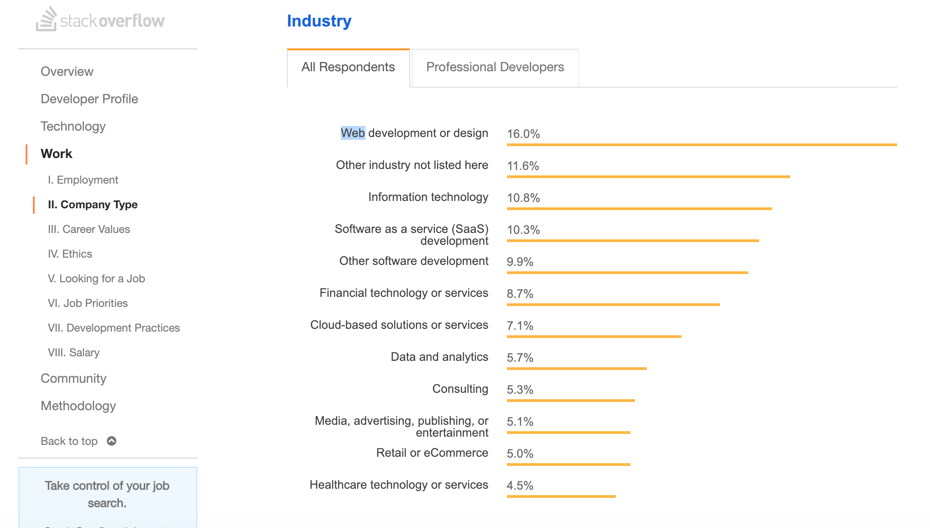
Continued..

Slide 9
What Project are we building

Slide 10
To Solve a Real World Business Problem!!!

Slide 11
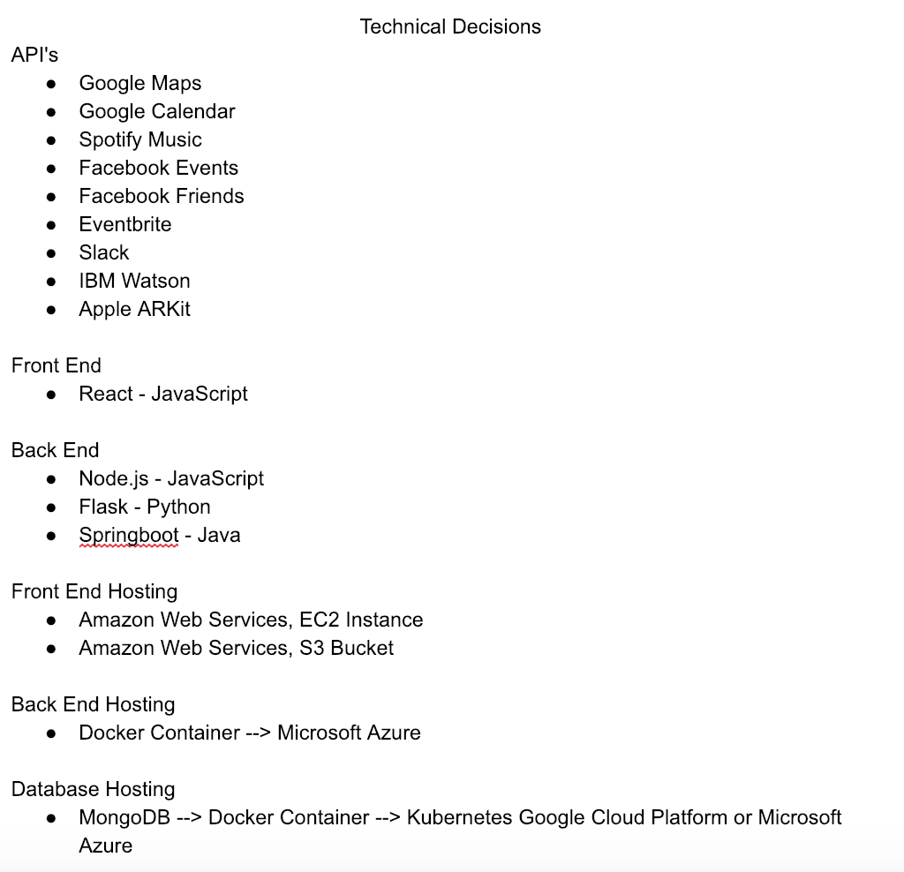
My Proposal

Slide 12
Result
Languages | JavaScript Python or Java
Frameworks / Libraries / Other | Docker Kubernetes Microsoft Azue MongoDB React Amazon Web Services Google Cloud Platform
Tangible “Interview” Skills | Teamwork Strengths and weaknesses “When have you faced struggle working as a team” “How have you overcome a technical challenge” Something on GitHub Utilizing agile development

Slide 13
Thoughts?

