Slide 1
Ideation Portal
Intern Summer Project
July 18, 2019
Silas Adams and Lis Rizvanolli

Slide 2
Contents
01
02
03
04
Problems
Product
Features
Potential

Slide 3
Problems
1

Slide 4
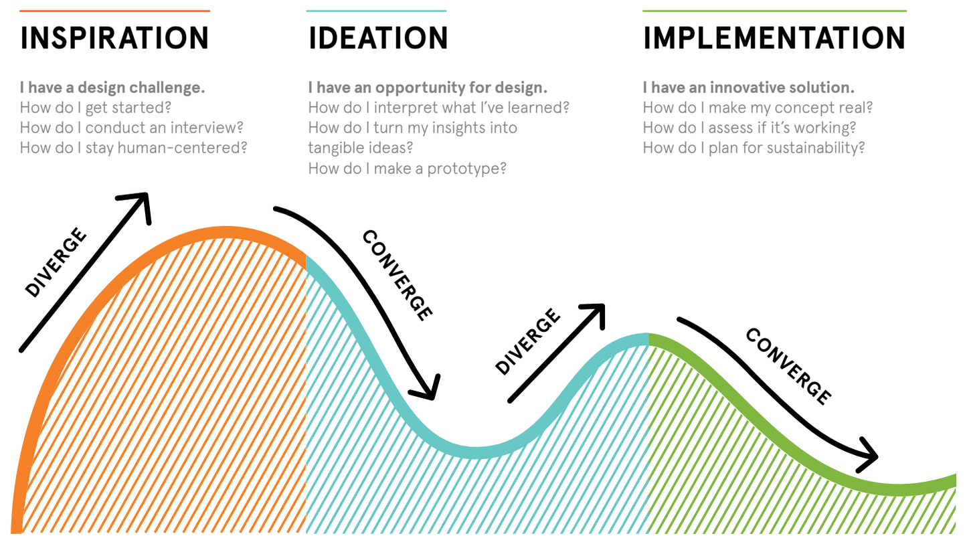
Ideation
Formation of ideas or concepts
39% of 5,000 adults identified as creative
“Creativity is problem solving with relevance and novelty”

Slide 5



Problems
Tool Diversity
Too many are scattered
Searching manually is time consuming
Users can be misguided by online resources
User Motivation
Missing a sense of progression
User is unaware of progress at any point
Sense of progression keeps them coming
Mental Block
Need to soothe the mind
User gets stressed which prevents creativity
Trying to force through only makes creativity worse

Slide 6
Product
2

Slide 7

MindWell
Web application that helps with ideation
Name symbolizes result of using our product
Pink and blue symbolize mind and well
Minimal design prevents distractions

Slide 8
Features
3

Slide 9
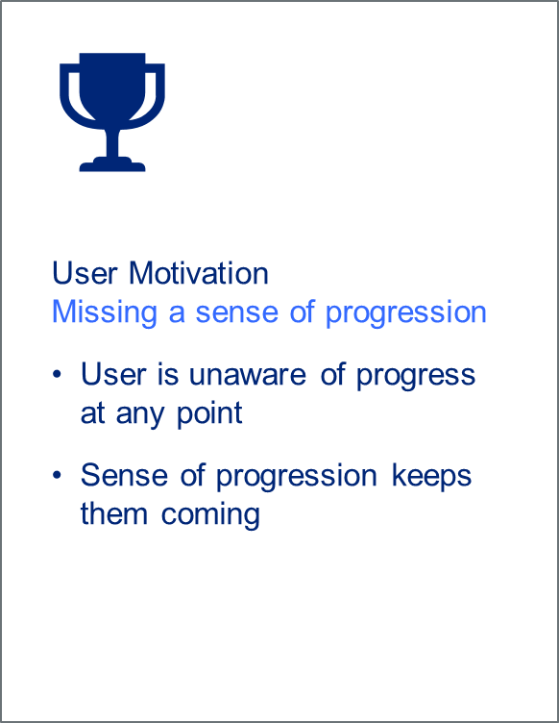
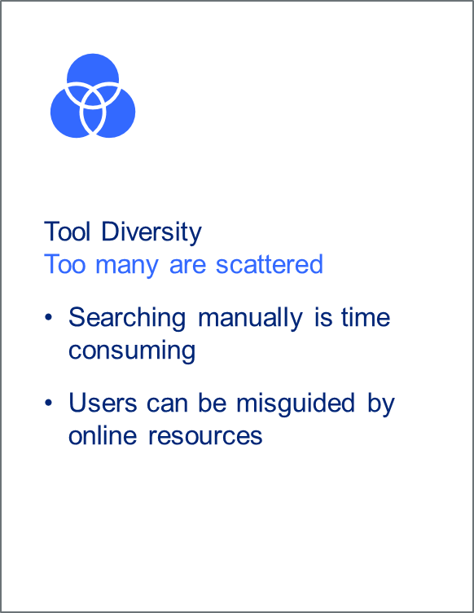
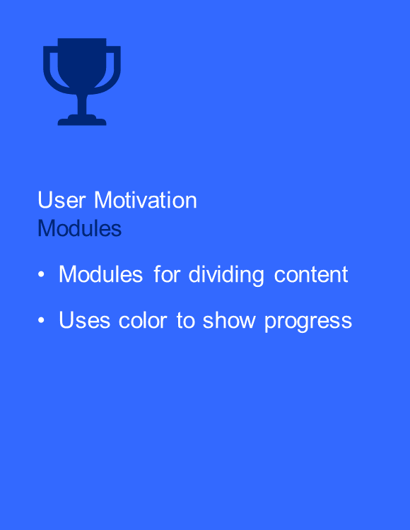
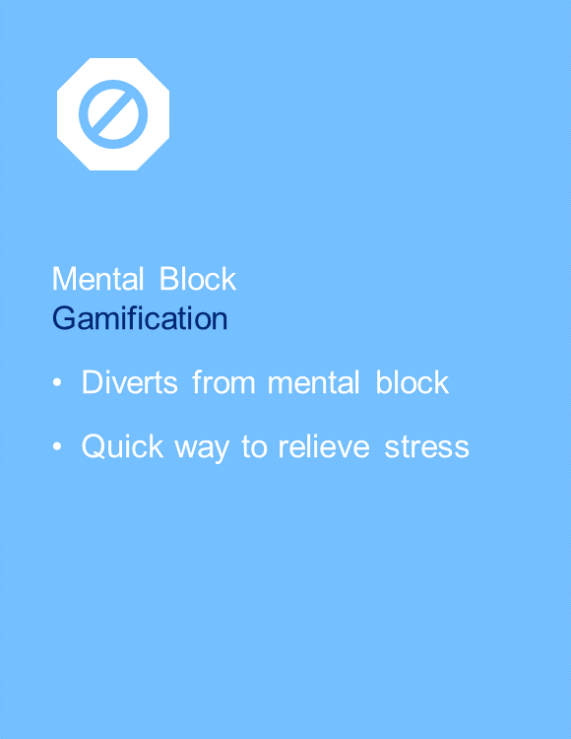
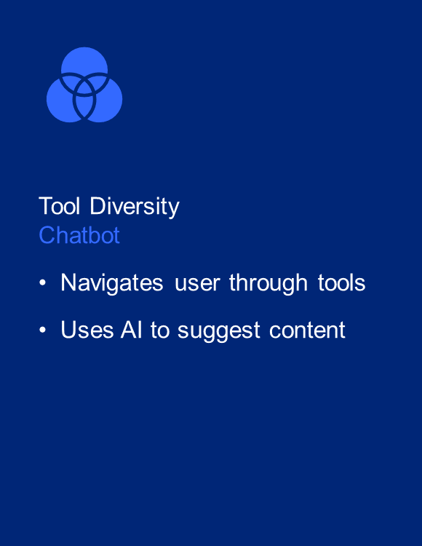
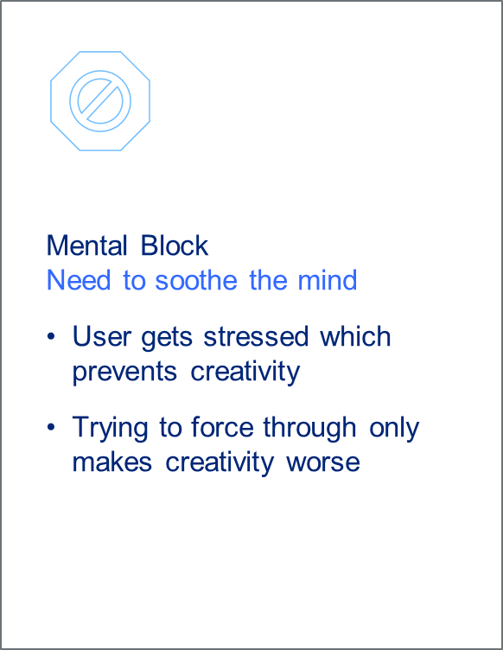

Features

Slide 10
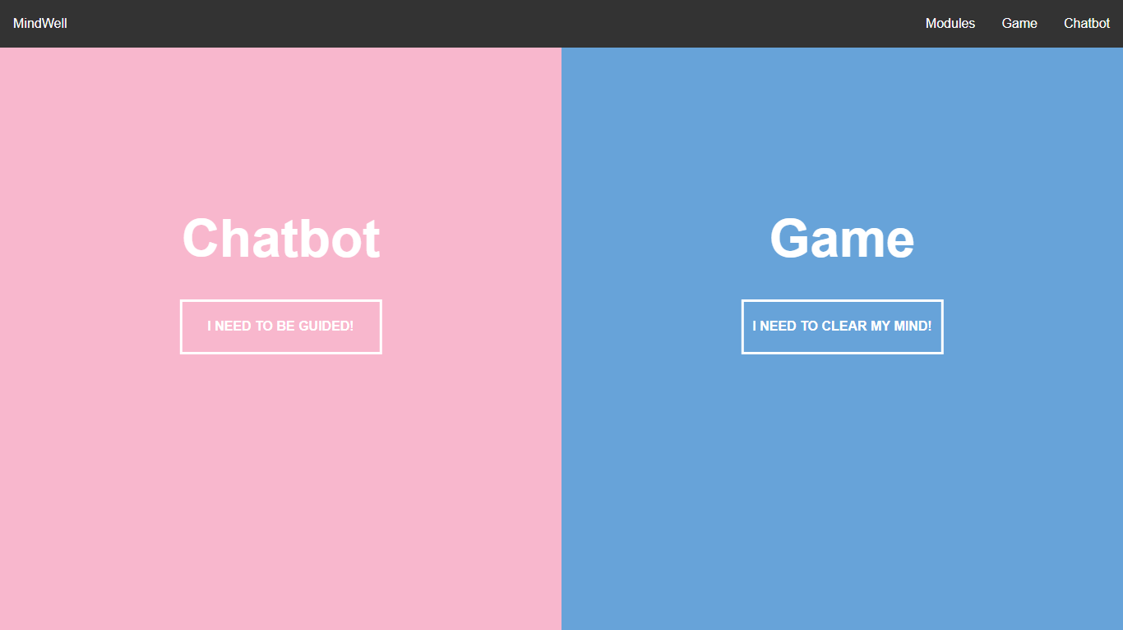
Product

Slide 11
Potential
4

Slide 12
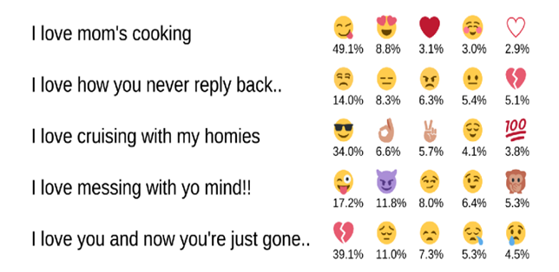
Chatbot
DeepMoji
Emotion detecting UI
Automated navigation

Slide 13
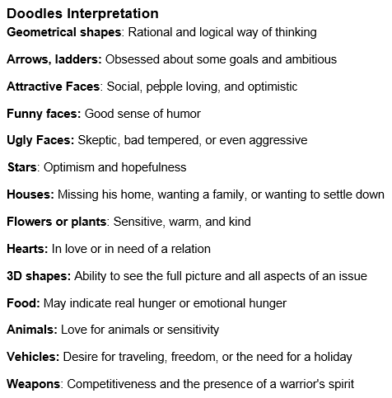
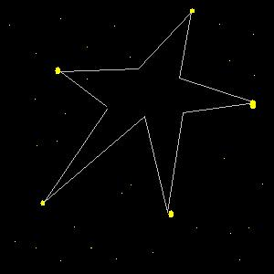
Game
Record traveled path in the background
Reveal the created shape at the end
Diagnose emotions based on interpretation

Slide 14
Conclusion
01
02
03
04
Problems
Product
Features
Potential

