Slide 1
Ideation Portal
Intern Summer Project
June 25, 2019
Silas Adams and Lis Rizvanolli

Slide 2
Contents
01
02
03
04
Problems
Product
Features
Prototype

Slide 3
Problems
1

Slide 4

Ideation
Formation of ideas or concepts
Third step in the design process
Define
Describe
Develop
Demonstrate
Can be a frustrating experience for anyone

Slide 5



Problems
Tool Diversity
Too many are scattered
Searching manually is time consuming
Users can be misguided by online resources
User Motivation
Missing a sense of progression
User is unaware of progress at any point
Sense of progression keeps them coming
Mental Block
Need to soothe the mind
User gets stressed which prevents creativity
Trying to force through only makes creativity worse

Slide 6
Product
2

Slide 7
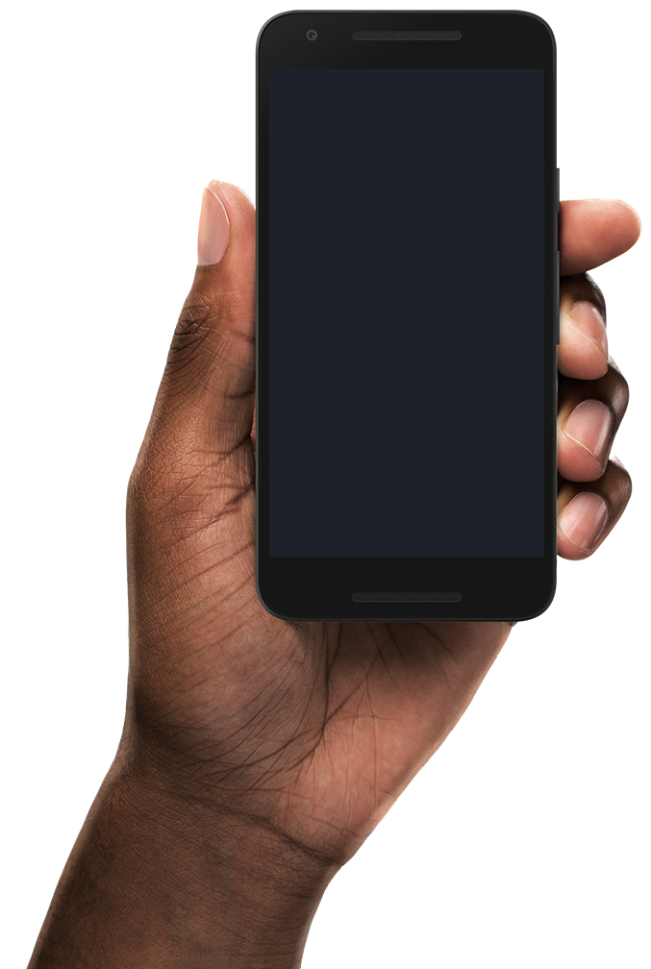
Mind Well
Web application that helps with ideation
Name symbolizes result of using our product
Mind is a well of ideas

Slide 8
Features
3

Slide 9
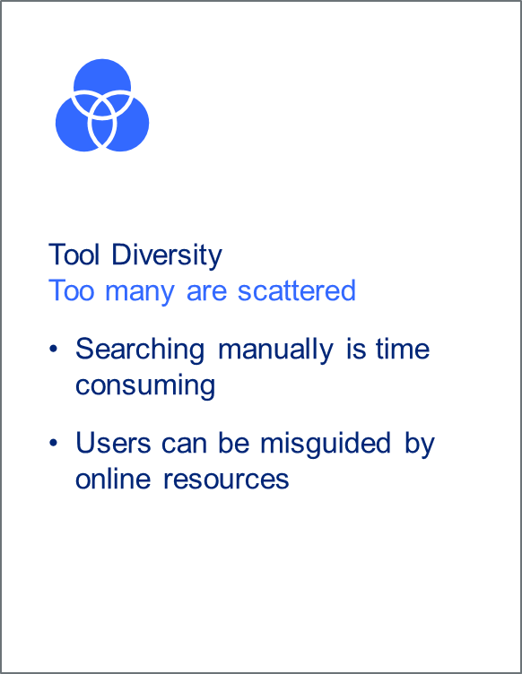
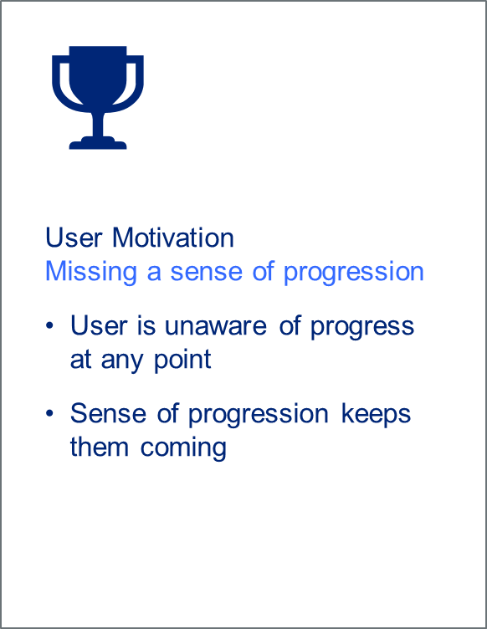
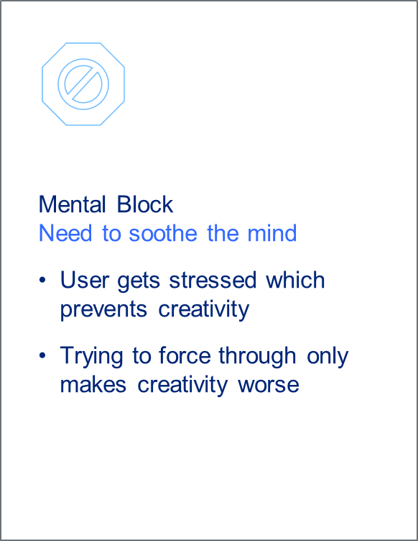
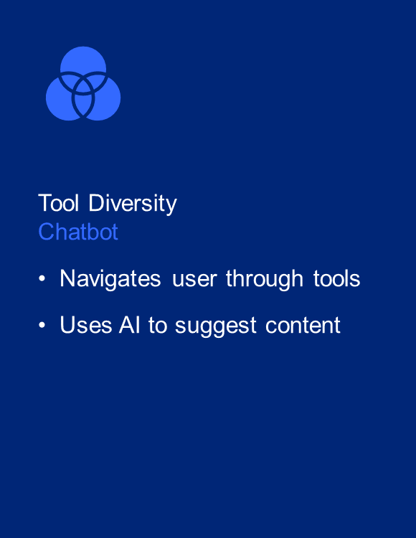
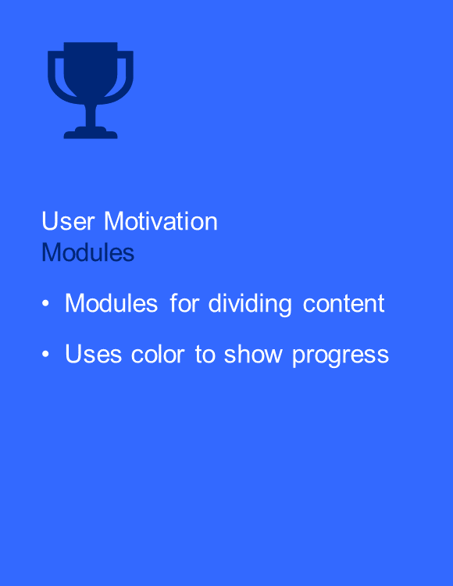
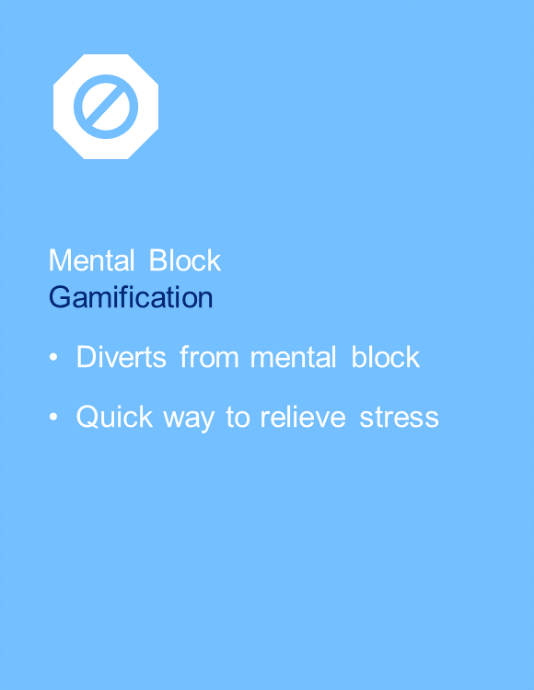



Features

Slide 10
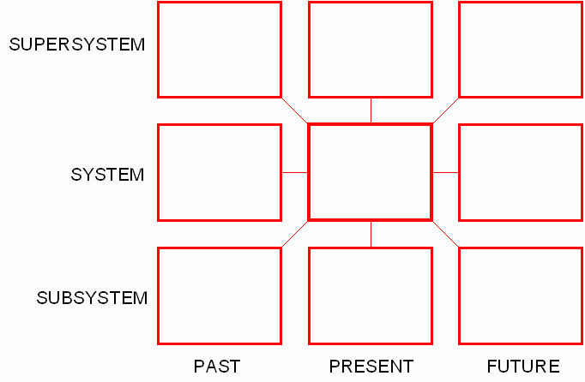
Nine Windows Technique
Examine innovation using time and scale
Problem is surrounded by eight new perspectives
Decide how and where to apply innovation

Slide 11
Prototype
4

Slide 12


Mind Well

Slide 13
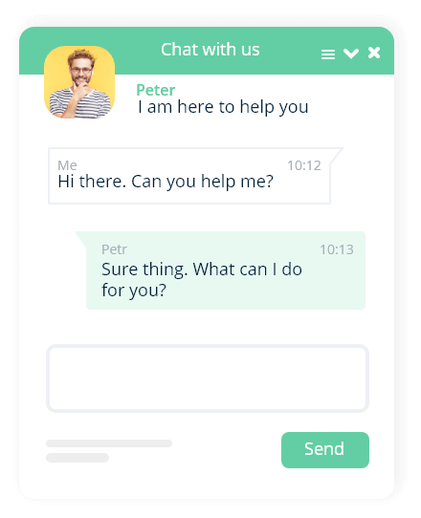

Mind Well - Chatbot

Slide 14


Mind Well - Chatbot

