Slide 1
Ideation Portal
Intern Summer Project
July 18, 2019
Silas Adams and Lis Rizvanolli

Slide 2
Contents
01
02
03
04
Problems
Product
Features
Potential

Slide 3
Problems
1

Slide 4
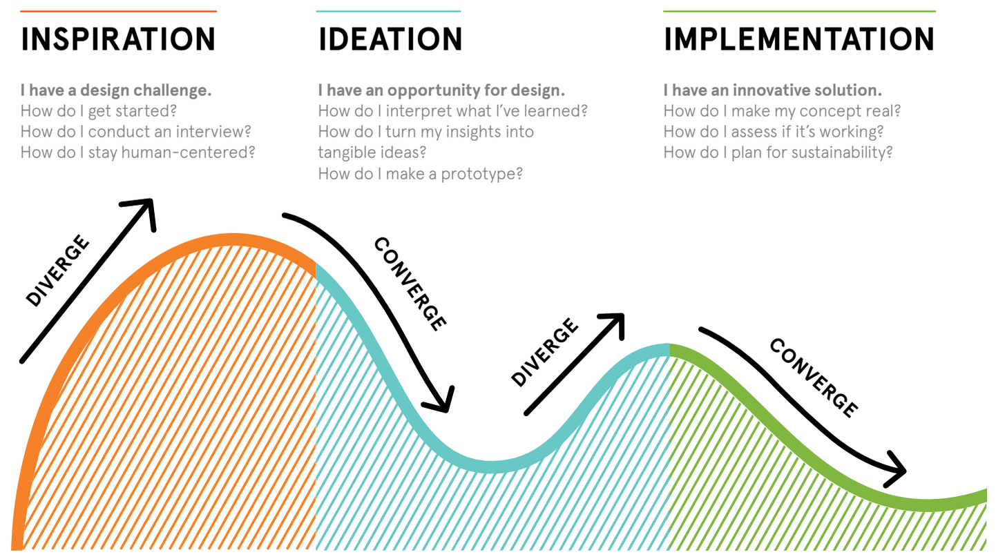
Importance of Ideation
Ideation is the formation of ideas or concepts
Only 39% of 5,000 adults identified as creative
Creativity is problem solving with relevance and novelty

Slide 5



Problems with Ideation
Tool Diversity
Too many are scattered
Searching is time consuming
Possible to be misguided
User Motivation
Missing a path to follow
Unaware of progress
Keeps users interested
Mental Block
Need to soothe the mind
Stressed prevents creativity
Not possible to push through

Slide 6
Product
2

Slide 7
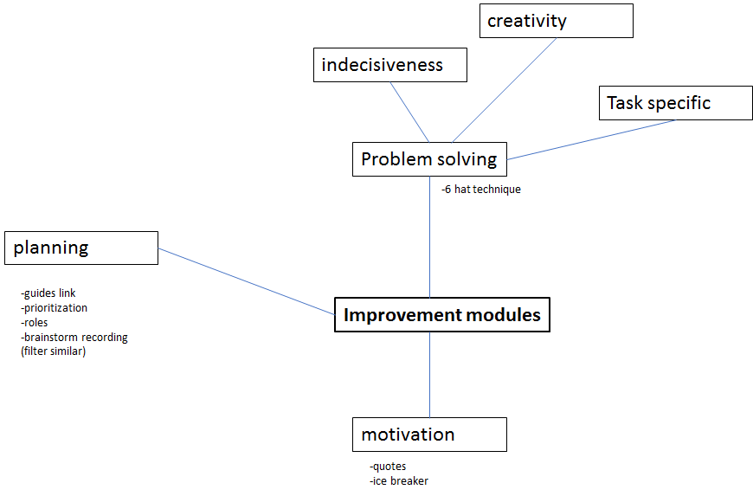
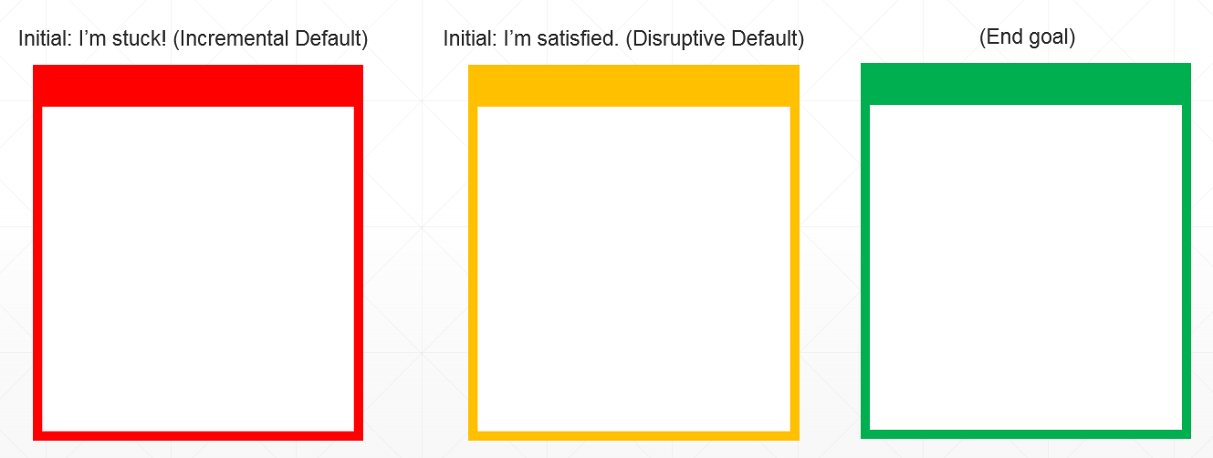
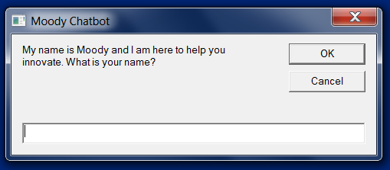
Sprint I
Planned I
Tasked with creating ideation portal and chatbot
Discussed using SharePoint and Azure together
Imagined creating a game and scheduler
Prototyped I
Designed a game using paper and sticky notes
Wrote a chatbot simulation using Visual Basic
Sketched a portal design using storyboards
Presented I
Pivoted away from creating a project scheduler
Focused on personalized emotion analysis
Decided against using SharePoint and Azure

Slide 8

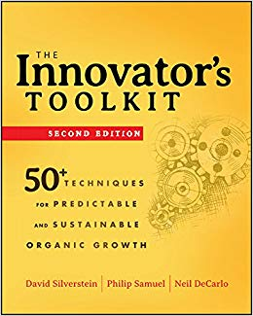
Sprint II
Planned II
Decided on creating a web application
Implementing the D4 Model framework
Found the open-source project DeepMoji by MIT
Prototyped II
Used JavaScript to design chatbot and game
Embedded the D4 Model worksheets with Excel
Decided on a name, logo, and colors scheme
Presented II
Our color scheme came off as unprofessional
Adding game complexity to keep things fresh
Chatbot should automate forms through questions

Slide 9

MindWell
Web application that helps jump start ideation
Name symbolizes result of using our product
Mind and well silhouette creates a light bulb

Slide 10
Features
3

Slide 11
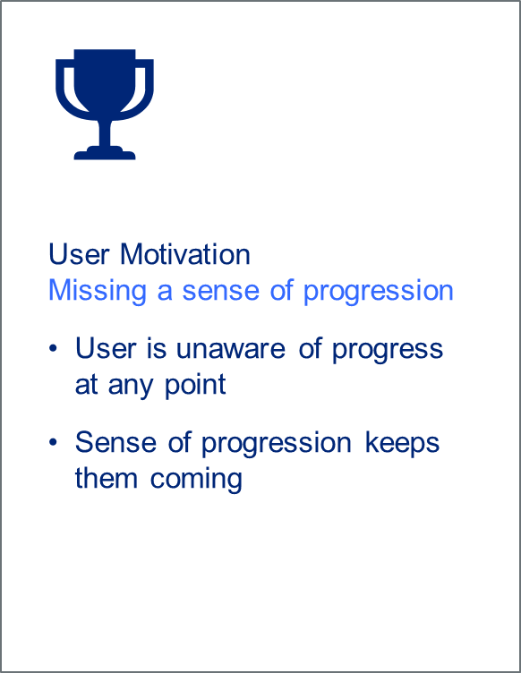
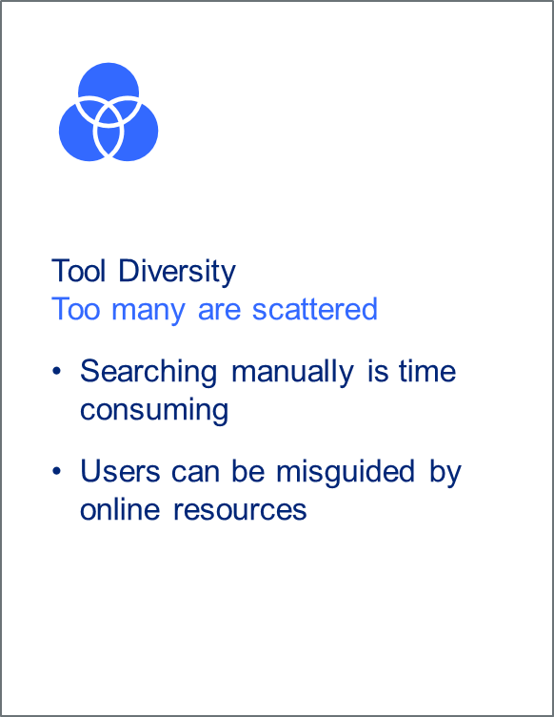
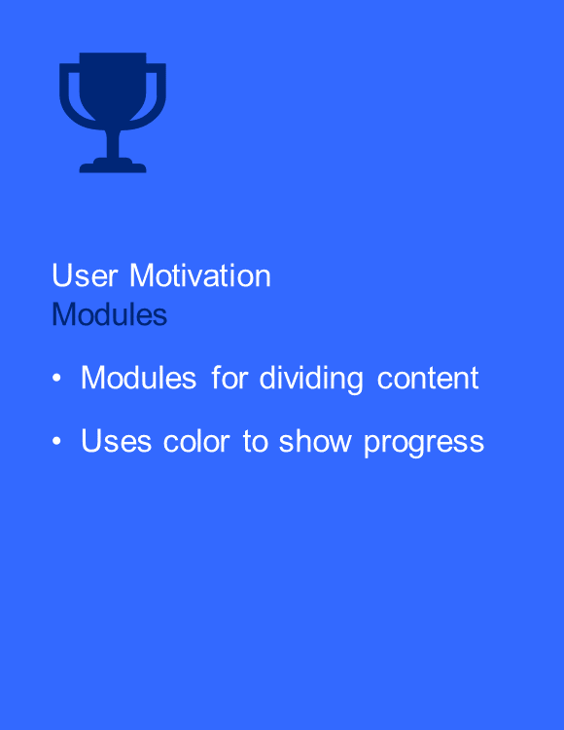
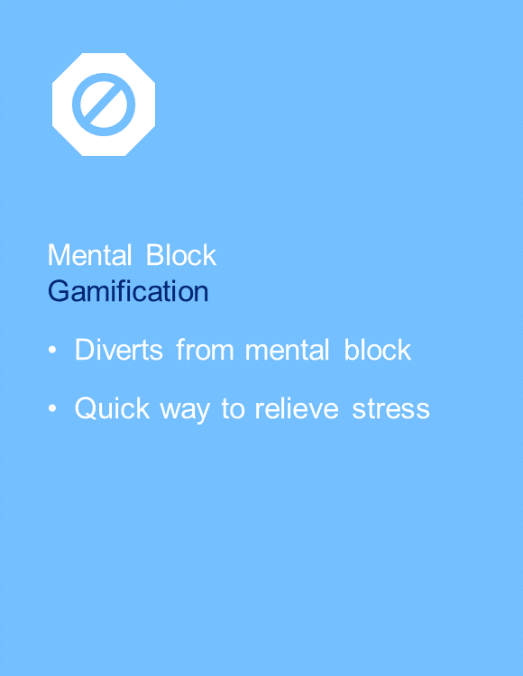
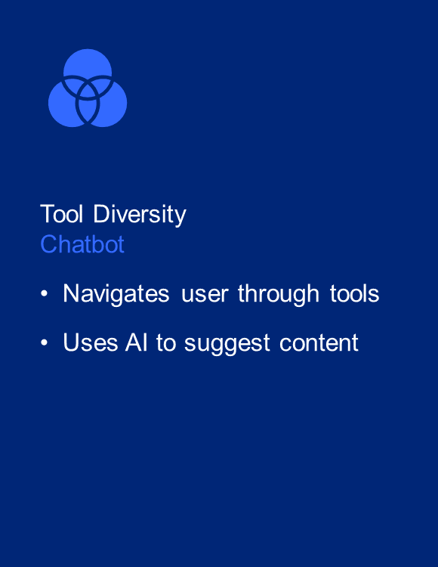
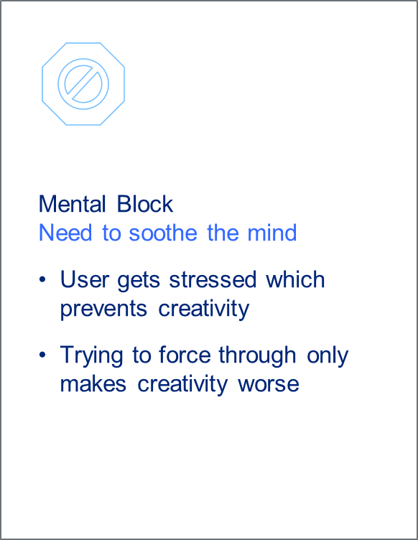

Features Improving Ideation

Slide 12
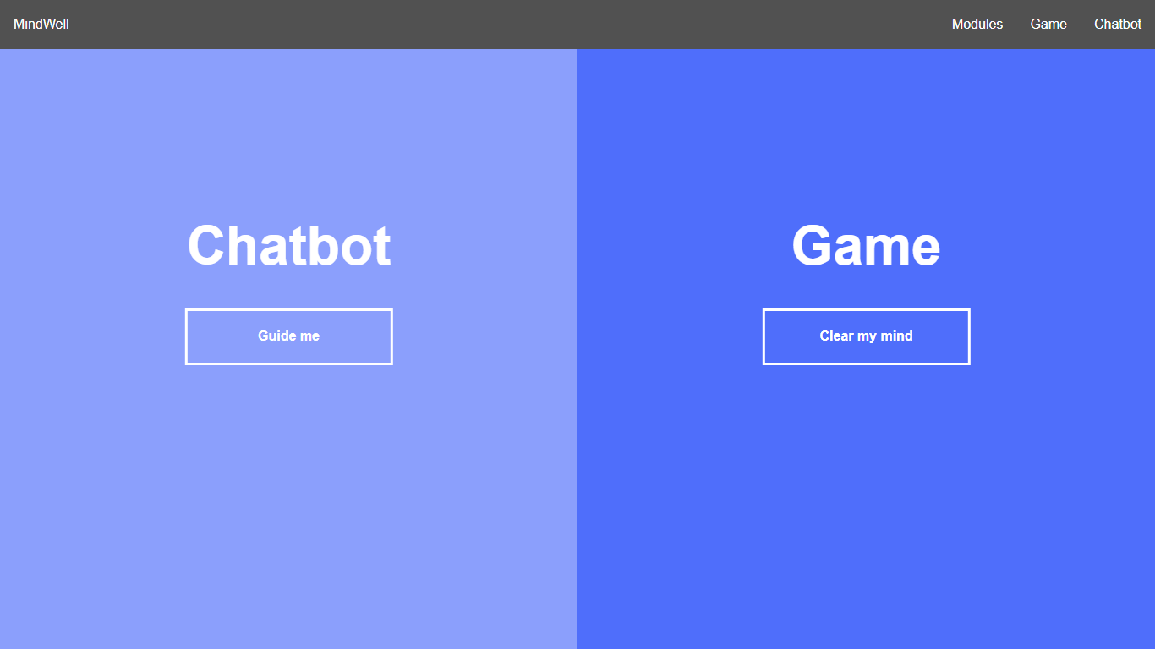
Product

Slide 13
Potential
4

Slide 14
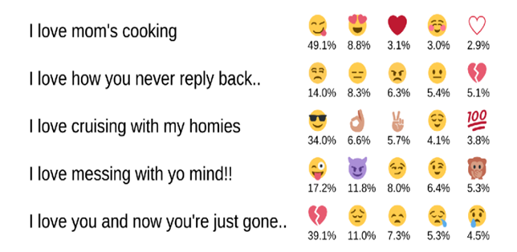
Conversational Chatbot
More realistic conversations with DeepMoji
UI that adjusts based on the detected emotions
Automatically fill out forms through conversation

Slide 15
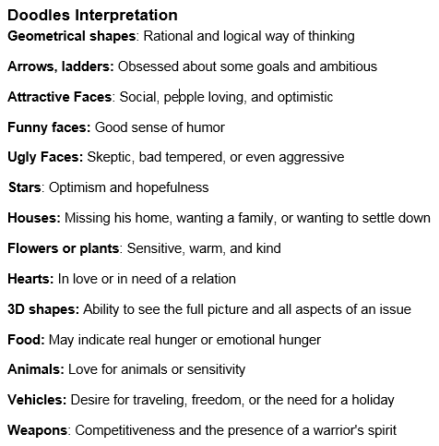

Explorable Game
Incorporate more content to keep it fresh
Reveal the traveled path once completed
Diagnose emotions based on interpretation

Slide 16
Conclusion
01
02
03
04
Problems
Project management
Building relationships
Product
Agile methodology
Product branding
Features
Software Development
Artificial Intelligence
Potential
Disruptive innovation

