Slide 1
Ideation Portal
Intern Summer Project
July 18, 2019
Silas Adams and Lis Rizvanolli

Slide 2
Contents
01
02
03
04
Problems
Product
Features
Potential

Slide 3
Problems
1

Slide 4
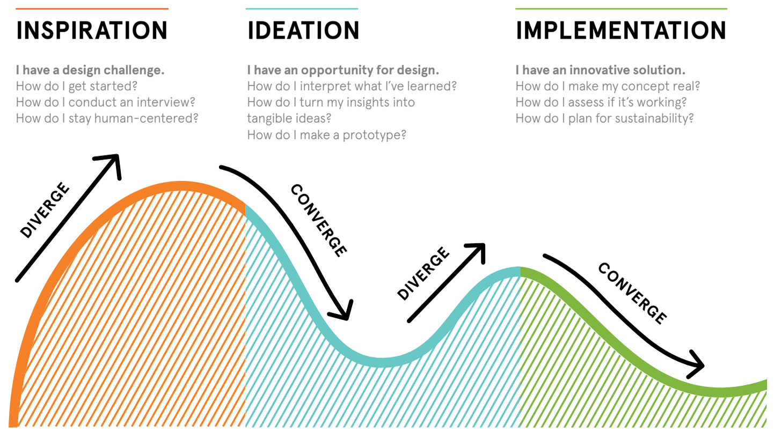
Ideation
Ideation is the formation of ideas or concepts
39% of 5,000 adults identified as creative
“Creativity is problem solving with relevance and novelty”

Slide 5



Problems
Tool Diversity
Too many are scattered
Searching manually is time consuming
Users can be misguided by online resources
User Motivation
Missing a sense of progression
User is unaware of progress at any point
Sense of progression keeps them coming
Mental Block
Need to soothe the mind
User gets stressed which prevents creativity
Trying to force through only makes creativity worse

Slide 6
Product
2

Slide 7
Sprint I and II
Planned I
Tasked with creating ideation portal and chatbot
Were told of potentially using SharePoint and Azure
Imagined a game for relieving stress
Potentially schedule tasks through chatbot
Prototyped I
Designed a game using paper and sticky notes
Wrote a chatbot simulation using Visual Basic
Decided on a portal design using storyboards
Presented I
Schedules was the wrong direction
Focus on emotion analysis
Won’t have access to SharePoint and Azure
Planned II
Decided on creating a web application
Implementing the D4 Model into our website
Discovered the MIT project called DeepMoji
Created a product name, logo, and chose colors
Prototyped II
Used JavaScript for game and chatbot
Embedded the D4 Model excel spreadsheets
Attempted to integrate DeepMoji into our prototype
Presented II
Our color scheme came off as unprofessional
Adding game complexity to keep it fresh
Chatbot should filled out forms through questions

Slide 8

MindWell
Web application that helps with ideation
Name symbolizes result of using our product
Mind and well silhouette creates a light bulb

Slide 9
Features
3

Slide 10
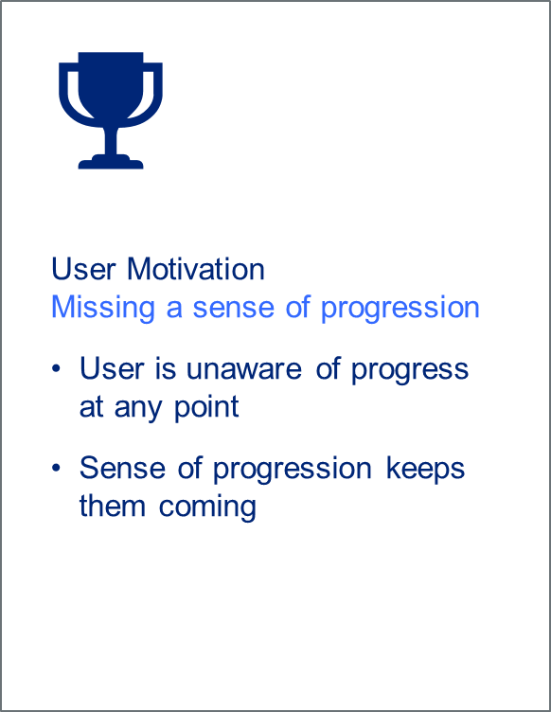
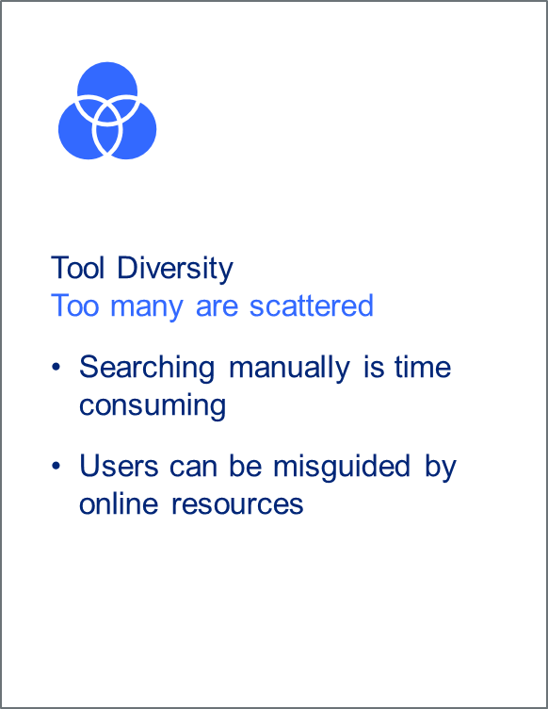
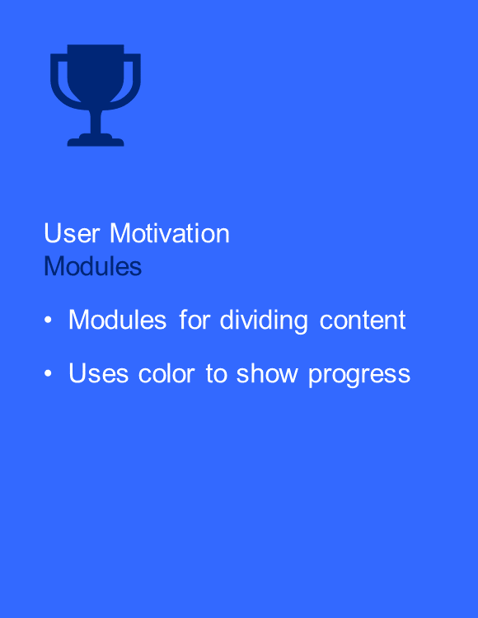
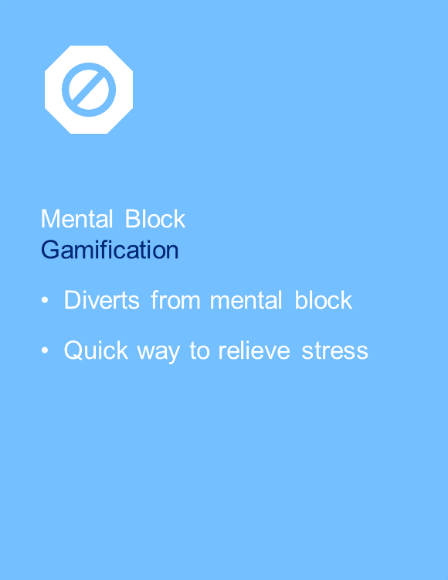
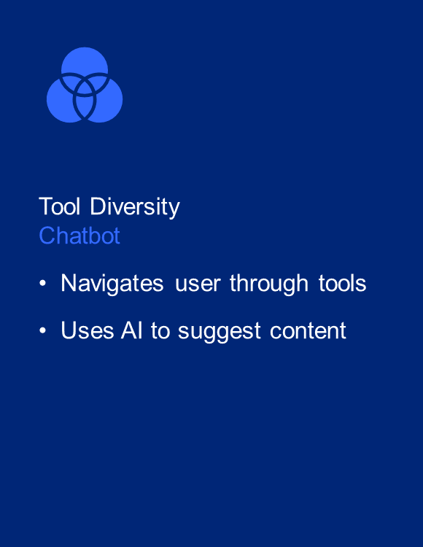
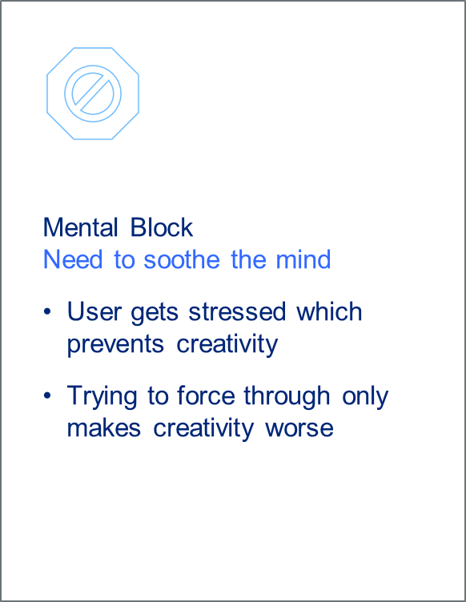

Features

Slide 11
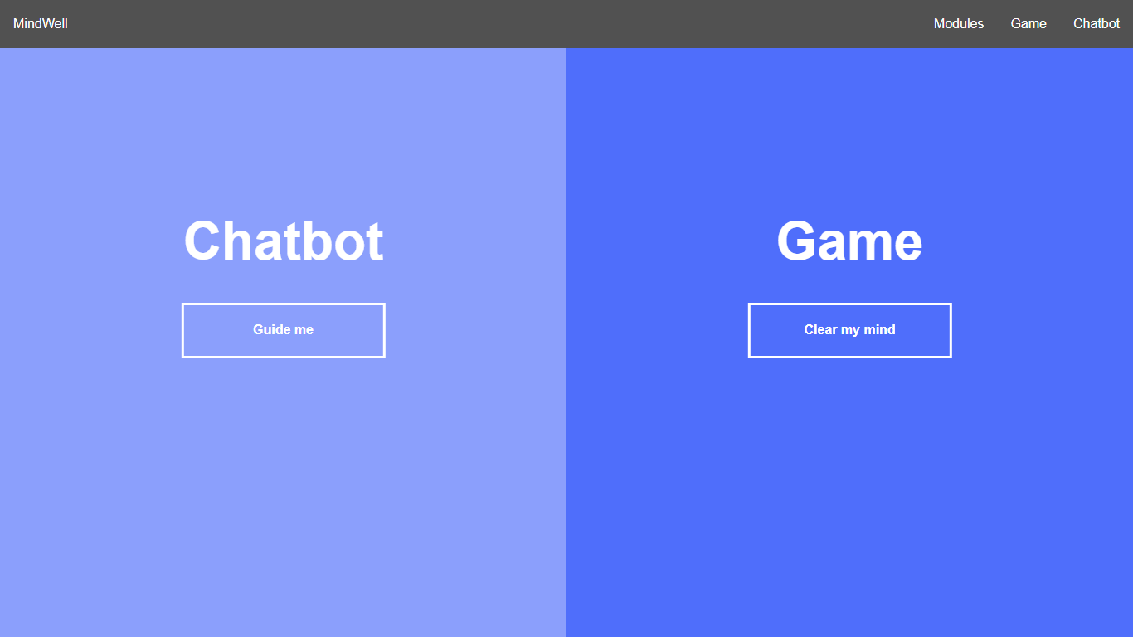
Product

Slide 12
Potential
4

Slide 13
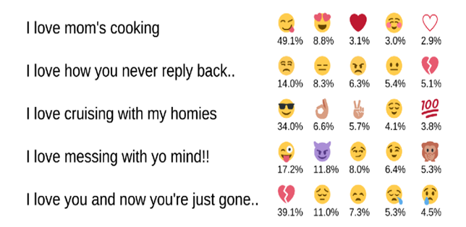
Chatbot
More realistic conversations with DeepMoji
UI that adjusts based on the detected emotions
Navigation to content based on key words

Slide 14
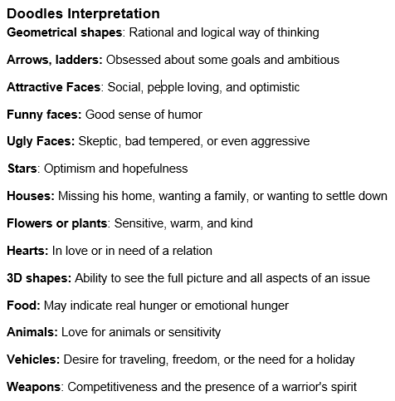
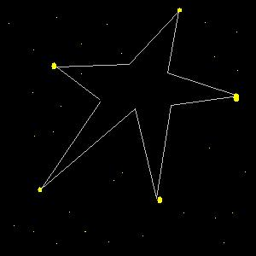
Game
Record traveled path in the background
Reveal the created shape at the end
Diagnose emotions based on interpretation

Slide 15
Conclusion
01
02
03
04
Problems
Product
Features
Potential

