Slide 1

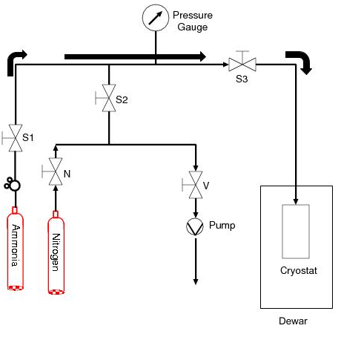
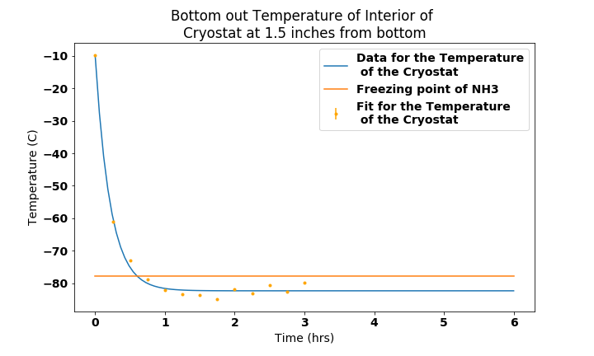
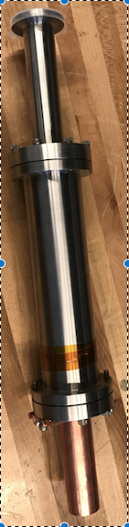
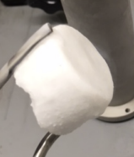
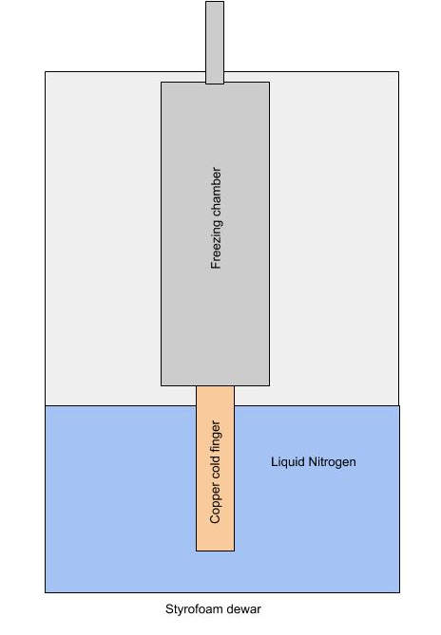
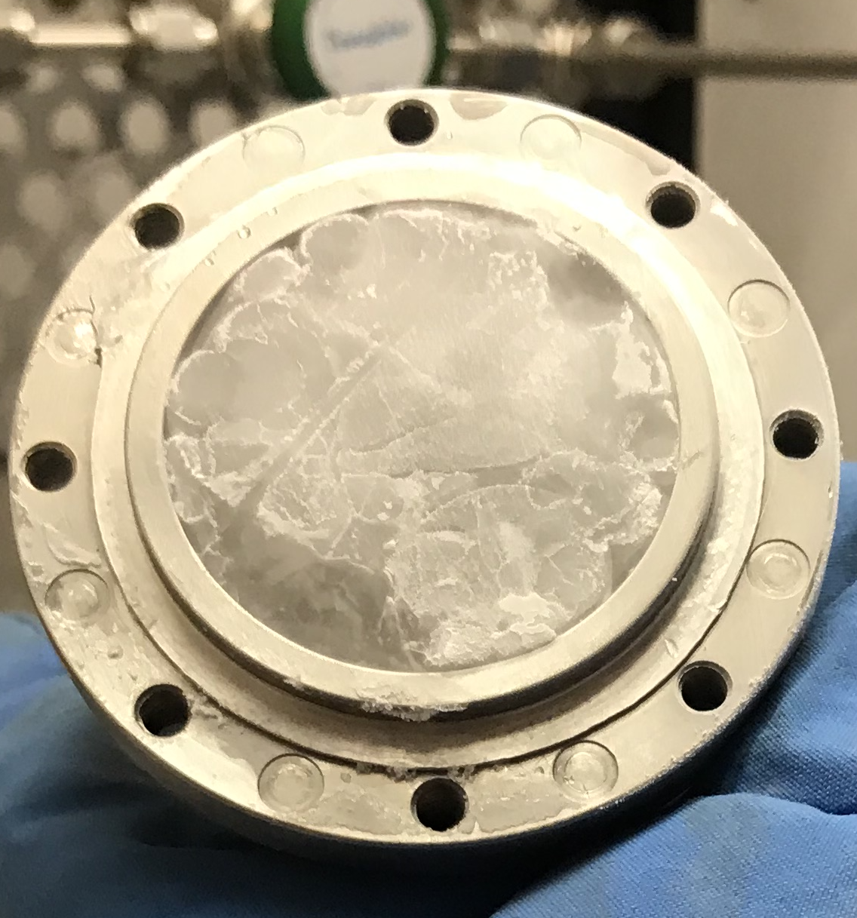
Solidification of Ammonia for Polarized Targets
Lucas Jameson|Advisor: Karl Slifer
University of New Hampshire
Department of Physics UNH Nuclear Physics Group
I. Introduction
Polarized targets are produced at Slifer Lab as part of the UNH NPG research program. The goal is to produce polarized targets with a Dynamic Nuclear Polarizer (DNP) that is used in the spin-dependent physics program at Jefferson Lab. Ammonia that has free radicals by irradiation and is polarized by Dynamic Nuclear Polarization is a common polarized target.
III. Process
As gaseous ammonia flows into the freezing chamber, it deposits heat into the walls and begins to liquify. A puddle of liquid ammonia forms on the bottom of the freezing chamber first and then a solid slowly begins to grow from that. To ensure that the cold finger is working properly, the entire copper rod must remain under liquid nitrogen. This allows the cold finger to remain at a constant temperature and to optimize performance. After the solidification process has finished, typically several hours for half the freezing chamber to be filled, the material is harvested from the freezing chamber and crushed and sorted into ~2mm beads. These are then stored in 30 mL Nalgene bottles and stored in liquid nitrogen until they get irradiated and polarized.
IV. Results
The new process was able succeeded in getting the interior of the freezing chamber to just below the temperature. This in turn created a more transparent solid that was more difficult to crush.
Figure 2. – Flow of ammonia through the gas panel into the freezing chamber.
Figure 1. - The large stainless steel cylinder is where the ammonia is solidified. Attached to the bottom is the cold finger system used for bringing the cylinder to just below the freezing point of ammonia.
Figure 4. – The bottom out temperature of the interior of the freezing chamber. This is just below the freezing point of ammonia.
Figure 4. – Bottom: The solid ammonia produced using the cold finger method.
The material is a white, powdery material. Top: Solid ammonia made using the liquid nitrogen cold bath. The material is clear and much more difficult to break.
Liquid Nitrogen Freezing Process | White and powdery Easy to crush Cloudy
Cold Finger Freezing Process | Clear and transparent Difficult to crush Glassy
Figure 3. – How the cold finger design works. The copper rob deposits heat into the liquid nitrogen bath, bringing the walls to just below the freezing point of ammonia.
II. Design
The cold finger system is submerged in a bath of liquid nitrogen and acts as a heatsink to cool down the interior walls of the freezing chamber to 195 K which is the freezing point of ammonia. The level of liquid nitrogen in which the cold finger sits is to be maintained such that the entire copper rod is fully submerged at all times. A dewar with a level probe is used to ensure that the level of liquid nitrogen remains constant by periodically adding liquid nitrogen to the dewar.
Table 1. – Overview of the properties of the material frozen using the two methods. First the method of liquid nitrogen cooling bath, second, the copper cold finger heat sink method.
V. Conclusions & Future
Future work includes adding thermometry to the system so that the freezing chamber can be maintained at a certain temperature. Quantitative analysis of the density of the solid ammonia produced from both methods. Another area of work is in investigating whether there is a difference in how the sample acts as a polarized target.
Acknowledgements:
I would like to thank Slifer lab and Long lab for providing the means and resources used throughout this project

