Slide 1
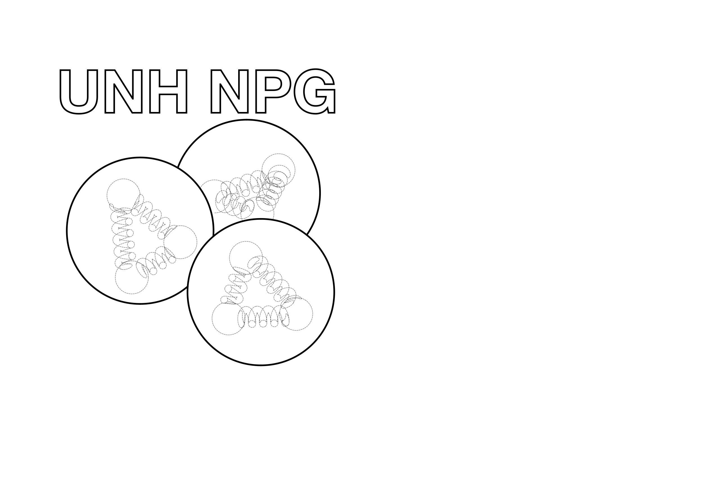

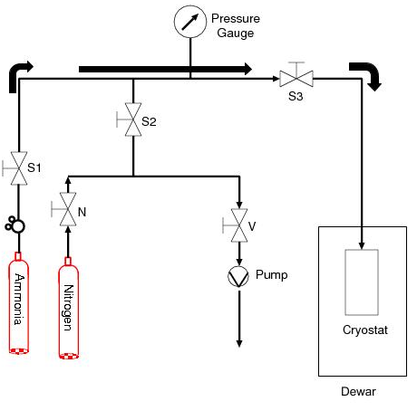
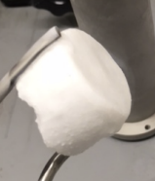
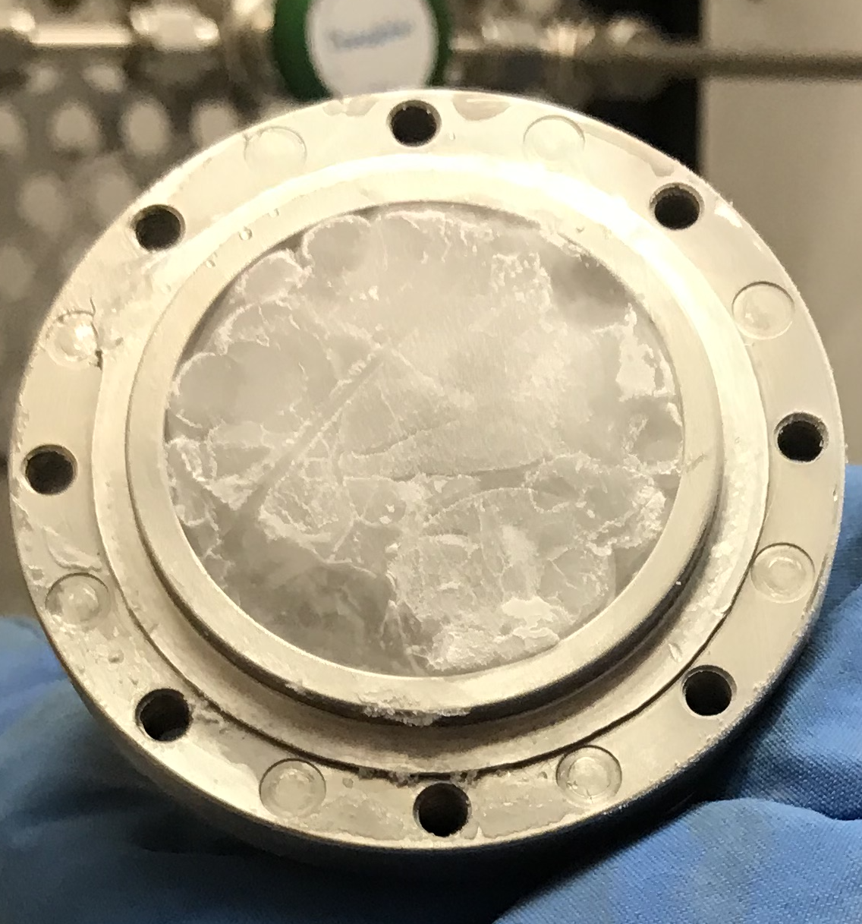
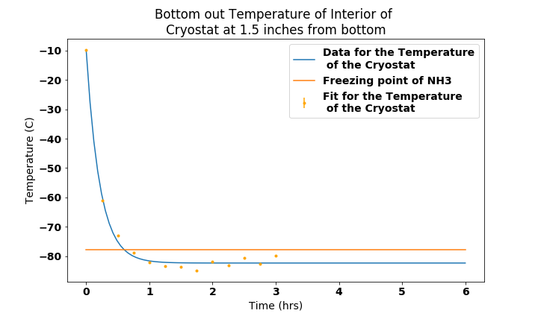
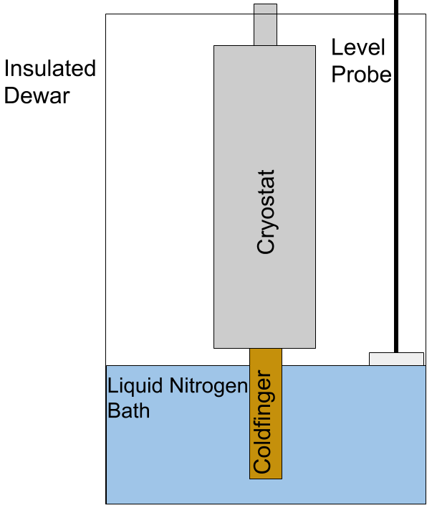
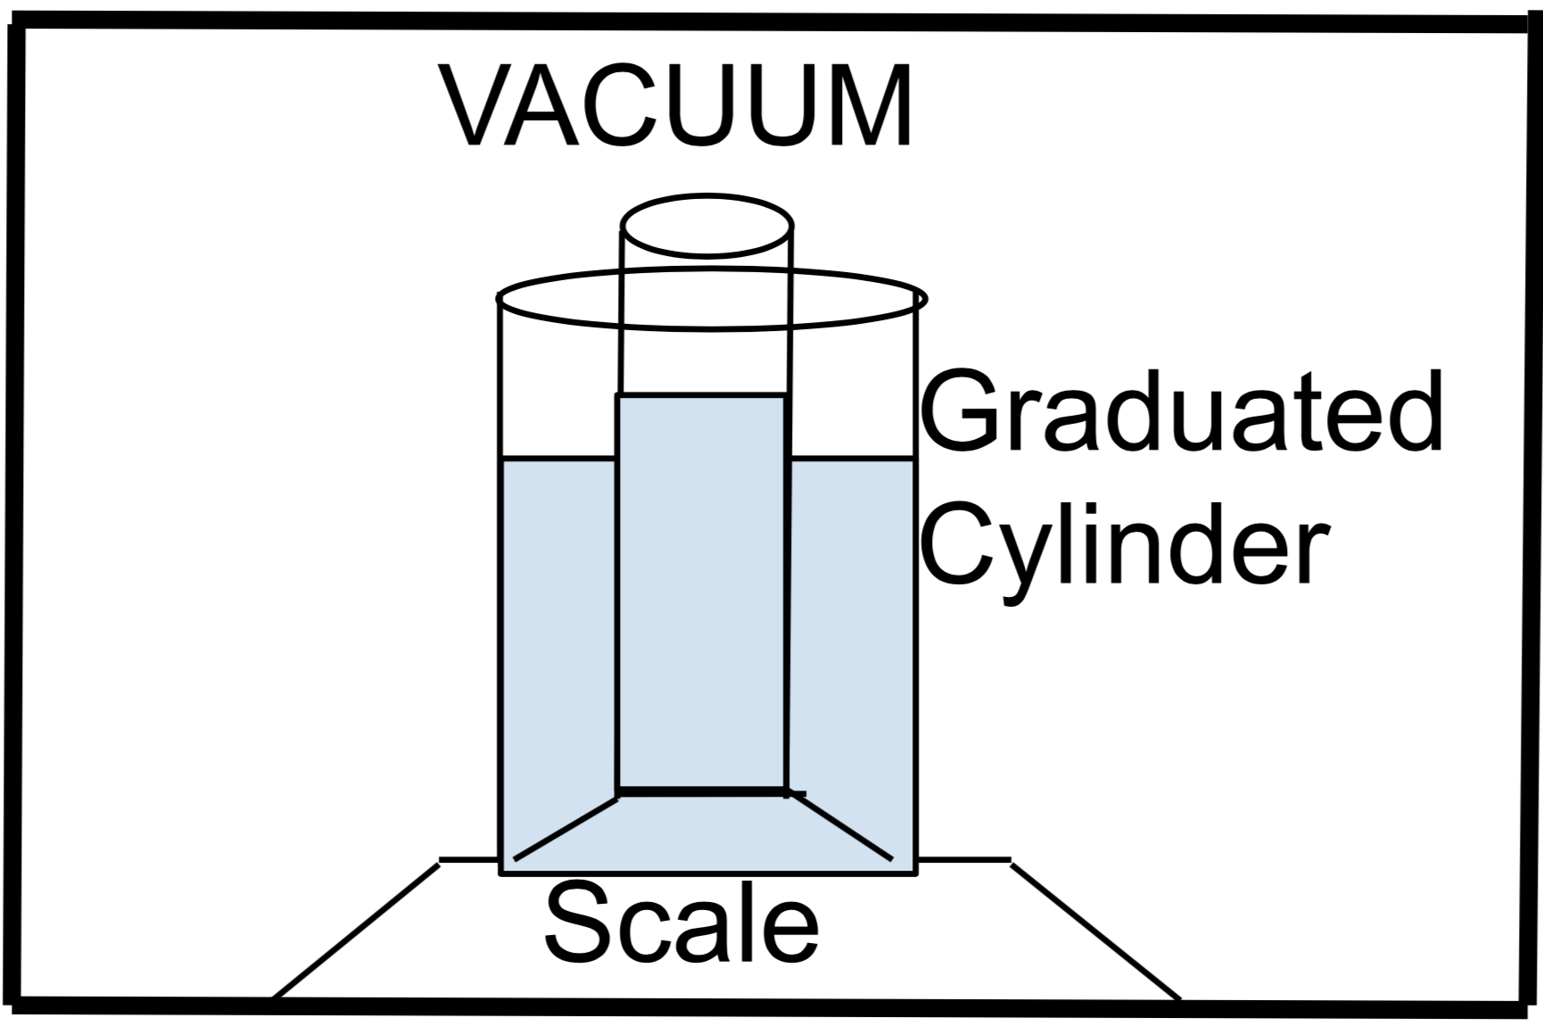
Solidification of Ammonia for Polarized Targets
Lucas Jameson|Advisor: Karl Slifer
University of New Hampshire
Department of Physics UNH Nuclear Physics Group
I. Introduction
Polarized targets are produced at Slifer Lab as part of the UNH NPG research program. The goal is to produce polarized targets with a Dynamic Nuclear Polarizer (DNP) that is used in the spin-dependent physics program at Jefferson Lab. Ammonia that has free radicals by irradiation and is polarized by Dynamic Nuclear Polarization is a common polarized target. A method for slowly cooling the ammonia in the cryostat was designed to introduce less of a thermal gradient between the the walls of the cryostat and the freezing point of ammonia is -77 C. The prior method used liquid nitrogen as a cooling bath which introduced a larger thermal gradient since nitrogen boils at -195 C. By slowly freezing the ammonia, the density can be increased and and this will improve radiation resistance and short the amount of time needed to run scattering experiments
III. Process
As gaseous ammonia flows into the freezing chamber, it deposits heat into the walls and begins to liquify. A pool of liquid ammonia forms on the bottom of the freezing chamber first and then a solid slowly begins to grow from that. To ensure that the coldfinger is working properly, the entire copper rod must remain under liquid nitrogen. This allows the coldfinger to remain at a constant temperature and to optimize performance. After the solidification process has finished, typically several hours for half the freezing chamber to be filled, the material is harvested from the freezing chamber and crushed and sorted into ~2mm beads. These are then stored in 30 mL Nalgene bottles and stored in liquid nitrogen until they get irradiated and polarized.
IV. Results
The former process used liquid nitrogen as a cooling bath and with a boiling point of -195 C, the interior walls of the cryostat were brought to far below the freezing point of ammonia, -77 C. This new method uses a coldfinger which acts as a heatsink to bring the temperature of the interior walls to -83 C, just below the freezing point of ammonia.
The density of a cryogenic solid like solid ammonia can be measured by using a vacuum chamber with a 25 mL beaker nested in a bath of liquid nitrogen and a scale to measure the mass change. This device shown in Figure 4, is still in the testing phase and is yet ready to work with ammonia.
Temperature (C)
Figure 3. – Bottom: The solid ammonia produced using the coldfinger method.
The material is a white, powdery material. Top: Solid ammonia made using the liquid nitrogen cold bath. The material is clear and much more difficult to break.
Time (hrs)
Figure 1. – Flow of ammonia through the gas panel into the freezing chamber.
Figure 5. – The bottom out temperature of the interior of the freezing chamber. This is just below the freezing point of ammonia.
II. Design
The coldfinger system is submerged in a bath of liquid nitrogen and acts as a heatsink to cool down the interior walls of the freezing chamber to -77 C which is the freezing point of ammonia. The level of liquid nitrogen in which the coldfinger sits is to be maintained such that the entire copper rod is fully submerged at all times. A dewar with a level probe is used to ensure that the level of liquid nitrogen remains constant by periodically adding liquid nitrogen to the dewar.
The density of the material can be measured using Archimedes principle where the fluid used to measure the displaced volume is liquid nitrogen. In order to make accurate measurements on the volume of liquid nitrogen in the graduated cylinder, the whole system in placed in a rough vacuum.
Liquid Nitrogen Freezing Process | White and powdery Brittle amorphous solid Cloudy
Coldfinger Freezing Process | Clear and transparent Durable crystalline solid Glassy
Table 1. – Overview of the properties of the material frozen using the two methods. First the method of liquid nitrogen cooling bath, second, the copper coldfinger heat sink method.
V. Conclusions & Future
In the future I will add thermometry to the system so that the freezing chamber can be maintained at about -80 C. I will perform a quantitative analysis of the density of the solid ammonia produced from both methods.
The coldfinger method produces better material for scattering targets at a qualitative level.
Figure 4. – Schematic of the system used to measure the density of a cryogenic solid. This stabilizes the liquid nitrogen and makes the process of measuring the volume accurately possible
Acknowledgements:
I would like to thank Slifer lab and Long lab for providing the means and resources used throughout this project
Figure 2. – The level of liquid nitrogen is maintained at 7 cm from the bottom and the coldfinger acts as a heatsink.

