Slide 1

Sample Slides for “Velis”
Laurens R. Krol
International Conference for Template Showcases
2021-10-20

Slide 2
Sample Slides
Contents
You already saw the layout for
Presentation title
Section title and content (current)
Upcoming layouts include
General content
Two columns
Single-title layouts
Closing slide

Slide 3

Sample Slides
Public Domain
This template is in the public domain.
lrk-slides-velis by Laurens R. Krol is licensed under CC0 1.0

Slide 4
Sample Slides
Double-Title Layouts
The main design has two titles per slide.
A smaller, coloured title to keep track of the main topic and broader section breadcrumbs.
A larger, black title to serve as heading for the current slide.

Slide 5
Sample Slides: Double-Title Layouts
Default Layout
This is the default layout: the two titles, and a large content field.
Note that the order of the fields on each slide has been taken into account: with ctrl + enter, you can easily skip from the upper to the lower fields.
Write up your slides without touching the mouse!

Slide 6
Sample Slides: Double-Title Layouts
Two Columns
Here’s a two-column layout, for side-by-side stuff.
“Velis” is the ablative plural of the Latin word “velum”, meaning “curtain”.
The graphics on these slides are reminiscent of stage curtains.
The colour used in these slides is ‘dark teal’, or:
#005c69
RGB(0, 92, 105)
rgb(0, 0. 361, 0.412)

Slide 7
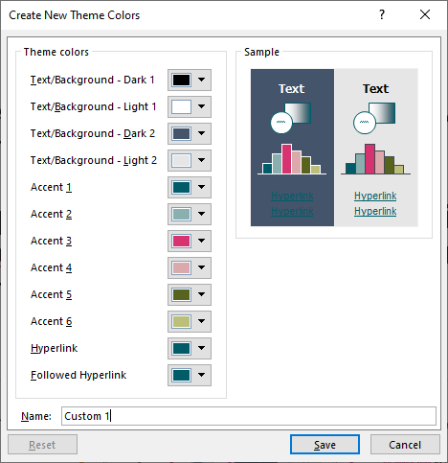
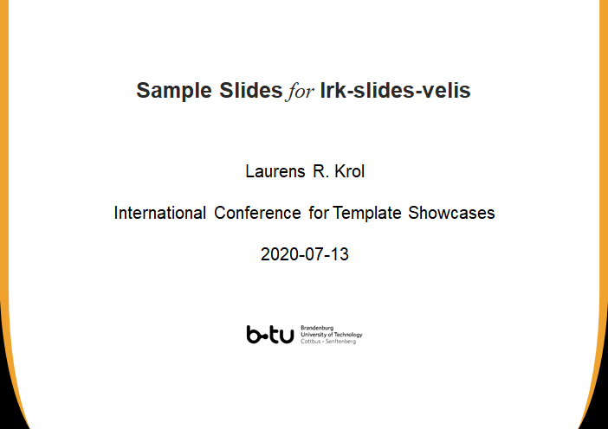
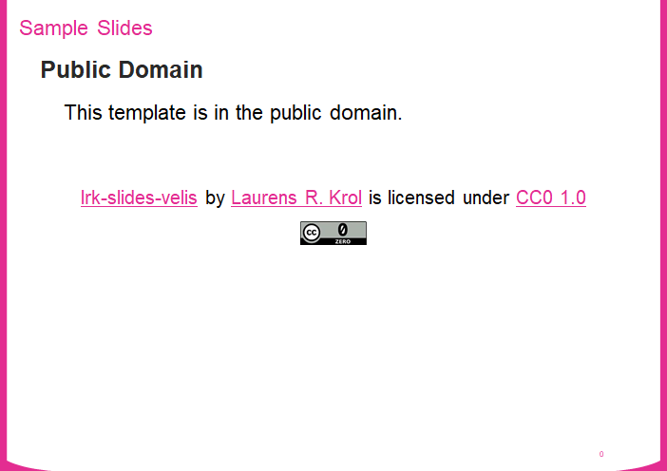
Sample Slides: Double-Title Layouts
Colours
The colour used in this template is linked to “Accent 1” from the current colour palette.
Therefore, simply changing this colour (and, if appropriate, the hyperlink colours, which here have the same colour) will change all theme colours on the slide.

Slide 8
Sample Slides: Double-Title Layouts
Colour Theme
A further Velis colour theme is included for accents 1-6.

Slide 9

Sample Slides: Double-Title Layouts
Content with Caption
The content-with-caption layout is a sort of two-column layout meant to showcase graphics with a brief caption.

Slide 10


Zoom or Side-Note Slide
This layout skips the higher-level title to “zoom in” on a particular topic, or address it separately.

Slide 11
Sample Slides
Single-Title Layouts

Slide 12
Single-Title Layouts
As mentioned on Slide 3, the main design uses two titles.
The more common single-title design is available too, as illustrated here.
The same layouts are available as for the double-title design.
The following slide is the presentation closing slide.

Slide 13
Sample Slides
Laurens R. Krol
lrkrol@gmail.com

