Slide 1
W7 Assignment Help Session
(Python3)
Rui Li

Slide 2
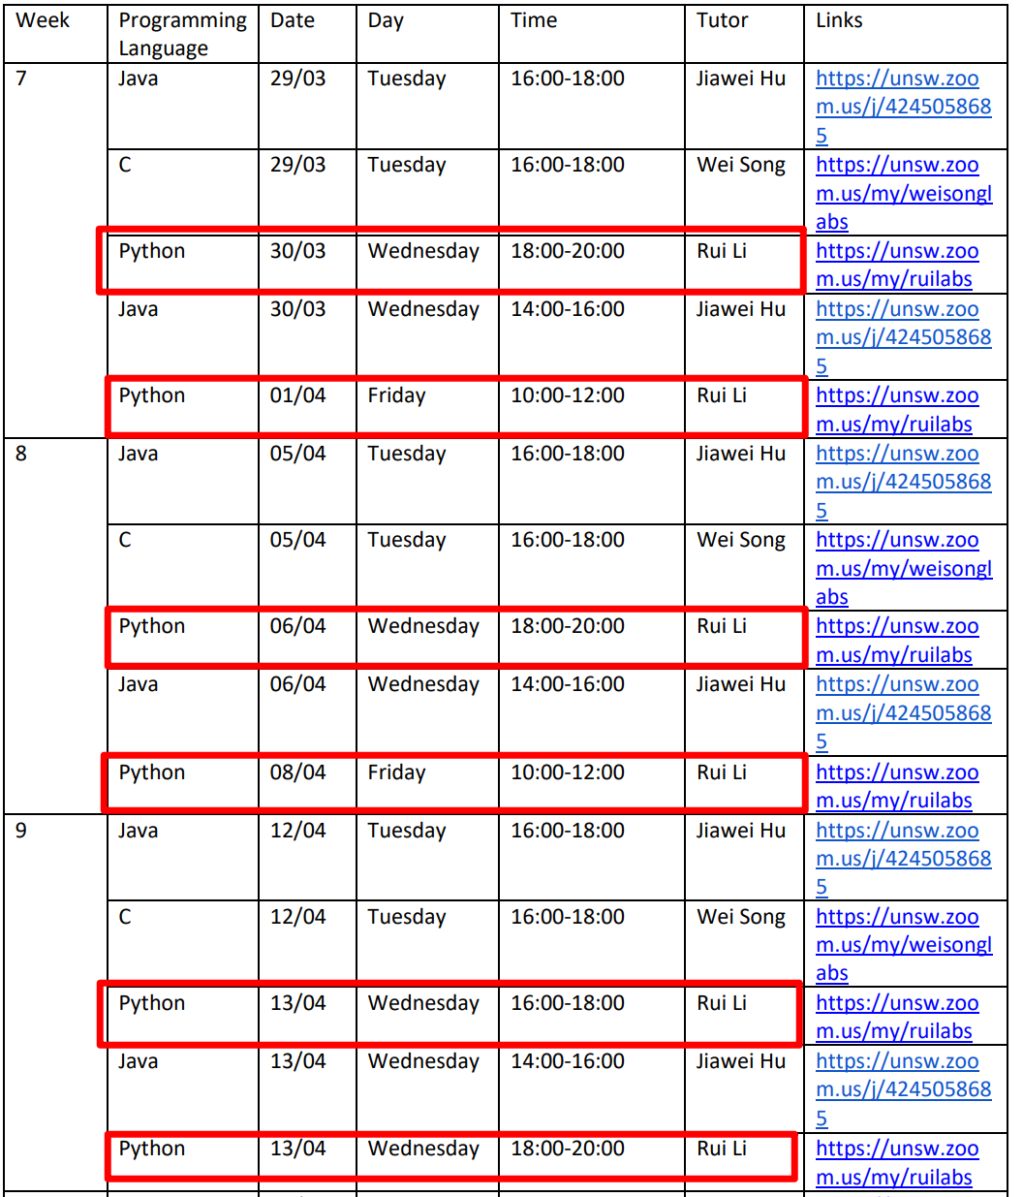
Help session schedule
Week 7 ~ Week10
Wed/Fri
Content:
Week 7 : How to get started with Config. 1?
What should we do?
How to design the program?
How to start with the example code?
UDP vs TCP
Useful library
Week 8: How to implement the Config. 2 ?
Program structure
Multi clients
TCP file transmission
Week 9~10: Debug/Testing/Submission
Demo code for some hard function
Testing
Submission
Ref: https://webcms3.cse.unsw.edu.au/COMP3331/22T1/resources/74210

Slide 3
Useful resources
EDstem
Assignment SPEC
Get your problem solved within 24 hours!
https://edstem.org/au/courses/7570/discussion/
Basically all the details.
https://webcms3.cse.unsw.edu.au/COMP3331/22T1/resources/70102
E
W
S
W
O
T
Assignment Overview Video Slides
Rui’s Github
Get started in 10min.
https://webcms3.cse.unsw.edu.au/COMP3331/22T1/resources/70098
Slides/Recordings for the session
https://github.com/lrlrlrlr/COMP9331_22T1/blob/main/README.md
T
O

Slide 4
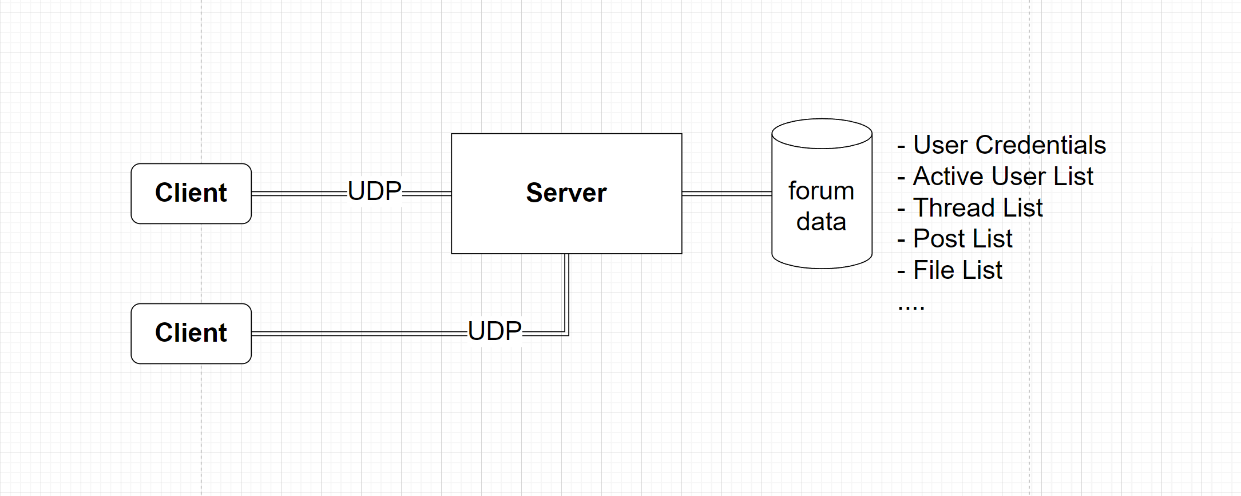
Project Overview
Assignment SPEC : https://webcms3.cse.unsw.edu.au/COMP3331/22T1/resources/70102
Assignment Overview: https://webcms3.cse.unsw.edu.au/COMP3331/22T1/resources/70098

Slide 5
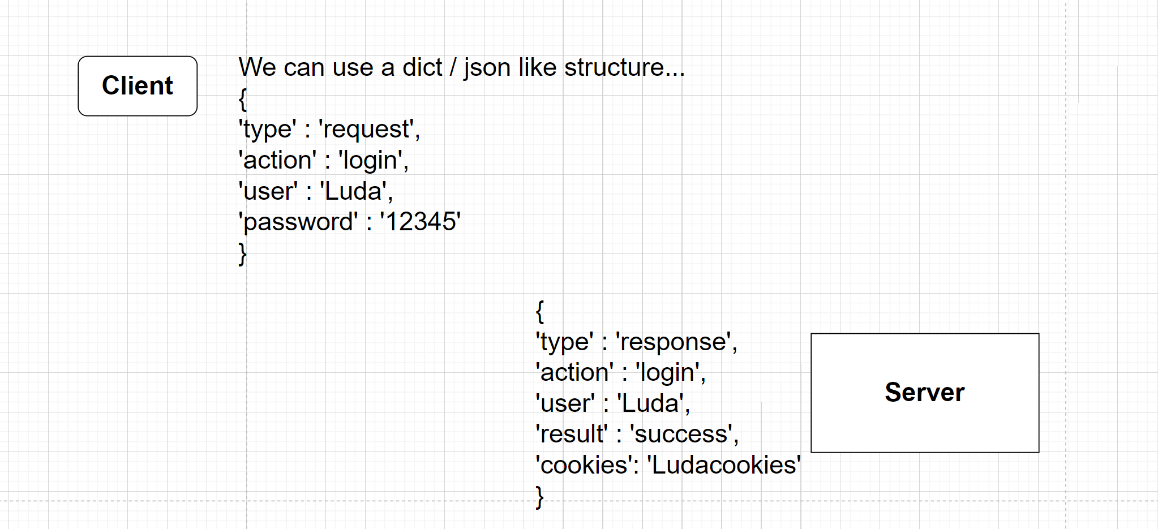
Protocol design
How can Server and Client communicate with each other?

Slide 6
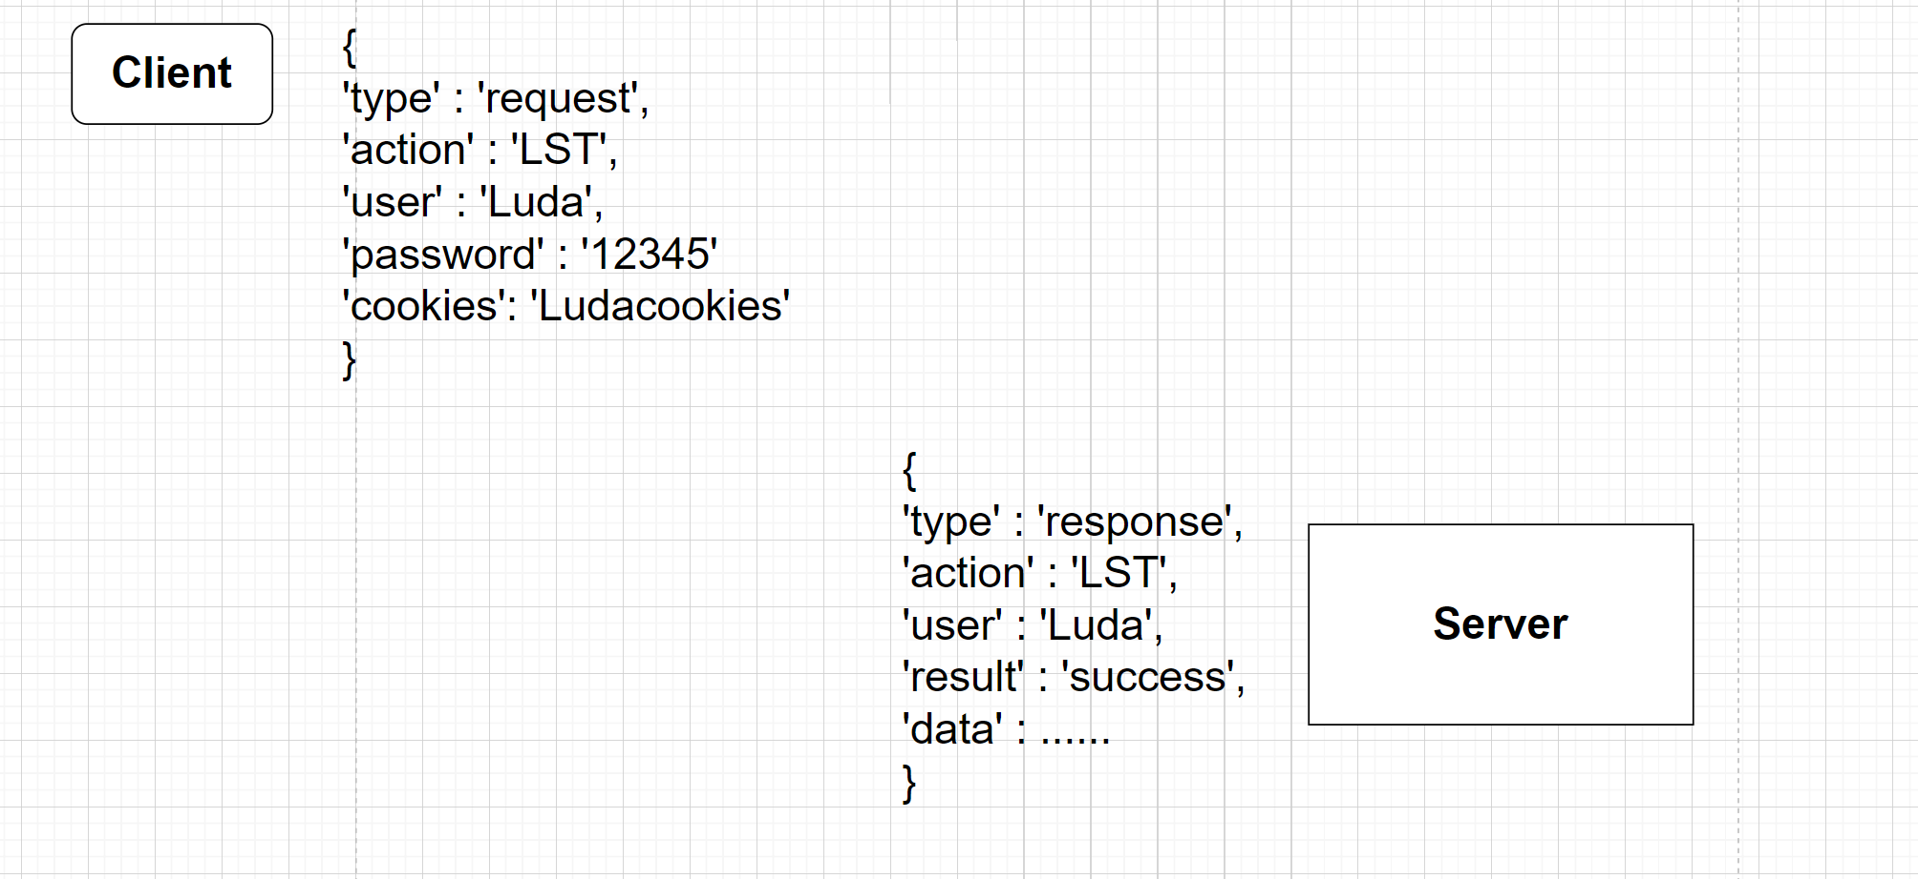
Protocol design
How can Server and Client communicate with each other?

Slide 7
Example code
Let’s have a look….
Server: https://webcms3.cse.unsw.edu.au/COMP3331/22T1/resources/70107
Client: https://webcms3.cse.unsw.edu.au/COMP3331/22T1/resources/70108
Be careful! This is the example code of TCP client/server!!
We have to do the UDP one!

Slide 8
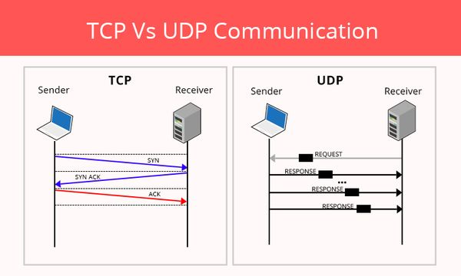
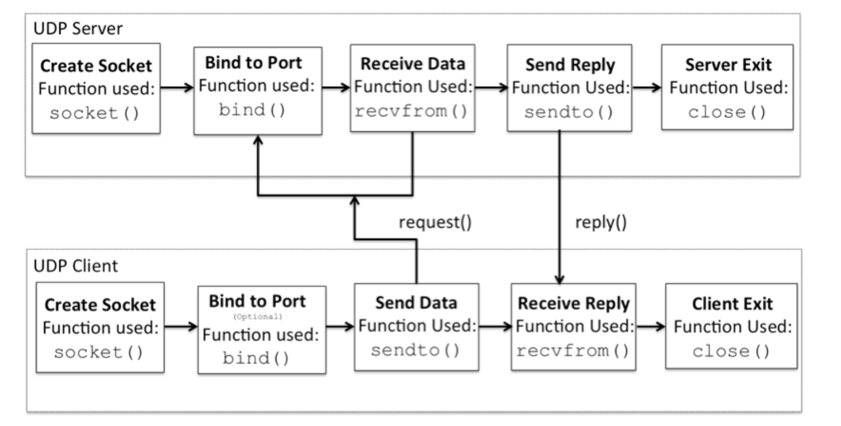
TCP vs UDP
1. Init
clientSocket = socket(AF_INET, SOCK_STREAM) socket.SOCK_DGRAM ------- UDP
socket.SOCK_STREAM ------- TCP
Send/Recv message
TCP:
sock.send()
sock.recv()
UDP:
sock.sendto()
sock.recvfrom()
UDP is connectionless
Ref: https://pythontic.com/modules/socket/udp-client-server-example

Slide 9
What’s Next?
It is free time!
Ask any question about the assignment (no Debug question)
Let me know what do you want me to present next week
Next week
Week 8: How to implement the Config. 2 ?
Program structure
Multi clients
TCP file transmission

Slide 10
THANKS

