Slide 1
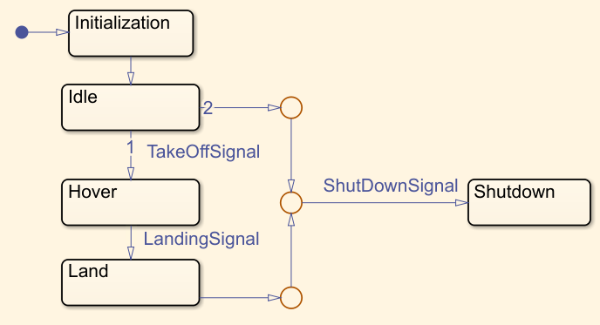
Initial State
Junction
Trigger
Final State

