Slide 1
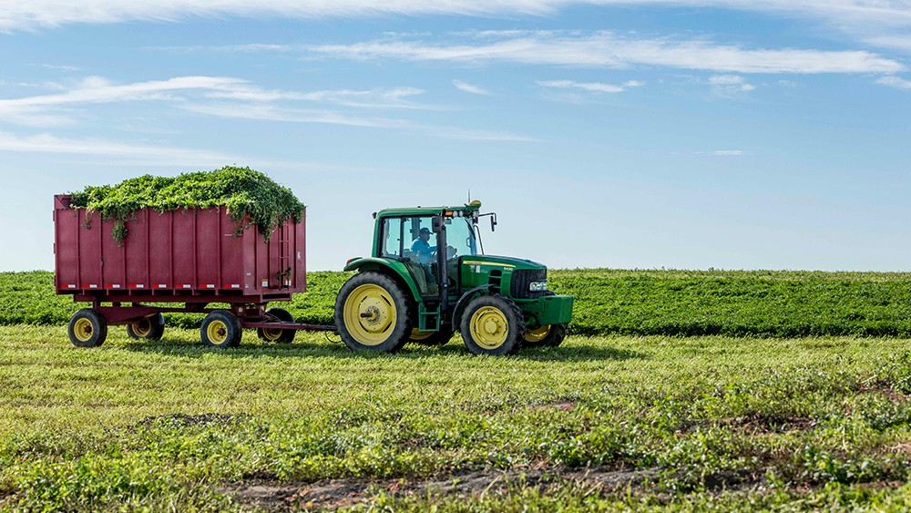
Make My Farm

Slide 2
CONTENTS
Introduction
Objectives and Goals
Scope
Requirements
Processes Involved
Functional Specification
Deliverables
Conclusion- Future outlook

Slide 3
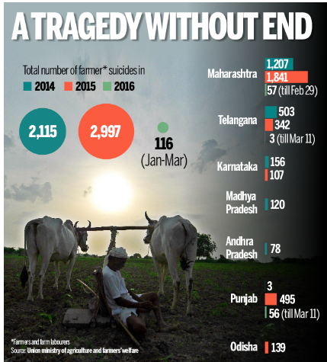
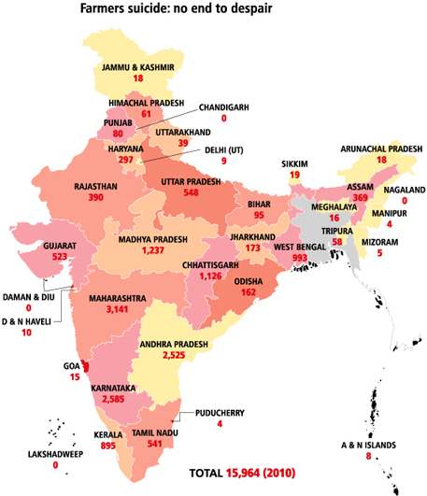

Slide 4
INTRODUCTION
Ideation
About 23% of the total population in India are Farmers, in which on an average 2% of the farmers are committing suicides every year. We as a team analyzed the reasons behind it and the first reason is lack of information like where to sell their product and at what price to sell and when to sell. The second reason is Natural calamities (cyclones and floods). We are taking up this problem and came with a solution which would benefit the farmers in larger way.

Slide 5





OBJECTIVES
Farmer Global Information Visibility System (FGIVS) application – A Website
Weather Forecasting
MODULES
Demand Forecasting
Market Price Information
Customer Contact

Slide 6

Goals
Project Goals
Business Goals
Information Sharing
Ease of Use
Data Security
Within Budget
Reduce the impact on other SBUs
SCOPE
It mainly focuses on the social aspect of the country. The scope of this project includes all requirements gathering, planning, design, development, and implementation of the website.

Slide 7
REQUIREMENTS
TIME REQUIRED
ESTIMATED COST
SOFTWARE TOOLS TO BE REQUIRED
Frame Work: .net
Programming Language: C#.Net
Database: MSSQLSERVER 2012
ETL TOOL: SQL SERVER INTEGRATION SERVICES
Server Side Validations: Asp.Net
Client Side Validations: JQuery, Angular JS
Module 1: 160 hours
Module 2: 260 hours
Module 3: 260 hours
Module 4: 150 hours
Total Estimated Time: 830 hours
Module 1: $16000
Module 2: $26000
Module 3: $26000
Module 4: $15000
Total Estimated Cost: $83000

Slide 8

PROCESSES INVOLVED
Initiating
Planning
Design
Development
Testing
Implementation

Slide 9
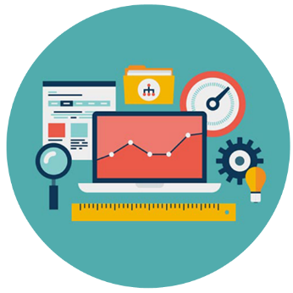
FUNCTIONAL SPECIFICATION
Weather Forecasting
Demand Forecasting
Market Price Information
Customer Contact

Slide 10

DELIVERABLES
Module1
The User can view the weather information for any place for the upcoming six months
Module 2
The demand is forecasted for the upcoming six months and the demand is completely based on the domestic trade.
Module 3
In the first phase the user will be able to search the places nearby and find the market prices in every city. Also, the future prices (next 7 days) can also be viewed by the user. The future market prices are estimated based on domestic trade.
Module 4
In this phase user will be able to interact . Here we have designed this module in the Indian context. The customers here include hotel chains and marriage contractors. Framers can directly connect with customers.

Slide 11
THANK YOU

