Slide 1
Control setup for BVTs
SDN controller
NETCONF SERVER
BVT1 Agent
BVT2 Agent
NETCONF SERVER
AGENT CORE
AGENT CORE
LASER iface class
REST CLIENT
REST CLIENT
LASER iface class
REST
REST SERVER
BVT1
MATLAB
DSP Tx
DSP Rx
BVT2
DAC1
DAC2
MZM1
MZM2
TLS2
TLS1
ADC1
ADC2

Slide 2
Hardware details
TLS1: YENISTA OSICS ch 2
TLS2: YENISTA OSICS ch 3
DAC1: LEIA DAC HI channel; ‘dac_out=1’
DAC2: LEIA DAC HQ channel; ‘dac_out=2’
ADC1: Tek DPO 70000C ch1; ‘osc_in=2’
ADC2: Tek DPO 70000C ch4; ‘osc_in=1’
MZM1: Photline MX-AN + Photline DR-AN driver
MZM2: SumiCem + SHF-807C driver

Slide 3
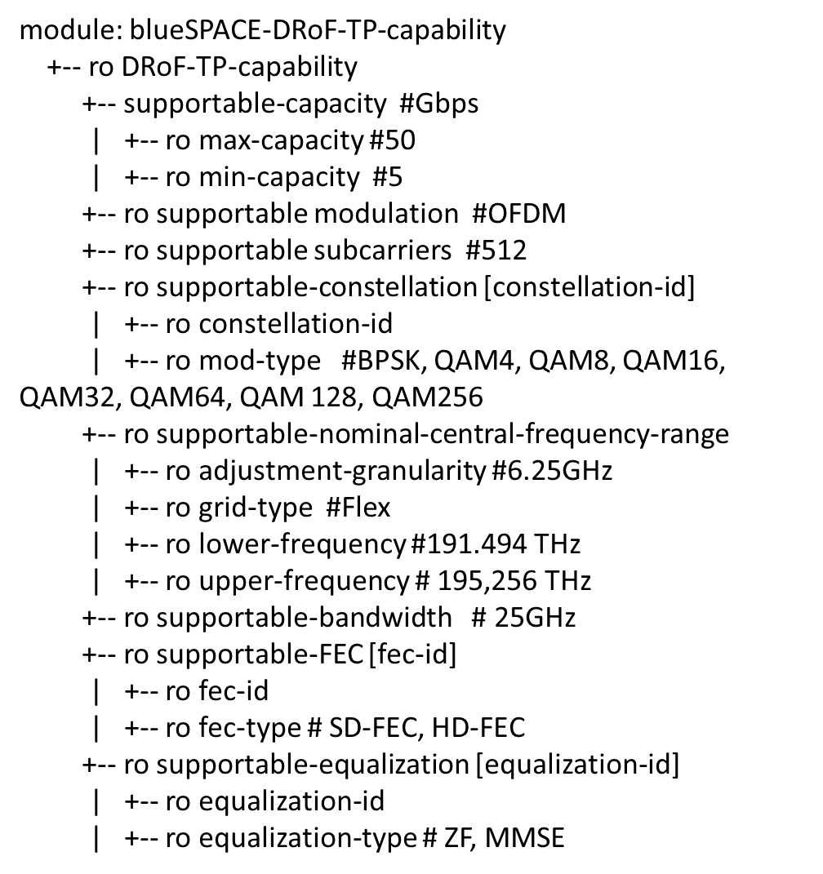
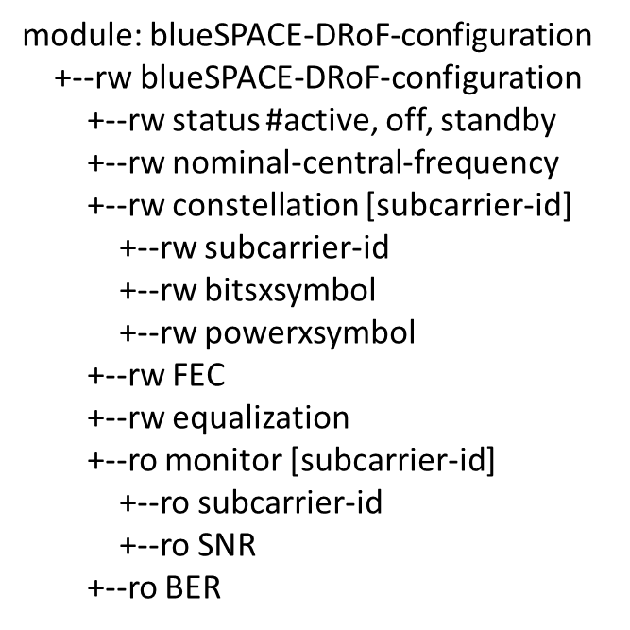
DRoF agent and data model (YANG/NETCONF)

Slide 4
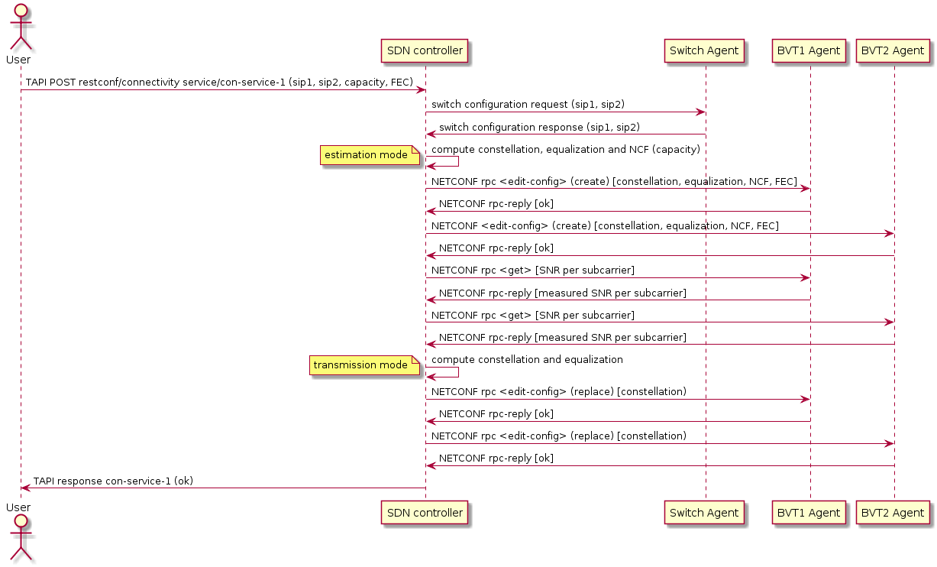
Workflow

Slide 5
Workflow actions per agent
Agent 1: NETCONF rpc <edit-config> create [constellation, equalization, NCF, FEC]
Laser setup
Ensure laser off: laser.enable(ch, False)
Calculate lambda0 from NCF -> use exact value for c=299792458 m/s
Set laser wavelength: laser.wavelength( ch, lambda0)
Set power to max (14.5 dBm): laser. power(ch, 14.5)
Set laser on: laser.enable(ch, True)
DAC setup
From constellation, extract Bn and En
Generate waveform and load to DAC channel: @REST dac.transmitter(dac_out, Bn, En)
Store Bn, En, equalization and FEC for Rx monitoring!
Agent 1: NETCONF rpc-reply OK
Agent 2: NETCONF rpc <edit-config> create [constellation, equalization, NCF, FEC]
Agent 2: NETCONF rpc-reply OK

Slide 6
Workflow actions per agent (cont.)
Agent 1: NETCONF rpc get [SNR per subcarrier]
Receive associated signal: @REST osc.receiver(dac_out, osc_in, bn, En, eq)
Retrieve SNR per subcarrier from output of @REST osc.receiver()
Agent 1: NETCONF rpc-reply [Measured SNR per subcarrier]
Agent 1: NETCONF rpc <edit-config> (replace) [constellation]
DAC setup
From constellation, extract Bn and En
Generate waveform and load to DAC channel: @REST dac.transmitter(dac_out, Bn, En)
Update stored Bn and En
Agent 1: NETCONF rpc-reply OK
Agent 2: NETCONF rpc get [SNR per subcarrier]
Agent 2: NETCONF rpc-reply [Measured SNR per subcarrier]
Agent 2: NETCONF rpc <edit-config> (replace) [constellation]
Agent 2: NETCONF rpc-reply OK

Slide 7
Dataset
Bn1: array Ncarriers, ‘2’
Bn2: array Ncarriers, ‘1’
En1: array Ncarriers, ‘1’
En2: array Ncarriers, ‘1/sqrt(2)’=0.707
Eq1=Eq2: ‘MMSE’
NCF1: 1550.12 nm // 193.4E6 MHz
NCF2: 1550.92 nm // 193.5E6 MHz
FEC1=FEC2: ‘HD-FEC’

