Slide 1
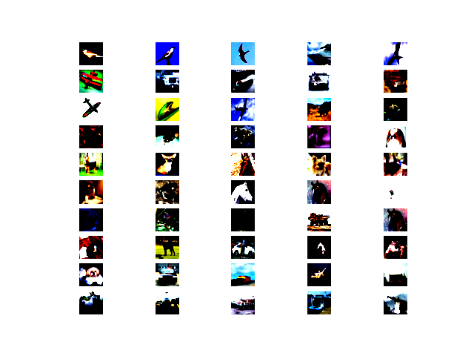
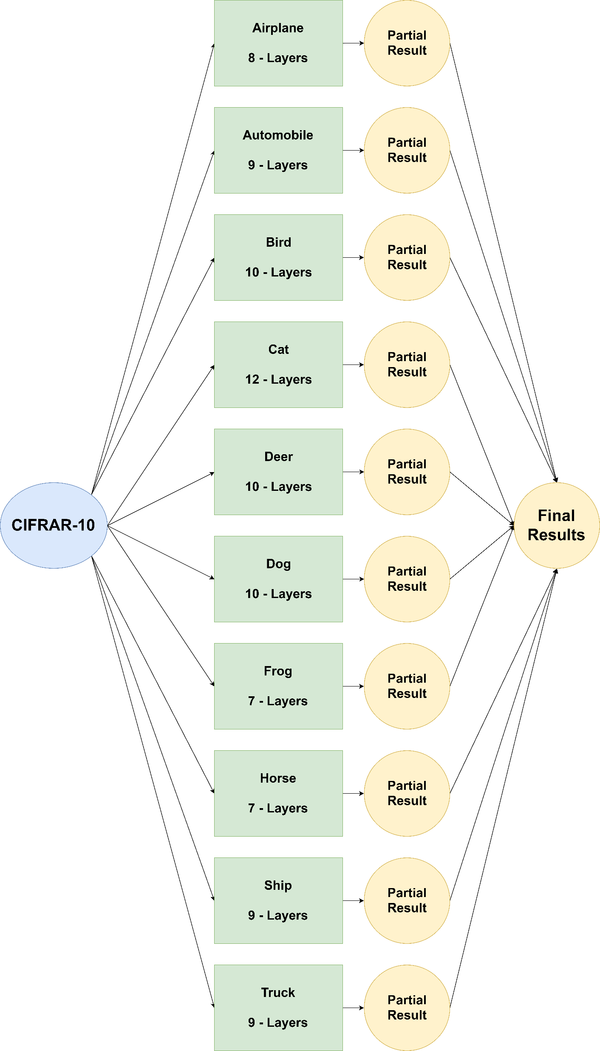
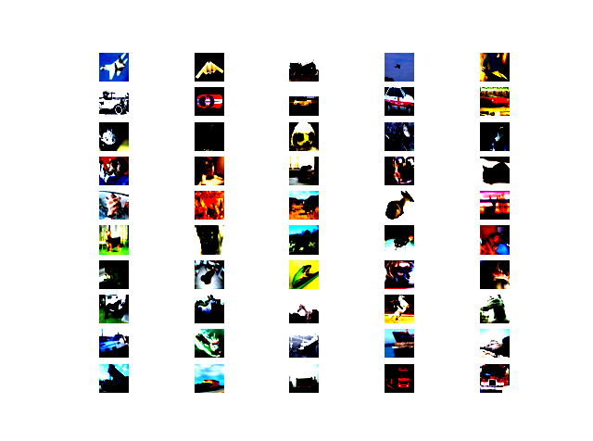
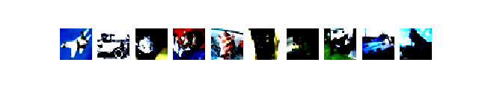
Recognizing Multiple Classes Using One-vs-All Classification and Ensembles
Project Architecture
False Positives
False Negatives
Unlabeled Images
Unlabeled Images by Class
Airplane | Automobile | Bird | Cat | Dog | Deer | Frog | Horse | Ship | Truck | Total
270 | 117 | 160 | 327 | 157 | 180 | 184 | 285 | 185 | 180 | 2045
By: Thomas Aurigemma and Liam Rothschild-Shea

