Slide 1



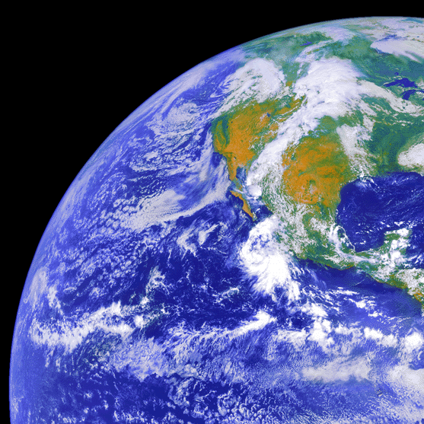
LIGO EM Follow-Up Search Overview
Peter Shawhan (U. of Maryland / JSI)
LIGO-Fermi Workshop Caltech — March 15, 2015
LIGO-G1500268-v1
GOES-8 image produced by M. Jentoft-Nilsen, F. Hasler, D. Chesters (NASA/Goddard) and T. Nielsen (Univ. of Hawaii)

Slide 2
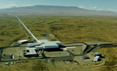

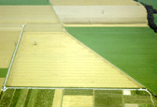

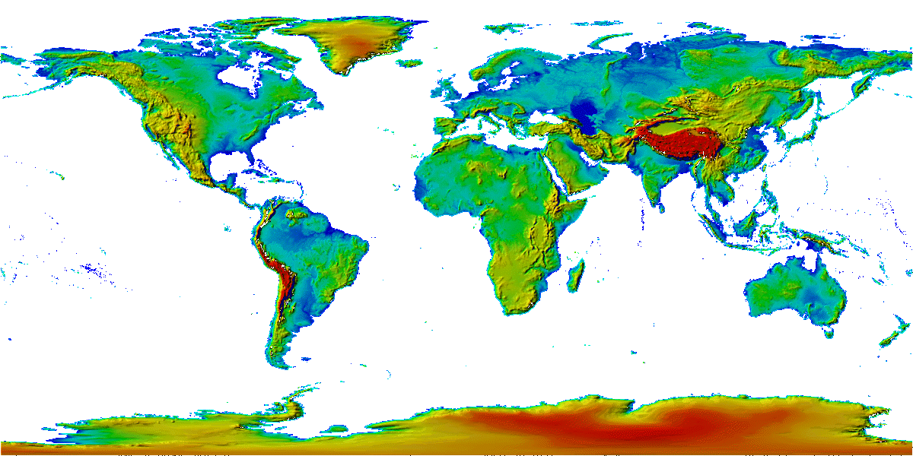

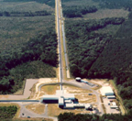
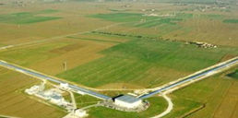
Advanced Detector Network – Under Construction
GEO-HF
Advanced LIGO
4 km
600 m
3 km
3 km
4 km
4 km
Advanced LIGO
(pending)
Advanced VIRGO
3 separate collaborations working together

Slide 3

Responses of Detectors in the Network
Location → Relative time delay
e.g., LIGO Hanford and Livingston are separated by 3000 km = 10 ms
Orientation → Polarization-dependent antenna response
An interferometer measures the (variation in the) difference between the lengths of the two arms → signed strain amplitude $h(t)$ [i.e., not just power]
Projects out a certain linear combination of GW polarization components
and other polarization combinations …
“Plus” polarization
“Cross” polarization
Circular polarization

Slide 4
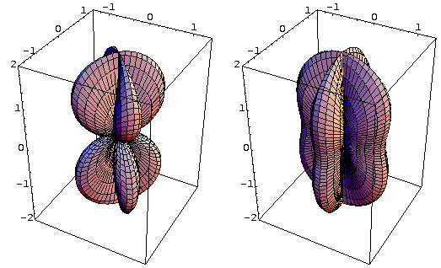
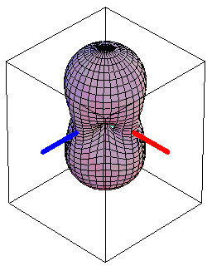
Antenna Pattern of a Laser Interferometer
Directional sensitivity vs. polarization, in a particular basis chosen with respect to the interferometer arms:
“×” polarization
“+” polarization
RMS sensitivity
Can demand time, amplitude and phase consistency between putative strain waveforms in the different detectors, i.e., coherent analysis

Slide 5
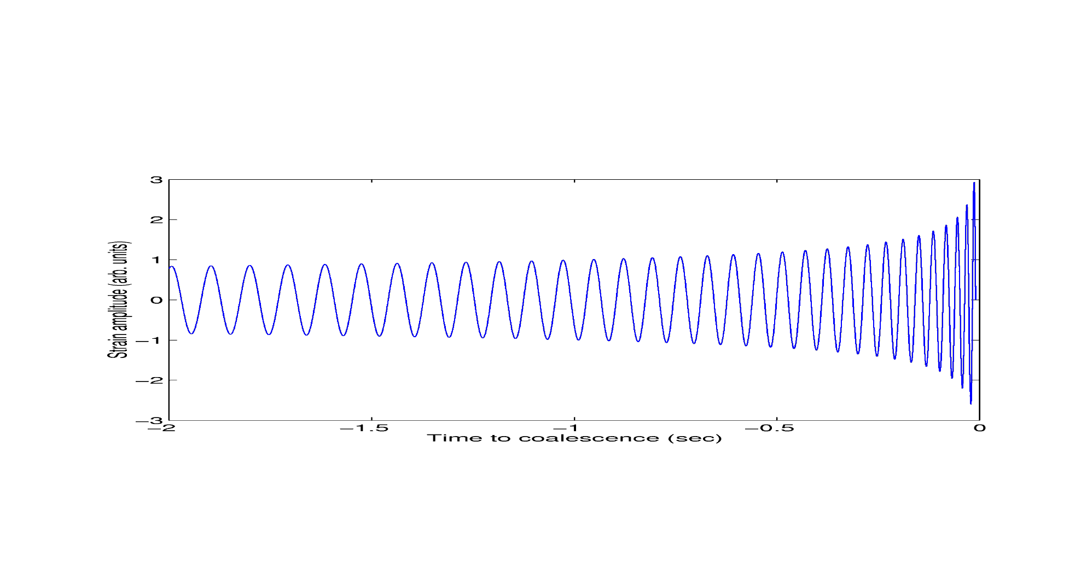
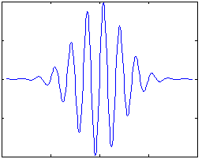
Low-Latency Searches for GW Transients
Binary Merger (CBC) Search
Waveforms known accurately
➔ Use optimal matched filtering with a bank of templates
Generally think we should focus on binaries with at least one neutron star to be disrupted
gstlal-svd, gstlal-spiir, MBTA
GW Burst Search
Consider arbitrary waveforms
➔ Use robust “coherent excess power” search algorithms
Sensitive to essentially any signal in the LIGO/Virgo frequency band with duration up to ~1 second
Coherent WaveBurst
?
Need a minimum of two detectors to do a believable search; having three or more detectors is preferable
5
7

Slide 6
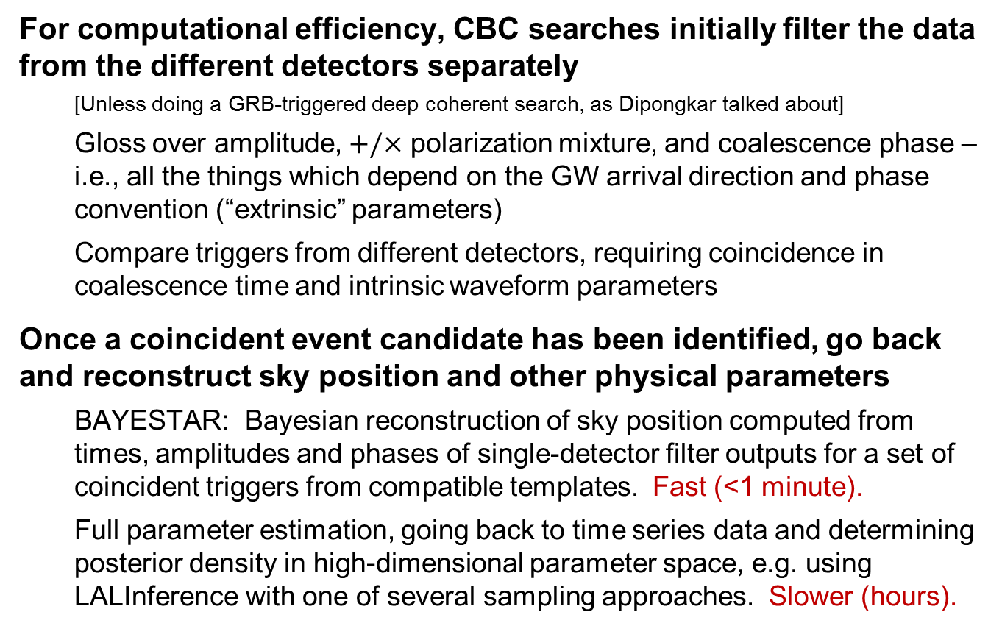
CBC Search Details
For computational efficiency, CBC searches initially filter the data from the different detectors separately
[Unless doing a GRB-triggered deep coherent search, as Dipongkar talked about]
Gloss over amplitude, $+/×$ polarization mixture, and coalescence phase – i.e., all the things which depend on the GW arrival direction and phase convention (“extrinsic” parameters)
Compare triggers from different detectors, requiring coincidence in coalescence time and intrinsic waveform parameters
Once a coincident event candidate has been identified, go back and reconstruct sky position and other physical parameters
BAYESTAR: Bayesian reconstruction of sky position computed from times, amplitudes and phases of single-detector filter outputs for a set of coincident triggers from compatible templates. Fast (<1 minute).
Full parameter estimation, going back to time series data and determining posterior density in high-dimensional parameter space, e.g. using LALInference with one of several sampling approaches. Slower (hours).

Slide 7
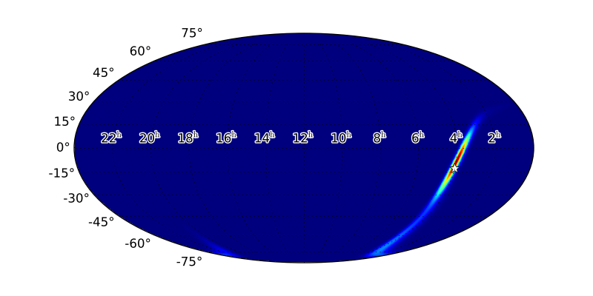
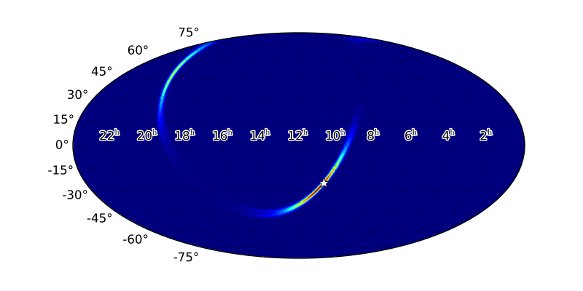
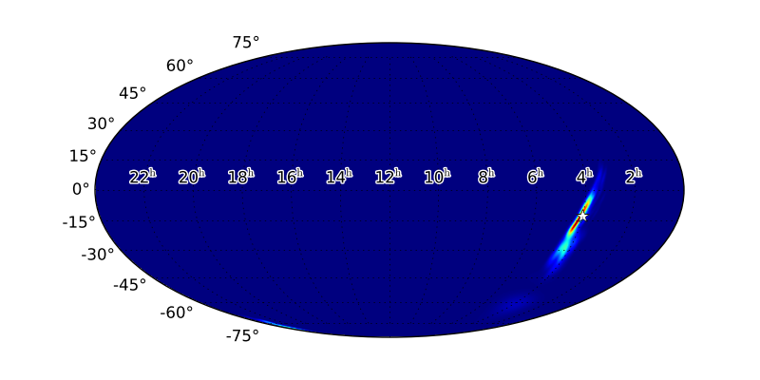
CBC Position Reconstruction Examples
Sky position estimation methods tested and compared with simulated events from first 2 years of advanced GW detectors
Singer et al., arXiv:1404.5623; Berry et al., arXiv:1411.6934; http://www.ligo.org/scientists/first2years/
Sample LIGO-only and LIGO-Virgo events:
Fast reconstruction (BAYESTAR)
Fast reconstruction (BAYESTAR)
MCMC-based reconstruction

Slide 8
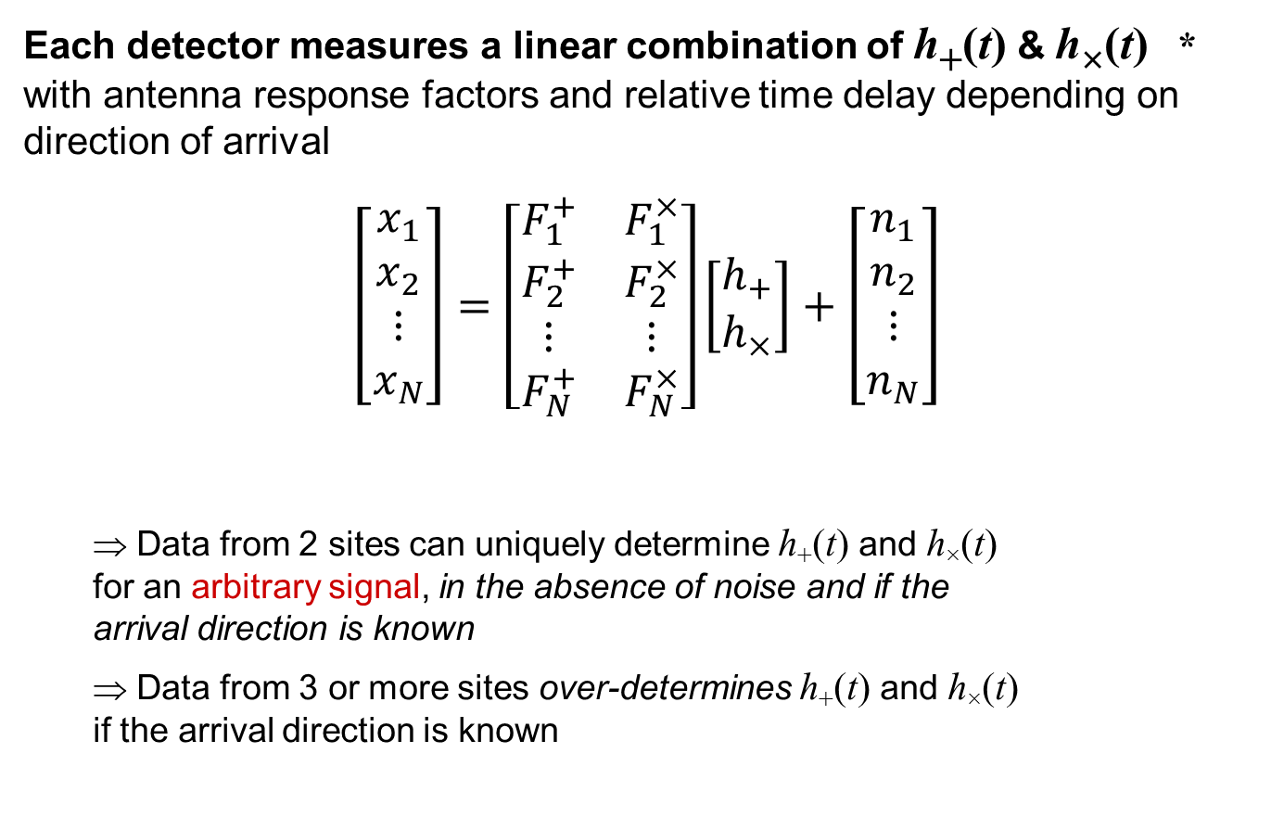
Coherent Burst Analysis
Each detector measures a linear combination of h₊(t) & h×(t) * with antenna response factors and relative time delay depending on direction of arrival
$$\left[\begin{matrix}x_{1} \\ x_{2} \\ ⋮ \\ x_{N}\end{matrix}\right]=\left[\begin{matrix}F_{1}^{+} & F_{1}^{×} \\ F_{2}^{+} & F_{2}^{×} \\ ⋮ & ⋮ \\ F_{N}^{+} & F_{N}^{×}\end{matrix}\right]\left[\begin{matrix}h_{+} \\ h_{×}\end{matrix}\right]+\left[\begin{matrix}n_{1} \\ n_{2} \\ ⋮ \\ n_{N}\end{matrix}\right]$$
⇒ Data from 2 sites can uniquely determine h₊(t) and h×(t) for an arbitrary signal, in the absence of noise and if the arrival direction is known
⇒ Data from 3 or more sites over-determines h₊(t) and h×(t) if the arrival direction is known
data = response × signal + noise
* Assuming that GR is correct !

Slide 9


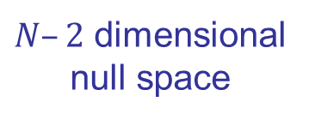
Geometric View of Coherent Analysis
Coherent sum:
Find linear combination of detector data that maximizes signal to noise ratio
Null sum
$N–2$ dimensional null space
detector data
Coherent sum
Null sum:
Linear combination of detector data that has no GW signal—provides consistency test
2 dimensional signal space
Treat this as a maximum likelihood problem
Find most likely h₊(t) & h×(t) , maximizing over arrival directions
Regulator penalizes physically unlikely signal hypotheses
Initial burst search with cWB uses wavelet decomposition of the data as basis; then can follow up with full parameter estimation (LALInference-Burst)

Slide 10
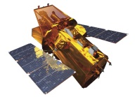
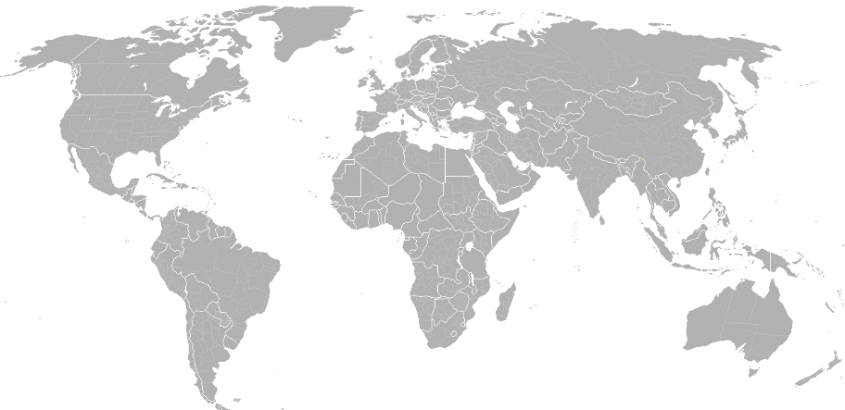
What We Have to Do
LIGO Hanford
GEO 600
KAGRA
Virgo
LIGO Livingston
LIGO-India
Send info to observers
Transfer data
Validate
(data quality, etc.)
Analyze data, identify triggers, infer sky position
Trigger database
GW data
Select event candidates
Estimate background
Swift: NASA E/PO, Sonoma State U., Aurore Simonnet

Slide 11
Generation of Alerts
Will analyze all data from two or more detectors for alerts
Two-detector candidates have poor localization, but sufficient for correlating with other surveys or very-wide-field instruments
Fold in additional detectors (Virgo, KAGRA, LIGO-India) as network grows
Estimate background by considering GW data streams with an artificial time shift, either by re-running full analysis algorithm or from expected coincidence rate of single-detector triggers. Look at distribution of detection statistic values → Assign a false alarm rate (FAR) to each candidate
Working to reduce or eliminate latency from manual data quality checks → Aiming to distribute alerts in 5-10 minutes

Slide 12
Forming Partnerships
Confident detection of first few GW signals will require time and care—need to avoid misinformation / rumors / media circus
LIGO/Virgo data has a proprietary period
Have signed MOUs with over 50 groups so far, with more coming!
Broad spectrum of transient astronomy researchers and instruments
Optical, Radio, X-ray, gamma-ray, VHE
Transient surveys and various instruments that can be pointed to follow up
Telescope owners, instrument science teams and ToO proposers
Have begun some discussions of science strategies, logistical details and testing plans – need to ramp this up this year

Slide 13
Communication Tools
GW event candidates will be distributed to partners via GCN
With a controlled list of recipients
Primary alert format is VOEvent
Significance indicated as estimated false alarm rate (FAR)
Sky probability maps are FITS files containing HEALpix pixel data
Four different types of alerts:
Preliminary: A transient in the GW data has been detected, but not yet checked for good data quality. Intended for making preparations.
Initial: Event candidate has passed basic data quality checks, and a sky-position probability map is available
Update: Updated sky map and/or estimate of significance
Retraction: In case we later find reason to reject the candidate
“GraceDB” database allows users to view detailed records
“Bulletin Board” interfaces allow observers to report observations

Slide 14
Example VOEvent – part 1
<?xml version="1.0" ?>
<voe:VOEvent xmlns:xsi="http://www.w3.org/2001/XMLSchema-instance" xmlns:voe="http://www.ivoa.net/xml/VOEvent/v2.0" xsi:schemaLocation="http://www.ivoa.net/xml/VOEvent/v2.0 http://www.ivoa.net/xml/VOEvent/VOEvent-v2.0.xsd" version="2.0" role="test" ivorn="ivo://gwnet/gcn_sender#G127992-3-Update">
<Who>
<Date>2014-12-03T16:03:34</Date>
<Author>
<contactName>LIGO Scientific Collaboration and Virgo Collaboration</contactName>
</Author>
</Who>
<What>
<Param name="Pkt_Ser_Num" dataType="string" value="3"/>
<Param name="GraceID" dataType="string" value="G127992" ucd="meta.id" unit="">
<Description>Identifier in the GraceDb database</Description> </Param>
<Param name="AlertType" dataType="string" value=“Update" ucd="meta.version" unit="">
<Description>VOEvent alert type</Description> </Param>
<Param name="EventPage" dataType="string" value="https://gracedb.ligo.org/events/G96195" ucd="meta.ref.url" unit="">
<Description>Web page for evolving status of this candidate event</Description> </Param>
<Param name="Instruments" dataType="string" value="H1,L1" ucd="meta.code">
<Description>List of instruments used in analysis to identify this event</Description> </Param>
<Param name="FAR" dataType="float" value="7.80321138878e-12" ucd="arith.rate;stat.falsealarm" unit="Hz">
<Description>False alarm rate for GW candidates with this strength or greater</Description> </Param>
<Param name="Pipeline" dataType="string" value="gstlal-spiir" ucd="meta.code" unit="">
<Description>Low-latency data analysis pipeline</Description> </Param>
<Param name="Search" dataType="string" value="LowMass" ucd="meta.code" unit="">
<Description>Low-latency search type</Description> </Param>
<Param name="ChirpMass" dataType="float" value="0.912880957127" ucd="phys.mass" unit="solar mass">
<Description>Estimated CBC chirp mass</Description> </Param>
<Param name="MaxDistance" dataType="float" value="57.5933" ucd="pos.distance" unit="Mpc">
<Description>Estimated maximum distance for CBC event</Description> </Param>
<Param name="Eta" dataType="float" value="0.2484173" ucd="phys.mass;arith.factor" unit="">
<Description>Estimated ratio of reduced mass to total mass</Description> </Param>

Slide 15
Example VOEvent – part 2
<Group type="GW_SKYMAP" name="BAYESTAR">
<Param name="skymap_png_x509" dataType="string" value="https://gracedb.ligo.org/api/events/G127992/files/skymap.png" ucd="meta.ref.url" unit="">
<Description>Sky Map image X509 protected</Description> </Param>
<Param name="skymap_fits_x509" dataType="string" value="https://gracedb.ligo.org/api/events/G127992/files/skymap.fits.gz" ucd="meta.ref.url" unit="">
<Description>Sky Map FITS X509 protected</Description> </Param>
<Param name="skymap_png_shib" dataType="string" value="https://gracedb.ligo.org/events/G127992/files/skymap.png" ucd="meta.ref.url" unit="">
<Description>Sky Map image Shibboleth protected</Description> </Param>
<Param name="skymap_fits_shib" dataType="string" value="https://gracedb.ligo.org/events/G127992/files/skymap.fits.gz" ucd="meta.ref.url" unit="">
<Description>Sky Map FITS Shibboleth protected</Description> </Param>
</Group>
</What>
<WhereWhen>
<ObsDataLocation> <ObservatoryLocation id="LIGO Virgo"/> <ObservationLocation> <AstroCoordSystem id="UTC-FK5-GEO"/>
<AstroCoords coord_system_id="UTC-FK5-GEO">
<Time> <TimeInstant> <ISOTime>2014-03-01T03:57:59.719037</ISOTime> </TimeInstant> </Time>
<Position2D>
<Value2> <C1>0.000000</C1> <C2>0.000000</C2> </Value2> <Error2Radius>180.000000</Error2Radius>
</Position2D>
</AstroCoords>
</ObservationLocation> </ObsDataLocation>
</WhereWhen>
<How>
<Description>H1: LIGO Hanford 4 km gravitational wave detector</Description>
<Description>L1: LIGO Livingston 4 km gravitational wave detector</Description>
<Description>Candidate gravitational wave event identified by low-latency analysis</Description>
</How>
<Citations>
<EventIVORN cite="supersedes">ivo://gwnet/gcn_sender#G127992-2-Initial</EventIVORN>
<EventIVORN cite="supersedes">ivo://gwnet/gcn_sender#G127992-1-Preliminary</EventIVORN>
<Description>Updated localization is now available</Description>
</Citations>
<Description>Report of a candidate gravitational wave event</Description>
</voe:VOEvent>

