Slide 1
Website / blog Scratchpad

Slide 2
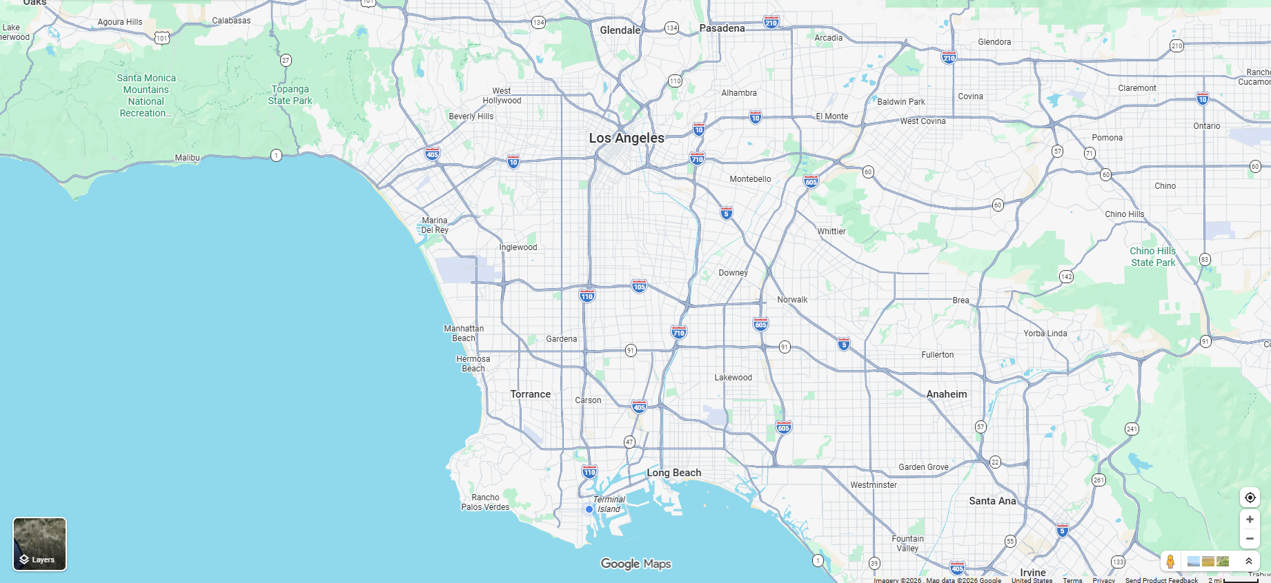
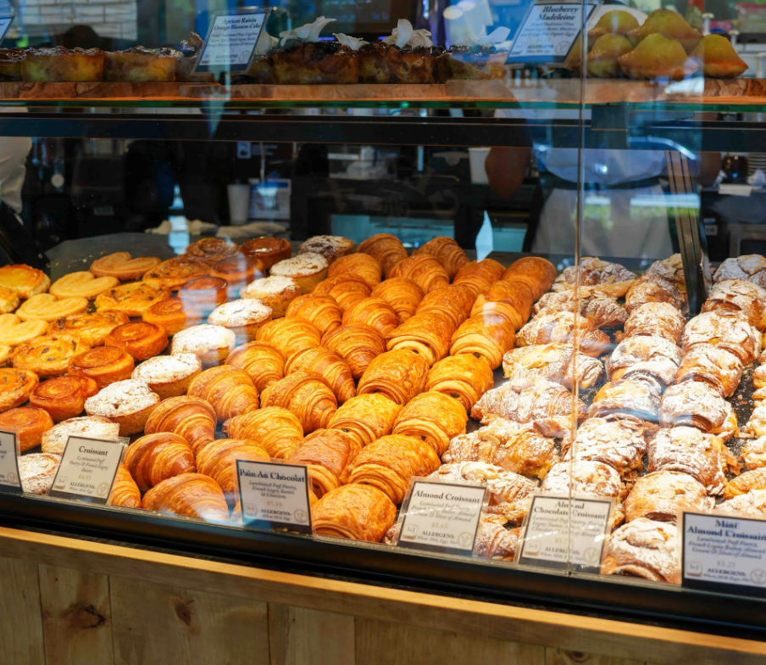
Home / landing page
Filter by:
Location
Rating
* Draw boundary
Featured
California
Sweet Wheat Bakery
San Francisco
Los Angeles
South Bay
Sweet Wheat Bakery

Slide 3
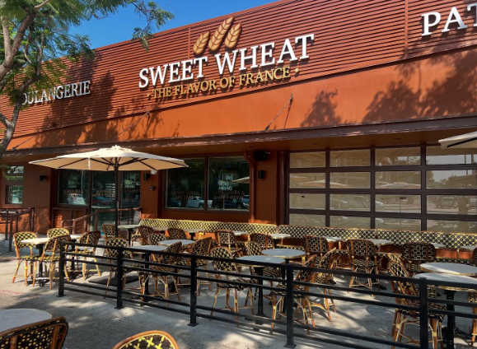
Review page // when a place is clicked on
Sweet Wheat Bakery
Description // etc Description // etc Description // etc Description // etc
Description // etc Description // etc Description // etc Description // etc
Description // etc Description // etc Description // etc Description // etc
Description // etc Description // etc
Description // etc Description // etc Description // etc Description // etc
Description // etc Description // etc Description // etc Description // etc
Description // etc Description // etc Description // etc Description // etc
Description // etc Description // etc
Description // etc Description // etc Description // etc Description // etc
Scores
Coffee
Pastries / Bakery Items
Atmosphere
Overall

