Slide 1
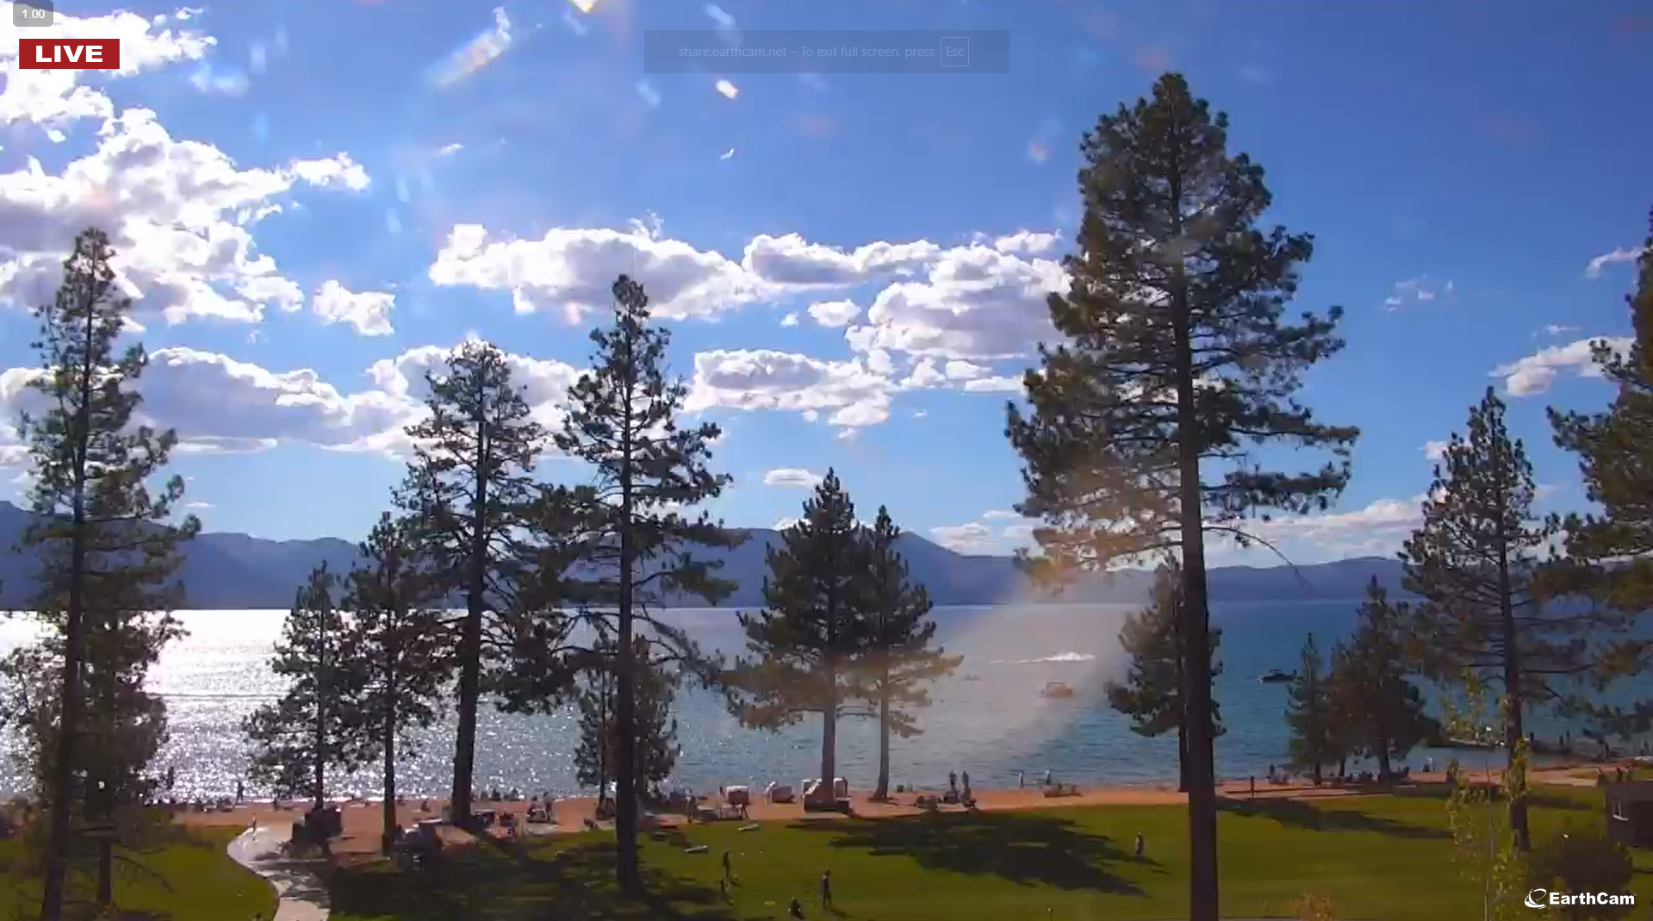
SCRATCHPAD DOC – WORKING NOTES ETC.
What it should look like
Edgewood Tahoe
09/01/2025 – 4:23pm local time

