Slide 1
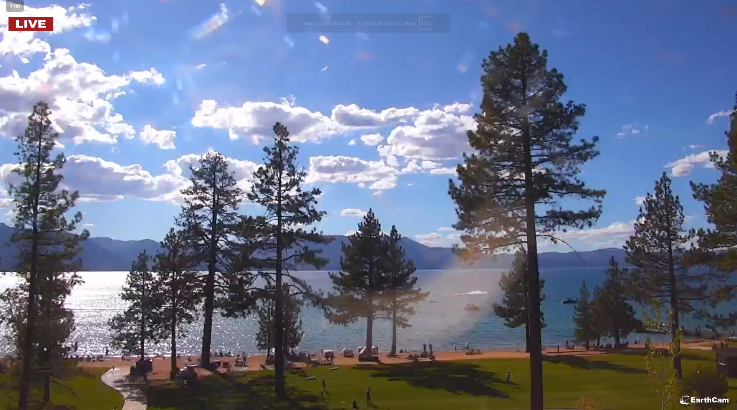
SCRATCHPAD DOC – WORKING NOTES ETC.
Screen should look like this.
Behaviour:
On during local daylight time (where the pi is located)
Off weekdays during work hours.
Change to next webcam every 30 seconds.
Use physical gpio button to switch between screens in a loop.
Edgewood Tahoe
09/01/2025 – 4:23pm local time

