Slide 1

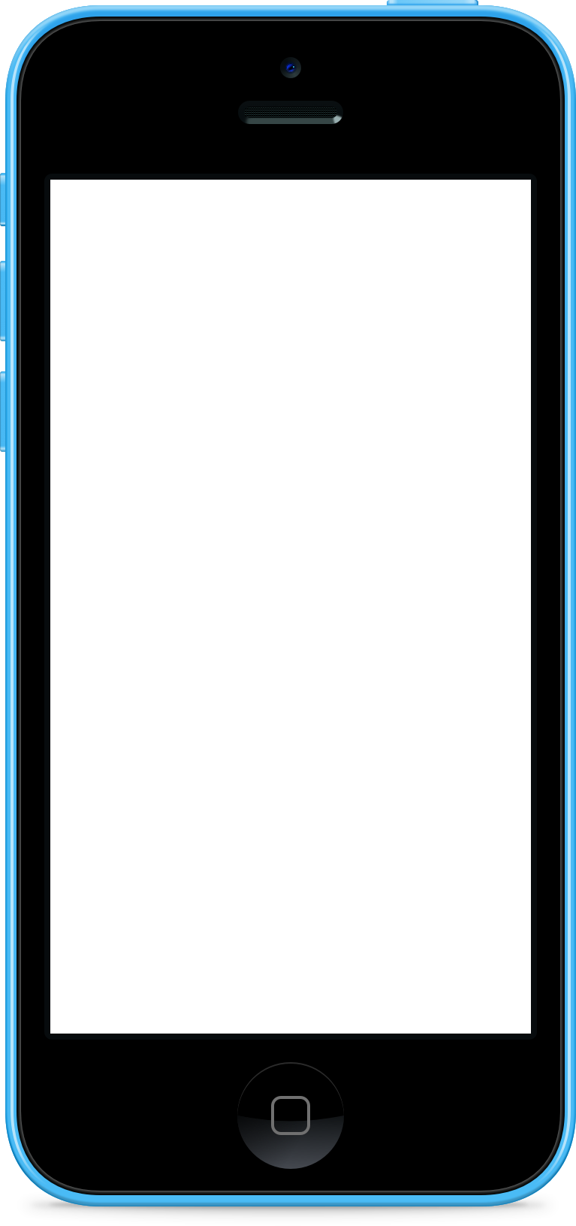
Websocket Server
Handshake
{User0, Server}
Handshake
{User1, Server}
Build
Login/Signin
Create Room
Join Room
Virtual Tunnel
{User0, User1}
User0
User1

Slide 2
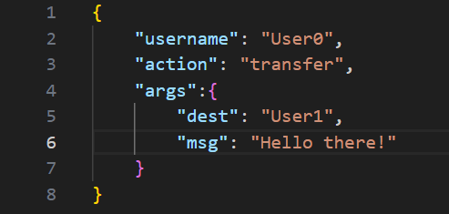
Self-defined protocol

