Slide 1
Apple Filesystems SW Eng. Manager Interview Prep
Key Talking Points and STAR Stories

Slide 2
Why Apple
Global scale: billions of devices depend on filesystem
Excited to work on APFS & core storage technologies
Value Apple’s iterative approach to critical infrastructure
Bring experience leading teams delivering complex system software

Slide 3
STAR: Leading Through Challenge
Situation: Intel HPC telemetry ingesting 1PB+ data every few minutes
Task: Stabilize & enable real-time analytics
Action: Built strong team, re-architected pipeline (Kafka, partitions)
Result: Handled 1T events/day with 99.99% reliability

Slide 4
STAR: Cross-Functional Collaboration
Situation: Integrated Jupyter with Kubernetes GPU cluster
Task: Deliver service in 6 months across many teams
Action: Weekly cross-org design reviews & dependency tracking
Result: Launched for 25K+ users on time, strong telemetry & isolation

Slide 5
STAR: Handling Critical Failure
Situation: Firmware update caused telemetry crashes
Task: Fix urgently & stabilize system
Action: Formed tiger team, reproduced bug, coordinated vendor fix
Result: Restored stability in days, added watchdog for resilience

Slide 6
STAR: Hiring & Developing Engineers
Grew team from 2 to 12 for HPC control-plane project
Recruited senior engineers & top college hires
Structured onboarding & mentorship program
Delivered on time, retained most hires long-term

Slide 7
Technical: APFS & FS Concepts
Copy-on-Write: write to new blocks, enables snapshots, avoids partial updates
Crash-consistency: journaling vs log-structured updates
Trade-offs: write amplification, fragmentation
Kernel & storage concepts: buffer/page cache, schedulers

Slide 8
Technical: Debugging & Performance
Check FS logs, driver versions, hardware batches
Use tools: fsck, verifier, tracepoints, stress tests
Implement regression tests & telemetry for early detection

Slide 9
Design: Extending APFS for New Hardware
Adapt allocator & I/O path for low-latency persistent memory
Revisit journaling & copy-on-write policies
Ensure atomicity & crash-consistency
Benchmark & adjust metadata layout

Slide 10
Leadership & Evaluation
Look for OS fundamentals, data-driven decisions, collaboration
Use practical design/debugging scenarios in interviews
Focus on communication of reasoning & problem-solving approach

Slide 11
Final Notes
Review APFS internals & FS fundamentals tonight
Rehearse STAR stories (challenge, collaboration, failure, hiring)
Prepare for 'Why Apple' and FS design discussions
Show enthusiasm for scale & impact of Apple’s storage tech

Slide 12
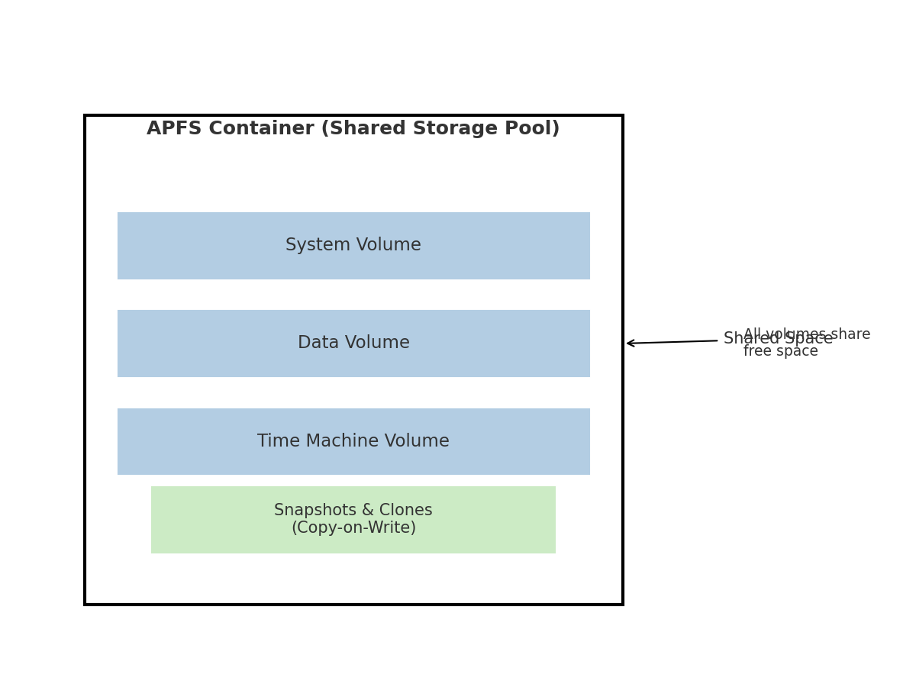
APFS Architecture Diagram

Slide 13
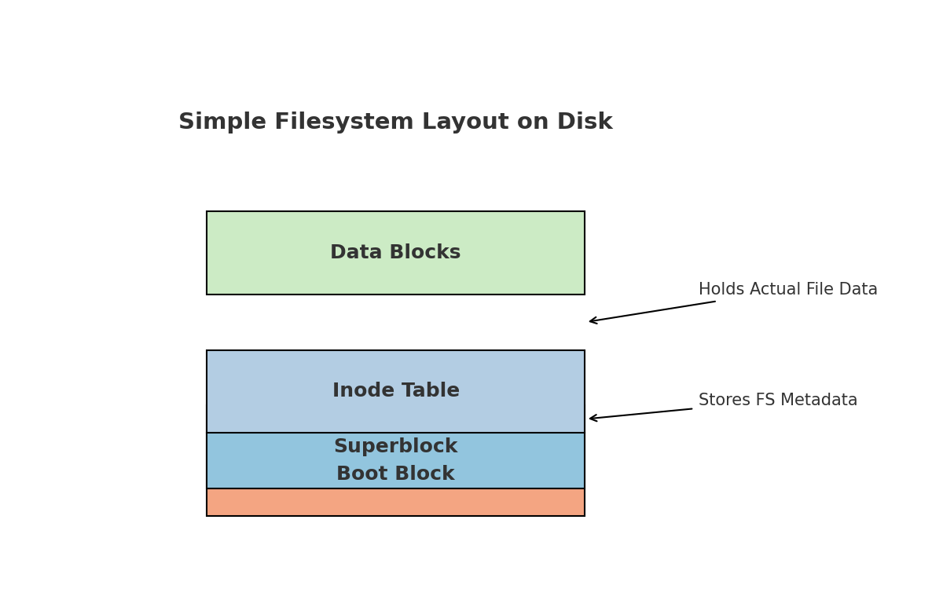
Simple Linux Filesystem Layout

