Slide 1
Apple Filesystems SW Eng. Manager Interview Prep
Key Talking Points and STAR Stories

Slide 2
Why Apple
Global scale: billions of devices depend on filesystem
Excited to work on APFS & core storage technologies
Value Apple’s iterative approach to critical infrastructure
Bring experience leading teams delivering complex system software

Slide 3
STAR: Leading Through Challenge
Situation: Intel HPC telemetry ingesting 1PB+ data every few minutes
Task: Stabilize & enable real-time analytics
Action: Built strong team, re-architected pipeline (Kafka, partitions)
Result: Handled 1T events/day with 99.99% reliability

Slide 4
STAR: Cross-Functional Collaboration
Situation: Integrated Jupyter with Kubernetes GPU cluster
Task: Deliver service in 6 months across many teams
Action: Weekly cross-org design reviews & dependency tracking
Result: Launched for 25K+ users on time, strong telemetry & isolation

Slide 5
STAR: Handling Critical Failure
Situation: Firmware update caused telemetry crashes
Task: Fix urgently & stabilize system
Action: Formed tiger team, reproduced bug, coordinated vendor fix
Result: Restored stability in days, added watchdog for resilience

Slide 6
STAR: Hiring & Developing Engineers
Grew team from 2 to 12 for HPC control-plane project
Recruited senior engineers & top college hires
Structured onboarding & mentorship program
Delivered on time, retained most hires long-term

Slide 7
Technical: APFS & FS Concepts
Copy-on-Write: write to new blocks, enables snapshots, avoids partial updates
Crash-consistency: journaling vs log-structured updates
Trade-offs: write amplification, fragmentation
Kernel & storage concepts: buffer/page cache, schedulers

Slide 8
Technical: Debugging & Performance
Check FS logs, driver versions, hardware batches
Use tools: fsck, verifier, tracepoints, stress tests
Implement regression tests & telemetry for early detection

Slide 9
Design: Extending APFS for New Hardware
Adapt allocator & I/O path for low-latency persistent memory
Revisit journaling & copy-on-write policies
Ensure atomicity & crash-consistency
Benchmark & adjust metadata layout

Slide 10
Leadership & Evaluation
Look for OS fundamentals, data-driven decisions, collaboration
Use practical design/debugging scenarios in interviews
Focus on communication of reasoning & problem-solving approach

Slide 11
Final Notes
Review APFS internals & FS fundamentals tonight
Rehearse STAR stories (challenge, collaboration, failure, hiring)
Prepare for 'Why Apple' and FS design discussions
Show enthusiasm for scale & impact of Apple’s storage tech

Slide 12
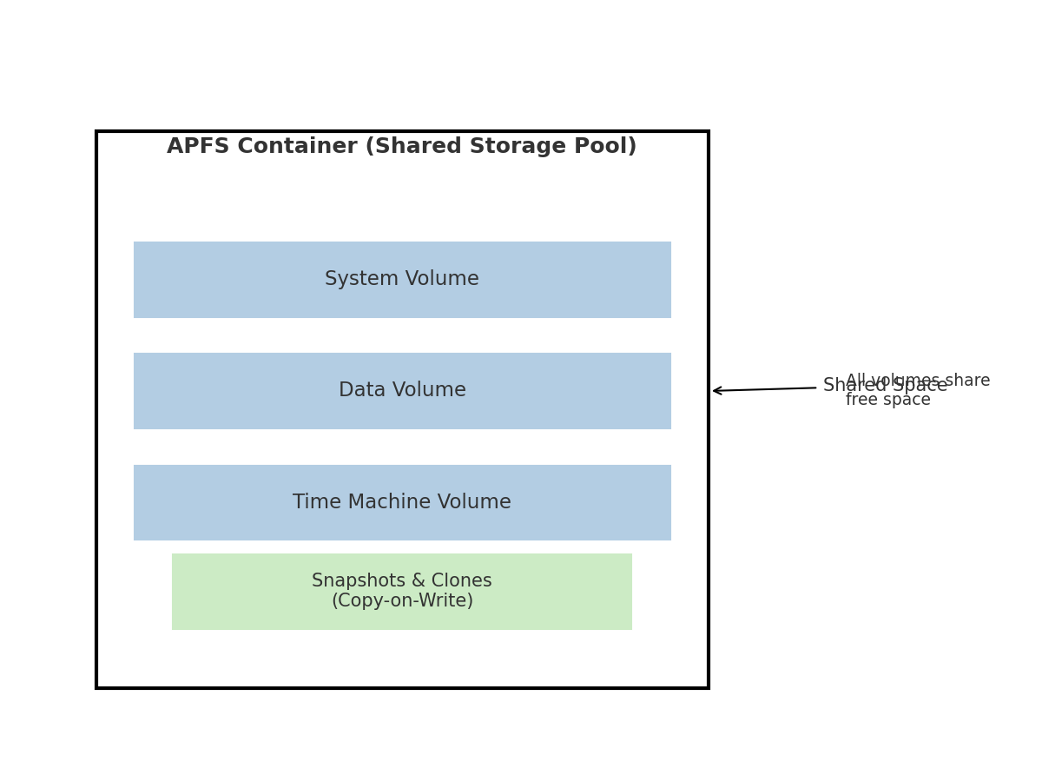
APFS Architecture Diagram

Slide 13
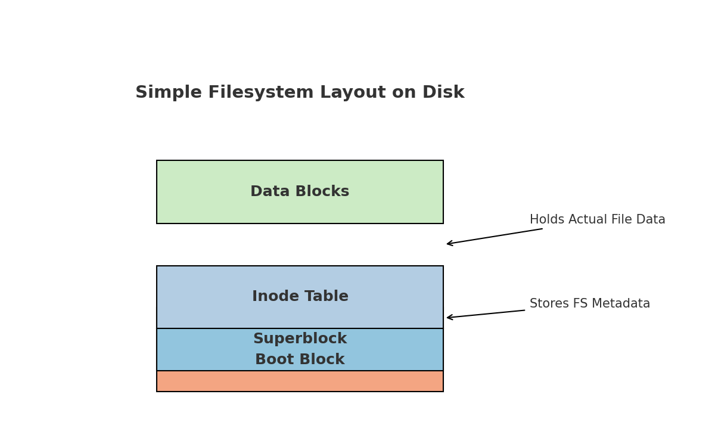
Simple Linux Filesystem Layout

Slide 14
Simple Linux Filesystem – Key Concepts
Boot Block – reserved for bootloader code
Superblock – stores FS metadata (block size, counts, etc.)
Inode Table – each inode stores file metadata and block pointers
Data Blocks – hold the actual file and directory contents
Mounted via Linux VFS layer
Can prototype with FUSE for quick experimentation

Slide 15
SECTION: Building a Simple Linux Filesystem
A practical guide with FUSE prototype and key concepts

Slide 16
Building a Simple Linux FS – Overview
A learning exercise to understand filesystem fundamentals
Not production‑grade but great for grasping FS basics
Focus on metadata, APIs, and storage layout

Slide 17
Filesystem Basics
Metadata structures: superblock, inodes, directories
APIs for access: open, read, write
Manages allocation and persistence of data blocks
Integrates with Linux VFS layer
FUSE allows quick prototyping in user space

Slide 18
Basic Components
Superblock: describes size, block size, counts of inodes and blocks
Inodes: metadata about files and pointers to data blocks
Data Blocks: store the actual file contents
Directory Structure: maps file names to inode numbers
Journal / Log (optional for crash recovery)

Slide 19
FUSE Prototype – Install & Setup
Install FUSE on Ubuntu/Debian:
sudo apt update
sudo apt install build-essential libfuse3-dev
Compile & run example FS:
gcc -Wall myfs.c `pkg-config fuse3 --cflags --libs` -o myfs
mkdir mountpoint
./myfs mountpoint

Slide 20
Minimal FUSE FS in C – Part 1
#define FUSE_USE_VERSION 31
#include <fuse3/fuse.h>
#include <string.h>
static const char *hello_path = "/hello.txt";
static const char *hello_str = "Hello from simple FS!\n";
static int myfs_getattr(const char *path, struct stat *stbuf,
struct fuse_file_info *fi) {
memset(stbuf, 0, sizeof(struct stat));
if (strcmp(path, "/") == 0) {
stbuf->st_mode = S_IFDIR | 0755;
stbuf->st_nlink = 2;
} else if (strcmp(path, hello_path) == 0) {
stbuf->st_mode = S_IFREG | 0444;
stbuf->st_nlink = 1;
stbuf->st_size = strlen(hello_str);
} else {
return -ENOENT;
}
return 0;
}

Slide 21
Minimal FUSE FS in C – Part 2
static int myfs_readdir(const char *path, void *buf, fuse_fill_dir_t filler,
off_t offset, struct fuse_file_info *fi,
enum fuse_readdir_flags flags) {
if (strcmp(path, "/") != 0)
return -ENOENT;
filler(buf, ".", NULL, 0, 0);
filler(buf, "..", NULL, 0, 0);
filler(buf, hello_path + 1, NULL, 0, 0);
return 0;
}
static int myfs_open(const char *path, struct fuse_file_info *fi) {
if (strcmp(path, hello_path) != 0)
return -ENOENT;
return 0;
}
static int myfs_read(const char *path, char *buf, size_t size, off_t offset,
struct fuse_file_info *fi) {
if (strcmp(path, hello_path) != 0)
return -ENOENT;
size_t len = strlen(hello_str);
if (offset < len) {
if (offset + size > len) size = len - offset;
memcpy(buf, hello_str + offset, size);
} else
size = 0;
return size;
}
static struct fuse_operations ops = {
.getattr = myfs_getattr,
.readdir = myfs_readdir,
.open = myfs_open,
.read = myfs_read,
};
int main(int argc, char *argv[]) {
return fuse_main(argc, argv, &ops, NULL);
}

Slide 22
Approach 2 – Block‑Based FS
Create a virtual disk image using dd
Implement superblock, inode table, and data blocks
Use fopen/fread/fwrite to manage storage
Kernel module integration possible for advanced use

Slide 23
Key Concepts & Interview Points
Allocation strategies: contiguous, linked, indexed
Consistency and recovery: fsck, journaling
Performance: caching, read‑ahead, delayed allocation
Interview Tip: Outline design → choose VFS/FUSE → discuss trade‑offs

Slide 24
Acronyms
FS – File System
VFS – Virtual File System
FUSE – Filesystem in Userspace
COW – Copy-On-Write
SSD – Solid State Drive
HDD – Hard Disk Drive
APFS – Apple File System
inode – Index Node
I/O – Input/Output
dd – Disk Dump utility
RAID – Redundant Array of Independent Disks
fsck – File System Consistency Check

Slide 25
Alternatives to VFS for High Performance
Direct I/O (O_DIRECT) – bypass page cache for lower latency, app manages caching
io_uring – asynchronous, low‑overhead I/O submission/completion queues
DAX / Persistent Memory – map NVDIMM/PMEM directly, skips page cache
High‑perf user‑space FS / SPDK – bypass kernel block layer for ultra‑low latency
Trade‑off: less portability & simplicity in exchange for maximum performance

