Slide 1
GPU Driver Task Isolation
Overview of mechanisms used by GPU drivers to securely and efficiently isolate user jobs on shared GPUs

Slide 2
Overview
Modern GPU clusters often share one physical GPU among many jobs.
Isolation prevents one job from interfering with another in terms of security, performance, or stability.
Drivers and hardware enforce this with memory protection, context switching, and partitioning.

Slide 3
Key Isolation Mechanisms
1. Context Management – per-job GPU context (registers, queues, state)
2. Virtual Memory – per-context page tables with IOMMU/SMMU
3. Scheduling & Partitioning – time-slicing and hardware partitioning (MIG, SR‑IOV)
4. Command Queue Isolation – separate, validated queues
5. Preemption & Fault Containment – contain faulty kernels
6. Host-Level Controls – containers, cgroups, schedulers restrict GPU access

Slide 4
Common Flow of GPU Isolation
1. Scheduler assigns a GPU partition or VF to the job
2. Driver creates GPU context and maps memory
3. Commands submitted to isolated queues
4. GPU hardware enforces memory & execution isolation
5. Preemption and error handling contain faults per job

Slide 5
NVIDIA MIG-Based Isolation
NVIDIA Multi‑Instance GPU (MIG) partitions GPU into hardware‑isolated slices.
Each slice has dedicated SMs, L2 cache, and memory.
Each job’s context binds to one MIG slice, ensuring secure and predictable workload separation.
Multi‑Instance GPU (MIG) partitions a physical GPU into several isolated hardware instances.
• Each MIG slice has its own SMs, L2 cache, and memory.
• Jobs are bound to a single MIG slice, preventing cross‑job interference.
• Hardware guarantees memory and execution isolation between MIG slices.

Slide 6
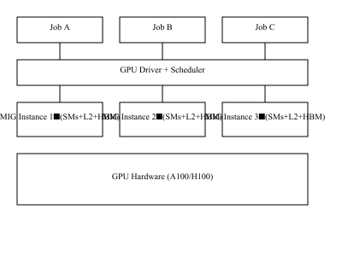
NVIDIA MIG-Based Isolation
Multi‑Instance GPU (MIG) partitions a physical GPU into several isolated hardware instances.
• Each MIG slice has its own SMs, L2 cache, and memory.
• Jobs are bound to a single MIG slice, preventing cross‑job interference.
• Hardware guarantees memory and execution isolation between MIG slices.

Slide 7
Intel Gaudi / SR‑IOV-Based Isolation
Intel Gaudi GPUs use PCIe SR‑IOV to expose multiple Virtual Functions (VFs).
Each VF has its own queue, DMA engine, and page tables.
Jobs in containers or VMs bind to separate VFs, managed by the PF driver for secure isolation.

Slide 8
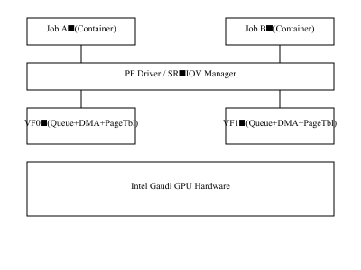
Intel Gaudi / SR‑IOV-Based Isolation
Single Root I/O Virtualization (SR‑IOV) allows a single physical GPU (PF) to present multiple Virtual Functions (VFs).
• Each VF has its own queues, DMA engines, and memory mappings.
• PF driver manages global resources, while each job runs in its assigned VF.
• Hardware isolation ensures secure, scalable multi‑tenant GPU sharing.

Slide 9
Appendix: Acronyms
GPU: Graphics Processing Unit – hardware accelerator for compute and graphics
SM: Streaming Multiprocessor – core compute unit in NVIDIA GPUs
HBM: High‑Bandwidth Memory – fast on‑package memory for GPUs
MIG: Multi‑Instance GPU – NVIDIA feature that partitions a GPU into isolated slices
SR‑IOV: Single Root I/O Virtualization – PCIe technology to virtualize a device into multiple functions
VF: Virtual Function – virtualized GPU instance presented to a VM or container
PF: Physical Function – host‑level GPU function managing all VFs
IOMMU / SMMU: I/O Memory Management Unit / System MMU – hardware for memory protection of DMA
DMA: Direct Memory Access – allows GPU to access host or device memory directly
RAS: Reliability, Availability, and Serviceability – hardware error detection and reporting framework
SMT / Preemption: Simultaneous Multithreading / Preemption – techniques for scheduling and isolating GPU workloads

