Slide 1
Ironic in Cloud Environments
Overview of Ironic functions and architecture in cloud computing

Slide 2
Ironic Core Functions
• Hardware Provisioning: Power control, PXE/iPXE-based image deployment, disk setup
• Hardware Lifecycle Management: Node discovery, cleaning, firmware updates
• Networking Integration: Works with Neutron or SDN for VLAN isolation and port binding
• Scheduling and Pooling: Integrates with Nova to manage bare-metal as compute resources
• Driver Framework: Supports IPMI, Redfish, and vendor-specific drivers

Slide 3
Typical Workflow
1. Admin registers new hardware in Ironic
2. Ironic powers on nodes for introspection and collects specs
3. Ironic cleans and prepares the node
4. User (via Nova/K8s) requests bare-metal instance
5. Ironic provisions OS/image and sets up networking
6. Node is returned to pool after workload finishes

Slide 4
Integration and Benefits
• Integrates with OpenStack (Nova, Neutron, Glance)
• Used beneath Kubernetes for cluster node provisioning
• Supports HPC and AI GPU nodes needing bare-metal access
• Reduces manual provisioning effort
• Enables hybrid VM + bare-metal clouds

Slide 5
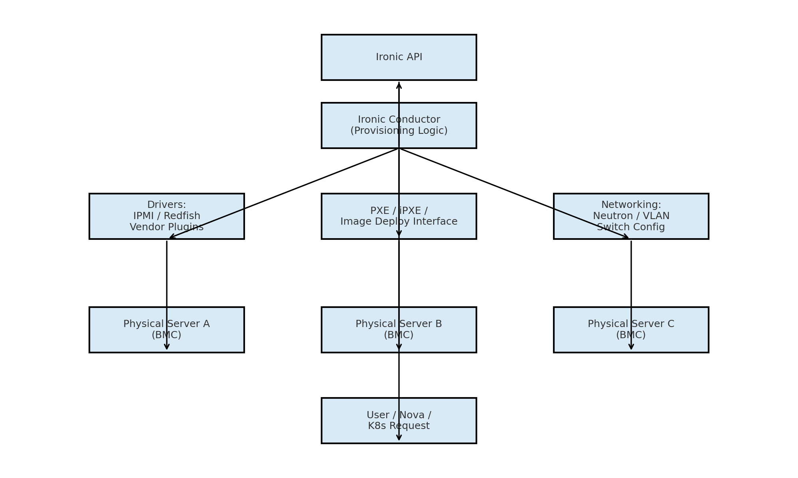
Ironic Architecture Diagram

