Slide 1
Guided Capstone Project
Big Mountain Resort
Luis Ruiz

Slide 2
Problem Identification
With the increase of operation cost of 1.5m, how can Big Mountain Resort set their ticket price to maximize sales without undermining the ticket price or support an even higher ticket price to offset the cost of the new lift and increase profit?
Context
Big Mountain Ski Resort recently installed an additional chair lift to help
increase the distribution of visitors across the mountain. Using data from
similar ski resort across the country we aim to create a model which will help offset the cost of the new lift and identify way in which we can increase our ticket price.
Criteria for Success
By the beginning of the ski season, we will identify the key connections between ticket value and facilities using data from ski resorts across the country which will lead to an increase of price, decrease operational cost or both.
Scope of Solution
When identifying and verifying our relationship between price and facilities we must focus on resorts that offer similar features. We will only analyze the skiing side of our business.

Slide 3
Recommendations and Key Findings
Key features
Below is the list of facilities that closely correlate with ticket price:
Vertical Drops
FastQuads
Runs
Snow making area
Night skiing capacity
Recommendation
Acquire additional data(Big Mountain customers, visitors, operating cost) to improve the accuracy of the model
Analyzing different iterations of our model with the key features listed above.

Slide 4
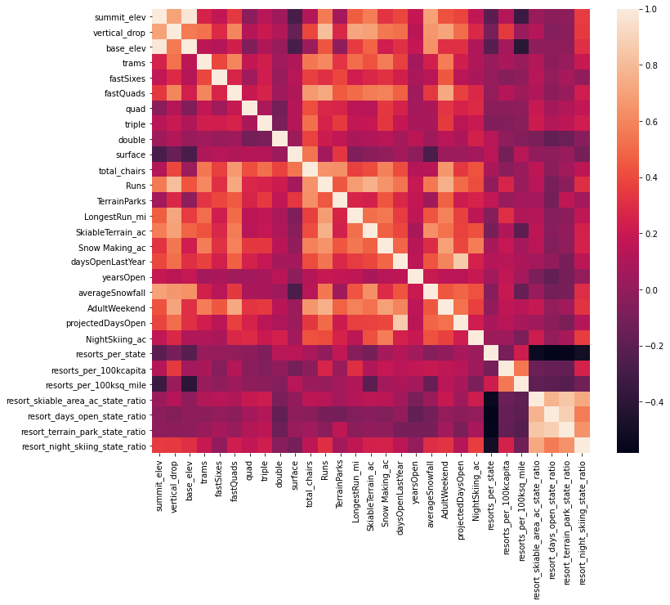
Modeling Results and Initial Analysis
I analyzed the relationship between the ticket price and each feature.
Based on general market data from all states, below are features that seem affect ticket prices:
Vertical drops
FastQuads
Runs
Total chairs
Snow making area
Night skiing capacity

Slide 5
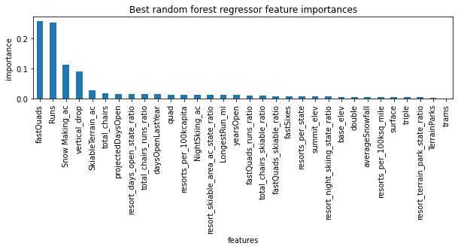
Modeling Results and Analysis cont.
Further analysis using our Random Forest model confirmed our initial conclusion by assigning a numerical value of importance to each feature as it relates to the price.
The graph to the right highlight each feature. The top 4 of listed below:
FastQuads
Runs
Snow making area
Vertical drop

Slide 6
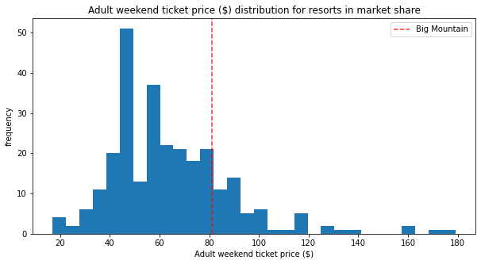
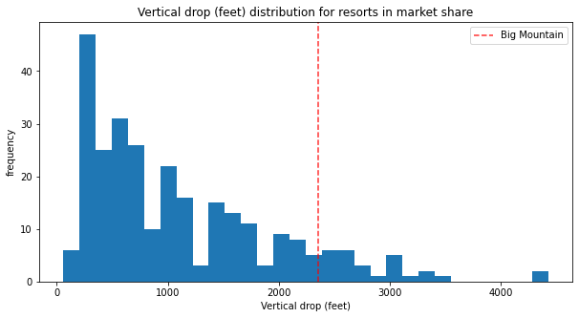
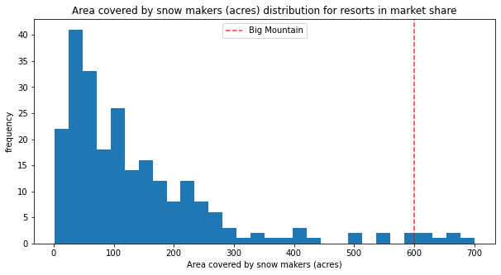
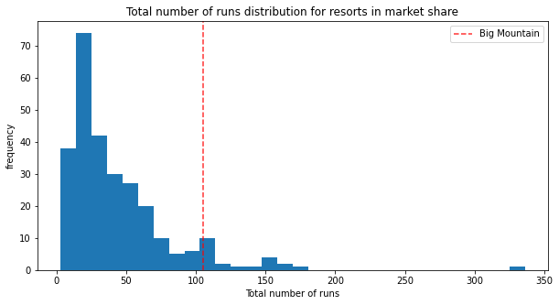
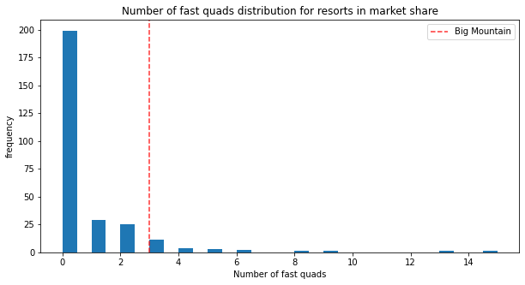
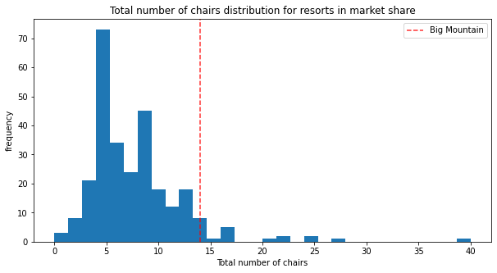
Big Mountain vs Nation Analysis
We can see that Big Mountain ranks high in performance of important facilities as relative to other resorts in the market.

Slide 7
Summary
Using the data provided, Big Mountain Resort has the facilities to support a price increase that can offset the price of the new lift as well as increase our revenue.
What I would like to continue to investigate would be:
Historical visitor data(Season pass holders, 5 days pass and daily pass)
Customer data(demographics, income and age)
Operational cost of other facilities
We can see that our model supports the price increase, Big Mountain Resort would benefit from further analysis which can solidify our findings.

