Slide 1
PH551 EPSRC Proposal Outline
MITIGATING JOULE EXPANSION IN MULTICELL ATOMIC QUANTUM MEMORY
Kata Benedek | Christoforos Iakovou | Lewis Russell

Slide 2
What does this mean?
Joule Expansion?
P_{i}
V_{i}
Thermal Barrier
Removed
Thermal Barrier
P_{f}
V_{f}
P_{f}
V_{f}
MITIGATING JOULE EXPANSION IN MULTICELL ATOMIC QUANTUM MEMORY

Slide 3
What does this mean?
Multicell Atomic Quantum Memory (MAQM, aka qRAM)?
Analogous to standard computer memory (hence, qRAM)
Stores quantum states for later retrieval
One design approach -> Quantum Repeaters
Quantum Repeaters contain (2D) atomic arrays used for quantum state (qubit) storage.
MITIGATING JOULE EXPANSION IN MULTICELL ATOMIC QUANTUM MEMORY

Slide 4
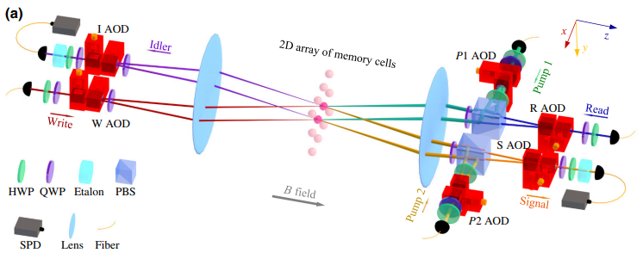
What does this mean?... Merging Tech
What we aim to do…
[1]
I still need to think about how best to do this diagram (LEWIS) :D
MITIGATING JOULE EXPANSION IN MULTICELL ATOMIC QUANTUM MEMORY

Slide 5
Objectives
Pass 551? ;P…
MITIGATING JOULE EXPANSION IN MULTICELL ATOMIC QUANTUM MEMORY

Slide 6
Why? What’s the Impact?
Good PowerPoint, good grade…
MITIGATING JOULE EXPANSION IN MULTICELL ATOMIC QUANTUM MEMORY

Slide 7
Experimental Specification
Hmmm…
MITIGATING JOULE EXPANSION IN MULTICELL ATOMIC QUANTUM MEMORY

Slide 8
Team with Expertise
Pure Wizards…
MITIGATING JOULE EXPANSION IN MULTICELL ATOMIC QUANTUM MEMORY

Slide 9
Timeline
Gnatt chart seems to be what Bernhard is after (3yrs)…
MITIGATING JOULE EXPANSION IN MULTICELL ATOMIC QUANTUM MEMORY

Slide 10
Finance
$$$$…
MITIGATING JOULE EXPANSION IN MULTICELL ATOMIC QUANTUM MEMORY

Slide 11
References
C. Li, S. Zhang, Y.-K. Wu, N. Jiang, Y.-F. Pu, and L.-M. Duan. Multicell atomic quantum memory as a hardware-efficient quantum repeater node. PRX Quantum, 2:040307, Oct 2021.
Wang Y, Shevate S, Wintermantel T M, et al. Preparation of hundreds of microscopic atomic ensembles in optical tweezer arrays. npj Quantum Inf, 6, 54, June 2020.
Ryo Asaka et al. Quantum random access memory via quantum walk. Quantum Sci. Technol., 6:035004, May 2021.
Daniel J. Bernstein and Tanja Lange. Post-quantum cryptography. Nature, 549:188–194, September 2017.
Charles H. Bennett and Gilles Brassard. Quantum cryptography: Public key distribution and coin tossing. Theoretical Computer Science, Theoretical Aspects of Quantum Cryptography – celebrating 30 years of BB84, 560:7–11, 2014.
Gg
Gg
Gg
MITIGATING JOULE EXPANSION IN MULTICELL ATOMIC QUANTUM MEMORY

Slide 12
Summary
Boom…
MITIGATING JOULE EXPANSION IN MULTICELL ATOMIC QUANTUM MEMORY

Slide 13
End slide – anything after here just for adding notes/etc for working on.

Slide 14
What does this mean?
What we aim to do?
…… Reduce the free expansion rate of the 2D atomic multicell array within a quantum repeater, applied within a MAQM Module
Spare Slide
MITIGATING JOULE EXPANSION IN MULTICELL ATOMIC QUANTUM MEMORY

Slide 15
Spare Slide
Purpose
Establish a QComSys research cluster for physicists, engineers, and commercial stakeholders.
Accelerate the development of communication and encryption systems for the quantum era.
Develop a highly skilled, interdisciplinary and in-demand workforce.
Innovation
Experiment
Industry
Theory
Engineering
Why ?
Aligned with the Nation’s £ 150 million investment portfolio in novel quantum technologies.
Maintain UK’s leading position in academia and further expand its industrial impact.
Quantum cryptography and communication may radically transform business, society and government.
Research Themes
Quantum Communication
Quantum-Resistant Cryptography
Quantum Internet
References
[1] M. J. Everitt et al. IEEE, ICTON, 10.1109
[2] Kumar et al. Arch Computat Methods Eng 28, 10.1007
Lewis Russell | Kata Benedek | Christoforos Iakovou

Slide 16
A thought on the talks
In your talk you need to convince us, the audience that your proposal is worth doing, is possible to be done, is soundly staffed and financed and well laid out in time and resources requested.
Remember the Common denominator:
• What?
• Why?
• How?
• Who?
• When?
• How much?

Slide 17
A thought on the talks
Typical case for support
Title
Abstract
Introduction
Objectives
Theory
Experimental
Team
Timeline
Finance
Impact
References
Not all the bits you present in your case for support will feature equally strong in your talk but you probably touch on most of them to some extent.

Slide 18
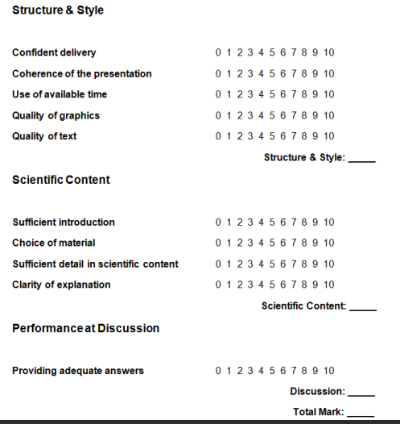
Marking Sheet

Slide 19
Comments from emails:
Hi Group Adv. Res I, Here's a bit of feedback: > Objectives are clear, but they need to be measurable
You mention "Improve lifespan" -- you have to quantify this, see lecture slides.
> Team: talk not only about collaborators, but more importantly about the local CAS team. > 5 years is long, has to be well justified and a detailed Gantt chart would be expected, probably more objectives. If you can adjust to three years duration, the objectives may be fine, depends on how exactly you define it. > Outreach: ok, but it receives quite over-proportional emphasis on the one-pager. E.g. less on Outreach and more on Impact would be good

