Slide 1
PH551 EPSRC Proposal Outline
MITIGATING JOULE EXPANSION IN MULTICELL ATOMIC QUANTUM MEMORY
Kata Benedek | Christoforos Iakovou | Lewis Russell

Slide 2
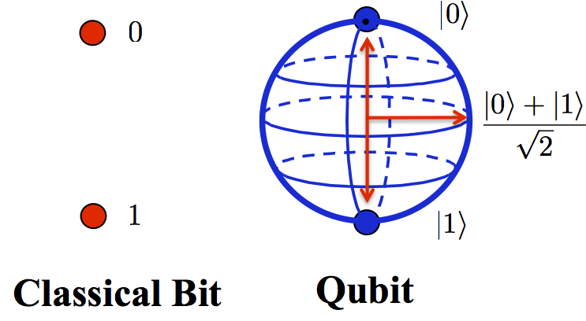
Introduction: Quantum Systems
Aim: Increase the memory lifespan of quantum memories by mitigating Joule expansion with optical tweezers
Quantum Computation high area of interest
More possibilities with quantum states
Read/Write one current limitation in QCommSys
Many hardware designs being researched, ours based on Multicell Atomic Quantum Memory (MAQM)
Source: ResearchGate
MITIGATING JOULE EXPANSION IN MULTICELL ATOMIC QUANTUM MEMORY
2.

Slide 3
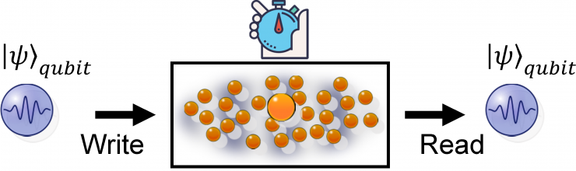
Introduction: MAQM
Analogous to standard computer memory
Stores quantum states for later retrieval
One design approach Quantum Repeaters
Source: Quantum Information and Communication
MITIGATING JOULE EXPANSION IN MULTICELL ATOMIC QUANTUM MEMORY
3.
Notes:
The quantum memory should be able to release a photon with the same quantum state as the stored photon, after a duration set by the user.

Slide 4
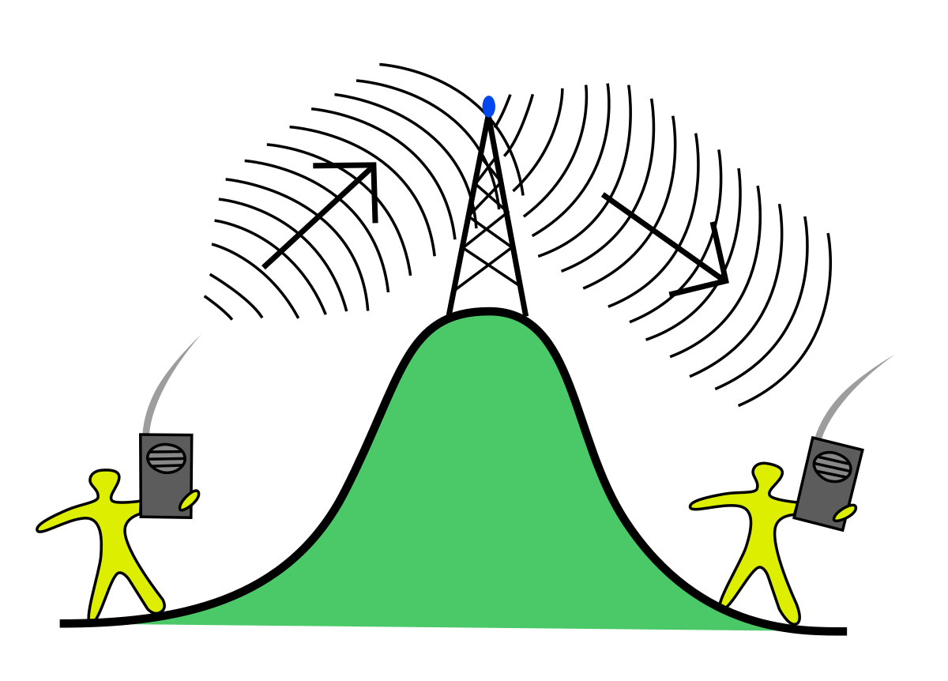
Introduction: Quantum Repeaters
Analogous to signal boosters in telecommunication networks
Transmission line is broken up into segments
At each segment, a quantum repeater can distribute entanglement further through the network.
MITIGATING JOULE EXPANSION IN MULTICELL ATOMIC QUANTUM MEMORY
4.
Notes:
The quantum memory should be able to release a photon with the same quantum state as the stored photon, after a duration set by the user.

Slide 5
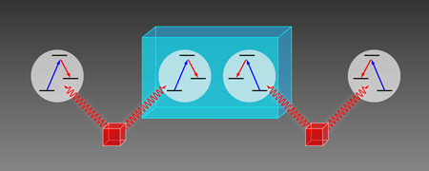
Introduction: Quantum Repeaters
How it works:
Qubit A is entangled to the repeater qubit via a photon
The repeater qubits can hold to that entanglement
Qubit B gets entangled to it , and with that to Qubit A
Repeater
Qubit A
Qubit B
Measuring devices
MITIGATING JOULE EXPANSION IN MULTICELL ATOMIC QUANTUM MEMORY
5.
Notes:
Entanglement swapping allows one to entangle two photons that have never encountered
eachother.
Qubits can be entangled with each other or photons
Photons can be transferred via fibers
BUT over long distances photons can get lost

Slide 6
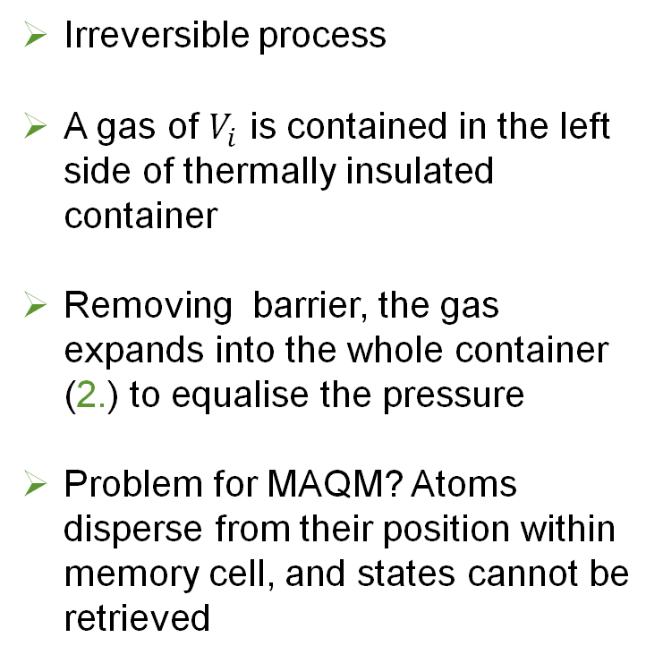
Introduction: Joule Expansion
Irreversible process
A gas of $V_{i}$ is contained in the left side of thermally insulated container
Removing barrier, the gas expands into the whole container (2.) to equalise the pressure
Problem for MAQM? Atoms disperse from their position within memory cell, and states cannot be retrieved
1.
P_{i}
V_{i}
Barrier
Barrier
Removed
2.
P_{f}
V_{f}
P_{f}
V_{f}
MITIGATING JOULE EXPANSION IN MULTICELL ATOMIC QUANTUM MEMORY
6.

Slide 7
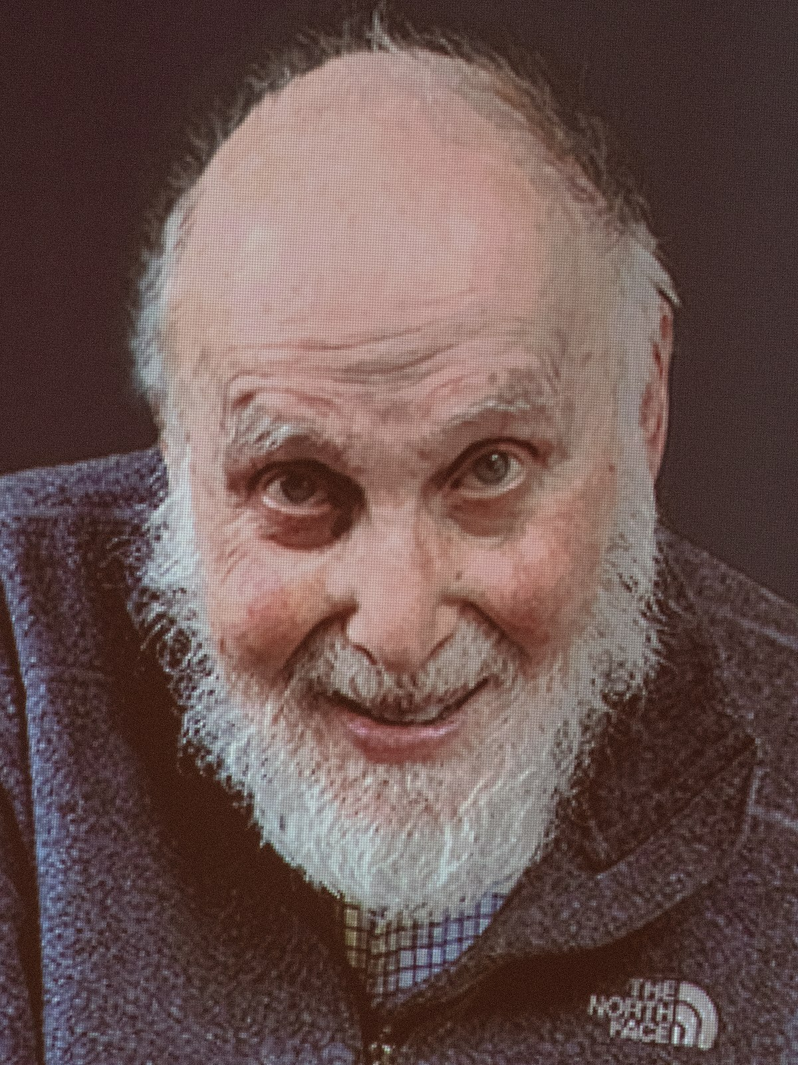
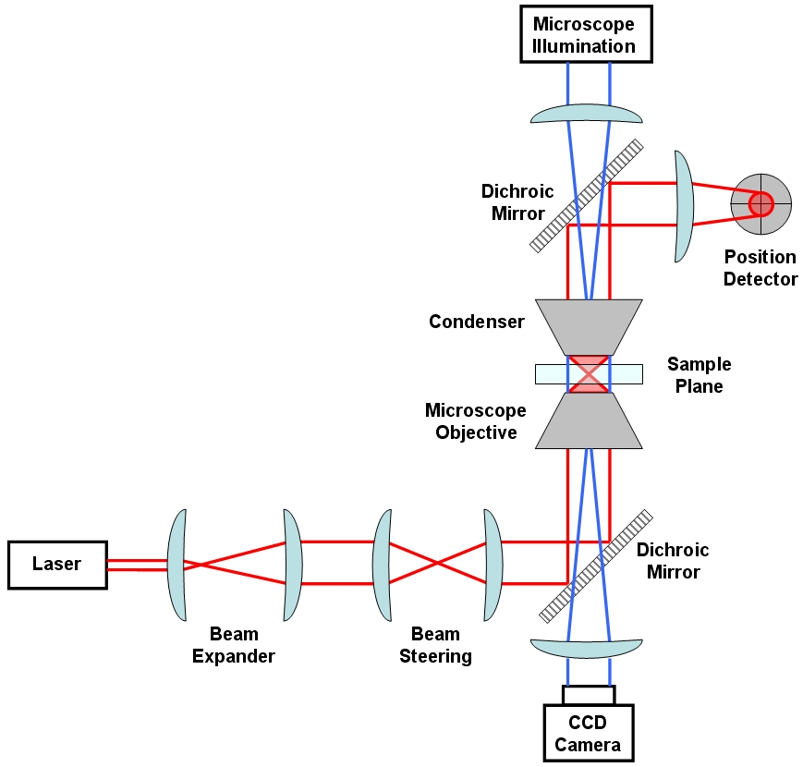
Introduction: Optical Tweezers
What is it: Instrument that uses highly focused laser beam to trap and move atoms
How it works:
Laser beam (A) – typically Nd:YAG – focused by a microscope objective (B)
Beam waist (C) - point of strongest E-field gradient attracts atoms atoms confined in x
Light gets absorbed or scattered
momentum is conserved
atoms confined in y
y
x
Arthur Askin
C
B
A
Image source:
Wikipedia
MITIGATING JOULE EXPANSION IN MULTICELL ATOMIC QUANTUM MEMORY
7.
Notes:
2018 – Arthur Askin Nobel for optical tweezers
Nd:YAG : neodymium – dopet yttrium aluminium Nd:Y3Al5O12
: „for the optical tweezers and their application to biological systems”

Slide 8
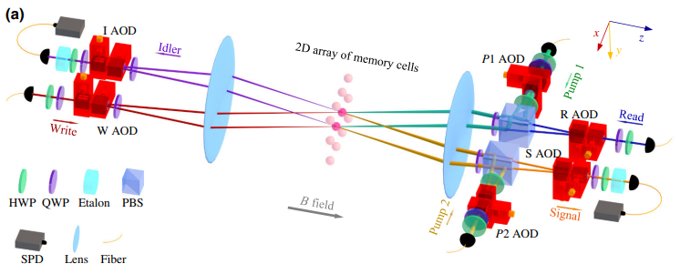
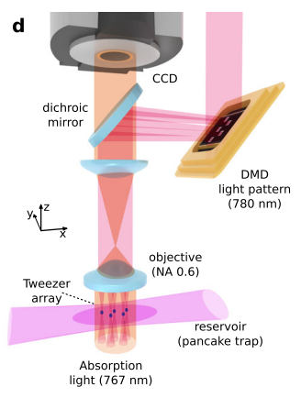
Proposed Methodology
[2]
[1]
Current state of the art, confines atomic ensemble with MOTs
Replace MOTs with optical tweezers trap can give greater robustness against particle loss
MITIGATING JOULE EXPANSION IN MULTICELL ATOMIC QUANTUM MEMORY
8.

Slide 9
Objectives
Build the experimental setup for MQAM with optical tweezers array trap [2]
Achieve current state-of-the-art memory cell lifespan of 1ms [1]
Surpass current state-of-the-art by 2 to 3 orders of magnitude.
Participate in R&D of with M2Lasers partners
Organise outreach workshops on quantum hardware with Chinese collborators
Publication of results
MITIGATING JOULE EXPANSION IN MULTICELL ATOMIC QUANTUM MEMORY
9.

Slide 10
Timeline I
Proposed Starting Point: Monday 10th of January 2022
Total Project Duration: 36 months
Work is split into trimesters, 4 per year
Each milestone is associated with a work package
Work Package 1: Operation "Kickstart"
Order Optical Components (Trimester I 2022)
Literature Review: Compile and Write (Trimester I 2022)
Numerical Simulations of Atomic Ensembles in Optical Tweezers (Trimester I-II 2022)
Start Building the Experimental Optical Set-up (Trimester II-IV 2022 – Trimester I 2023)
End of Year Review and Progress Report (Trimester IV 2022, December)
Work Package 2: Experiment and Data
Run Experiments and Analysis of Data (Trimester II-III 2023)
Agreement Between Numerical Simulations and Experiment (Trimester III)
Write a Preprint (Trimester IV 2023)
Publication (Trimester IV 2023)
End of Year Review and Progress Report (Trimester IV 2023, December)
MITIGATING JOULE EXPANSION IN MULTICELL ATOMIC QUANTUM MEMORY
10.

Slide 11
Timeline II
Work Package 3: Outreach and Industrial R&D
R&D of Quantum Hardware with M2Lasers (Trimester I-IV 2024)
International Conference in Quantum Electronics and Laser Science (Trimester III 2023)
IEEE International Conference on Quantum Computing and Engineering (Trimester IV 2024)
Organise: Workshop in Advances in Quantum Hardware (WACQ 2023): Glasgow, U.K (Trimester II 2024)
Organise: Workshop in Advances in Quantum Hardware (WACQ 2023): Beijing, China (Trimester III 2024)
Overall Project Valuation
MITIGATING JOULE EXPANSION IN MULTICELL ATOMIC QUANTUM MEMORY
11.

Slide 12
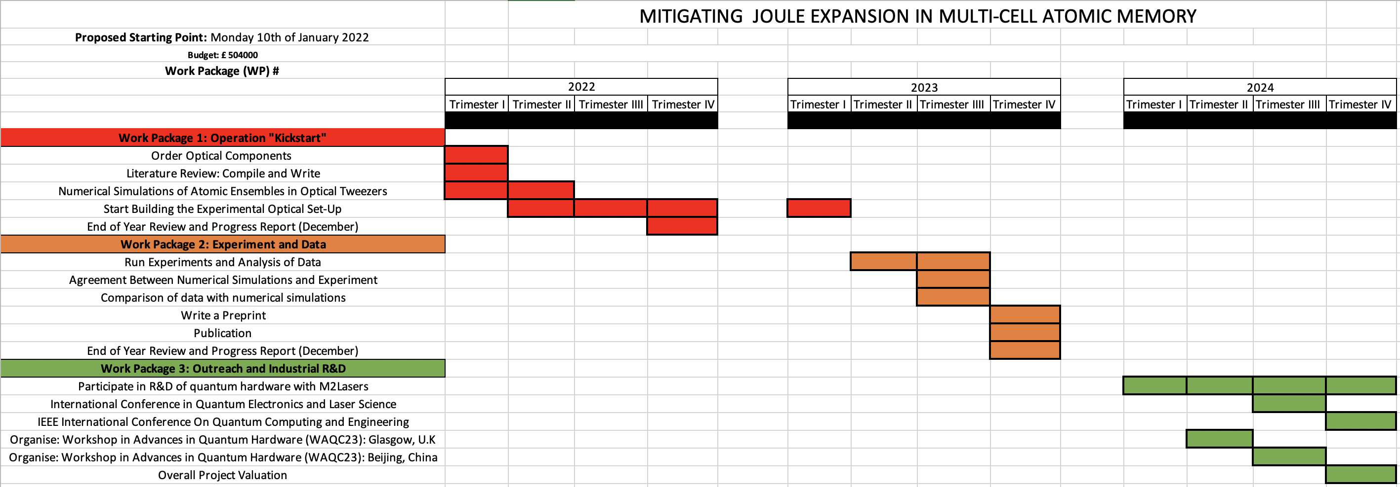
Gantt Chart
MITIGATING JOULE EXPANSION IN MULTICELL ATOMIC QUANTUM MEMORY
12.

Slide 13


Team with Expertise
University of Strathclyde
Prof. Kata Benedek
Dr. Christoforos Iakovou
Dr. Lewis Russell
Beijing Normal University
Dr. Chang Li
Dr. Yukai Wu
M Squared Lasers
Dr. Nils Hempler
Specialisation :
Mult-cell Atomic Quantum Memories
Specialisation :
Integration of Technologies
Host Location for the Proposed MAQM-w/ADT Hardware
MITIGATING JOULE EXPANSION IN MULTICELL ATOMIC QUANTUM MEMORY
13.
Notes:
Specialisation :
Supplier of Quantum Hardware and QIntSys
Optical Lattice Trap:
Hz Comparisions, delHz < ${10 ×10}^{−17}$Hz
MOT Atom Number > 106
Full Timing Control via FPGA-device

Slide 14
Finance and Resources
Projected Costs | Total £ (GBP)
Equipment | £55820
Staff | £399767
Travel & Subsistence | £15000
Facilities | £13000
Indirect Costs | £20000
Total | £503587
Staff Effort | Time (Months)
Existing Staff | 36
New Staff | 22
Project Students | 0
Technician | 16
Other
Total | 74
MITIGATING JOULE EXPANSION IN MULTICELL ATOMIC QUANTUM MEMORY
14.

Slide 15
Impact
Critical step for realising a functional and scalable quantum computer
Aligned with the U.K's £ 150 million investment diverse research portfolio of quantum technologies
Quantum computing research is included in China's next 5-year plan
Quantum computing promises a major impact from business to government and society overall
Promote ground-breaking international collaboration
MITIGATING JOULE EXPANSION IN MULTICELL ATOMIC QUANTUM MEMORY
15.

Slide 16
References
C. Li, S. Zhang, Y.-K. Wu, N. Jiang, Y.-F. Pu, and L.-M. Duan. Multicell atomic quantum memory as a hardware-efficient quantum repeater node. PRX Quantum, 2:040307, Oct 2021.
Wang Y, Shevate S, Wintermantel T M, et al. Preparation of hundreds of microscopic atomic ensembles in optical tweezer arrays. npj Quantum Inf, 6, 54, June 2020.
Ryo Asaka et al. Quantum random access memory via quantum walk. Quantum Sci. Technol., 6:035004, May 2021.
Daniel J. Bernstein and Tanja Lange. Post-quantum cryptography. Nature, 549:188–194, September 2017.
Charles H. Bennett and Gilles Brassard. Quantum cryptography: Public key distribution and coin tossing. Theoretical Computer Science, Theoretical Aspects of Quantum Cryptography – celebrating 30 years of BB84, 560:7–11, 2014.
Joshua Nunn. Quantum Memory in Atomic Ensembles. Doctoral Thesis. St John’s Colllage Oxford. 2008
MITIGATING JOULE EXPANSION IN MULTICELL ATOMIC QUANTUM MEMORY
16.

Slide 17
Thank you for listening!

Slide 18
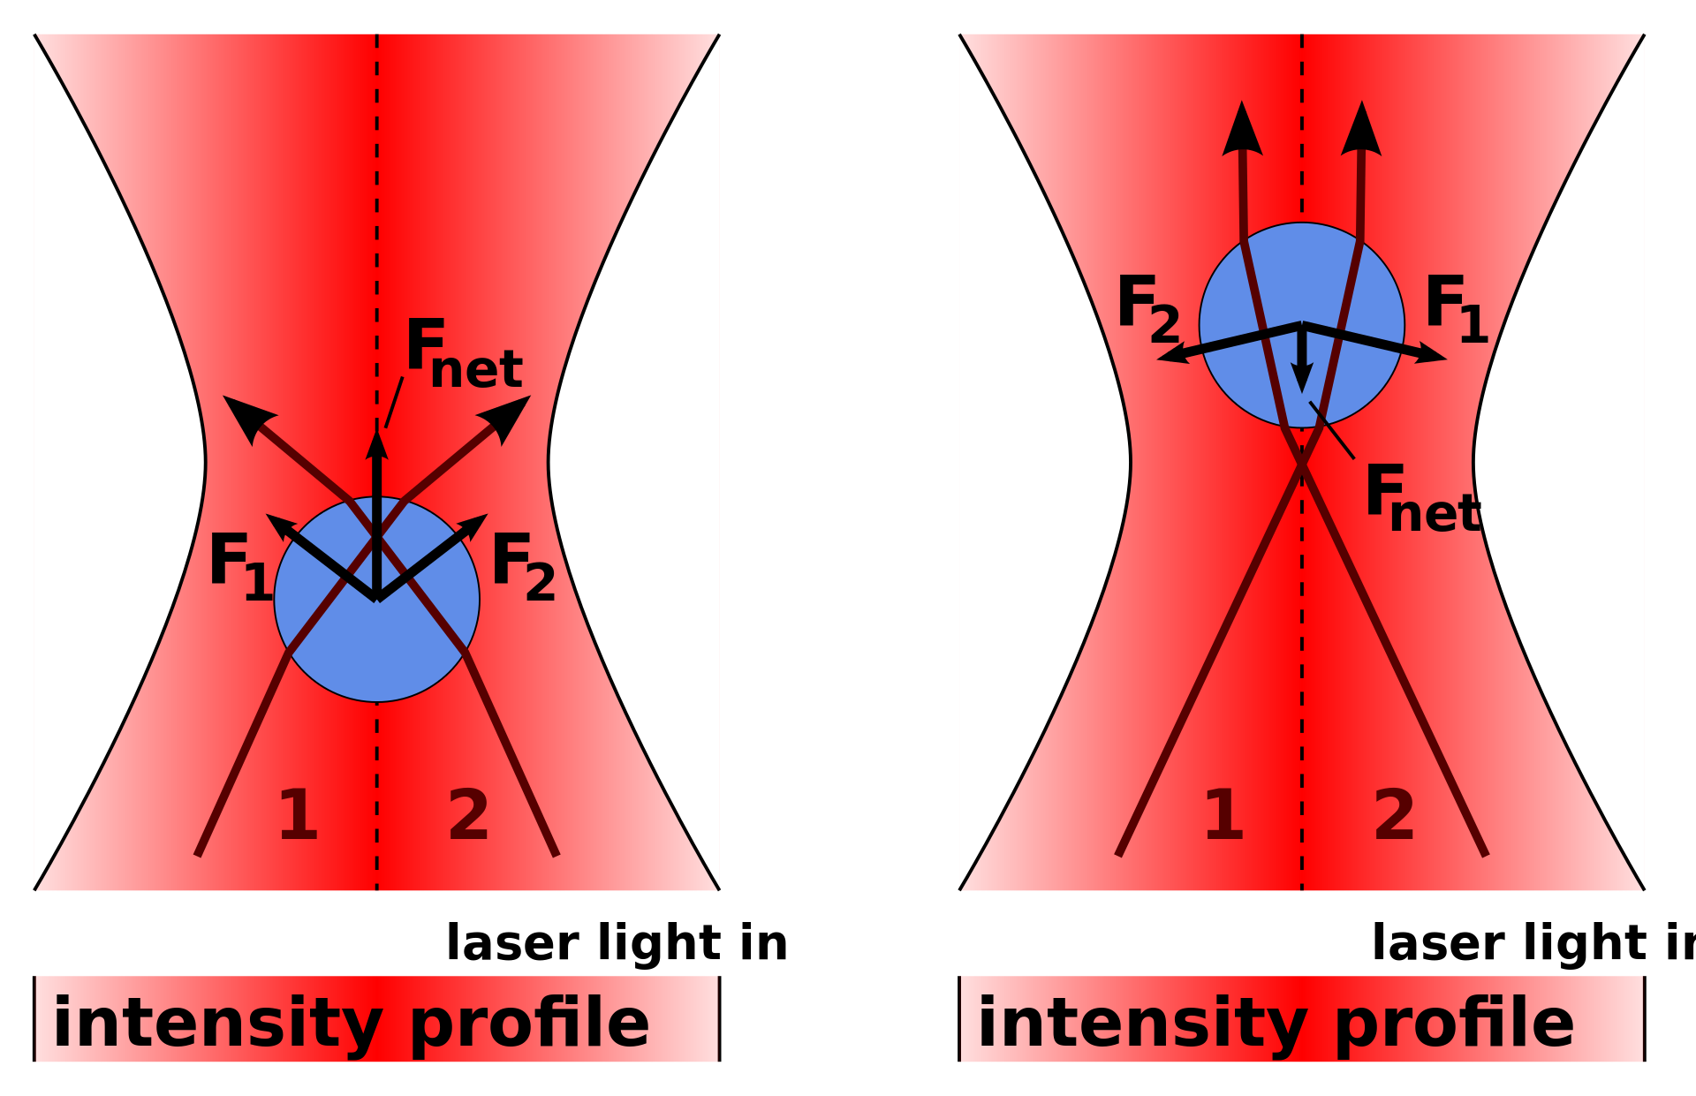

Optical tweezers
Laser entering from Section 1 refracted into Section 2, laser entering from Section 2 refracted into 1
Direction change change in momentum
Equal but opposite change in the atom’s momentum results in creates $F_{1}$and $F_{2}$
Net force returns the force to the centre and will trap it there
Microscope objectives
MITIGATING JOULE EXPANSION IN MULTICELL ATOMIC QUANTUM MEMORY
15 + 1

Slide 19
Experimental Specification
The Duan-Lukin-Cirac-Zoller (DLCZ) protocol is a
well-known scheme to realize quantum repeaters
https://www.nature.com/articles/35106500
https://journals.aps.org/rmp/abstract/10.1103/RevModPhys.83.33
Y. Wang, S. Shevate, T. M. Wintermantel, M. Morgado, G. Lochead, and S. Whitlock, Preparation of hundreds of microscopic atomic ensembles in optical tweezer arrays, npj Quantum Inf. 6, 54 (2020).
6 ms lifetime:
https://www.nature.com/articles/nphys1152#Sec2
MITIGATING JOULE EXPANSION IN MULTICELL ATOMIC QUANTUM MEMORY

