Slide 1
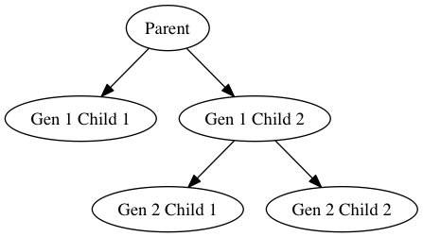
Gen 2/3 Child 1

